Slide 1
陈文教授纪念研讨会
8/8/2019, Hohai University, Nanjing, China
Speaker: YangQuan Chen, University of California Merced
(ychen53@ucmerced.edu)

Slide 2
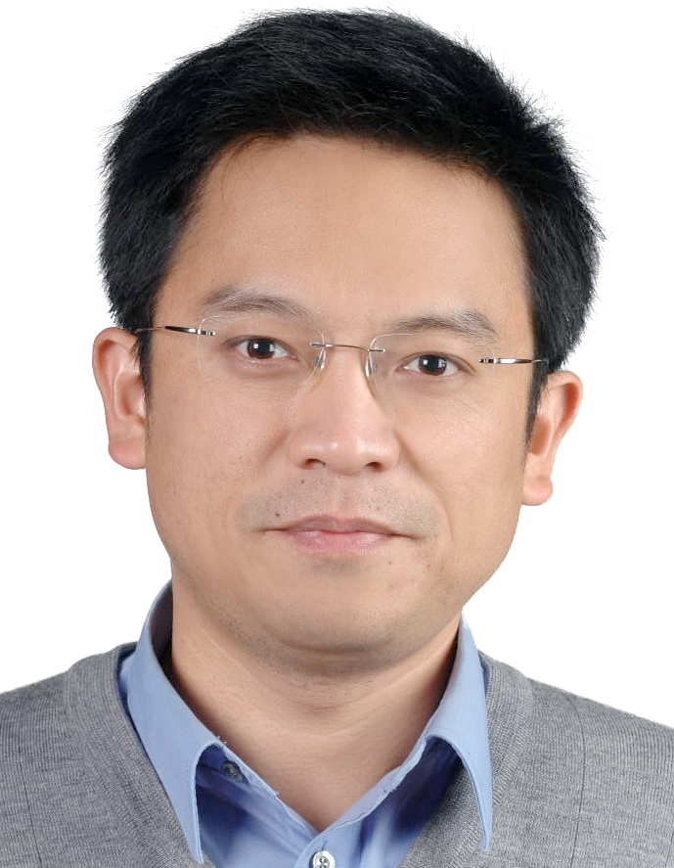
Wen Chen did not really leave us!

Slide 4
We will remember him!

Slide 5
FCAA (Fractional Calculus and Applied Analysis) Special Issue Dedicated to Professor Wen Chen
Lead Guest Co-editors:
YangQuan Chen, Changpin Li, Hongguang Sun and Igor Podlubny
Invited Contributors
Igor Podlubny (*) (?)
YangQuan Chen (*)
Changpin Li (*)
Hongguang Sun (*)
Yingjie Liang
Mark M Meerschaert (?)
Yong Zhang
Dumitru Baleanu
Sverre Holm
George Em Karniadakis (?)

Slide 6
Prime number distribution
Structure derivative
Topological derivative

Slide 7
Memories - snapshots
2004 Beijing with ICFDA Proc.
2006 Porto – FDA06 – his ambition revealed
2007/9/3 Utah State Univ. FC Day
http://169.236.9.29/mechatronics.ece.usu.edu/foc/event/FOC_Day@USU/2007.html
2008 FDA Ankara
2010 FDC Day at SHU
2012 Nanjing FDA
2016 NJIT

Slide 8
“Wen is one of fractional pioneers in China. In the past summer holidays, he called me with very weak breath for discussing some possible co-operations... His death is a big loss in fractional community. “
Changpin Li, Shanghai University, China

Slide 9
“… His engineering insights to fractional order operators are excellent. His book in Chinese is widely read. He has a wide caliber of interests driven by his curiosity. I wish to say, his work on prime number distribution (ML fitting), as well as his work on LRD toolbox are both very fascinating to me among many others. Of course, his outstanding organization of ICFDA 2012 Nanjing is one of the many of his contributions. We will remember Wen Chen for his contribution to our community in various ways.”
YangQuan Chen, UC Merced, USA

Slide 10
“It is not easy to describe in words the lost of Wen Chen.... My lecture during the conference organized last week by Professor Luis Vazquez in Madrid was dedicated to him. I met Wen in 2006 in Porto and in several many occasions in Europe and China. In December 2017 I discussed last time with him about the nonlocality and fractional calculus.... I am sure that the group Wen established in his faculty will continue to work very hard in the future and the ideas of Wen will continue...”
Dumitru Baleanu, Cankaya University, Turkey

