Slide 1

Unmanned Autonomous Systems:
A Tutorial (Part 1)
YangQuan Chen, Ph.D., Director,
MESA (Mechatronics, Embedded Systems and Automation)Lab
ME/EECS/SNRI/HSRI/UCSolar, School of Engineering,
University of California, Merced
E: yqchen@ieee.org; or, yangquan.chen@ucmerced.edu
T: (209)228-4672; O: SE2-273; Lab: CAS Eng 820 (T: 228-4398)
July 30, 2016. Saturday
东北大学2016人工智能与机器人国际暑期学校
Northeastern University, China

Slide 2
Acknowledgement
Prof. Chengdong Wu for the invitation
This lecture module is based on IFAC 2008 World Congress tutorial paper/slides by Kevin L. Moore
  “A Tutorial Introduction to Autonomous Systems,” Kevin L. Moore, Proceedings of 2008 IFAC World Congress, pp. 11720-11731, Seoul, Korea. July 2008 (invited Keynote paper for Invited Session on Intelligent Autonomous Systems).

Slide 3
Outline/Miniplan
Part 1: CSOIS Ground Mobile Robots (unmanned autonomous systems/vehicles)
Part 2: UAS (unmanned aircraft systems)
Part 3: Future Robotics Research: From CPS to CHS

Slide 4

Skip Ad in 1 minutes

Slide 5

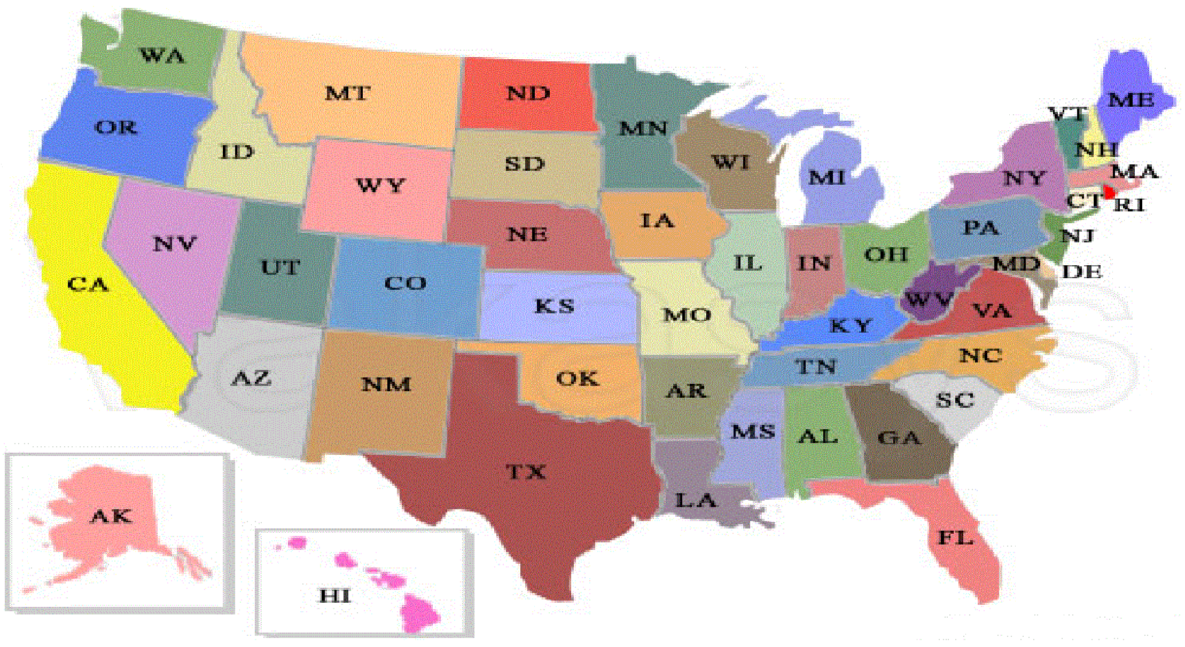
University of California, Merced
The Research University of the Central Valley
Centrally Located
  Sacramento – 2 hrs
  San Fran. – 2 hrs
  Yosemite – 1.5 hrs
  LA – 4 hrs
Surrounded by farmlands and sparsely populated areas

Slide 6

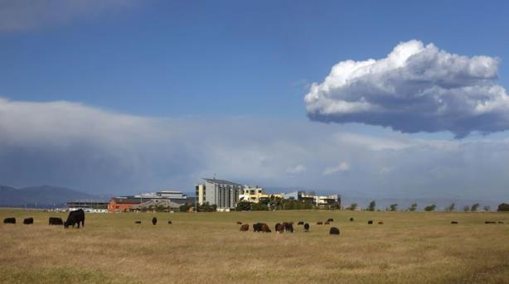
UC Merced
Established 2005
1st research university in 21st century in USA.
5,764 Undergraduates
442 Grads (90% Ph.Ds)
Strong Undergraduate Research Presence (HSI, MSI)

Slide 7
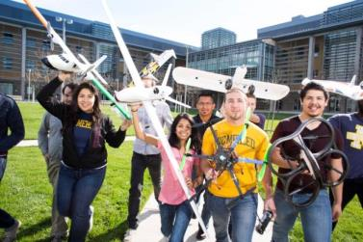
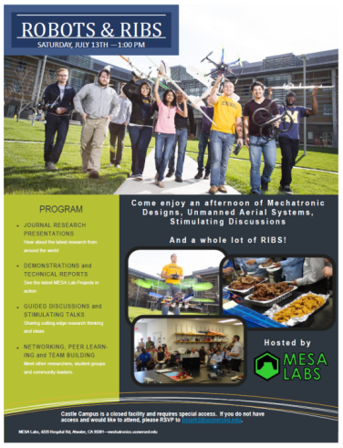
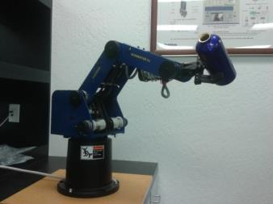
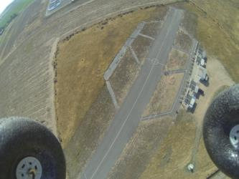
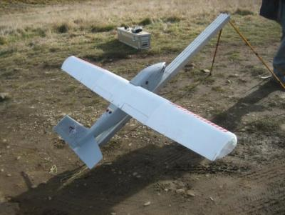
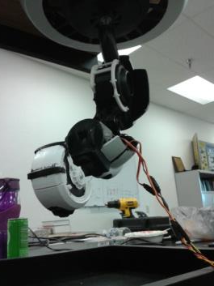
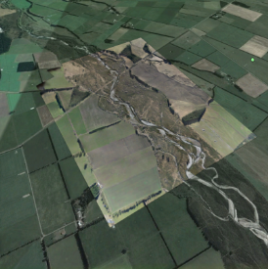
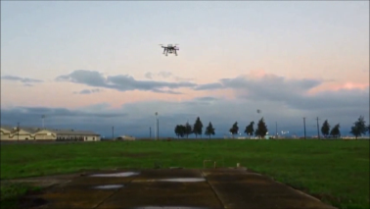
The MESA Lab
Mechatronics, Embedded Systems, Automation Lab
http://mechatronics.ucmerced.edu
Lab Director: Prof. YangQuan Chen
  Lab Manager: Brandon Stark
  6 Ph.D. Students
  40+ Undergrads
  9 Visiting Ph.D. Students
  6 Visiting Professors/Scholars
Unmanned Aerial Systems
Cyber-Physical Systems
Renewable Energy Systems
Mechatronic Systems
Applied Fractional Calculus

Slide 8
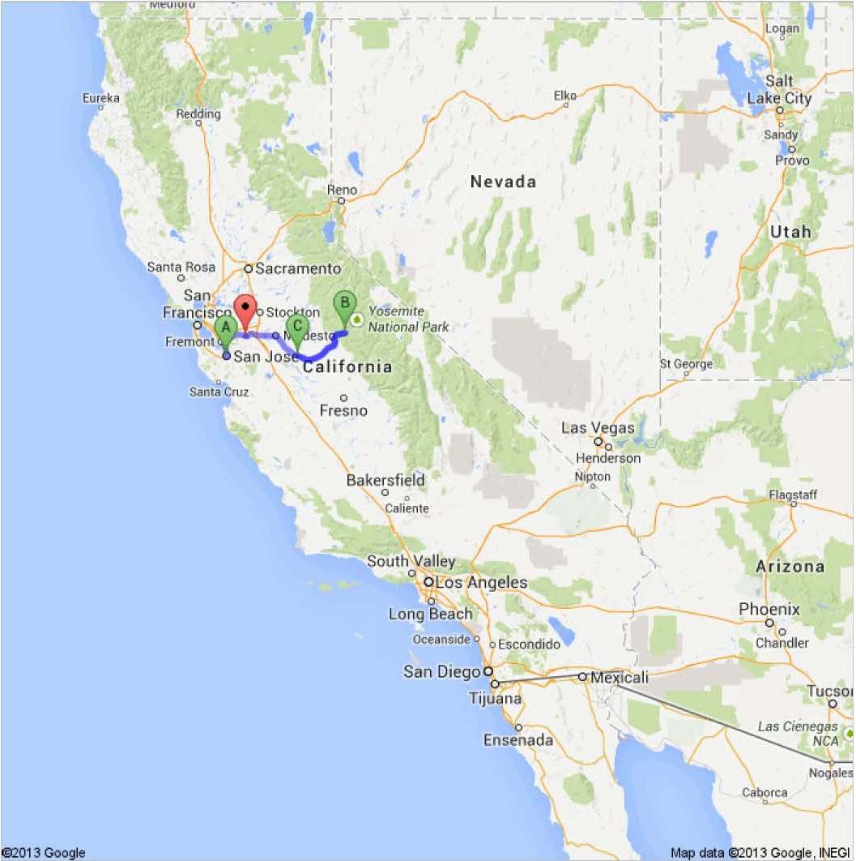
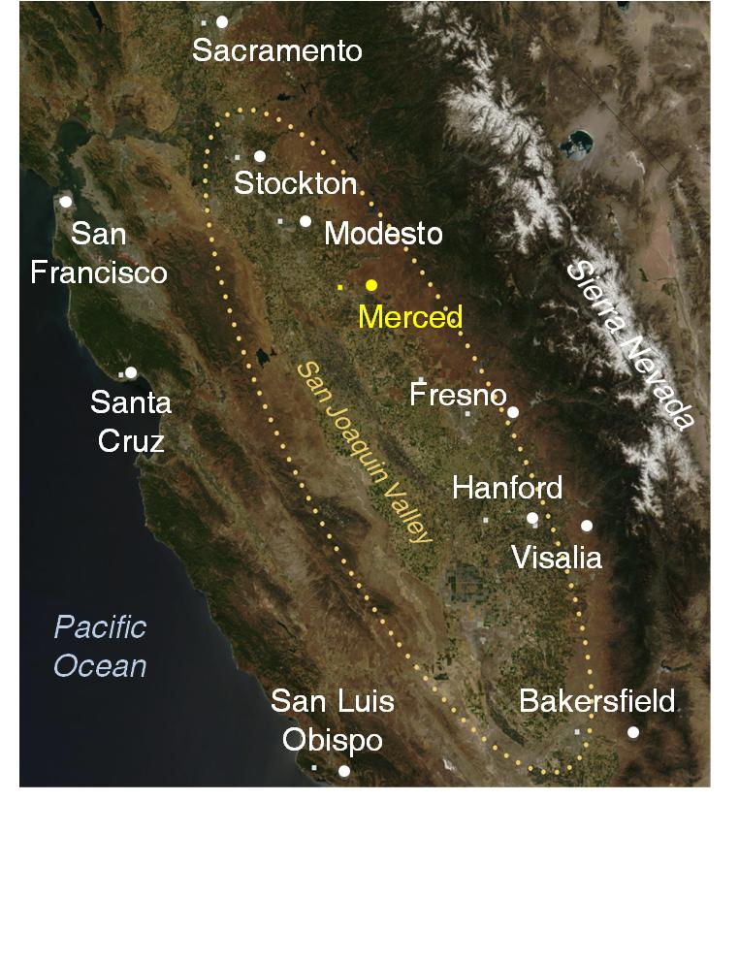
Scientific
Data Drone Valley

Slide 9
MESA Research Areas/Strengths
Unmanned Aerial Systems and UAV-based Personal Remote Sensing (PRS)
Cyber-Physical Systems (CPS)
Modeling and Control of Renewable Energy Systems
Mechatronics
Applied Fractional Calculus (AFC)

Slide 10
Overview
Purpose of paper is to present a
  tutorial-level introduction to the technical aspects of unmanned autonomous systems.
We emphasize
  a system engineering perspective on the conceptual design and integration of both
    the components used in unmanned systems including the locomotion, sensors, and computing systems needed to provide inherent autonomy capability, and
    the algorithms and architectures needed to enable control and autonomy, including path-tracking control and high-level planning strategies.
Concepts are illustrated using case study examples from robotic and unmanned system developed by the author and his colleagues

Slide 11





Acknowledgments
Professor D. Subbaram Naidu
Idaho State University
Measurement and Control Engineering Research Center
Professor YangQuan Chen
Professor Nicholas Flann
Utah State University (USU)
Center for Self-Organizing and Intelligent Systems (CSOIS)
Mr. Mel Torrie
Autonomous Solutions, Inc.
David Watson
David Schiedt
Dr. I-Jeng Wang
Dr. Dennis Lucarelli
Johns Hopkins Applied Physics Lab (APL)
ALL MY STUDENTS OVER THE YEARS!
Autonomous Solutions, Inc.™

Slide 12
Outline
  What is an Unmanned System?
  Unmanned system components
    Motion and locomotion
    Electro-mechanical
    Sensors
    Electronics and computational hardware
  Unmanned system architectures and algorithms
    Multi-resolution approach
    Software Architecture
    Reaction, adaptation, and learning via high-level feedback

Slide 13
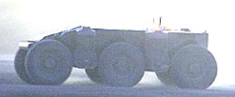
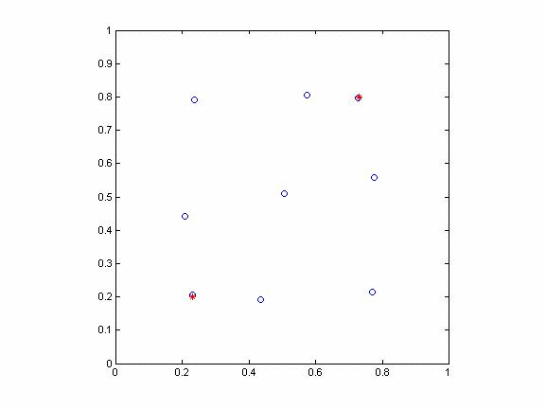
Unmanned Systems
What is an unmanned system?
What is an unmanned vehicle?
Is an unmanned system a robot?
Is a robot an unmanned system?
Is an unmanned system an autonomous system?
What about unmanned sensors?
What about mobile sensors?
What about telepresense or tele-operation?
What about teams of unmanned vehicles, or swarms?
DARPA Crusher 1.0

Slide 14
Unmanned System
Let us define:
  Unmanned system: any electro-mechanical system which has the capability to carry out a prescribed task or portion of a prescribed task automatically, without human intervention
  Unmanned vehicle: a vehicle that does not contain a person
    Can be tele-operated
    Can be autonomous
    Typically deploys a payload (sensor or actuator)
Focus today will be on unmanned vehicles
Unmanned vehicles can come in several flavors: UxV
  Land: UGV
  Air: UAV
  Maritime: UUV, USV
  Sensors: UGS

Slide 15

What Makes a UxV?
All UxVs have common elements:
  Mechanical components (drive, power, chassis)
  Electronics
  Sensing/mission payloads
  Communication systems
  Control
  “Smarts”
  Interface to user
Our perspective is that all unmanned systems should be developed from the perspective of its concept of operations (CONOPS)

Slide 16
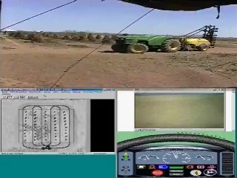

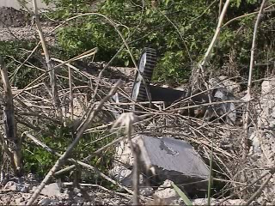
Example CONOPS - Automated Tractors
Example CONOPS -Unique Mobility Robots
(Autonomous Solutions, Inc.)

Slide 17
What Makes a UxV?
All UxVs have common elements:
  Mechanical components (drive, power, chassis)
  Electronics
  Sensing/mission payloads
  Communication systems
  Control
  “Smarts”
  Interface to user
Our perspective is that all unmanned systems should be developed from the perspective of its concept of operations (CONOPS)
Once a CONOPS has been defined, then systems engineering is used to flow-down requirements for subsystems.

Slide 18
Unmanned Systems: Capabilities and Control
We consider two key aspects of unmanned vehicles and autonomy:
  Inherent physical capabilities built into the system
  Intelligent control to exploit these capabilities
Inherent physical capabilities
  Mechanisms for mobility and manipulation
  Power
  Sensors for perception
    Proprioceptive
    External
  Computational power
Intelligent control to exploit these capabilities
  Machine-level control
  Perception algorithms
  Reasoning, decision-making, learning
  Human-machine interfaces
These are driven by
your CONOPS
These are driven by
your CONOPS, but also by your inherent physical capabilities

Slide 19
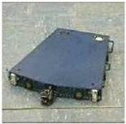
Case Study/Illustrative Example
In following, we discuss
  Inherent capability in unmanned ground systems
  Exploitation of these inherent capabilities
Primarily use the Omni-Directional Inspection System (ODIS) as a case study
  Inherent capability in ODIS
  Exploitation of these inherent capabilities

Slide 20
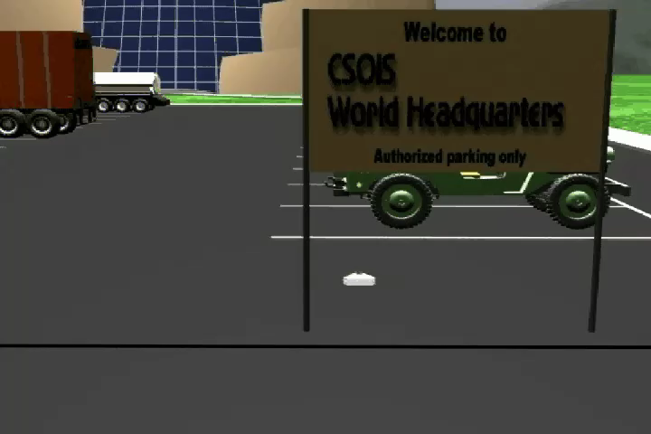
ODIS I – An Autonomous Robot Concept

Slide 21
Outline
  What is an Unmanned System?
  Unmanned system components
    Motion and locomotion
    Electro-mechanical
    Sensors
    Electronics and computational hardware
  Unmanned system architectures and algorithms
    Multi-resolution approach
    Software Architecture
    Reaction, adaptation, and learning via high-level feedback
  Toward an algorithmic framework for autonomous UxVs

Slide 22
UGV Technology
Motion

Slide 23
Motion and Locomotion for Unmanned Systems
Except for UGS, most unmanned systems must move:
UGV: wheels and tracks
UAV: fixed wing, rotary wing, VTOL
USV/UUV: propeller based, jetted
In general the motion and locomotion aspects of an unmanned vehicle are not remarkably different than that of their manned counterparts:
  Design of motion and locomotion system becomes “only” an engineering task!

Slide 24
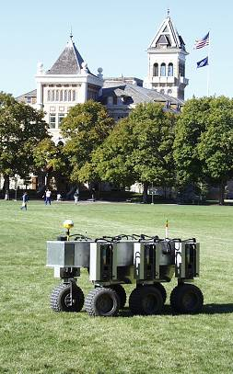
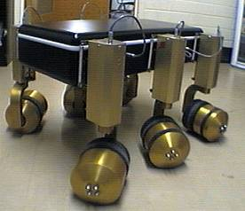
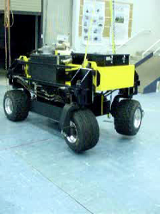
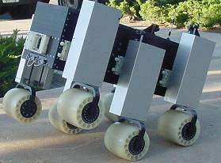
Some ODV Robots Built At USU
T1 -1998
T2 -1998
ODIS I -2000
Typical UGV Mobility Platforms
    Ackerman
    Skid-Steer
    Unicycle
    Unique Mobility
T4 -2003
T3 -1999
(Hydraulic drive/steer)

Slide 25
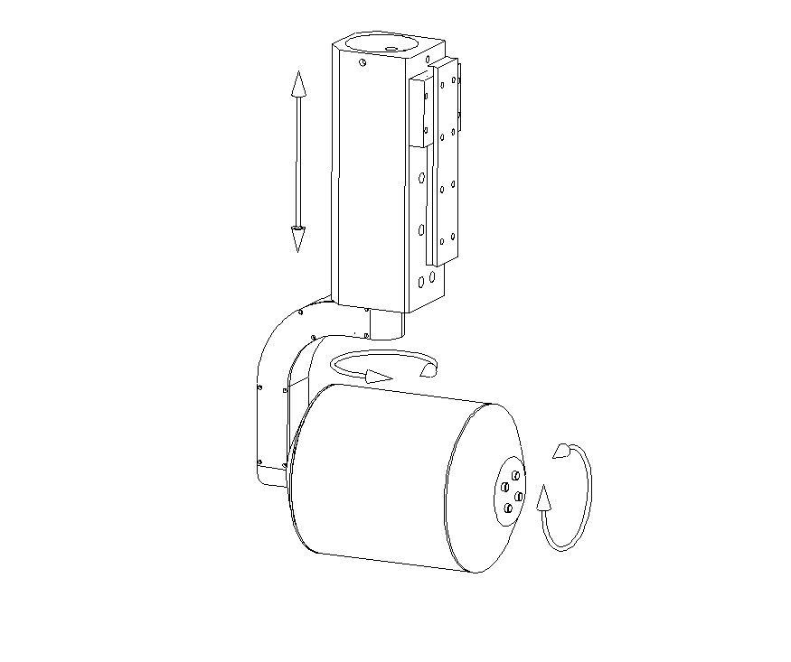
Mobility Example: USU ODV Technology
USU developed a mobility capability called the “smart wheel”
Each “smart wheel” has two or three independent degrees of freedom:
  Drive
  Steering (infinite rotation)
  Height
Multiple smart wheels on a chassis creates a “nearly-holonomic” or omni-directional (ODV) vehicle

Slide 26
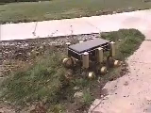
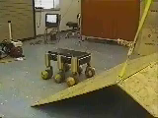

T1 Omni Directional Vehicle (ODV)
ODV steering gives improved mobility compared to
conventional steering
Smart wheels make it
possible to simultaneously
- Translate
- Rotate

Slide 27
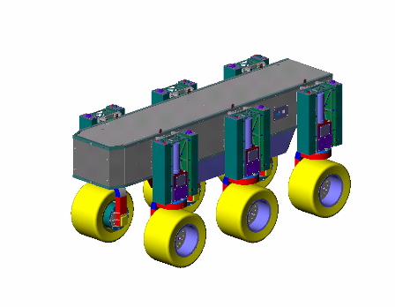
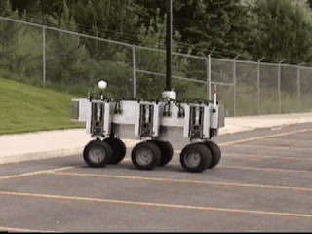
T2 Omni Directional Vehicle
T2 can be used for military scout
missions, remote surveillance, EOD,
remote sensor deployment, etc.

Slide 28
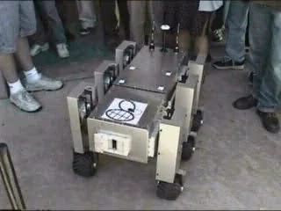

Slide 29
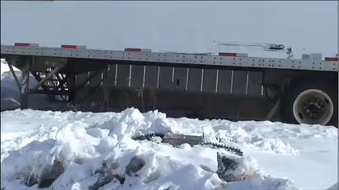

Slide 30
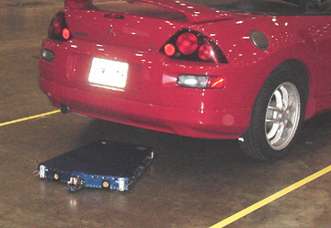
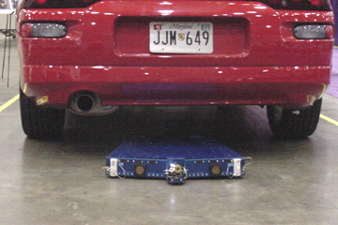
Omni-Directional Inspection System (ODIS)
First application of ODV technology
Man-portable physical security mobile robotic system
Remote inspection under vehicles in a parking area
Carries camera or other sensors
Can be tele-operated, semi-autonomous, or autonomous

Slide 31
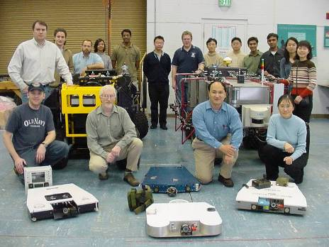
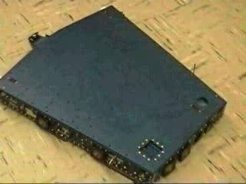
“Putting Robots in Harm’s Way So People Aren’t”
ODIS – the Omni-Directional Inspection System
An ODV Application: Physical Security
Under joystick control

Slide 32
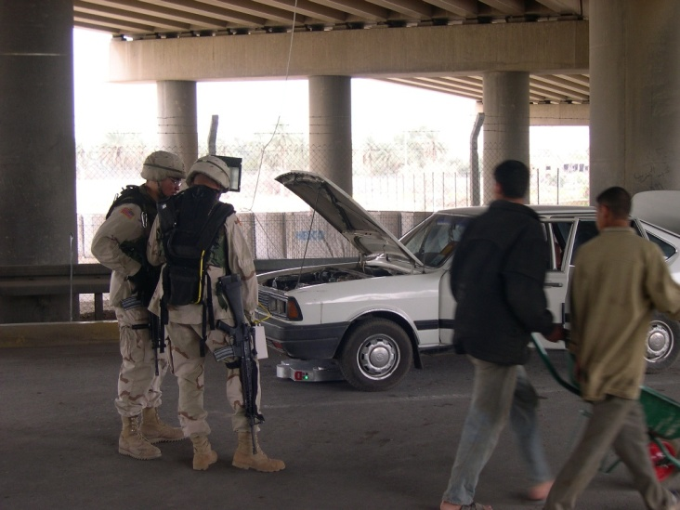
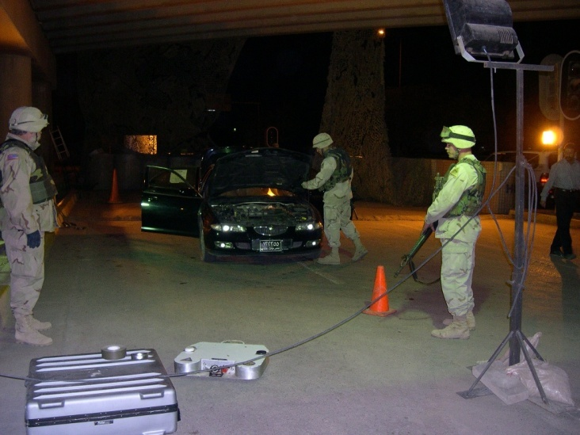
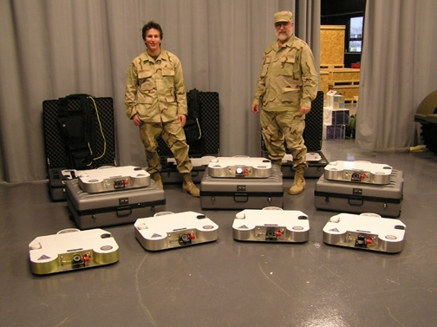
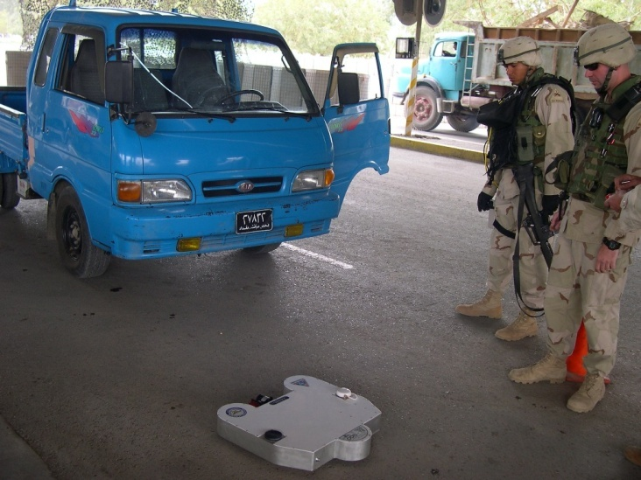
ODIS On Duty in Baghdad
“Putting Robots in Harm’s Way, So People Aren’t”

Slide 33
Systems Engineering a UGV: Case Study
ODIS Design and Implementation

Slide 34
Overall Specifications
Weight: approx. 40 lb.
Height: 3.75 inches
Footprint: 25” X 32”
Velocity: 2.5 ft/sec
Power Source: Battery
Number of Wheels: 3
Number of Processors: 8
Environmental Sensing: Sonar, IR, Laser
Position Sensing: dGPS, FOG
Vehicle Runtime: 1 Hour
Number of Battery Packs: 2 (12 V and 24 V)
Ground Clearance: 0.5 inches

Slide 35
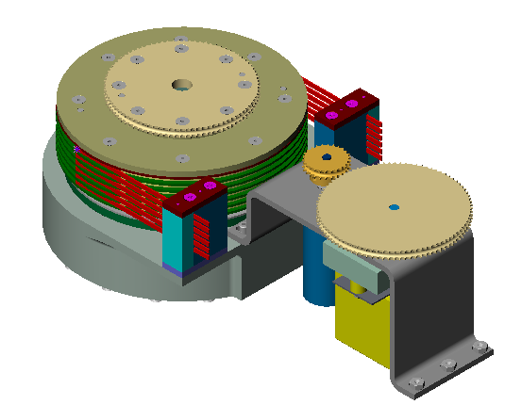
Steering Characteristics
24 Volt Maxon 110125 Motor
98:1 Gear Reduction
Integrated 6 Contact Custom
Slipring Assembly
Steering Rate of 1 rev/sec max.
Overall Weight = 3.24 lb.
Computer Optics 10 bit Absolute
Encoder

Slide 36
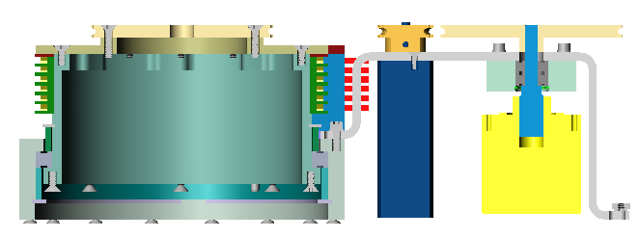
ODIS Steering Layout
BELT PULLEYS
SLIPRING
ASSEMBLY
BEARING
STEERING MOTOR
& GEARHEAD
CHASSIS ATTACHMENT
ABSOLUTE ENCODER
DRIVE ASSEMBLY

Slide 37
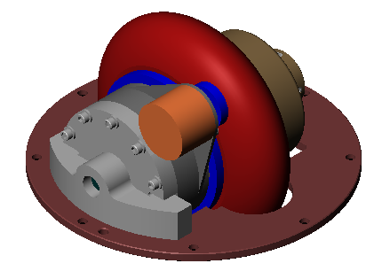
Drive Characteristics
QT 1221A 17 Volt Kollmorgen Frameless Torquer Motor
43:1 Micro-Mo Gearbox
2.6 Feet/Second Top Speed
25 Pounds Max Drive Force Per Wheel
80 mm Wheel Diameter
CUI Stack Incremental Encoder

Slide 38
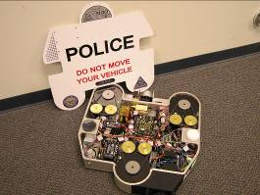
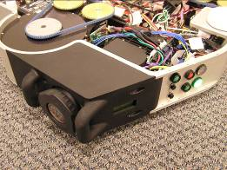
Power for Unmanned Systems
Power for UxVs is one of today’s limiting issues.
Battery-based systems
  Lead-acid
  Nickel-Metal Hydride
  Lithium-Ion
  Silver-Zinc
Combustion-engines
  Gasoline
  Diesel
Fuel cells
Novel: wind/water
Station-keeping sailboat
Fuel-cell powered ODIS developed by Kuchera Defense Systems

Slide 39
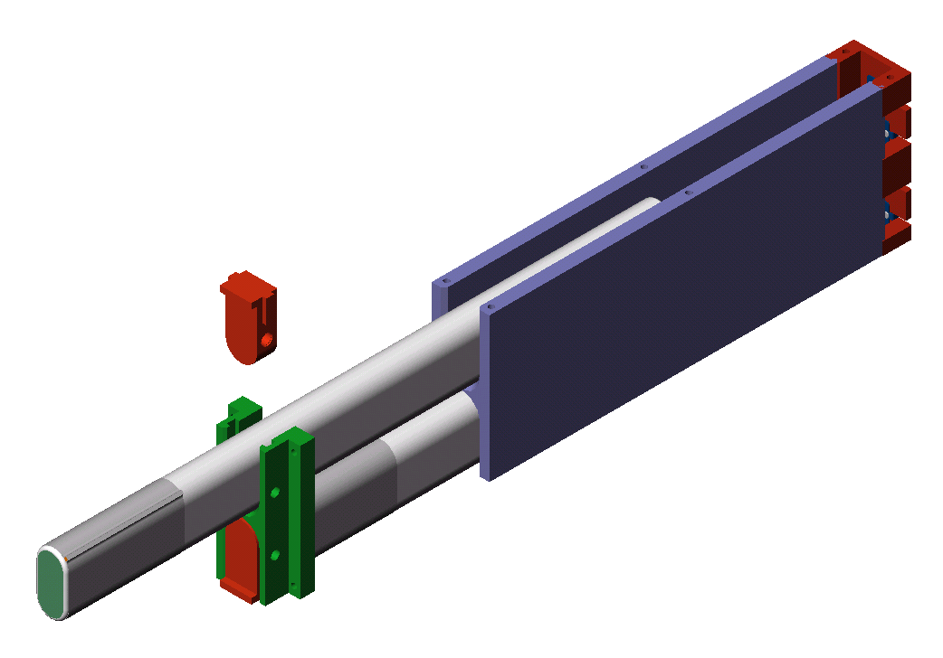
ODIS Battery Assembly
Guide Block
Battery Clip
12V NiMH Battery
Contacts

Slide 40
UGV Technology
Chassis
Motion

Slide 41
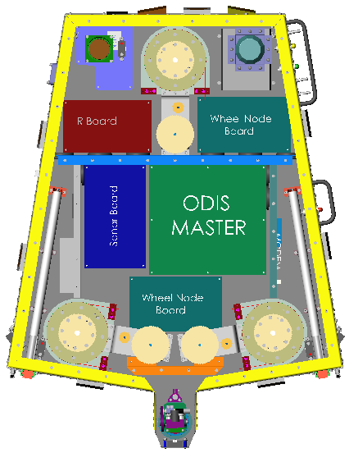
ODIS Chassis Layout
FIBER OPTIC
GYRO
1/16” Aluminum Panels
Glued & Riveted on Joints
Interior Shear Panels
LASER
BATTERY PACKS
STEERING/DRIVE
ASSEMBLIES
VETRONICS
PAN/TILT
CAMERA

Slide 42
UGV Technology
Ve-Tronics
Chassis
Smart
Wheel

Slide 43

Vetronics Block Diagram
Off-board Vehicle
GPS
FOG
Joystick
RF
Modem
Laser
Master Node
(SBC)
Planner
Node
Sonar
Sensor
Node
Planner
GUI
RF
Modem
PPP
LAN
IR
Sensor
Nodes
Vehicle
GUI
Camera
Node
Wheel Node
(x 3)
Video
Display
Video
TX
Vetronics Overview

Slide 44
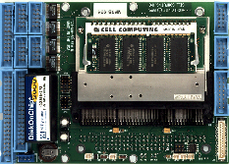
Master Node
Path Planner
PPP Modem
Joystick
Command Modem
Freewave
900Mhz
Modem
Freewave
900Mhz
Modem
Master Node
COM1
Cell 233 MHz PC Card
with PC-104 Stack
COM2
10BaseT
LAN
FOG
COM3-RX
COM3 TX
2.5”
HDD
dGPS
COM4
PC104
LPT1
Sync
Reset
RS-485 (x3)
Wheel Nodes (x3)
IR Sensor Nodes (2)
Connect Tech
D-Flex 8
RS-232/RS-485
Sonar Sensor Node
RS-232 (x4)
Camera Node
RS-485
Laser Range finder
Master Node Subsystem

Slide 45
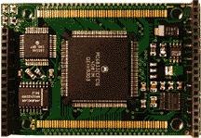
Wheel Node Block Diagram
RS232
MC68332
Microcontroller
(TT8)
Motor Driver
PCB
Steering
Motor
RS485
Tx-Rx
Reset
Sync
SPWM
2
Wheel
Master
Interface
SDIR
RS232
DPWM
LMD18200T
Motor Driver
DDIR
Advanced Motion
Controls
10A8DD
Motor Driver
Drive
Motor
Hardware
Watchdog
Enable
2
RS232
Debug
Port
CHA
CHB
Quadrature
Encoder
Absolute
Encoder
Interface
Steering
Angle
Computer
Optical Products
10-Bit Absolute Enc.
10
Wheel Node Subsystem

Slide 46
Vehicle Power System
Freewave
Modem
Freewave
Modem
Battery
Power
Latch
Reset
24V
Power
GPS
Master
Computer
Carrier Board
External
12V
Power
Switch Interface
12V M
FOG
DC-DC
Converters
Fuses
12V BUS
12V
NiMH
24V-Laser
IR Sensor
Node
(2)
12V Power
Distribution
PCB
12V Wheels
12V
NiMH
Laser
Wheel
Vectronics
24V Power
Distribution PCB
Sonar
Sensor
Node
Fuses
12V
NiMH
24V
Power
Relays
24 Volt
Motor
Drivers
12V
NiMH
Camera
Node
Power System

Slide 47
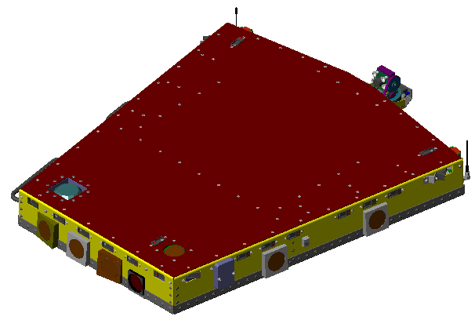
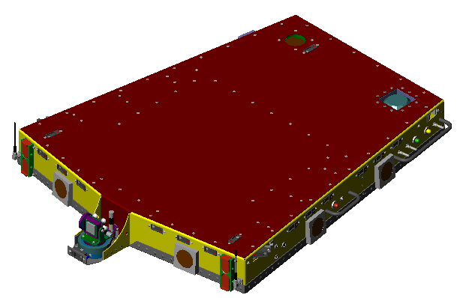
ODIS Weight Budget
900 MHz
ANTENNAS
Chassis = 11.28 lbs
Vetronics = 9.53 lbs
Drive/Steering = 14.11 lbs
Batteries = 5.80 lbs
ODIS = 40.72 lbs
GPS ANTENNA
PAN/TILT
CAMERA ASSEMBLY
IR SENSORS
LASER
BATTERY PACKS
SONAR SENSORS

Slide 48
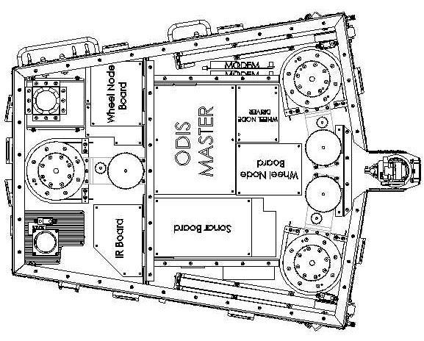
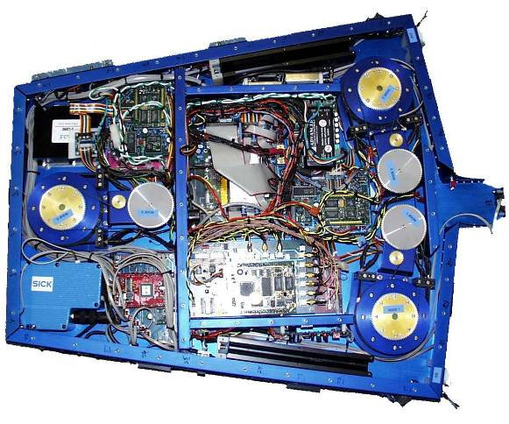
ODIS Vetronics System

Slide 49
UGV Technology
Sensors
Ve-Tronics
Chassis
Smart
Wheel

Slide 50

ODIS Sensor Suite
Laser
IR Boards
Sonar Board
Sonar
IR
Camera Board
Camera

Slide 51

B
E
A
M
P
A
T
T
E
R
N
|
IR
|
Sonar
|
Laser

Slide 52

Sensors and Safety: Automated Tractor Project Example

Slide 53
Safety Scenarios
We need to halt the vehicle if:
  Tractor leaves field boundary or deviates from path
  Unavoidable obstacle within given threshold
  Communication disrupted or lost
  d-GPS dropout corrupts position information
  Computer failures occur
  Emergency stop button
  Vehicle halt computer command
  Mission complete
Some safeguards include
  Sensor suite for detecting vehicle path obstructions
  Redundant radio link to protect against wireless communication dropout or corruption.
  Use of odometry to complement/supplement dGPS

Slide 54




Awareness Issues

Slide 55


3 Tiered Proximity Detection
Hazard zone
d
Pressure Bumper
Ultrasonic/IR
Radar
30’

Slide 56

Localization Issues
Poor Radio Communications
  High power antennas
  Lower Frequency
Intermittent GPS
  Dead-reckoning
  Reactive positioning
    Hole-following with range data
    Row sensing with laser

Slide 57
Mission Payloads for UxVs
Different CONOPS will produce different mission payload requirements.
ODIS-T Sensor Suites:
  Visual – pan/tilt imaging camera
  Passive & active thermal imaging
  Chemical sniffers – i.e. nitrates, toxic industrial chemicals
  Night vision sensors
  Acoustic sensors
  Radiation detectors – i.e. dirty bombs
  Biological agents detection
  MEMS technology – multiple threats
  License plate recognition

Slide 58


Mission Packages - IR
IR Image – Warm Brake
IR Image – Recently Driven Vehicle
Notes:
If we view the underside of a cold vehicle with an IR camera, we see some indication of the vehicles components, but very little stands out. We do see some hot spots, in this case a tire warmed by the sun. Bases on telemetry from the ODIS robot compass and a time of day clock, we can determine that this is the likely case. If the opposite tire had been showing as a hot spot, this should be flagged as an anomaly and the inspector alerted via the OCU. A recently arrived vehicle has a different signature than a cold vehicle. In this case, the brakes and wheel rim are radiating thermal energy (Figure 9a), the exhaust system is glowing brightly and the differential is also glowing, although less brightly (Figure 9b). This indicates a very recently arrived vehicle. As the parked vehicle cools, the exhaust system will cool faster than the much more massive differential. By comparing the intensity of components, we can determine approximately how long the vehicle has been in place and make appropriate decisions.

Slide 59

Mission Payloads for UxVs
Different CONOPS will produce different mission payload requirements
ODIS-T Sensor Suites:
  Visual – pan/tilt imaging camera
  Passive & active thermal imaging
  Chemical sniffers – i.e. nitrates, toxic industrial chemicals
  Night vision sensors
  Acoustic sensors
  Radiation detectors – i.e. dirty bombs
  Biological agents detection
  MEMS technology – multiple threats
  License plate recognition
Mission payload can be actuators as well as sensors
Samsung Robot Sentry

Slide 60
UGV Technology
Mission Planning
Path Tracking Control
Sensors
Ve-Tronics
Chassis
Smart
Wheel

Slide 61
Outline
  What is an Unmanned System?
  Unmanned system components
    Motion and locomotion
    Electro-mechanical
    Sensors
    Electronics and computational hardware
  Unmanned system architectures and algorithms
    Multi-resolution approach
    Software Architecture
    Reaction, adaptation, and learning via high-level feedback

Slide 62
Multi-Resolution Control Strategy
At the lowest level:
  Actuators run the robot
Mission Planner
Low
Bandwidth
(1 Hz)
Command Units
Path-Tracking
Controllers
Medium
Bandwidth
(10 Hz)
Actuator Set-points
Low-Level
Controllers
Highest
Bandwidth
(20 Hz)
Voltage/Current
Robot Dynamics

Slide 63
Multi-Resolution Control Strategy
At the middle level:
  The path tracking controllers generate set-points (steering angles and drive velocities) and pass them to the low level (actuator) controllers
Mission Planner
Low
Bandwidth
(1 Hz)
Command Units
Path-Tracking
Controllers
Medium
Bandwidth
(10 Hz)
Actuator Set-points
Low-Level
Controllers
Highest
Bandwidth
(20 Hz)
Voltage/Current
Robot Dynamics

Slide 64
Multi-Resolution Control Strategy
At the highest level:
  The mission planner decomposes a mission into atomic tasks and passes them to the path tracking controllers as command-units
Mission Planner
Low
Bandwidth
(1 Hz)
Command Units
Path-Tracking
Controllers
Medium
Bandwidth
(10 Hz)
Actuator Set-points
Low-Level
Controllers
Highest
Bandwidth
(20 Hz)
Voltage/Current
Robot Dynamics

Slide 65
  Behavior Generation Strategies
First Generation: pre-T1
  Waypoints fit using splines for path generation
  User-based path generation
Second Generation: T1, T2
  decomposition of path into primitives
  fixed input parameters
  open-loop path generation

Slide 66
  Behavior Generation Strategies
First Generation: pre-T1
  Waypoints fit using splines for path generation
  User-based path generation
Second Generation: T1, T2
  decomposition of path into primitives
  fixed input parameters
  open-loop path generation
Third Generation: T2, T3, ODIS
  decomposition of paths into primitives
  variable input parameters that depend on sensor data
  sensor-driven path generation

Slide 67



  3rd Generation Maneuver Command:
  Sensor-Driven, Delayed Commitment Strategy
  (ALIGN-ALONG (LINE-BISECT-FACE CAR_001) distance)

Slide 68
ODIS Command Environment: MoRSE
Based on command unit:
  Set of individual commands defining various vehicle actions that will be executed in parallel
Commands for XY movement:
  moveAlongLine(Line path, Float vmax, Float vtrans = 0)
  moveAlongArc(Arc path, Float vmax, Float vtrans = 0)
Commands for Yaw movement:
  yawToAngle(Float angle_I, Float rate = max)
  yawThroughAngle(Float delta, Float rate = max)
Commands for sensing:
  SenseSonar – SenseIR
  SenseLaser – Camera commands
A set of rules defines how these commands may be combined

Slide 69
Software Architecture
Command actions are the lowest-level tasks allowed in our architecture that can be commanded to run in parallel
For planning and intelligent behavior generation, higher-level tasks are defined as compositions of lower-level tasks
In our hierarchy we define:
Mission
User-defined
Tasks
Subtasks
Variable (planned)
Atomic Tasks (Scripts)
Command Units
Command Actions
Hard-wired (but,
(parameterized and
sensor-driven)

Slide 70
External
User Input
Internal
GUI Communicator
Awareness
Localize
Mission
Laser
Sonar
Camera
IR
wheels
Internal
External
Events
Actions
Environment

Slide 71

54
68
- Curbs
59
60
- Lamp Posts
53
58
61
67
1 thru’ 68 - Stall Numbers
57
62
Robot’s Home
52
66
56
63
51
55
64
65
35
36
37
38
39
40
41
42
43
44
45
46
47
48
49
50
19
20
21
22
23
24
25
26
27
28
29
30
31
32
33
34
01
02
03
04
05
06
07
08
09
10
11
12
13
14
15
16
17
18

Slide 72
User-tasks in the environment
{MoveTo Point}
{Characterize a stall}
{Inspect a stall}
{Characterize a row of stalls}
{Inspect a row of stalls}
{Localize}
{Find my Car}
{Sweep the parking lot}
{Sweep Specific area of the parking lot}

Slide 73
External
User Input
Internal
GUI Communicator
Awareness
Localize
Mission
Laser
Sonar
Camera
IR
wheels
Internal
External
Events
Actions
Environment

Slide 74
External
User Input
Internal
GUI Communicator
Awareness
Localize
Mission
WD
Updated Environment
Knowledge
Supervisory
Task Controller
Queries & updates
World
Database
States and results of
atomic tasks execution
Task
Sensors
Actuators
Laser
Sonar
Camera
IR
wheels
Internal
External
Events
Actions
Environment

Slide 75
External
User Input
Internal
GUI Communicator
Awareness
Localize
Mission
Un-optimized
group of tasks
WD
Updated Environment
Knowledge
Optimization &
Ordering Module
Supervisory
Task Controller
Ordered
group of tasks
Queries & updates
World
Database
States and results of
atomic tasks execution
Task
Sensors
Actuators
Laser
Sonar
Camera
IR
wheels
Internal
External
Events
Actions
Environment

Slide 76
External
User Input
Internal
GUI Communicator
Awareness
Localize
Mission
Un-optimized
group of tasks
WD
Updated Environment
Knowledge
Optimization &
Ordering Module
Supervisory
Task Controller
Ordered
group of tasks
Queries & updates
World
Database
Ordered group
of Sub-tasks &
Atomic-tasks
States and results of
atomic tasks execution
Task
Task
Behavior Generator &
Atomic-Task Executor
E-Stop
Joy-stick
Command-Units
Resources
Sensors
Actuators
Laser
Sonar
Camera
IR
wheels
Internal
External
Events
Actions
Environment

Slide 77
External
User Input
Internal
GUI Communicator
Awareness
Localize
Mission
Un-optimized
group of tasks
WD
Updated Environment
Knowledge
Optimization &
Ordering Module
Supervisory
Task Controller
Ordered
group of tasks
Queries & updates
World
Database
Ordered group
of Sub-tasks &
Atomic-tasks
States and results of
atomic tasks execution
Task
Task
Sensor
Processor
Filtered &
Perceived input
World Model
Predictor
Predicted changes
in the environment
Behavior Generator &
Atomic-Task Executor
E-Stop
Joy-stick
Observed input
Command-Units
Resources
Sensors
Actuators
Laser
Sonar
Camera
IR
wheels
Internal
External
Events
Actions
Environment

Slide 78
External
User Input
Internal
GUI Communicator
Awareness
Localize
Mission
Un-optimized
group of tasks
WD
Updated Environment
Knowledge
Optimization &
Ordering Module
Supervisory
Task Controller
Ordered
group of tasks
Queries & updates
World
Database
Ordered group
of Sub-tasks &
Atomic-tasks
States and results of
atomic tasks execution
Task
Task
Sensor
Processor
Filtered &
Perceived input
World Model
Predictor
Predicted changes
in the environment
Behavior Generator &
Atomic-Task Executor
E-Stop
Joy-stick
Observed input
Command-Units
Control Supervisor (CS)
Resources
Command Actions
Sensors
Actuators
Laser
Sonar
Camera
IR
wheels
Internal
External
Events
Actions
Environment

Slide 79
Reactive Behaviors
Reactive behaviors are induced via:
Localization thread
  Compares expected positions to actual sensors data and makes correction to GPS and odometry as needed
Awareness thread
  Interacts with the execution thread based on safety assessments of the environment

Slide 81

Awareness Thread

Slide 82
Reactive Behaviors
Reactive behaviors are induced via:
Localization thread
  Compares expected positions to actual sensors data and makes correction to GPS and odometry as needed
Awareness thread
  Interacts with the execution thread based on safety assessments of the environment
Logic within the execution thread
  Scripted adaptive behaviors

Slide 83

T2 Adaptive/Reactive Hill-Climbing

Slide 84
Reactive Behaviors
Reactive behaviors are induced via:
Localization thread
  Compares expected positions to actual sensors data and makes correction to GPS and odometry as needed
Awareness thread
  Interacts with the execution thread based on safety assessments of the environment
Logic within the execution thread
  Scripted adaptive behaviors
  Exit conditions at each level of the hierarchy determine branching to pre-defined actions or to re-plan events

Slide 86

Example: ODIS FindCar() Script

Slide 87
Outline
  What is an Unmanned System?
  Unmanned system components
    Motion and locomotion
    Electro-mechanical
    Sensors
    Electronics and computational hardware
  Unmanned system architectures and algorithms
    Multi-resolution approach
    Software Architecture
    Reaction, adaptation, and learning via high-level feedback

Slide 88


