Slide 1
Scientific Data Drone Research @ The MESA Lab of UC Merced
YangQuan Chen, Ph.D., Director,
MESA (Mechatronics, Embedded Systems and Automation)Lab
ME/EECS/SNRI/HSRI/UCSolar, School of Engineering,
University of California, Merced
E: yqchen@ieee.org; or, yangquan.chen@ucmerced.edu
T: (209)228-4672; O: SE1-254; Lab: CAS Eng 820 (T: 228-4398)
March 27, 2015. Friday
UNR-WVU-UCMERCED Nexus Visit

Slide 2
UC Merced
The Research University of the Central Valley
Centrally Located
Sacramento – 2 hrs
San Fran. – 2 hrs
Yosemite – 1.5 hrs
LA – 4 hrs
Surrounded by farmlands and sparsely populated areas

Slide 3
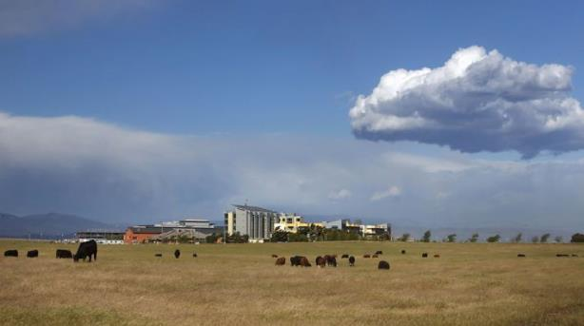
UC Merced
Established 2005
1st research university in 21st century in USA.
6,200 Undergraduates
300 Grads (200+ Ph.D)
Strong Undergraduate Research Presence (HSI, MSI)

Slide 4
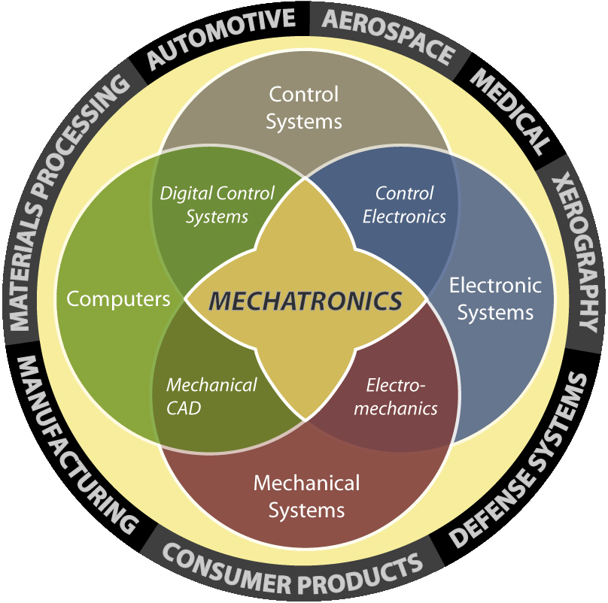
mechatronics.ucmerced.edu
Dr. YangQuan Chen, yqchen@ieee.org
Mechatronics, Embedded
Systems and Automation Lab
Research Areas of Excellence:
(ISI H-index=32, Google H-index=54; i10-index=281)
Unmanned Aerial Systems & UAV-based Personal Remote Sensing (PRS)
Cyber-Physical Systems (CPS)
Mechatronics
Applied Fractional Calculus
Modeling and Control of Renewable Energy Systems
Real solutions for sustainability!
Established Aug. 2012 @ Castle of 1500 sq ft
5 Ph.D/1 MS/ 20+ undergrad members
10 visiting scholars || Sponsored 3
capstone projects and mentored
5+2 capstone teams (Sp’14)
Education and
Outreach Activities:
Projects Related to
San Joaquin Valley:
Eng Service Learning(Sp14)
AIAA Student Branch @UCM
Preview Days
“The Drone Age” @ Castle Air Museum
Robots-n-Ribs| MESABox! ASME tutorials
7 capstone teams (39 seniors) …
Energy [Solar energy, CPV, Building efficiency (HVAC lighting), smart grids integration, NG pipelines]
Water (Water/soil salinity management, water sampling UAVs)
Precision Ag/Environment (Crop dynamics, optimal harvest, pest …)
ME142 Mechatronics (take-home labs)
ME280 Fractional Order Mechanics

Slide 5
MESA Lab Philosophy and Ambition
"We make real systems that work and others want them."
MESA Lab: Staying on top and for sustainability.
Nationally and internationally visible and prominent!

Slide 6
Outline
Our CIDER dream/vision/reality
Drone Research Emphasis @ MESA Lab
Platform
Sensing Payload
Actuation Payload
Down-stream Processing
Smart sensing and actuation policies
Why us, why here and why now

Slide 7
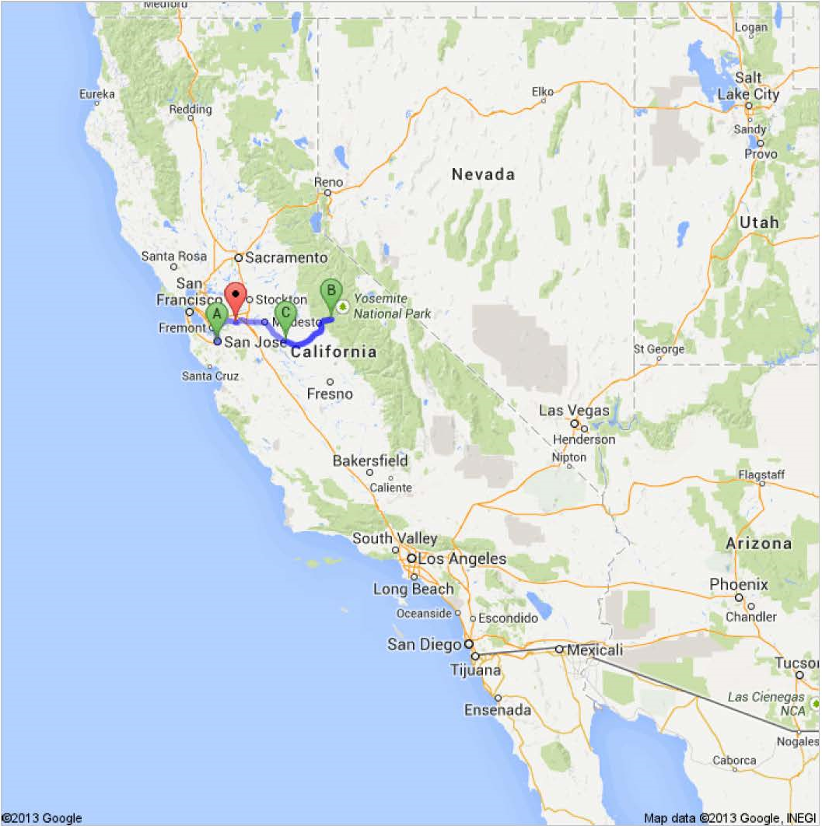
Ag Drone Valley

Slide 8
Data Drone Valley

Slide 9
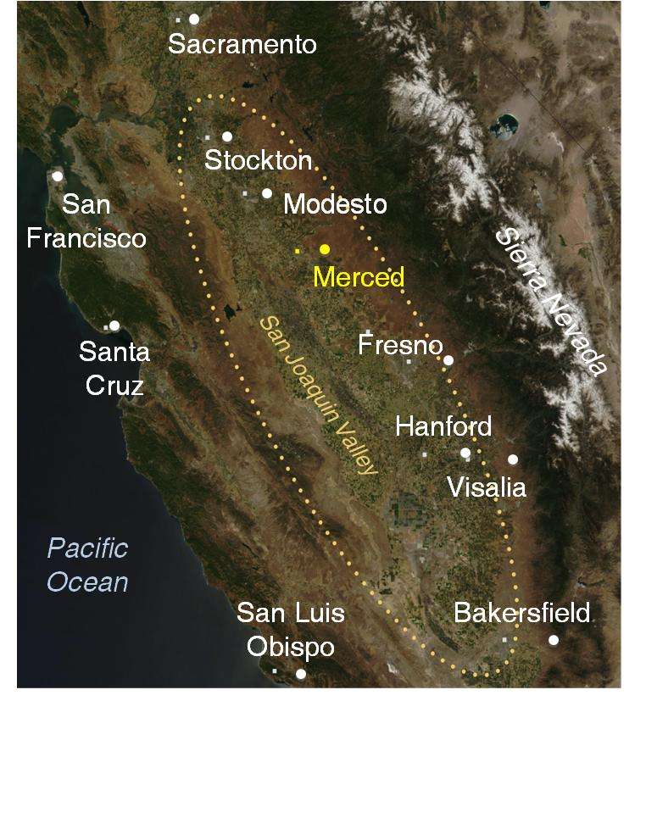
Data Drone Valley

Slide 10
UCCE + MESALAB = ?
http://cemerced.ucanr.edu/
+ http://mechatronics.ucmerced.edu/
__________________________________
= Ag Drone Valley (fractional)
We got funded for 5 years!
UC ANR Seed Grant $279580; (170 to 70 to 15, competitive)

Slide 11
CIDER
California Institute of Drone Engineering Research (CIDER)
Strategic Academic Focusing Initiative
Our faculty-focused development of a strategic academic vision
Resulted Funding Proposals
NSF NRI, MRI, REU, INSPIRE, LTREB …
CITRIS, MRPI …
DoD, NASA, ARPA-E, NRC

Slide 13
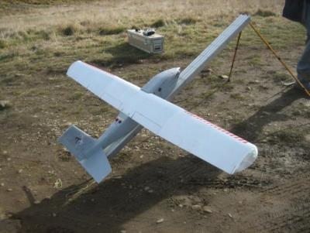
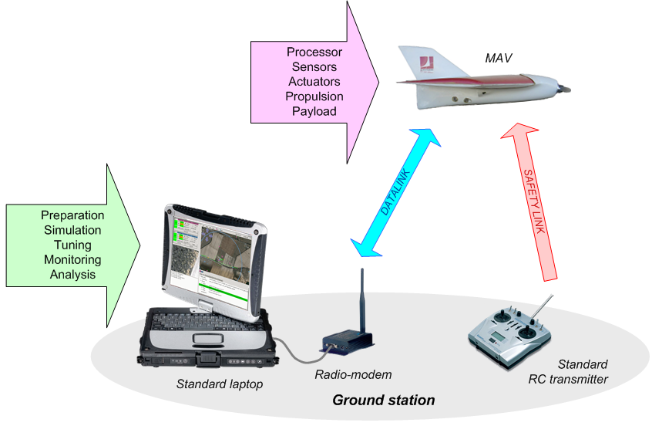
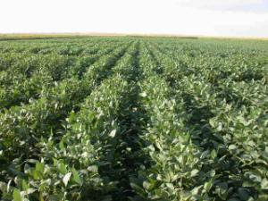
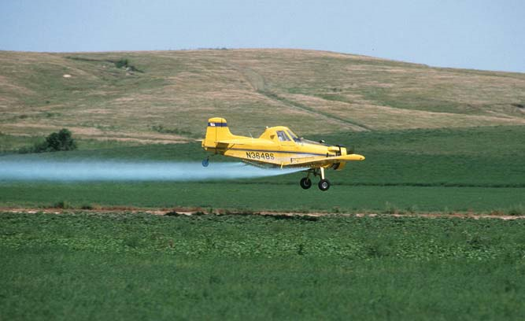
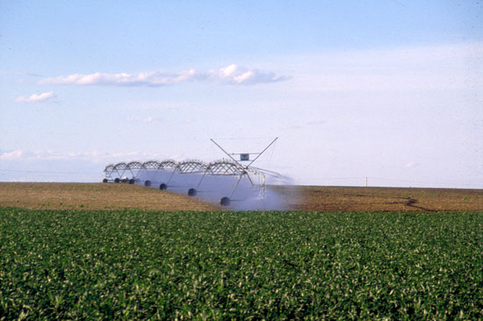
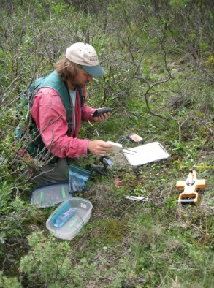
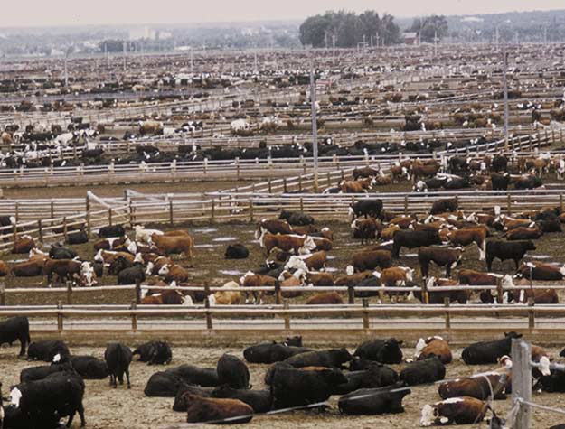
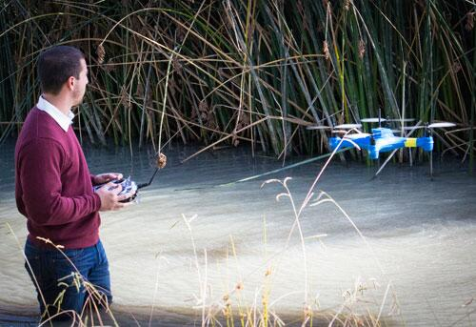
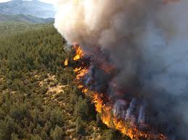
UC Multi-campus Synergy on CIDER
UCM, UCSC,UCB, UCSD, LLNL
CIDER in Scientific data-drones: platforms, operation, and certification
UCM
UCD
UCSD
CIDER in precision agriculture
UCM
UCD
LBL
SNL
UCSD
Courtesy of NPS: https://www.flickr.com/photos/alaskanps/8446139444/in/photostream/
CIDER in environmental monitoring: water, fire, soil, air …

Slide 14
Outline
Our CIDER dream/vision
Drone Research Emphasis @ MESA Lab
Platform
Sensing Payload
Actuation Payload
Down-stream Processing
Smart sensing and actuation policies
Why us, why here and why now

Slide 15
Platforms
VTOL
Y3 rotor
Y6 rotor
Quadrotor
Hexarotor
Fixed-Wing
Battery (AggieAir)
Gas engine (MESAKit, MCRC’s)

Slide 16
UAS (Remote) Sensing Payloads
MET (temperature, humidity, wind)
AQ (PM/CO2, microbials etc)
Lidar
RGB
NIR
TIR
SWIR
?? Salinity ?? Valley Fever ??

Slide 17
UAS (Remote) Actuation Payloads
(Precision Spot) Drone Sprayer (crop-dusting)
Seeding
Seeding errors cost extra water + fertilizer + herbicides + pesticides.
Acoustic deterrent (loudspeaker)
?? Remote application
Variable rate Applications (VRA)

Slide 18
Down-stream Processing
NDVI
Other indices
Crop stress (water, nutrient, frost, heat, pest)
3D elevation map
Variability maps
VRA (variable rate application)

Slide 19
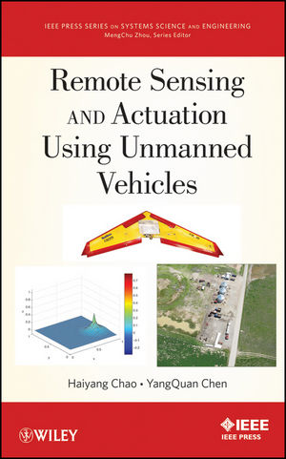
Smart sensing and actuation policies
???????????
By
Brandon Stark
Brendan Smith
Tiebiao Zhao et al

Slide 20
Outline
Our CIDER dream/vision
Drone Research Emphasis @ MESA Lab
Platform
Sensing Payload
Actuation Payload
Down-stream Processing
Smart sensing and actuation policies
Why us, why here and why now

Slide 21
Why us, why here and why now
8 approved FAA COAs (s2013); NSF RAPID grant (2011-2012)
NASA UAS2NAS grant (2011-2014)
UC ANR grant with UCCE Merced (2014-2019)
AggieAir (2006-2012) commercialization ready
ICUAS Executive Committee, ICUAS14 General Co-Chair
Unmanned Systems (World Scientific) journal founding AE
JINT (Springer) Senior Editor; IEEE RAS ARUAV TC Co-Chair
FAA UASTSS proposal team member
FAA COE proposal team member
UAV Handbook (Springer): two chapters from MESA LAB.
ASPRS Manual of Remote Sensing (4th ed.): invited to contribute.
UAV Engineering Service Learning @ UC Merced (2014-)
Three capstone projects with PG&E sponsorship (2013, 2015)

Slide 22
Why us, why here and why now
UC Merced: 1st research university in the 21st century in US
Strong institutional support (CIDER vision, UC Merced 2020)
Strong community support (UCCE, MCRC)
Strong student base (mechatronics, robotics, ME/CS)
Strong research track record with leading roles in the field
Strong engineering hands-on and team work spirit
Strong partnership with Utah State’s AggieAir
Strong vision towards democratic data drone use
Idea testing sites (UC NRS, Vernal Pool NR of UC Merced, FAA COA approved!)
90% of drone applications in agriculture and public safety
High value crops, draught and lots of wild fires …

Slide 23
Why us, why here and why now
FAA released new rules (55 lb sUAS and 4.4 lb micro-UAS)
Obama drone safety and privacy memoradum
Wright Brothers 2.0; drone age
2015 FAA will open NAS for commercial use of drones
Low cost and high reliability is both possible
Privacy aware practice is maturing;
MESA LAB has established now as a drone research hub in Central Valley and nationally and internationally visible.
New Ph.D. students are going through the learning curves and ready to contribute to new challenges.

Slide 24
University of California, Merced
Brief Description of MESA Lab’s Scientific Data-Drone Platform Capacities
10/20/2014
Contact: Prof. YangQuan Chen, yqchen@ieee.org
Lab Web:
http://mechatronics.ucmerced.edu/research/unmanned-aerial-systems

Slide 25
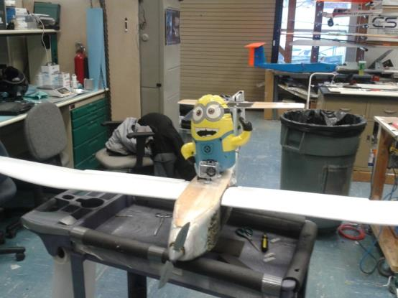
Fixed-Wing Platform (AggieAir)
Total Weight | 12 lbs
Wingspan | 8 ft
Max Flight Time | 60 minutes
Typical Flight Altitude | 300 – 1500 ft
Max Altitude | 3200 ft
Typical Flight Area Coverage | 700 acres
Max Flight Area Coverage | 2000 acres
Typical Payload | VIS Camera NIR Camera
Max Payload Capacity | 2.5 lbs
VIS-NIR Resolution | 2.5” – 12”
Thermal Resolution | 12” – 60”

Slide 26
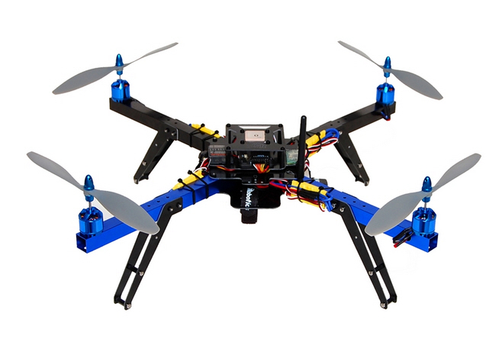
Multi-Rotor UAS Platforms
Single or dual camera mobile sensing platforms
Best utilized for small areas
Flight Time | 10-15 minutes
Max Payload | 1 lb
Max Flight Altitude | 150 ft
Typical Flight Coverage | 20 acres
VIS-RGB Resolution | < ¼”

Slide 27
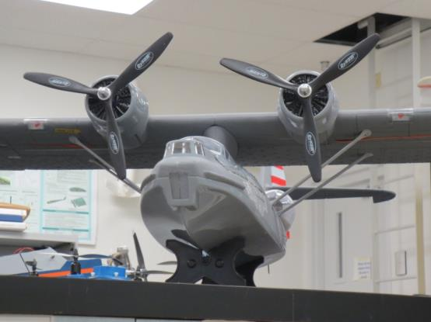
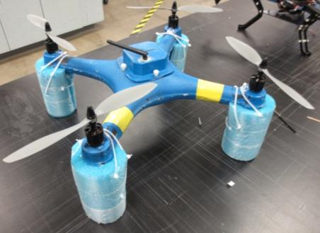
Other UAS Platforms @ MESA LAB (Water drone, soil co-physicist)
Imaging Systems | Point Sampling Systems
Thermal Camera⁺ | Water Collection Sampler*
Narrow-Band Imager* | Air Quality Sampler*
SWIR Imager | Soil Collection Sampler*

Slide 28
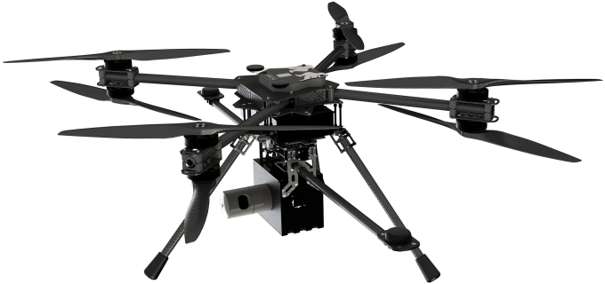
Lidar Remote Sensing Drone Platform (since 2014 Oct.)
Aerial LIDAR2 (AL2). (5.8Kg payload package)
UAV platform (7Kg + 8 Kg batteries)
70cm (28 in) propellers for a highly efficient propulsion, improving payload vs. flight-time characteristics
4 6S 16Ah Batteries in 2S2P setup
150*150cm wide and 62cm high.

Slide 29
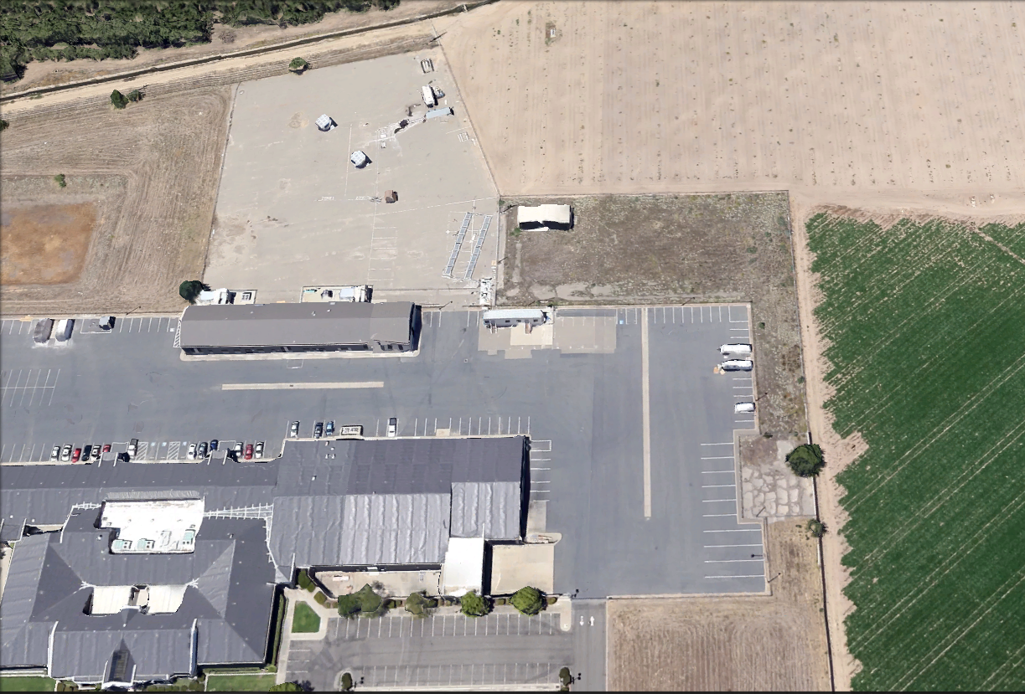
UC Merced Castle Research Facility
MESA Lab @ UC Merced
Scientific Data-drone Test Site (official since 7/24/14)
Scientific Data-drone Hangar
UCSolar.org
MESA Lab

Slide 30
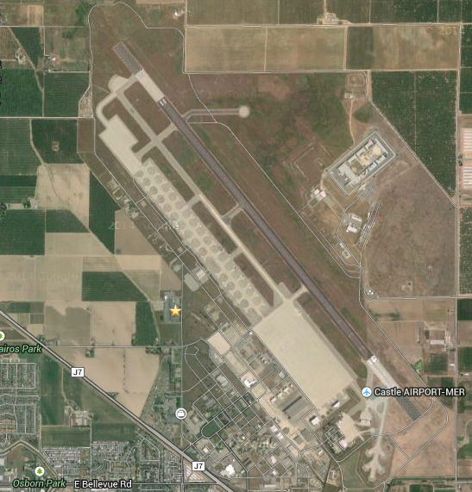
Castle Park Flyer Zone
UC Merced Castle Research Facility
Addr: 4225 Hospital Road, Atwater, CA 95301

Slide 31
Castle Park Flyer Zone

Slide 32
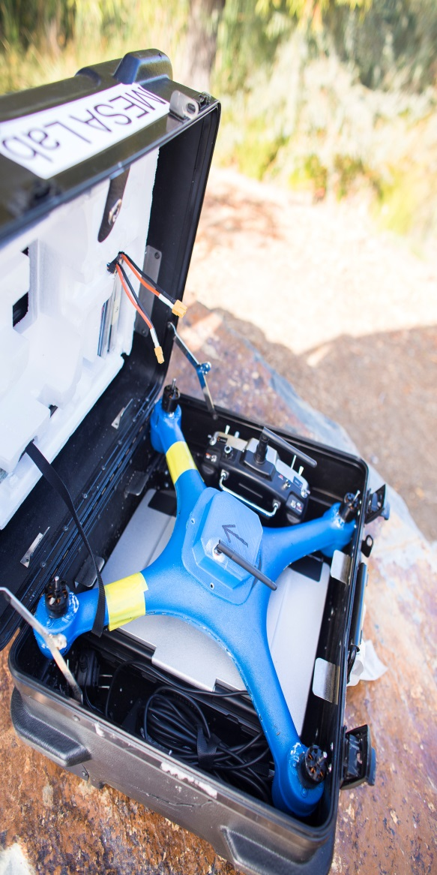
CITRIS funded scientific water quality (eDNA) drone Test Platform Design - Assembly

Slide 33
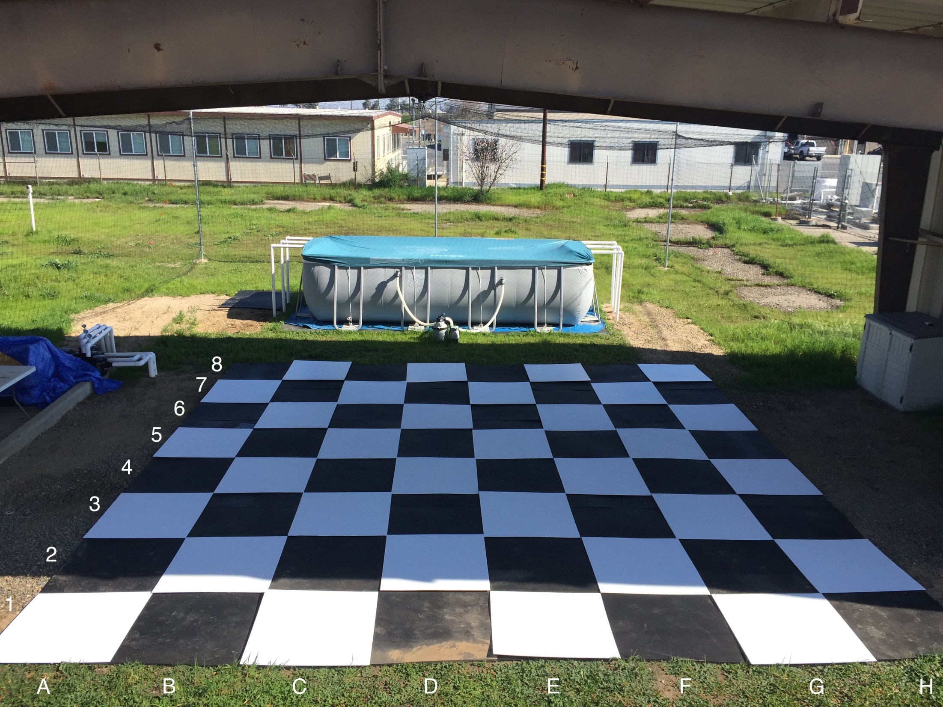

Slide 34
1st FAA CoA Site – UC Merced

Slide 35
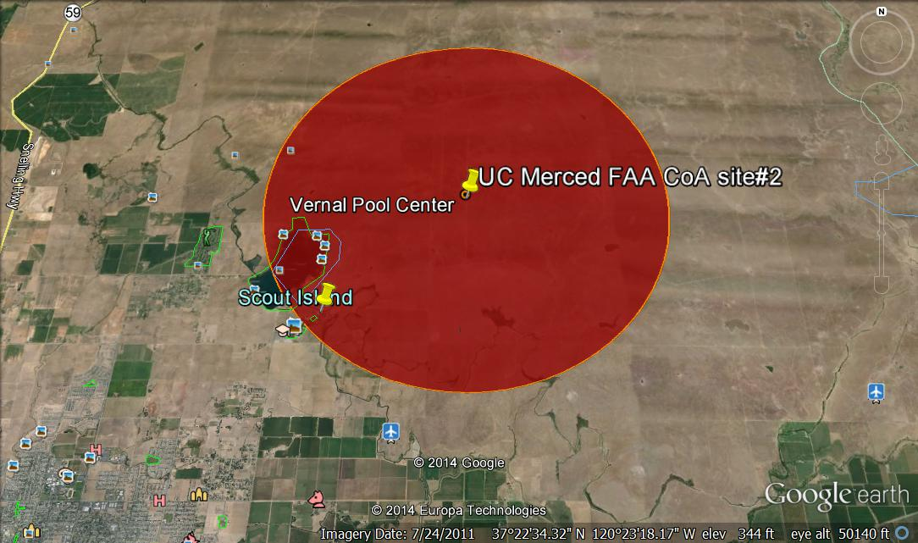
2nd FAA CoA Site – UC Merced (26 square miles in red, 2.5 nautical mile in radius)

Slide 36
Scientific data drone projects
Funded efforts
TIR night flight for migrating bird counting (via CITRIS)
Vernal pools count and change over the year in UCM NRS (SNRI)
eDNA water sampling drone (CITRIS)
Valley Fever aerial dust sampling (HSRI)
Almond tree water stress mapping (UCANR)
Potentially Fundable efforts (about 30 active projects mainly by undergraduate researchers mentored by Ph.D. students)
Biochar application for soil conditioning – assessment drone
SmartMelonDrone (BIG IDEA)
Small Drone Sprayer
Nigh flight airworthiness and mission protocols
Drone Pilot Training Class
… long list
Narrow band multispectral remote sensing

Slide 37
SDD projects @ UC Merced
Near future efforts
SF South Bay Restoration Project Mud Flat mapping
Arsenic water/soil sampling in rice paddies
True-wind ground truthing
Methane mapping groundtruthing
Chess playing drones (aerial pick-n-place, real time visual servoing)
Lidar – forest health
TIR - Forest Fire early detection
ARPA-E concept paper (Inspection Drone)
Fuel cell driven drone
… long list

