Slide 1
XAI Seminar Series S24 Ep2:
XAI explaining methods
Presenter: Rafal Krzysiak
(rkrzysiak@ucmerced.edu)
MESA (Mechatronics, Embedded Systems and Automation)Lab
ME/EECS, School of Engineering,
University of California, Merced

Slide 3
Agenda
Overview XAI
XAI Case studies
  LIME
  SHaP
  Grad-CAM
Discussion
Future Work

Slide 4
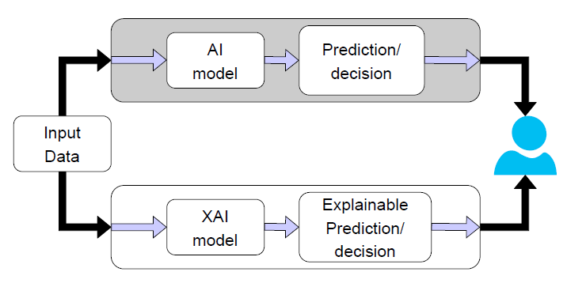
What is XAI?
Explainable Artificial Intelligence
Traditional AI is black box
  Lack of transparency and explanations
  Lacks trust in fields of medicine, military and security

Slide 5
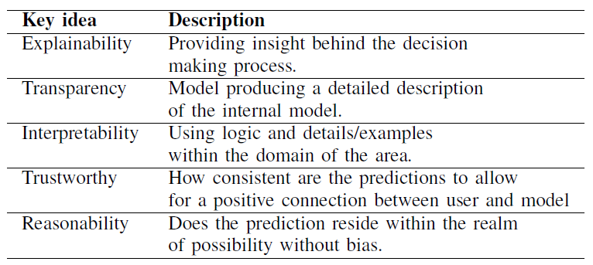
What is XAI?
XAI was derived from key questions on the decision-making process
  How? And Why?

Slide 6
XAI methods

Slide 7
Why pursue XAI?
Why should you care?
AI reach is expanding daily into everyday life
  Netflix movie recommendations
  YouTube suggested videos
  Google maps route planning
  Medical care
  Loan approval
  Autonomous driving

Slide 8


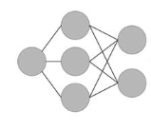
Why pursue XAI?
Humans need to understand what is going on when AI is implemented into our daily lives
Example: stroke prediction
Why?
90% stroke
Patient data
ML Model

Slide 9
XAI method agenda
LIME
  Case study (1)
  Case study (2)
SHaP
  Case study (1)
  Case study (2)
Grad-CAM
  Case study (1)
  Case study (2)

Slide 10
What is LIME?
Local Interpretable Model-agnostic Explanations
LIME gives a local explanation
Easy to use and has gained a major popularity since it can interpret outputs on any type of black-box model
Can be applied to many different types of data

Slide 11
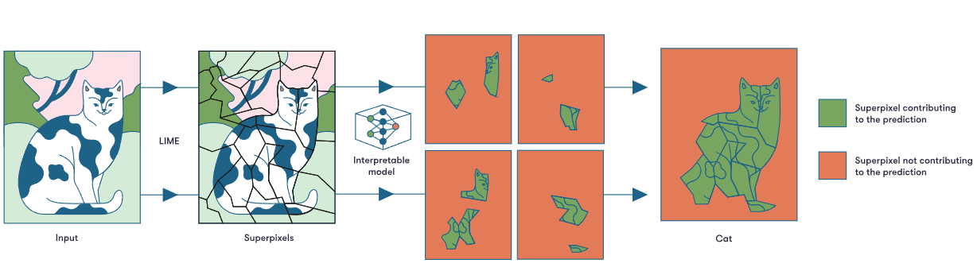
What is LIME?
Example of explaining a model that’s used for the classification of images
Takes the image and segments it into different superpixels (groups of pixels) to reduce the image to smaller interpretable regions

Slide 12
CS 1:

Slide 13
CS 1:

Slide 14
CS 2:

Slide 15
CS 2:

Slide 16
XAI method agenda
LIME
  Case study (1)
  Case study (2)
SHaP
  Case study (1)
  Case study (2)
Grad-CAM
  Case study (1)
  Case study (2)

Slide 17
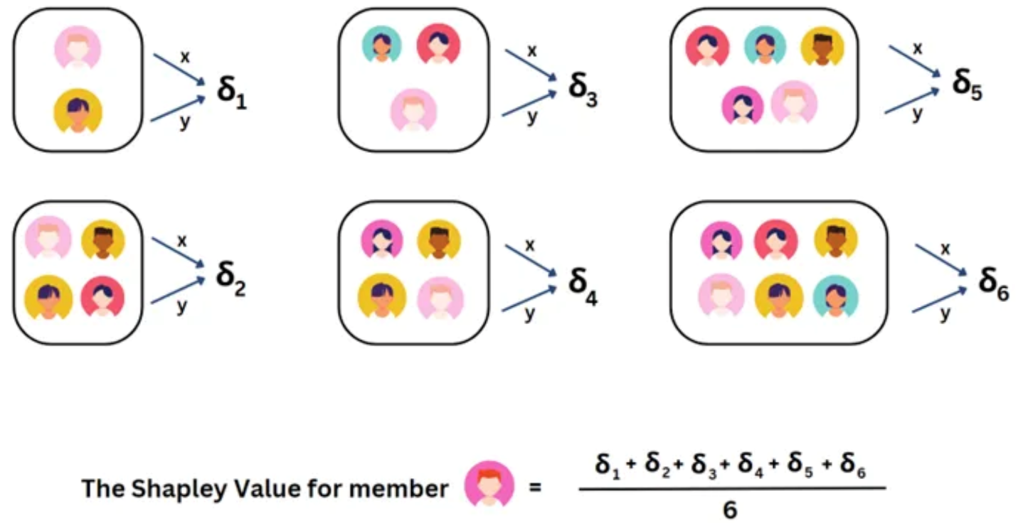
What is ShaP?
SHAP (Shapley Additive Explanations)
The Shapley value is the average marginal contribution of a feature value across all possible coalitions
Image: https://medium.com/@shahooda637/all-you-need-to-know-about-shap-for-explainable-ai-8ad35a05e6ec

Slide 18
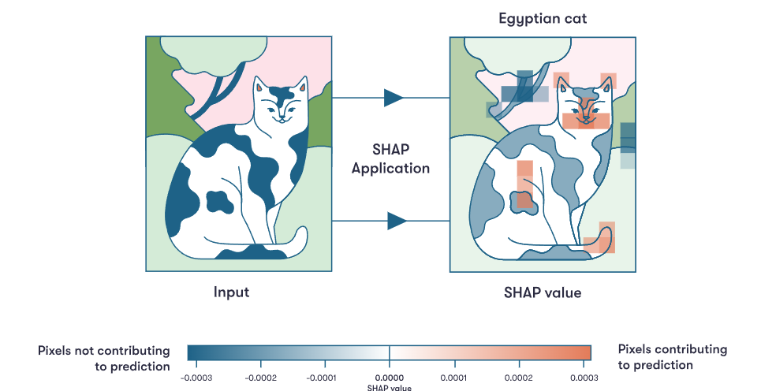
What is ShaP?
SHAP (Shapley Additive Explanations)
The Shapley value is the average marginal contribution of a feature value across all possible coalitions

Slide 19
CS 1:

Slide 20
CS 1:

Slide 21
CS 2:

Slide 22
CS 2:

Slide 23
XAI method agenda
LIME
  Case study (1)
  Case study (2)
SHaP
  Case study (1)
  Case study (2)
Grad-CAM
  Case study (1)
  Case study (2)

Slide 24
What is Grad-CAM?

Slide 25
Why use Grad-CAM?

Slide 26
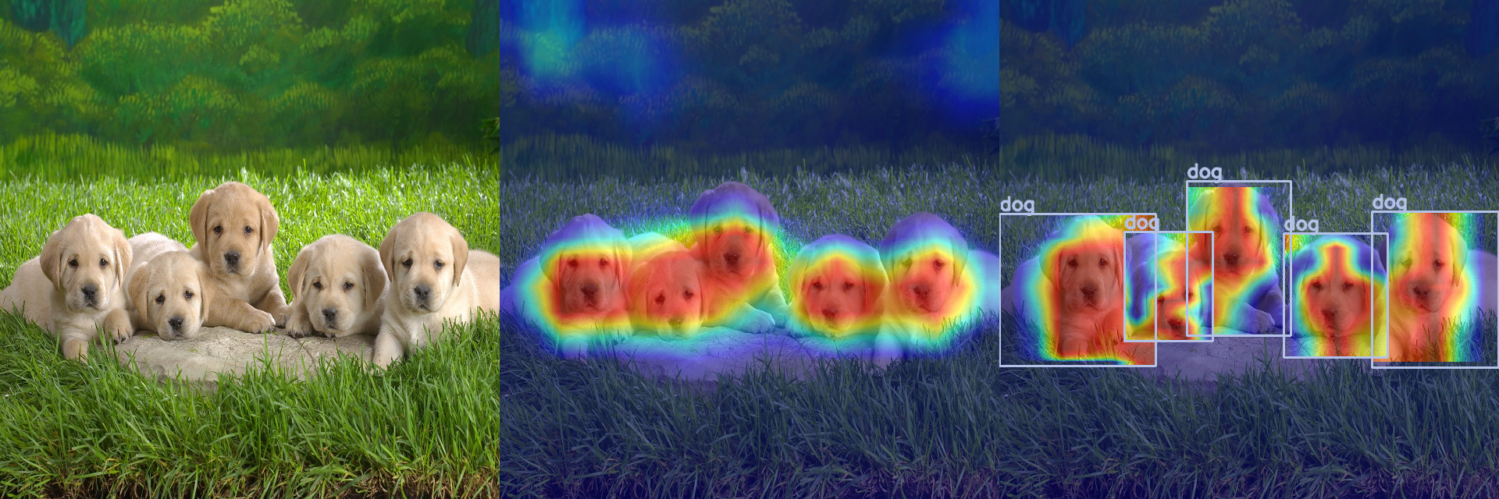
Why use Grad-CAM?

Slide 27
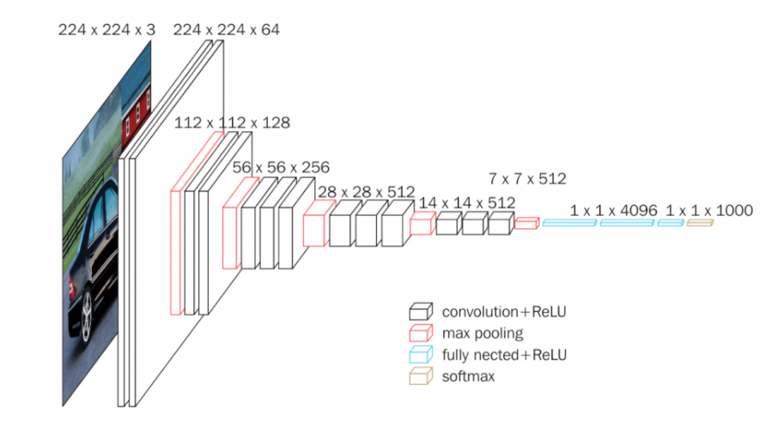
CS 1: Animal detection and features
Output label
Dog
Horse
Elephant
Butterfly
Chicken
Cat
Cow
Sheep
Squirrel
Spider
Input
Image (224 x 224 x 3)

Slide 28
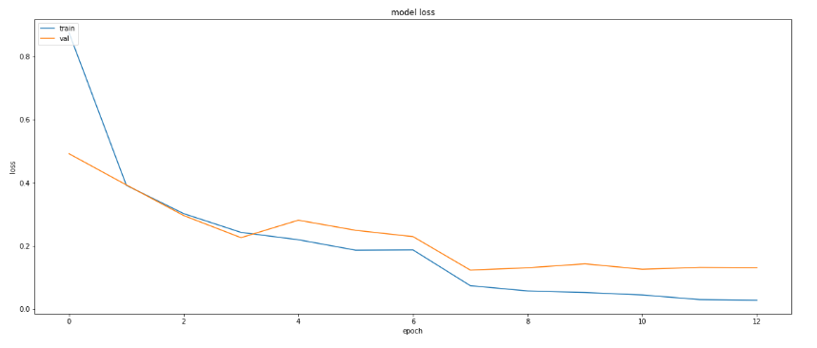
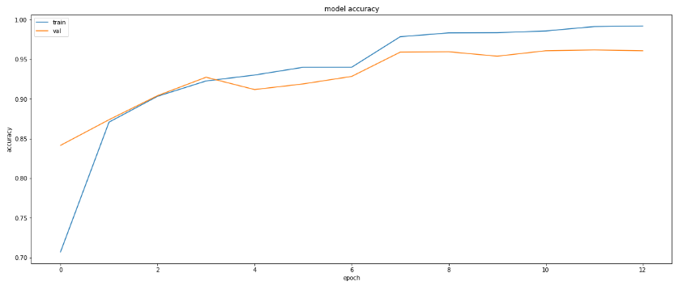
CS 1: Animal detection

Slide 29
CS 1: Animal detection

Slide 30
CS 1: Animal detection

Slide 31
CS 2: Remote Sensing

Slide 32
CS 2: Remote Sensing

Slide 33
CS 2: Remote Sensing

Slide 34
Conclusions
For Health monitoring
  We highlight the importance of developing models that can facilitate early detection, precise diagnosis, and individualized treatment strategies
  Discuss and implement a preliminary XAI digital twin framework (Xcardio-Twin) to help provide insight in not just the decision-making process of traditional black box AI machine learning model but help individuals understand features of their own physiological signals.
For planetary health
  We show, how to use Quantus to perform an insightful XAI method comparison and rank the different explanation method in application to our prepared network task.
  Also showed that using XAI evaluation we can quantitatively determine not only an appropriate explanation method but also the strengths and weaknesses of each method

Slide 35
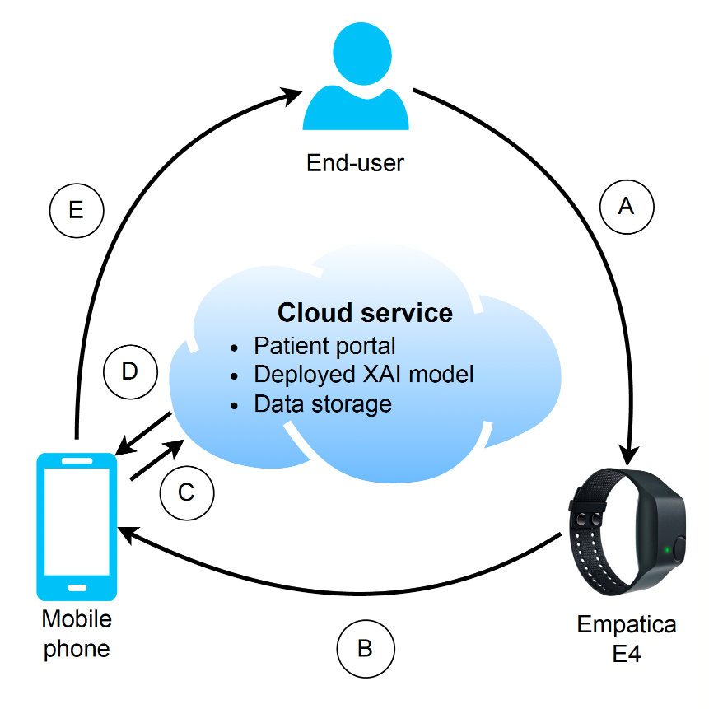
Future Work: Health monitoring
Expand towards having a more real-time data acquisition and adaption of physiological data.
Real-time data captured from a wearable device would help increase the rate at which individuals can monitor their health
R. Krzysiak, S. Nguyen, and Y. Chen, “Xaiot-the future of wearable internet of things,” in Proceedings of 2022 18th IEEE/ASME International Conference on Mechatronic and Embedded Systems and Applications (MESA). IEEE, 2022, pp. 1–6.

Slide 36
Future Work: Planetary health
Expand towards utilizing SAR data captured using active or passive monitoring.
  Satellites: Sentinel-1, SMAP etc.
  UAVs: UAVSAR etc.
Looking at individual aspects of our planet
  Water, CO2, methane etc.
Far future:
  Expand models trained on other planetary bodies to understand planetary processes within our solar systema and beyond

Slide 37
Thank you
Questions?
rkrzysiak@ucmerced.edu

