Slide 1
Main viewpoints of “Book of Extremes” and Why Fractional Calculus is the Tool
Applied Fractional Calculus Workshop Series
Tomas Oppenheim
MESA (Mechatronics, Embedded Systems and Automation)Lab
School of Engineering,
University of California, Merced
E: toppenheim@ucmerced.edu Phone: 310-853-9234
Lab: CAS Eng 820 (T: 228-4398)
June 30, 2014. Monday 4:00-6:00 PM
Applied Fractional Calculus Workshop Series @ MESA Lab @ UCMerced

Slide 2
Outline
Statistics, Sociology, Natural Phenomenon, and Economics
Reality is More of a Levy Walk
Flashmobs are Levy Flights
Hubs and Flashmobs
Conditional Probability and Its Links to Reality
Gause’s Competitive Exclusion Principle
Paradox of Enrichment and Bubbles
Shocks, Globalization, and Interdependence
Redistribution of Wealth
Leaps
Fractional Calculus

Slide 3
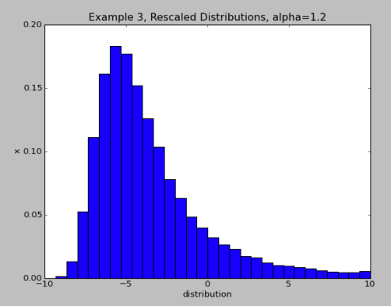

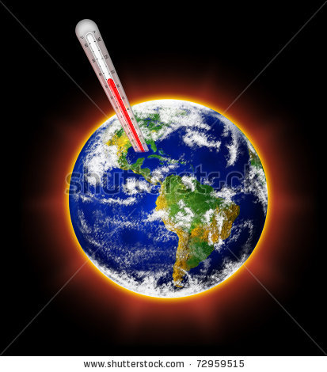

Statistics, Sociology, Natural Phenomenon, and Economics
Statistics
Sociology
Nature
http://cours-physique.lps.ens.fr/index.php/TD4
_Errors_2012_Fluctuations
http://www.dailymail.co.uk/news/article-2164536/
BBCs-coverage-Arab-Spring-sporadic-ignoring-uprisings
-failed-favour-big-stories-Libya-Egypt.html
http://www.shutterstock.com/s/global
+warming/search.html
Economics
http://blogs.swa-jkt.com/swa/10321/tag/economics/

Slide 4
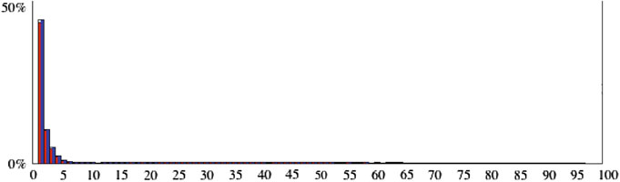
Reality is More of a Levy Walk
EXTREME events are NATURAL. What are some causes??
Fig. 2.8 Simulating the formation of flashmob
spontaneously formed by listening to neighbors
leads to a long-tailed size-distribution
Self-Similar Statistics

Slide 5
Sociological Extreme Events

Slide 6
Flashmobs are Levy Flights
Flashmobs
Arab Spring
“A group of people who assemble suddenly in a public space, perform an unusual and seemingly pointless act for a brief time, then disperse, often for the purposes of entertainment , satire, and artistic expression.
Big events mimic small events. Mobs of long-tailed size emerge from randomness with little provocation and a lot
of peer pressure. Spontaneous order emerges out of chaos.
EXTREME EVENT – Long-tailed”
http://www.dailymail.co.uk/news/article-2164536/BBCs-coverage-Arab-Spring-sporadic-ignoring-uprisings-failed-favour-big-stories-Libya-Egypt.html

Slide 7
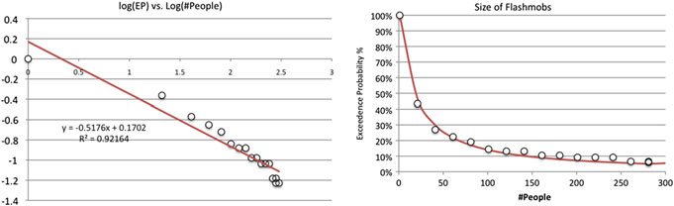
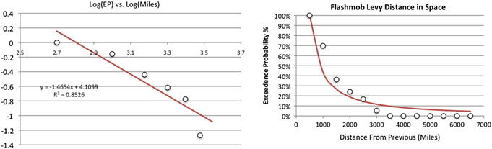
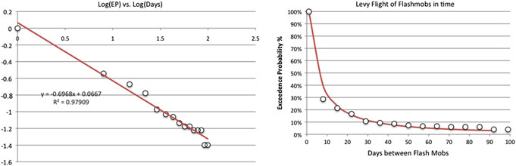
Flashmobs are Levy Flights

Slide 8
Hubs and Flashmobs
“a hub. In almost all social networks there is one actor that has far more connections than the average. This highly connected actor is called a hub, for obvious reasons and greatly influences a flashmob. Pinning a
hub introduces polarization of the network. The hub exercises social control over
the mob.”
Fig. 2.7 A social network forms groups—mobs—around RED and BLUE positions. The strip
chart at the bottom of the simulation display shows the change in mob size versus elapsed time.
Vertical lines mark points where the sizes are equal or cross each other

Slide 9

Hubs and Flashmobs
“What we know for sure is that if you want to stop a flashmob, you have to attack its hubs—the most highly linked actors. This is the key to governance in the 21st century where governments must walk a tightrope between anarchy and mob rule in the age of the global Internet.”
http://www.theguardian.com/commentisfree/cifamerica/2011/sep/25/occupy-wall-street-protest

Slide 10
What Sparks a Flashmob?

Slide 11
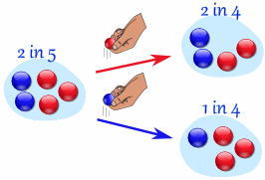
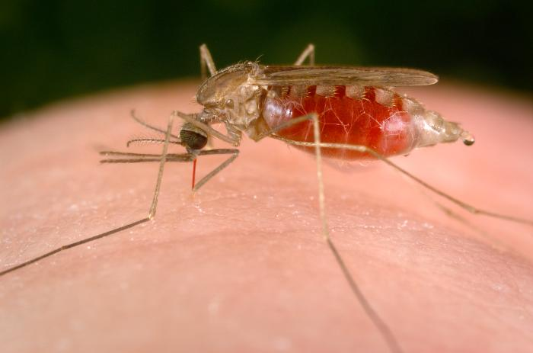

Conditional Probability and Its Link to Reality
Future Events depend on Past Events
Predicting the Future: Malaria Outbreak
http://www.mathsisfun.com/data/probability-events-conditional.html
http://wwwnc.cdc.gov/travel/diseases/malaria
Predicting the Future: Google Car
Predicting an Outlier Event
techcrunch.com/2014/05/14/googles-self-driving-car-project-is-a-worlds-fair-fantasy-turned-city-street-reality/

Slide 12
Economic Extreme Events: Monopolies

Slide 13
Gause’s Competitive Exclusion Principle
Competitive Exlusion Principle (Monopolies) – No two species within an ecological niche can coexist forever.
Preferential Attachment - All complex systems like the Internet, power grid, or national economy emerge from seemingly unstructured or chaotic circumstances into structured dominant organisms.

Slide 14
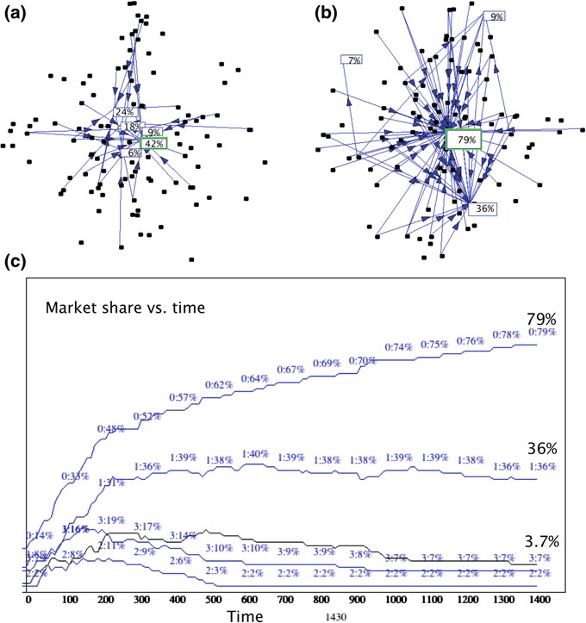
Gause’s Competitive Exclusion Principle
But the distribution
of market share among competitors follows a long-tailed power law!
Fig. 4.1 A monopolistic hub emerges from an evolving nascent market because of preferential
attachment. a Square nodes are competitors and round (black) dots represent consumers.
b Eventually one competitor gains market share over all others and its increase in market shares
accelerates. c Market share growth versus time shows how one dominant species emerges from
the pack along an S-shaped adoption curve

Slide 15

Gause’s Competitive Exclusion Principle
Online social networks self-organize through a dynamic process of preferential attachment. Each cluster is a community surrounding a hub (most-connected user). Communities typically form around a popular user (a celebrity), idea, or friendships. a Online social network
partially formed shows the emergence of clusters or tightly connected neighborhoods. b Same online social network shown in (a) after further evolution showing increased self-organization. A central core is surrounded by splinter groups with their own clustering.

Slide 16
Economic Extreme Events: Bubbles

Slide 17

Paradox of Enrichment and Bubbles
Bubbles are caused by having too much of a good thing! Look at the US Housing Crisis!
Shouldn’t an abundance of food stimulate more growth and more abundance? Quite the opposite—making the ecosystem ‘‘richer’’ damages it! But not always.
http://en.wikipedia.org/wiki/Bubble_gum

Slide 18
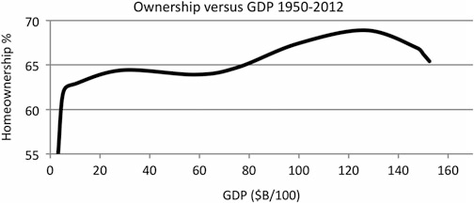
Paradox of Enrichment and Bubbles
The carrying capacity of the housing market was exceeded by the
general economic strength of the country—GDP (Gross Domestic Product). In
effect, the housing bubble burst because the US GDP was unable to support the
rapid increase in debt burden assumed by borrowers. The money supply enriched
this ecosystem by expanding too rapidly when the Federal Reserve artificially
lowered interest rates and printed money. This rapid expansion sent shocks
through the financial system, destabilizing it, and ruining the very ecosystem it was
supposed to save.

Slide 19
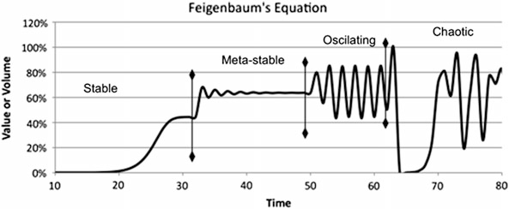
Shocks, Globalization, and Interdependence
Fig. 6.8 Segment of the world trade web connecting the LA/LB port with the rest of the world
shows dependencies with Panama and other ports

Slide 20
Controlling the Economy

Slide 21
Redistribution of Wealth
Fig. 8.3 Pareto distributions with and without taxes: (a). No taxes or redistribution. (b). Wealth
increases are taxed at 20 % and the proceeds are periodically redistributed to individuals with less
than average wealth

Slide 22
Leaps
Fig. 9.1 Elapsed time between Internet inventions and innovations follows a long tailed distribution. In the future, this distribution must become shorter to keep pace
Gone is incremental thinking and visionary journeys of a thousand small steps.
The 21st century is about waves, surges, bubbles, and leaps. Innovation alone will
not be enough in this century. Nothing less than leaps are required.

Slide 23
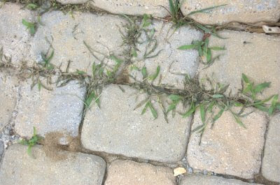
Leaps
Look in-between the cracks for problem solving and technological innovation!

Slide 24
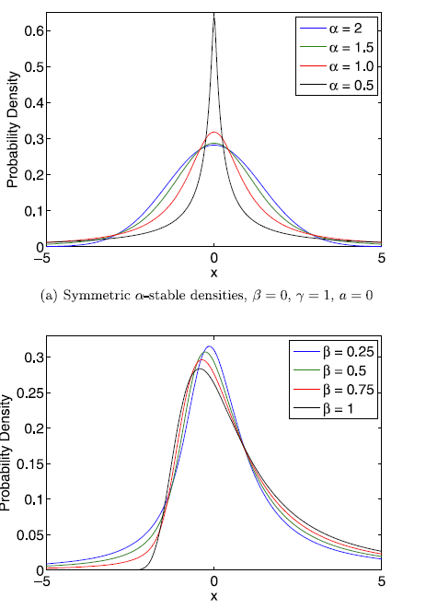
Why Fractional Calculus is the Tool
Fractional Order

Slide 25
Tomas Oppenheim
1. Bridging the gap between modelling and control of anesthesia: an ambitious ideal
Current problem in anesthesia: “problematic modeling the drug diffusion process that occurs in human body when anesthetic drug is taken up” – each human reacts differently to anesthetic drugs
“This paper presents the available tools emerging from fractional calculus (FC) to model the nonlinear characteristics of the pharmokinetic (PK) and pharmodynamic (PD) patient models.”
“PD models are usually represented by nonlinear Sigmoid curves and represent the relationship of drug concentration to drug effect in each patient” – FC offers tools to model such nonlinear characteristics
“Allows for automated closed-loop control of anesthesia – offers continuous drug delivery, contrary to intermittent control which is nowadays standard practice”
Safer for patients, better control for doctors

Slide 26
Tomas Oppenheim
2. Fractional dynamics of a model for HIV and TB coinfection
Paper studies fractional order model for HIV and TB coinfection
Vertical transmission from mother to child and treatment for HIV and TB is considered as well as treatment for both diseases
“For the numerical implentation of the fractional order derivatives, a series expansion based on the Grunwald-Letnikov definition was adopted”
Model approaches asymptotically the stable disease free equilibrium

