Slide 1
Vanderbilt haptic paddle Applied Fractional Calculus Workshop Series
Niloufar Irannejad
MESA (Mechatronics, Embedded Systems and Automation)Lab
School of Engineering,
University of California, Merced
E: nirannejad@ucmerced.edu
Lab: CAS Eng 820 (T: 228-4398)
July 28, 2014. Monday 4:00-6:00 PM
Applied Fractional Calculus Workshop Series @ MESA Lab @ UCMerced

Slide 2
Introduction
Haptic platform to feel force in virtual environments such as medical or tele-operation applications.
Originally created for educational purposes to teach dynamic and control systems.
Vanderbilt university designed an inexpensive, portable and robust version.
Can be further extended to medical usages.

Slide 3
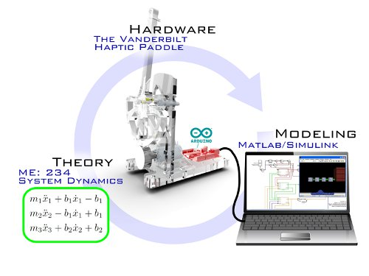
Haptic Paddle

Slide 4
Specifications
A device with 1 Degree of Freedom.
Printed with a 3D printer.
An angle sensor is connected through a magnet to drive wheel.
A DC motor actuates the paddle.
Arduino board and Ardumoto shield control the system.
Programmed with Matlab and Simulink.
1 directional Load cell recently added.

Slide 5
Additional Projects
With additional hardware such as Force sensors, electro optical encoders or high- performance data acquisitions cards we can do some typical projects :
Impedance control with force feedback
Admittance control
The effect of velocity estimation on stability
Electromyography control

Slide 6
Example Application

Slide 7
Remodeled Haptic Paddle
Changed in shape of the parts with Huong Phan.
Adjusted the parts to 3D printer capabilities.
Printable in 5 hours compared to 16 hours of the old model.

Slide 8
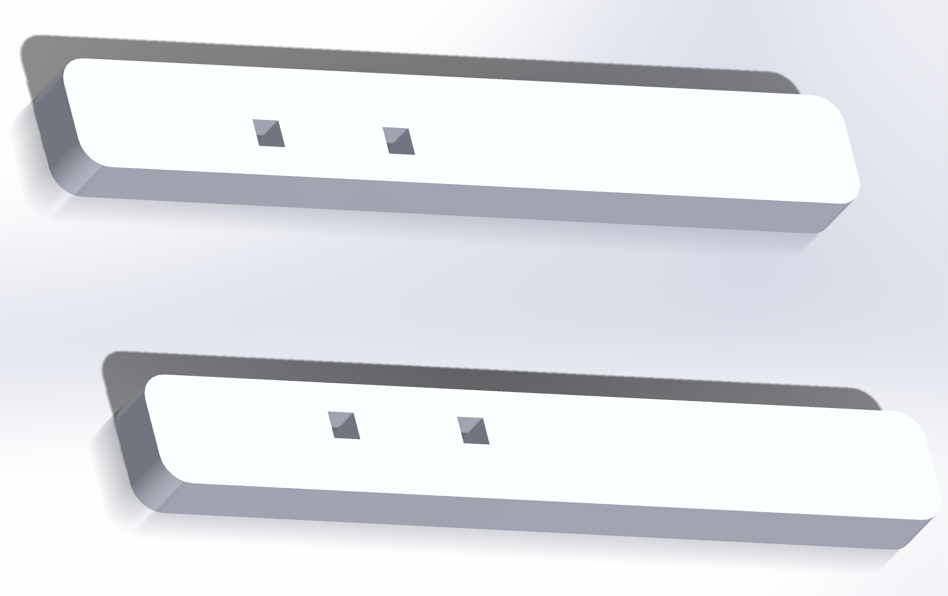
Remodeled Haptic Paddle(cont.)

Slide 9
Sample Simulink Model

Slide 10
Future Works
Integrate force sensor with two directions and full functionality.
Run experiments on fractional model of human muscles with Dr. Huang.
Realize the remodeled haptic device and run experiments with that too.
Use the device to teach dynamics and control systems at UC Merced.

Slide 11
References
Richard, Christopher, Allison M. Okamura, and Mark R. Cutkosky. "Getting a feel for dynamics: Using haptic interface kits for teaching dynamics and controls." 1997 ASME IMECE 6th Annual Symposium on Haptic Interfaces, Dallas, TX, Nov. 1997.
Gillespie, R. Brent, M. B. Hoffinan, and James Freudenberg. "Haptic interface for hands-on instruction in system dynamics and embedded control." Haptic Interfaces for Virtual Environment and Teleoperator Systems, 2003. HAPTICS 2003. Proceedings. 11th Symposium on. IEEE, 2003.
Bowen, Kevin, and Marcia Kilchenman O'Malley. "Adaptation of haptic interfaces for a labview-based system dynamics course." Haptic Interfaces for Virtual Environment and Teleoperator Systems, 2006 14th Symposium on. IEEE, 2006.
Hogan, Neville. "Impedance control: An approach to manipulation." American Control Conference, 1984. IEEE, 1984.
Kobayashi, Yo, et al. "Fractional impedance control for reproducing the material properties of muscle." Intelligent Robots and Systems (IROS), 2010 IEEE/RSJ International Conference on. IEEE, 2010.
Schneider, Stanley A., and Robert H. Cannon Jr. "Object impedance control for cooperative manipulation: Theory and experimental results." Robotics and Automation, IEEE Transactions on 8.3 (1992): 383-394.
Kobayashi, Yo, et al. "Haptic feedback control in medical robots through fractional viscoelastic tissue model." Engineering in Medicine and Biology Society, EMBC, 2011 Annual International Conference of the IEEE. IEEE, 2011.
http://eduhaptics.org/index.php/HapticDevices/HapticPaddles

Slide 12
Thanks for your attention Questions?!

