Slide 1

http://mechatronics.ucmerced.edu
Educational Excellence
http://methane.ucmerced.edu/
Prof. YangQuan Chen (yqchen@ieee.org)
Undergraduates
  ME142 Mechatronics (4cr, lab intensive)
  ME190/ME152 Digital Twins (4cr, lab intensive)
  ME143 Introduction to Drones (4cr, lab intensive)
  195 series: Independent Research (1 to 4 cr)
Graduates
  ME/EECS210: Linear Multivariable Control (3cr)
  ME211: Nonlinear Controls (4cr)
  ME212: Advanced Control: Optimality and Robustness
  ME280: Fractional Order Mechanics
Research Excellence
Mechatronics, smart control engineering, XAIoT
Cyber-physical human systems (CPHS)
UAVs / UGVs as mobile sensors & mobile actuators
Methane localization, quantification, mitigation
Complexity-aware machine learning & smart big data
Applied fractional calculus in complex systems
Precision ag, forestry, environmental monitoring
Digital Twins for smarter processes & systems
Service Excellence
Impacts
UCEAP Merced Campus Faculty Director (s’20)
Distinguished Scholarly Public Service Award (2018)
Editor-in-chief, Ag and Forestry Section of Drones (s’20)
Editor-in-chief (EiC), Optimization/big data/AI/ML Section of Fractal and Fractional (proposed 23, s’24)
Topical EiC in Field Robotics for Int. J. Adv. Rob. Sys.
General CoChair, Int. Conf. of UAS 2023.
Book Series coeditor: AFC4STEM, CRC Press (s’23).
AE for IEEE Trans. NNLS, IV, ICPS; Nonlinear Dynamics; Mechatronics; Fract. Calc. & Applied Analysis (FCAA)
Founding AE for Industrial AI and InteCom
Google citations 55.1K; H-index: 100; H-10 index: 642
Utah State University Robins Award (Researcher of The Year) (2012)
UC Merced Distinction in Research Award (2022)
ICFDA Dissemination Award (2010)
ICUAS 2015 Best Paper Award
International Award, Slovak Republic (2021) …
19 PH.D. finished; 24 MSc finished; 5 Ph.D. on-going
200+ undergrads research experienced with MESA Lab
120+ Int. exchange scholars/students/professors hosted

Slide 2
Current funded research projects (as of May 2024)
Lam Research (since 2013) [Justus/Osama] [Zhuo/Kai/Sina/Jairo]
  Digital Twins; Smart Control Engineering, Self-Optimizing Control, smart predictive maintenance, smart big data
NSF INFEWS (2020-2025) food-energy-water nexus [Shiang]
  Salt water greenhouse – digital twins, economic model predictive control, IoT
CMERI: Center for Methane Emission Research and Innovation (23-25) [Derek/Sachin/Rafal]
Pending USDA NIFA - Walnut rootstock genotyping/phenotyping for nematodes ($5M)

Slide 3
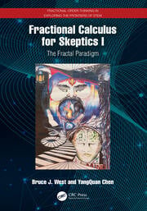
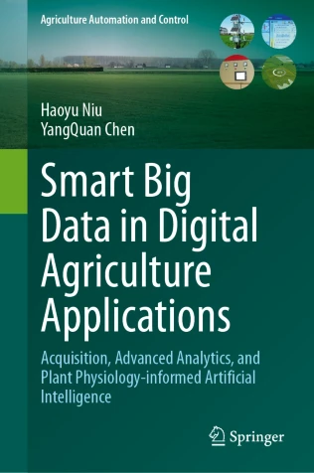
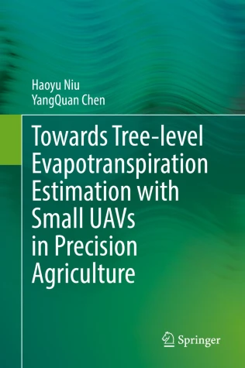
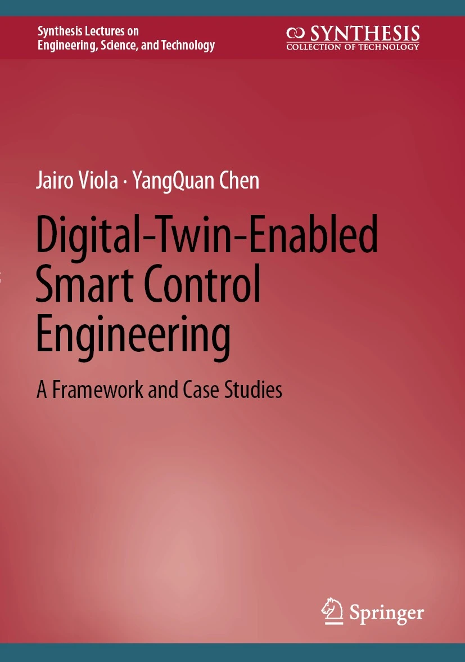
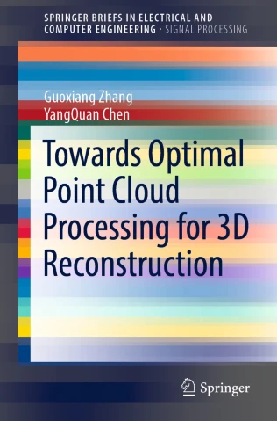
Recent MESA Lab books (2022-2024)
2024
2023
2022
2022
2022

Slide 4
DT (Digital Twins) related credentials @ MESA Lab https://mechatronics.ucmerced.edu/digital-twin
2012. “Cognitive Process Control” for Lam Research. (PPT) (PDF)
2019. A DT website we developed: http://www.theedgeai.com/
2021. A DT education paper: https://doi.org/10.1115/DETC2021-70708 + another one https://doi.org/10.1109/DTPI52967.2021.9540196
2022. A tutorial on DT at IFAC Mechatronics at UCLA. https://mechatronics.ucmerced.edu/spm
2022. A DT research monograph: https://link.springer.com/book/10.1007/978-3-031-22140-8
2022. Ph.D. dissertation finished "Self-Optimizing Smart Control Engineering Enabled by Digital Twins" (Dr. Jairo Viola)
2022. Ph.D. dissertation finished “Digital Twin Enabled Collective Sensing and Steering for Source Determination Problems” (Dr. Derek Hollenbeck)
2022. Ph.D. finished “Smart Big Data in Precision Agricultural Applications: Acquisition, Advanced Analytics, and Plant Physiology-informed Machine Learning” (Dr. Haoyu Niu)
2023. Ph.D. dissertation finished “Smart Predictive Maintenance Enabled by Digital Twins and Physics Informed Smart Big Data” (Dr. Furkan Guc)
2023. The Best Paper Award in the flagship DT conference (only one award, paper title: “FPGA-Based Digital Twin Implementation for Power Converter System Monitoring”) https://2023.ieee-dtpi.org/
2024. A chapter in DT handbook (chapter 34 is from us): https://www.routledge.com/Handbook-of-Digital-Twins/Lyu/p/book/9781032546070
2024. Ph.D. dissertation finished "XAIOT Enabled Smart Sensing of Soil Carbon Content for Smart Application of Biochar” (Dr. Di An)
2024. A DT undergraduate 4 cr. lab intensive course (Fall 2024) (ME190/ME152) [course flyer PDF]

