Slide 1
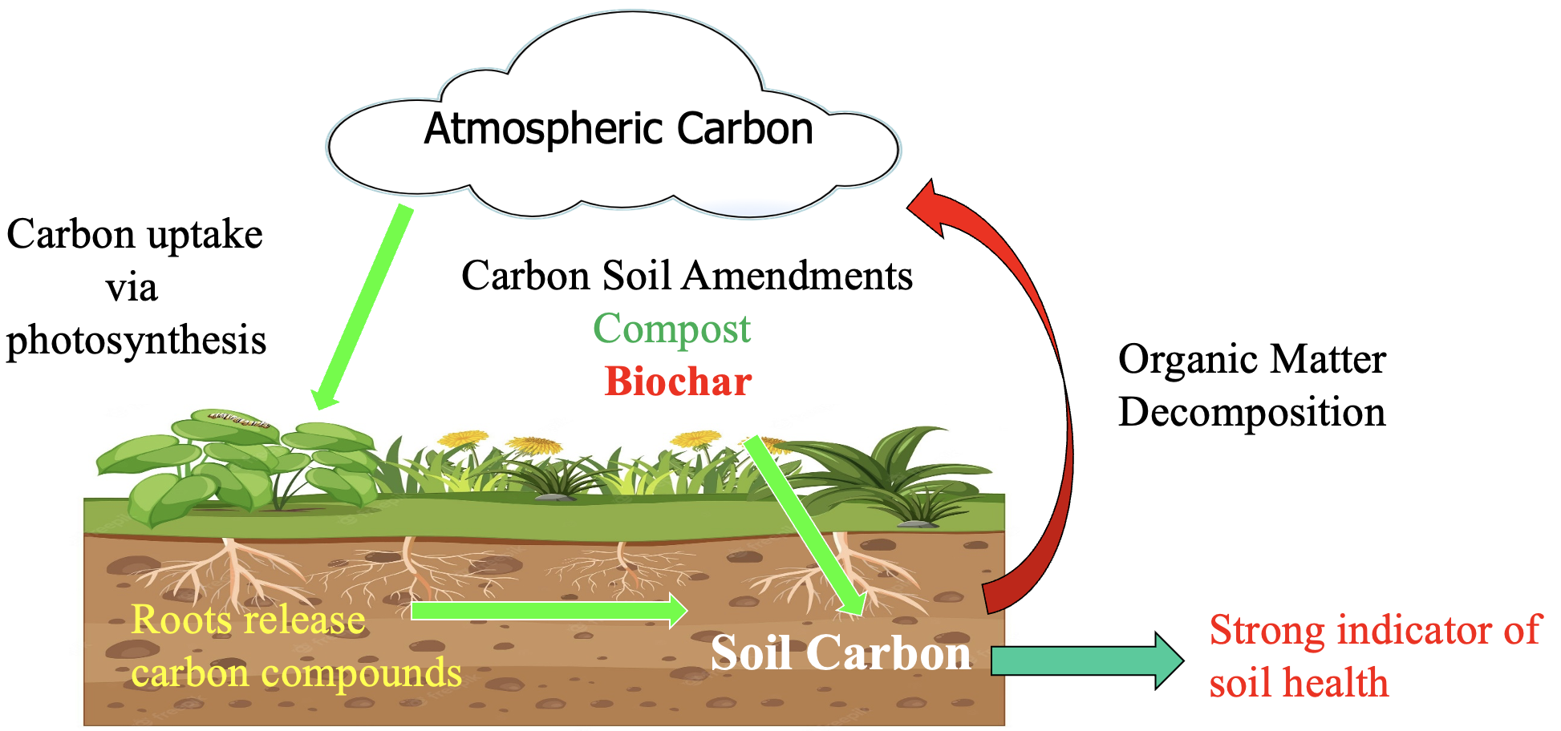
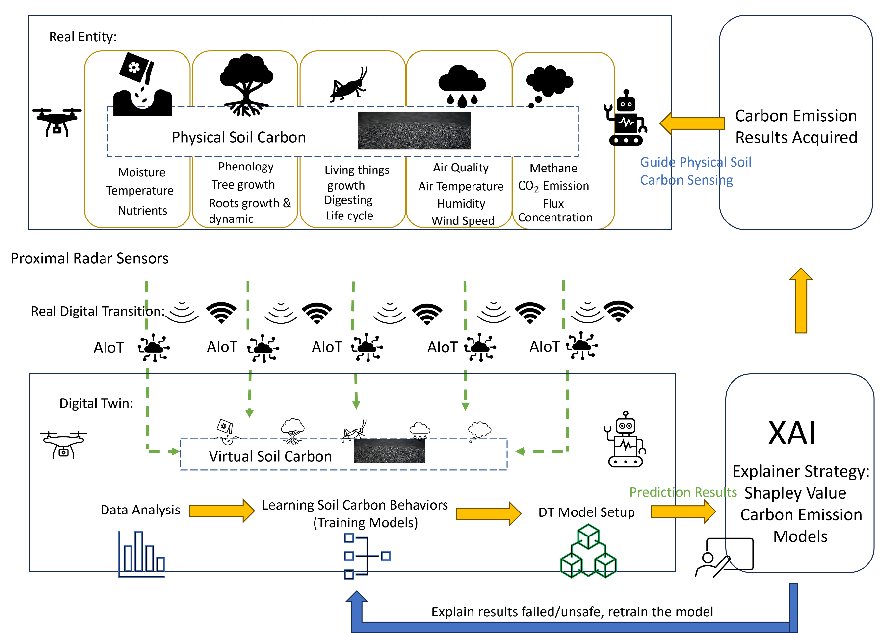
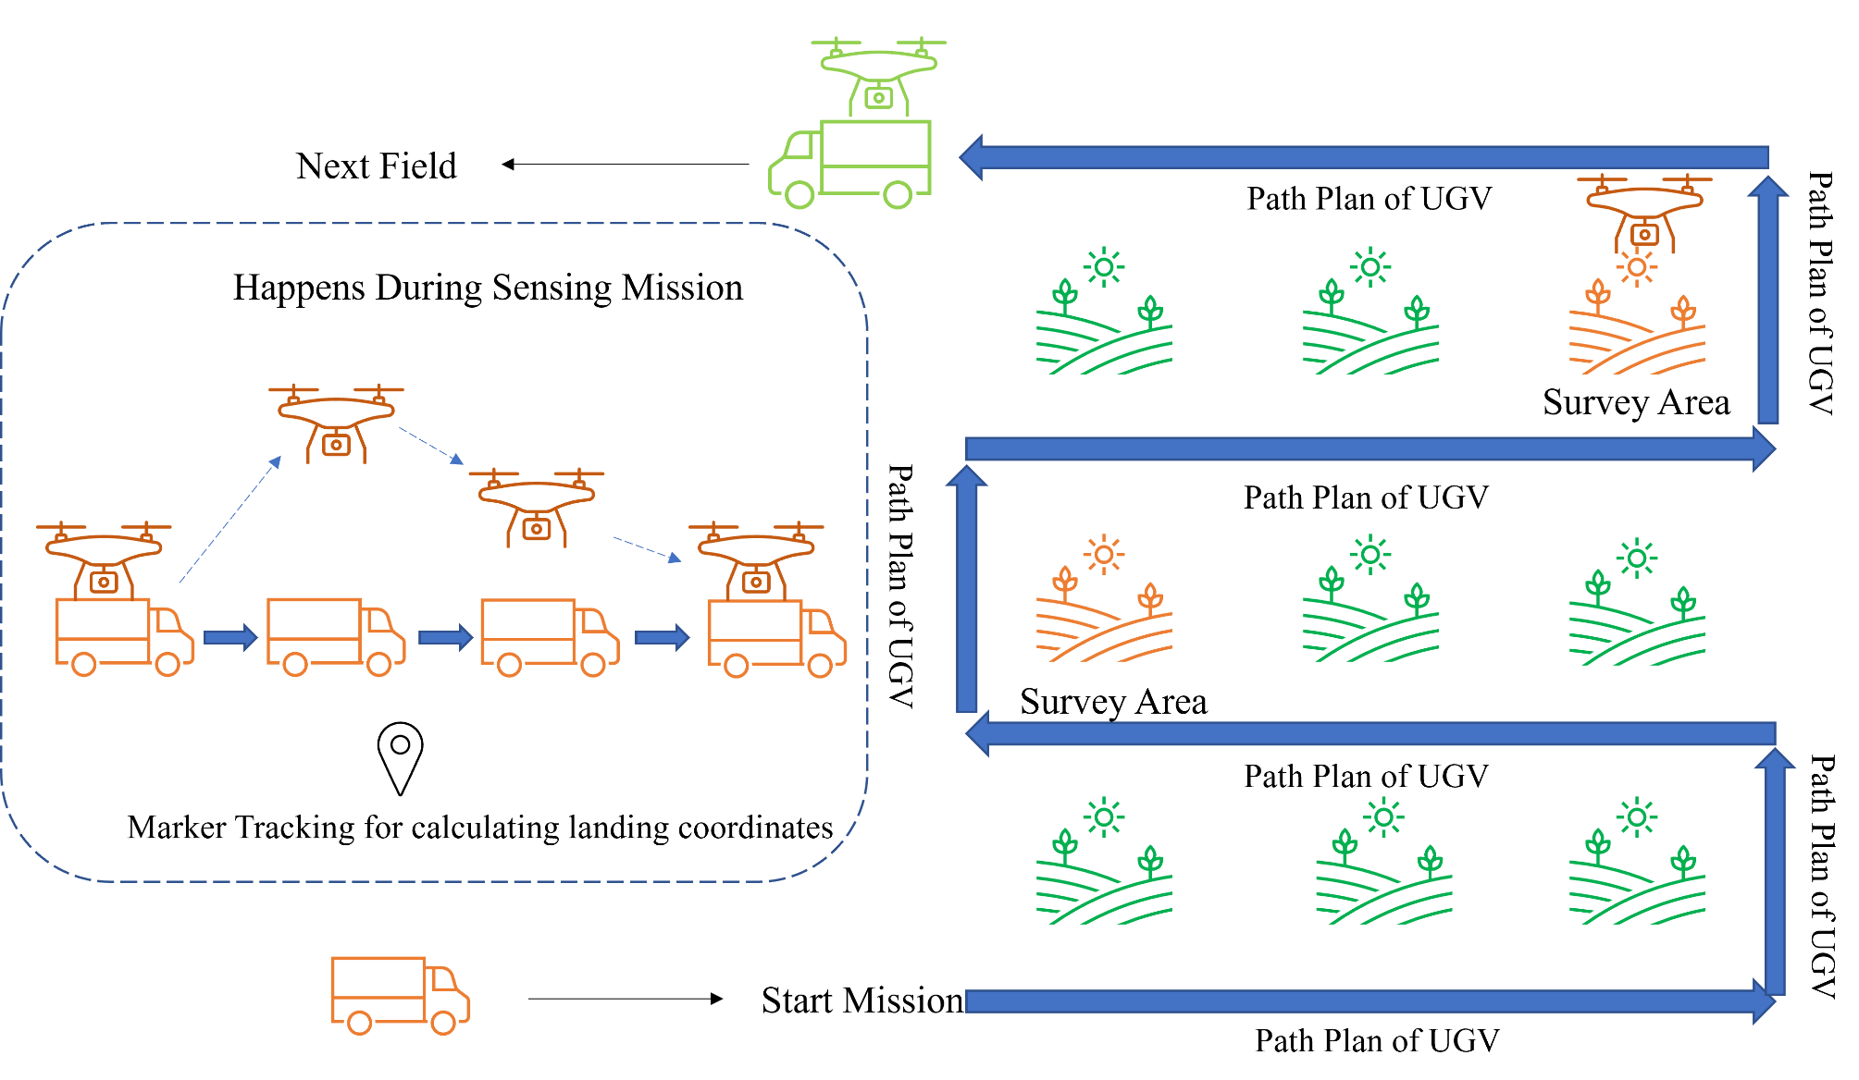
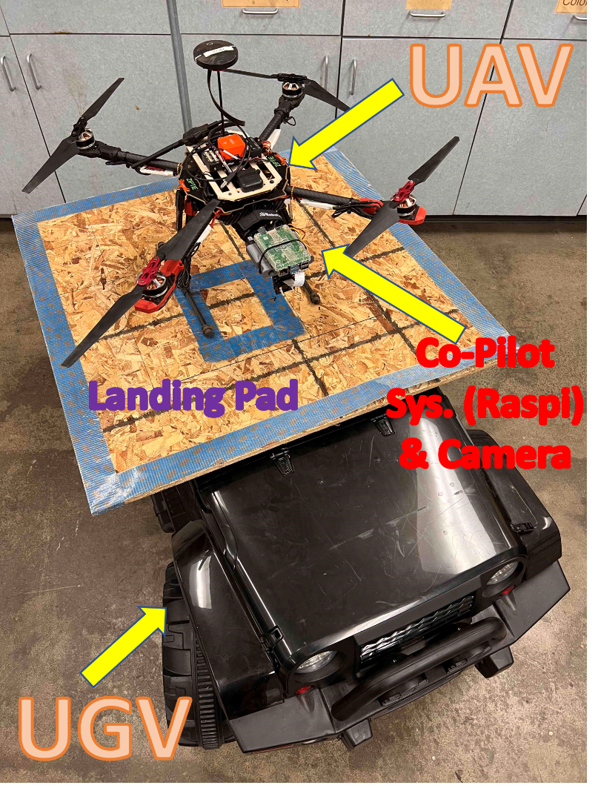
XAIoT Enabled Smart Sensing of Soil Carbon Content for Smart Application of Biochar
Di An, YangQuan Chen
{dan7, ychen53}@ucmerced.edu
University of California, Merced
CMERI (Center for Methane Emission Research and Innovation)
https://methane.ucmerced.edu
Introduction
Methodology/Approach
Evaluation Metrics
Soil carbon content is essential for soil vitality, directly affecting its ability to support agriculture, conserve water, and counteract climate change. As an integral aspect of soil's diverse functions, carbon is crucial for ecological equilibrium. Regrettably, prevalent practices like biomass burning are stripping away the soil's protective layer, resulting in a marked and enduring reduction of soil organic carbon. Such depletion not only jeopardizes soil integrity but also accelerates the rise in greenhouse gas (GHG) emissions, intensifying climate change. Therefore, it is imperative to precisely evaluate and manage soil carbon content to preserve its integrity and exploit its role in combating climate change.
XAIoT Framework Implementation: A robust framework integrating AI models interpretable by environmental and engineering domain experts for reliable data collection and interpretation.
Advanced Sensing Techniques: Utilization of microwave and millimeter-wave radar for high-resolution soil carbon content sensing.
Machine Learning Integration: Incorporation of machine learning algorithms within SSM systems for adaptive and precise soil management.
Digital Twin and Mobile Platforms: Deployment of Digital Twin models for real-time monitoring and management, complemented by the use of UAVs and UGVs for efficient field operations.
Accuracy of Carbon Content Measurement: Precision and reliability of soil carbon measurements are paramount, with a focus on reducing discrepancies and enhancing measurement consistency.
Efficiency of SSM Systems: The performance of SSM systems is assessed based on their ability to adapt to changing soil conditions and accurately manage soil carbon content.
Operational Sustainability: The longevity and maintenance requirements of the XAIoT smart sensing and actuation subsystems are critical metrics, ensuring the sustainability of the proposed solutions.
Impacts
Climate Change Mitigation: By enhancing the accuracy and efficiency of soil carbon content management, the proposed solutions contribute significantly to global efforts in climate change mitigation.
Community Empowerment: The research has the potential to improve the quality of life for low-income and disadvantaged communities
Problem Statement
Current techniques to measure soil carbon content present considerable limitations. They typically require costly equipment and substantial manpower, which makes them impractical for widespread use. Additionally, the dependability of data obtained through artificial intelligence that analyzes soil and atmospheric samples is reliant on the interpretation and expertise of humans. Without this, there is a notable uncertainty regarding the precision and efficacy of these methods in assessing and managing soil carbon content. This uncertainty underscores the necessity for more reliable measurement and management methods for soil carbon content.
Objectives
Acknowledgements
Contributions
This work of D. An is partly supported by SGC project entitled "Mobile Biochar Production for Methane Emission Reduction and Soil Amendment.'' Grant Agreement #CCR20014. Y.Q. Chen is supported by the University of California Merced Climate Change Action Seed Grant ``Center for Methane Emission Research and Innovation'' (CMERI 2023-2025).
XAIoT-Empowered Sensing: Implement microwave and millimeter-wave radar sensing for systematic data acquisition, providing precise measurements of soil carbon content.
Site-Specific Management Systems: Utilize in situ site-specific management (SSM) systems, integrating machine learning algorithms for dynamic soil carbon content management.
Digital Twin Strategy: Deploy a Digital Twin-enabled strategy for optimal soil carbon content management in large-scale fields. This approach uses mobile platforms like UAVs and UGVs for targeted application of biochar and manure mixtures.
Cognitive Battery Management: Develop a cognitive battery management system aimed at extending the battery life of XAIoT smart sensing and actuation subsystems, ensuring sustainable and prolonged field operations.
Innovative Smart Sensing Solutions: The use of XAIoT for soil carbon measurement introduces a new era of precision in environmental and agriculture monitoring.
Enhanced Data Reliability: By integrating domain knowledge into AI models, the reliability of data interpretation reaches unprecedented levels.
Optimized Management Strategies: The combination of SSM systems, Digital Twin technology, and mobile platforms represents a significant leap forward in soil carbon content management.
References
[1] An, D., & Chen, Y. (2023). Non-intrusive soil carbon content quantification methods using machine learning algorithms: A comparison of microwave and millimeter wave radar sensors. Journal of Automation and Intelligence, 2(3), 152-166.
[2] An, D., Hollenbeck, D., Cao, K., & Chen, Y. Q. (2022). Soil Methane Emission Suppression Control Using Unmanned Aircraft Vehicle Swarm Application of Biochar Mulch - A Simulation Study, Journal of Information and Intelligence, 1(1), 68-85.
[3] An, D., Krzysiak, R., Hollenbeck, D., & Chen, Y. (2023). Long Endurance Site-Specific Management of Biochar Applications Using Unmanned Aircraft Vehicle and Unmanned Ground Vehicle. IFAC-PapersOnLine, 56(2), 8908-8913
[4] An, D., & Chen, Y. (2021, July). Digital Twin enabled methane emission abatement using networked mobile sensing and mobile actuation. In 2021 IEEE 1st International Conference on Digital Twins and Parallel Intelligence (DTPI) (pp. 354-357). IEEE.
2024 North American Biochar Conference, February 13th-15th,Sacramento, California, USA. https://www.biocharconference.com/

