Slide 1
Fractional-Order Stochastic Extremum Seeking Control with Dithering Noise for Plasma Impedance Matching
The 2021 IEEE Conference on Control Technology and Applications (CCTA)
Jairo Viola¹, Derek Hollenbeck¹, Carlos Rodriguez², and YangQuan Chen¹
¹MESA (Mechatronics, Embedded Systems and Automation)Lab
Mechanical Engineering, University of California, Merced
²Ensenada Center for Scientific Research and Higher Education, Mexico
E: (jviola, dhollenbeck, ychen53)@ucmerced.edu, crodriguez@cicese.edu.mx
08/08/2021, San Diego, California

Slide 2
Outline
1
Introduction
2
3
L-Type network Plasma Impedance Matching
4
Conclusions and future works
Fractional-Order Extremum Seeking Control

Slide 3
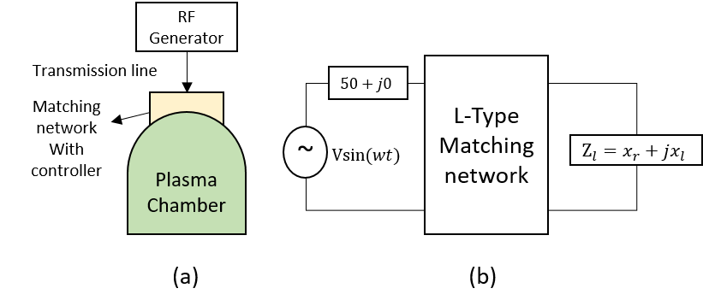
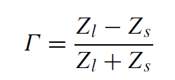
1.Introduction
RF Plasma Impedance Matching
$$Z_{m}$$
$$Z_{s}$$
High variability plasma impedance
Unknown plasma dynamics
Complex physics model
Maximum power transfer is granted when $Z_{s}=Z_{M}^{∗}=50+j0$
Reflection coefficient
Optimization goal
$$Γ=0$$

Slide 4
1.Introduction
Types of impedance matching:
Passive Impedance Matching
Fixed loads
Impedance adjusted by fixed capacitor or inductors
Automatic Impedance Matching
Real-time varying capacitors
PID control
Gradient based
Seeking algorithms (Magnitude and phase)
The impedance matching success is measured usually for a single and invariant load without considering performance criteria like:
Settling time
Reflected power coefficient $Γ$
Convergence rate under different capacitor initial conditions and uncertain load

Slide 5
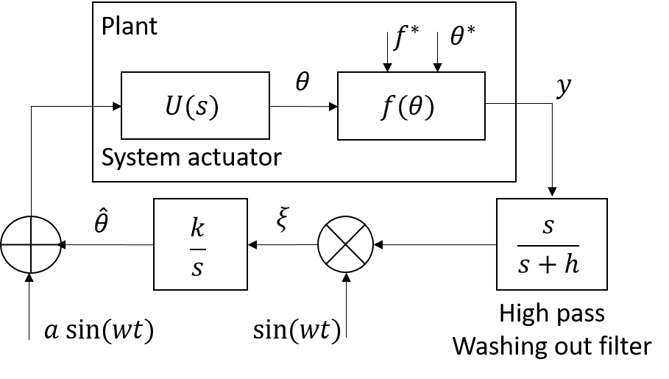
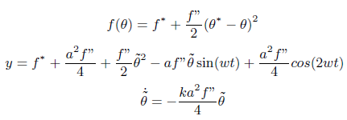
2. Fractional-Order Extremum Seeking Control
Integer-Order Sinusoidal Perturb and observe Extremum Seeking Control (IO P&O ESC)
Where:
$y:$ cost function output, $f^{∗}$: minimum of $f(θ)$
$θ^{∗}:$ unknown optimal parameters, $\hat{θ}:$ estimated value of $θ$, $\tilde{θ}=θ−\hat{θ}$: parameter error
$a,w$: amplitude and frequency of perturbing signal
$h:$ Low pass filter frequency

Slide 6
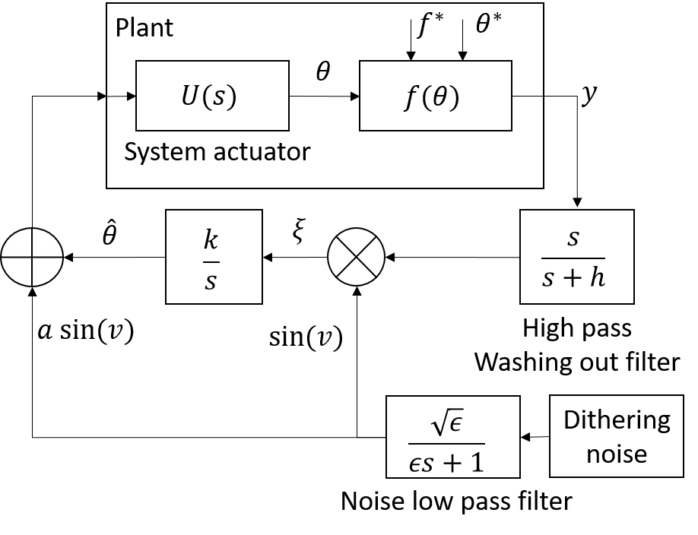
2. Fractional-Order Extremum Seeking Control
Fractional-Order Perturb and observe Stochastic Extremum Seeking Control (FO P&O SESC)
$v$ can be replaced by integer/fractional order gaussian noise
$v=Asin\left(η\right),$bounded noise
$v=fGn,Gn$, unbounded noise
Fractional gaussian noise
$$B_{H}\left(t\right)=\frac{1}{Γ(H+1/2)}\int_{0}^{t}{{\left(t−s\right)}^{H−0.5}dB (s)}$$
Hurst parameter $H$
Brownian motion $H=0.5$
Positively correlated (LRD) $H>0.5$
Negatively correlated (LRD) $H<0.5$
D. Hollenbeck and Y. Chen, “A More Optimal Stochastic Extremum Seeking Control Using Fractional Dithering For A Class of Smooth Convex Functions,” 2020.

Slide 7
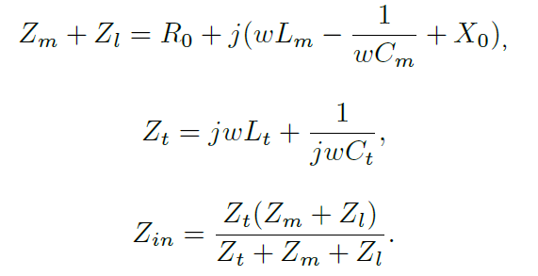
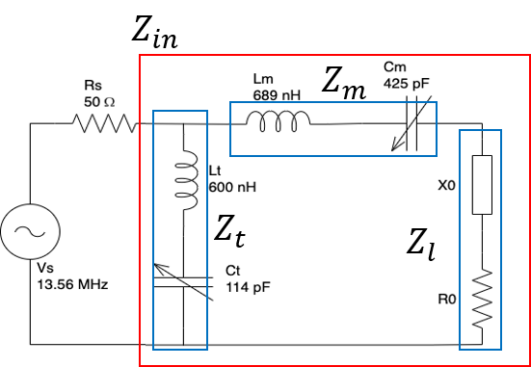
3. L-Type network Plasma Impedance Matching
L-Type Network configuration
Component | Value
 | min | max
$$z_{s}$$ | $$\text{50+}\text{j}\text{0} Ω$$
$$C_{t}$$ | $$425pF$$ | $$2240pF$$
$$C_{m}$$ | $$114pF$$ | $$445pF$$
$$L_{t}$$ | $$600nH$$
$$L_{m}$$ | $$689nH$$

Slide 8
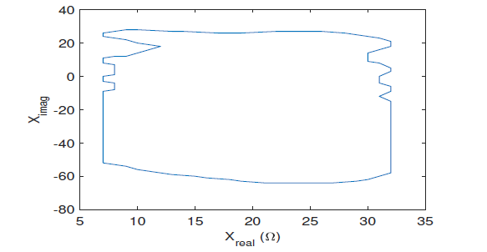
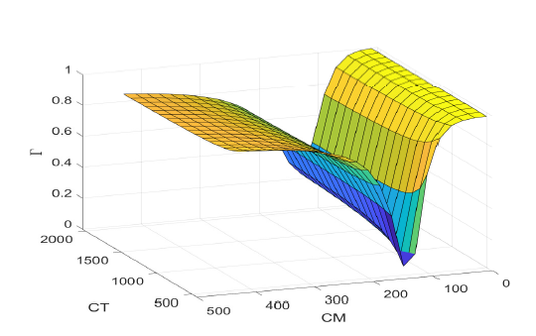
3. L-Type network Plasma Impedance Matching
L-Type Network configuration
Controllability challenge
Feasible matching
Feasible matching region for L-Type network
Capacitor-space (starting capacitor positions) for L-Type network for given $Z_{L} = 7.95 + 5.2$

Slide 9
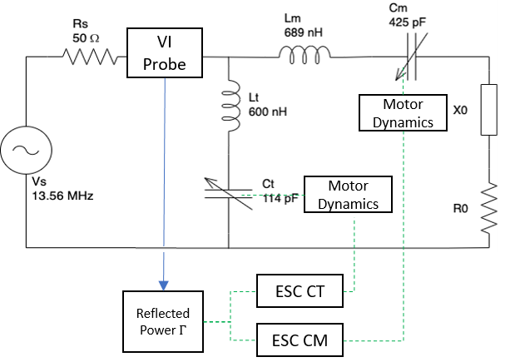
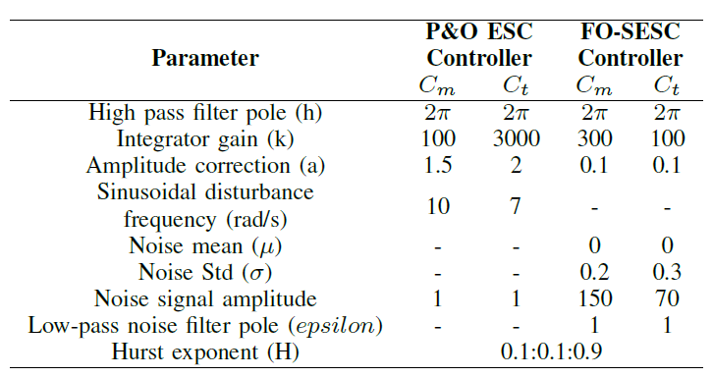
3. L-Type network Plasma Impedance Matching
MIMO FO/IO ESC controller for L-Type network
Motor dynamics ($20ms$)
ESC cost
function

Slide 10
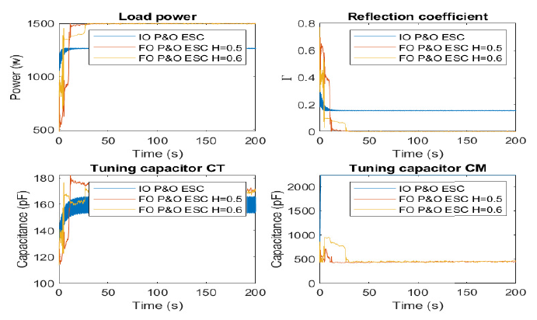
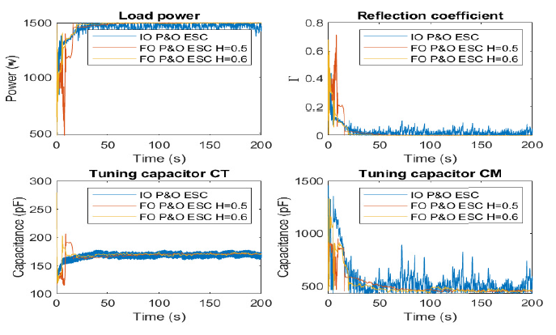
3. L-Type network Plasma Impedance Matching
Test 1: P&O ESC and FO-SESC for $Z_{L}=10−10jΩ$
Ten times simulation results average for five different IC
Performance indices: Settling time, convergence rate ($Γ<0.04$), and Reflection coefficient RMS
$$IC=[0,0]$$
$$IC=[50,50]$$
Capacitor initial condition has significant influence over ESC convergence

Slide 11
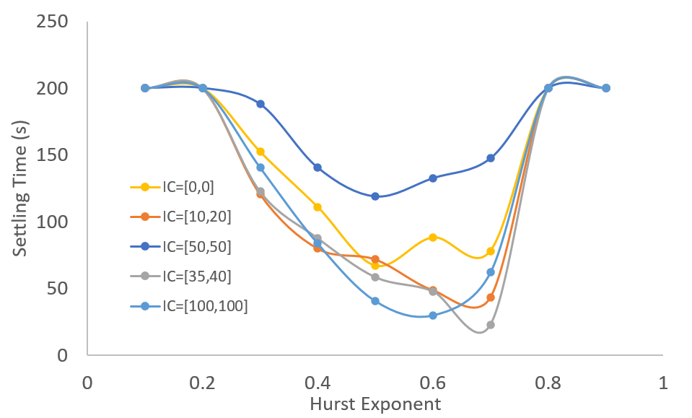
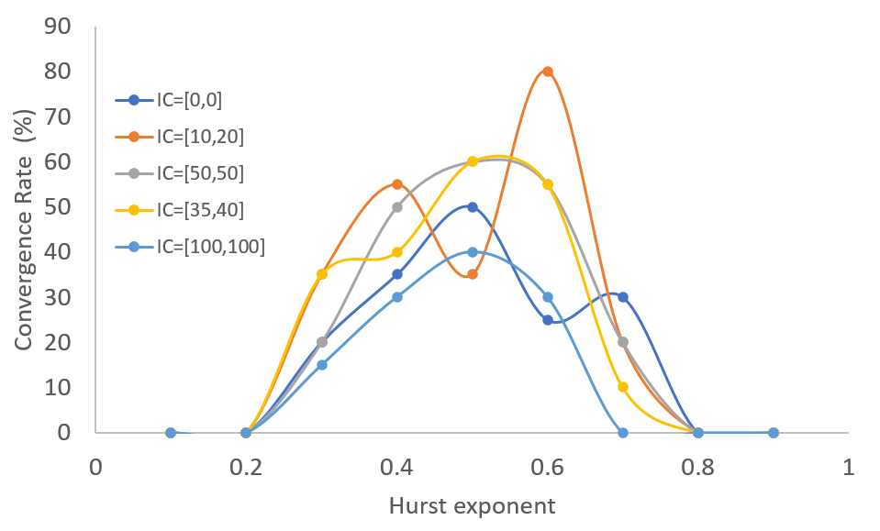
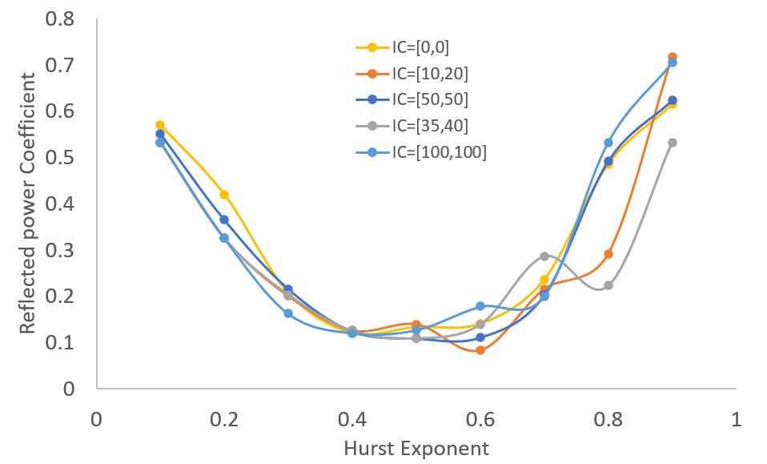
3. L-Type network Plasma Impedance Matching
Test 1: P&O ESC and FO-SESC for $Z_{L}=10−10jΩ$ and $0.1<H<0.9$
Ten times simulation results average for five different IC
Performance indices: Settling time, convergence rate ($Γ<0.04$), and Reflection coefficient RMS
Settling time $T_{s}$
C$onvergence Rate$ (%)
$$Γ RMS$$

Slide 12
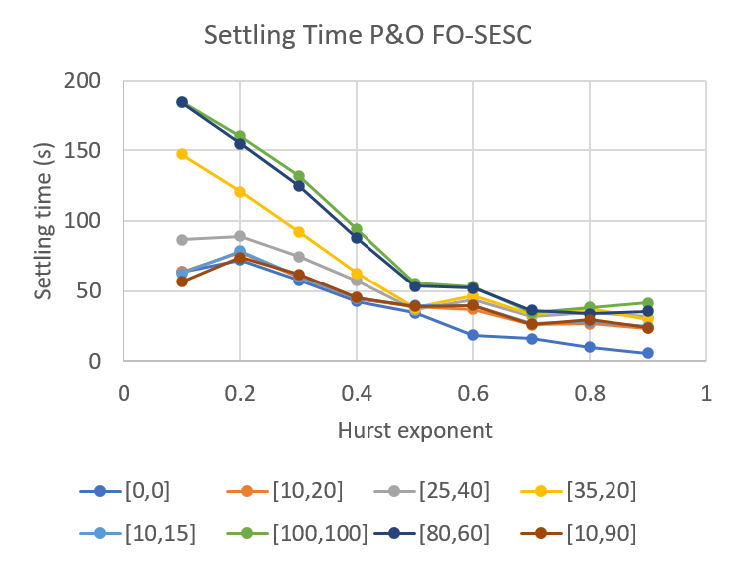
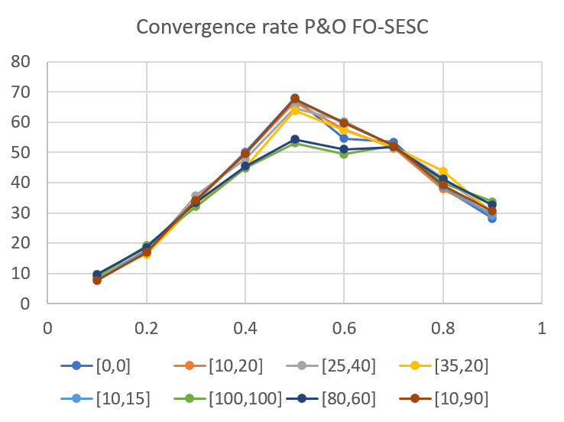
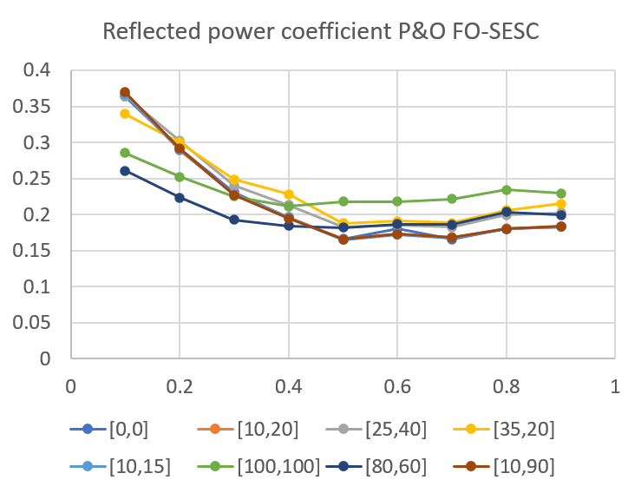
3. L-Type network Plasma Impedance Matching
Test 2: P&O ESC and FO-SESC Controllers Global Convergence Analysis
Evaluate convergence for all the feasible load space $Z_{L}$
Ten times simulation results average for five different IC
Performance indices: Settling time, convergence rate, and Reflection coefficient RMS
Settling time $T_{s}$
C$onvergence Rate$ (%)
$$Γ RMS$$

Slide 13
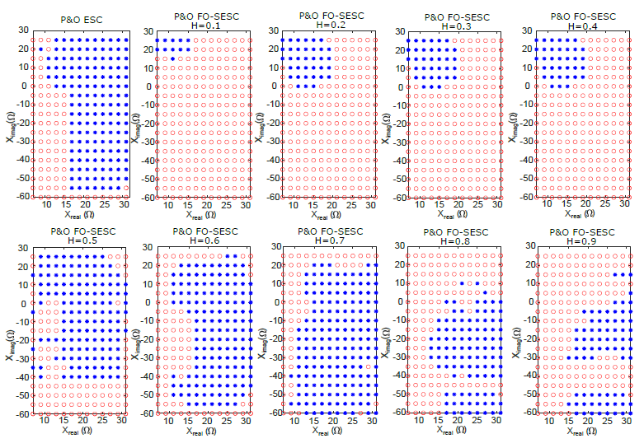
3. L-Type network Plasma Impedance Matching
Test 2: P&O ESC and FO-SESC Controllers convergence region evolution
For $0.5≤H≤0.6$ the convergence region increases
Blue: success
Red: miss

Slide 14
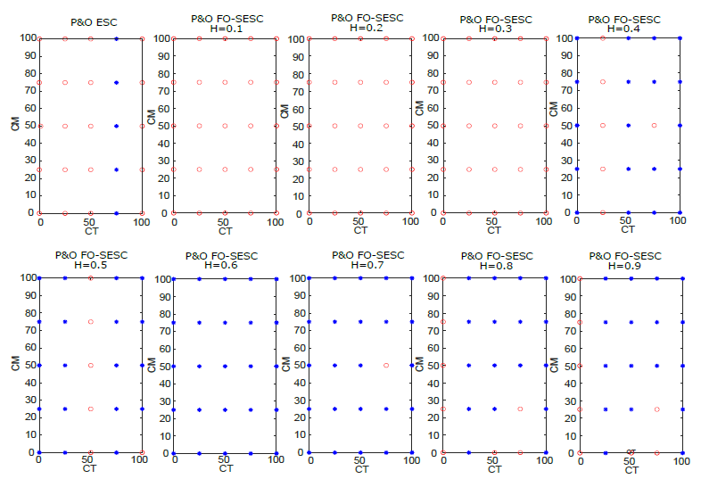
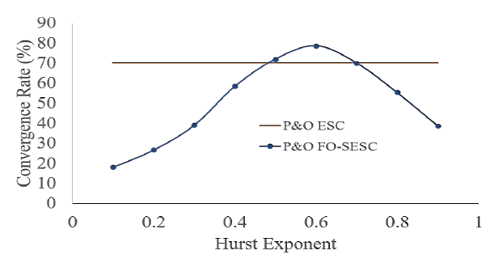
3. L-Type network Plasma Impedance Matching
Test 3: ESC Controllers Capacitor Initial Condition Robustness Analysis
25 different loads against 25 initial conditions $C_{t},C_{m}=0:25:100$.
Ten times simulation results average
IC convergence space for $Z_{l}=15−j25$
Total convergence rate for test 3
$H=0.6$ improves convergence rate

Slide 15
4. Conclusions and future work
A Perturb and Observe Fractional-Order Stochastic Extremum Seeking Control (P&O FO-SESC) with dithering noise was designed for plasma impedance matching.
Obtained results show that using a dithering noise in the P&O FO-SESC controller in the range $0.5≤H≤0.6$ can improve the system convergence rate, settling time, and minimize the total reflected power during the impedance matching process.
Obtained results show that using a dithering noise in the P&O FO-SESC controller in the range 0.5≤𝐻≤0.6 can improve the system convergence rate, settling time, and minimize the total reflected power during the impedance matching process.
As future works, the P&O FO-SESC controller design, simulation, and evaluation using the admittance model of the matching network instead of impedance is proposed based on Smith chart analysis. Likewise, introducing feedforward mechanisms based on magnitude and phase to improve ESC control performance can be considered.
The P&O FO-SESC controller is robust under different loads and capacitor initial conditions, indicating that the P&O FO-SESC controller is suitable for plasma impedance matching where plasma load impedance is time variant and unknown.
A L-Type network with two variable capacitors was employed to perform the matching control. The P&O FO-SESC controller was tested for single and multiple loads under different initial conditions and different levels of LRD on the dithering noise given by the Hurst exponent.

Slide 16
References
Y. F. Li, “Analysis and design of tracking control for the RF matching box of plasma system,” ACM International Conference Proceeding Series, pp. 18–23, 2019.
S. Ishida, A. Kawamura, A. Takayanagi, and H. Takada, “Robust convergence of the impedance matching process based on seek control,” IECON Proceedings (Industrial Electronics Conference), pp. 1554– 1559, 2011.
Y. Ma and G. Wu, “Automatic impedance matching using simulated annealing particle swarm optimization algorithms for RF circuit,” Proceedings of 2015 IEEE Advanced Information Technology, Electronic and Automation Control Conference, IAEAC 2015, pp. 581–584, 2016.
Y. Hirose, A. Kawamura, A. Takayanagi, and H. Takada, “Analysis of impedance matching control,” 2009 IEEE 6th International Power Electronics and Motion Control Conference, IPEMC ’09, vol. 3, pp. 1188–1191, 2009.
C. Zhang and R. Ordoñez, Extremum-Seeking Control and Applications, 1st ed. London: Springer-Verlag London, 2012. [Online]. Available: http://link.springer.com/10.1007/978-1-4471-2224-1
K. Bariyur and M. Krstic, Real-time optimization by extremum-seeking control. Wiley-Interscience, 2003.
S.-J. Liu and M. Krstic, Stochastic Averaging and Stochastic Extremum Seeking. Springer, 2013, vol. 53, no. 9.
C. Yin, Y. Chen, and S. M. Zhong, “Fractional-order sliding mode-based extremum seeking control of a class of nonlinear systems,” Automatica, vol. 50, no. 12, pp. 3173–3181, 2014. [Online]. Available: http://dx.doi.org/10.1016/j.automatica.2014.10.027
D. Hollenbeck and Y. Chen, “A more optimal stochastic extremum seeking control using fractional dithering for a class of smooth convex functions,” in 2020 IFAC World Congress, 2020, pp. 1–6.
P. Dix, B. Ashrafi, S. Drakunov, and U. O¨ zguner, “ABS Control Using Optimum Search via Sliding Modes,” IEEE Transactions on Control Systems Technology, vol. 3, no. 1, pp. 79–85, 1995.
G. A. Frantsuzova, “Use of a Relay Controller for Automatic Extremum Seeking in Nonlinear Systems,” Avtometriya, vol. 47, no. 3, pp. 274–280, 2011.
R. L. Magin, “Fractional calculus in bioengineering.” Critical reviews in biomedical engineering, vol. 32, no. 1, pp. 1–104, 2004.
H. Sheng, Y. Chen, and T. Qiu, Fractional Processes and Fractional- Order Signal Processing Techniques and Applications. Springer, 2012

Slide 17
Thanks for your attention!

