Slide 1

Control Theory for Machine Learning: An Overview
YangQuan Chen, Ph.D,
Professor, Mechanical and Aerospace Engineering Dept.,
Director, MESA (Mechatronics, Embedded Systems & Automation)Lab
University of California, Merced
E: yqchen@ieee.org; ychen53@ucmerced.edu W:
http://mechatronics.ucmerced.edu; methane.ucmerced.edu; TheEdgeAI.com
http://mechatronics.ucmerced.edu/ct4ml /ci-ml /fc4fl
4/17/2026, 11:35am-11:50pm @ California State University, Monterey Bay

Slide 2
Thank you
Dr. Luis Cabrales Arriaga
Dr. Prashanta Pokharel
Dr. Haoyu Niu
All of you for coming!

Slide 3
Outline
Why CT4ML
CT4ML Syllabus
Looking into the Future

Slide 4
CT4ML why?
ML4CT vs. CT4ML
Two sides of a coin
Courage / Braveness
Soldiers versus Researchers
So CT4ML needs some courage from you

Slide 5
ML is nothing but
Optimization
Statistics
Control theory (CT)

Slide 6
Controls – 7 levels
I: entry level first control course (Routh to Youla)
II: linear systems (MIMO, LTI/LTV)
III: nonlinear control (Lyapunov, passivity, SGT)
IV: robust and optimal (LFT, SSV, DK, Gap Metric)
V: CoV/optimal control (PMP) Pontryagin
VI: Stochastic/data-driven/ML(NN) control
VII: PDE/DPS, multi-agent cooperative, distributed sensing and actuation control

Slide 7
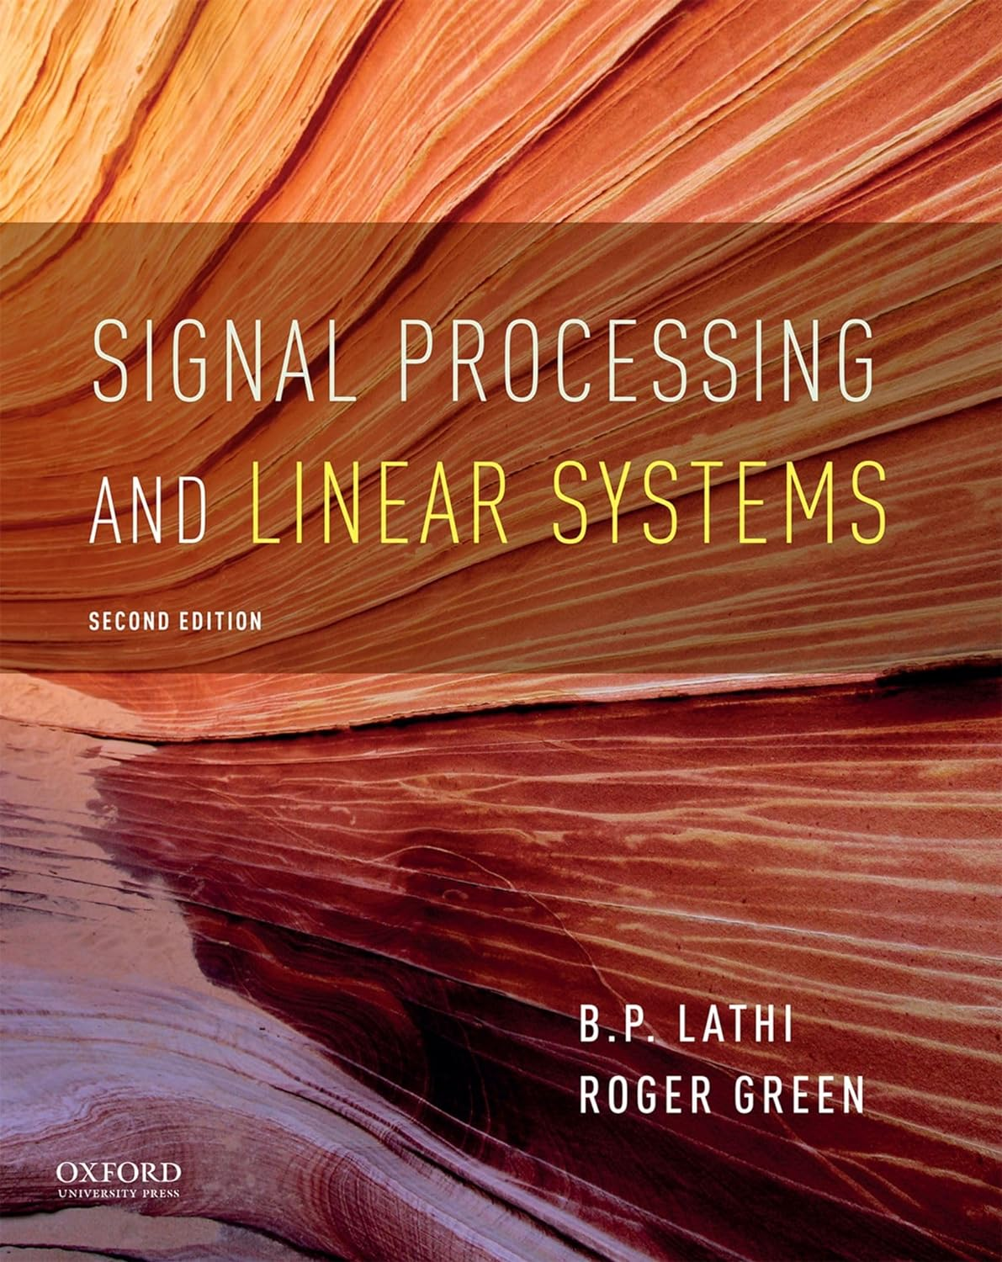
Linear | nonlinear
Time-invariant | time-varying
Finite dimensional | infinite dimensional
Deterministic | stochastic
Continuous time | Discrete time
SISO | MIMO
Causal | noncausal
Integer order | fractional order
Lumped parameter | distributed parameter
Rational | irrational
Delay-free | delayed
Short memory | long memory
Differential | Pseudo-differential
Non-periodic | Periodic (repetitive)
(2021 2nd ed)
(linear time-invariant finite dimensional deterministic continuous-time SISO causal integer order
lumped parameter rational delay free short memory) Signal Processing and Linear Systems

Slide 8
Textbooks:
Graham C. Goodwiny, Stefan F. Graebe, Mario E. Salgado. Control System Design. Pearson (October 6, 2000). 996 pages. http://www.csd.elo.utfsm.cl/index.html
Wilson Rugh. Linear Systems Theory (2nd edition). Prentice Hall; 2 edition (August 13, 1995) http://www.amazon.com/Linear-System-Theory-Wilson-Rugh/dp/0134412052
Hassan K. Khalil. Nonlinear Control. 1/E. Pearson Education 2015. ISBN-10: 0-13-349926-X; ISBN-13: 978-0-13-349926-1
Kemin Zhou, Essentials of Robust Control with John C. Doyle, Prentice Hall 1998, 411 pp. Paper back. ISBN 0-13-525833-2
CoV, OCP: Bryson, A.E.; Ho, Y.C. (1975). Applied optimal control. Washington, DC: Hemisphere. ISBN 978-0-89116-228-5.

Slide 9
JFK and Control/AI
“Ask not what your country can do for you – ask what you can do for your country,” (1/20/1961)
“Ask not what AI can do for control – ask what control can do for AI” – taken by SysDO2024, and CDC24 plenary talk title 12/16/24 Paulo Tabuada UCLA
https://ieeecss.org/presentations

Slide 10
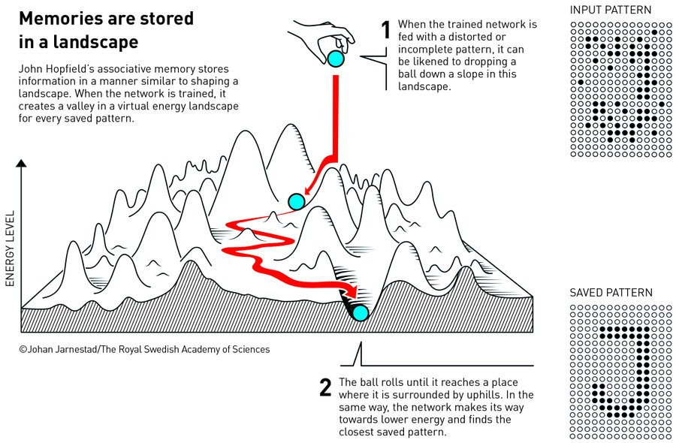

Slide 11
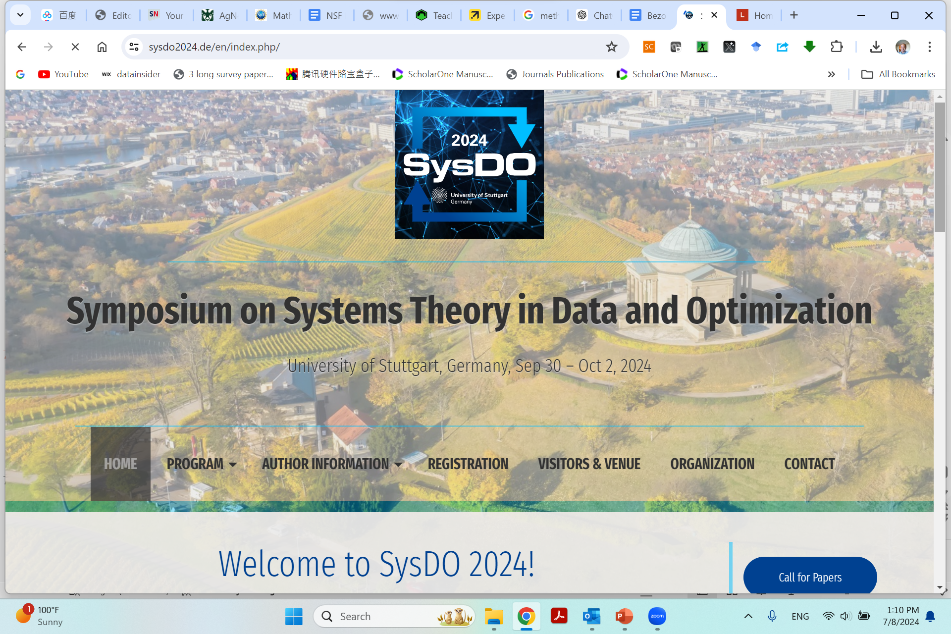
https://www.sysdo2024.de/en/index.php/

Slide 12
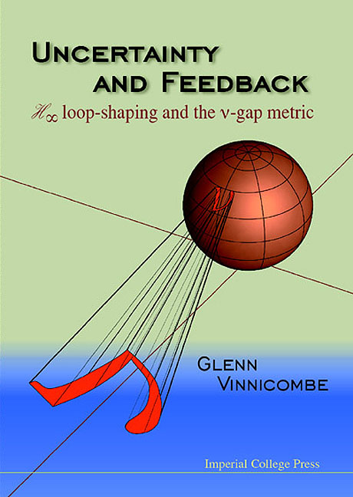
What control community can/should offer to AI/ML community?
“The Three Musketeers”
  Internal model principle (IMP)
  Nu-Gap metric
  Model discrimination (Maciejowski, 1979, Automatica 15:5) https://doi.org/10.1016/0005-1098(79)90006-2
https://www.ifac2020.org/program/workshops/machine-learning-meets-model-based-control.html Eric Kerrigan, Imperial College London, UK

Slide 13
What the machine should learn about models for control, Eric Kerrigan
We revisit, with 20/20 hindsight, three fundamental concepts from the control theory literature, viewed through a machine learning lens from 2020. Within the control community, these concepts are known to various degrees,
depending on which group you talk to. Outside of control, these concepts are either absent or only partially formed. The first result to call to mind is the internal model principle of control, which states that a controller can
only reject a disturbance if the feedback path contains an internal model of the dynamic structure of the disturbance. The second is the concept of the gap metric, which measures how close two systems are from a feedback, rather than open-loop, perspective. The third, and least widely known, is an extension of algorithmic information theory that allows one to measure the informativeness of a model, particularly if the system is "badly-defined" [Maciejowski, Automatica, 1979]. These three ideas should be reintroduced, to the control community and beyond, if we are aiming to understand fundamental trade-offs between complexity, robustness and performance when designing learning-based controllers.

Slide 14
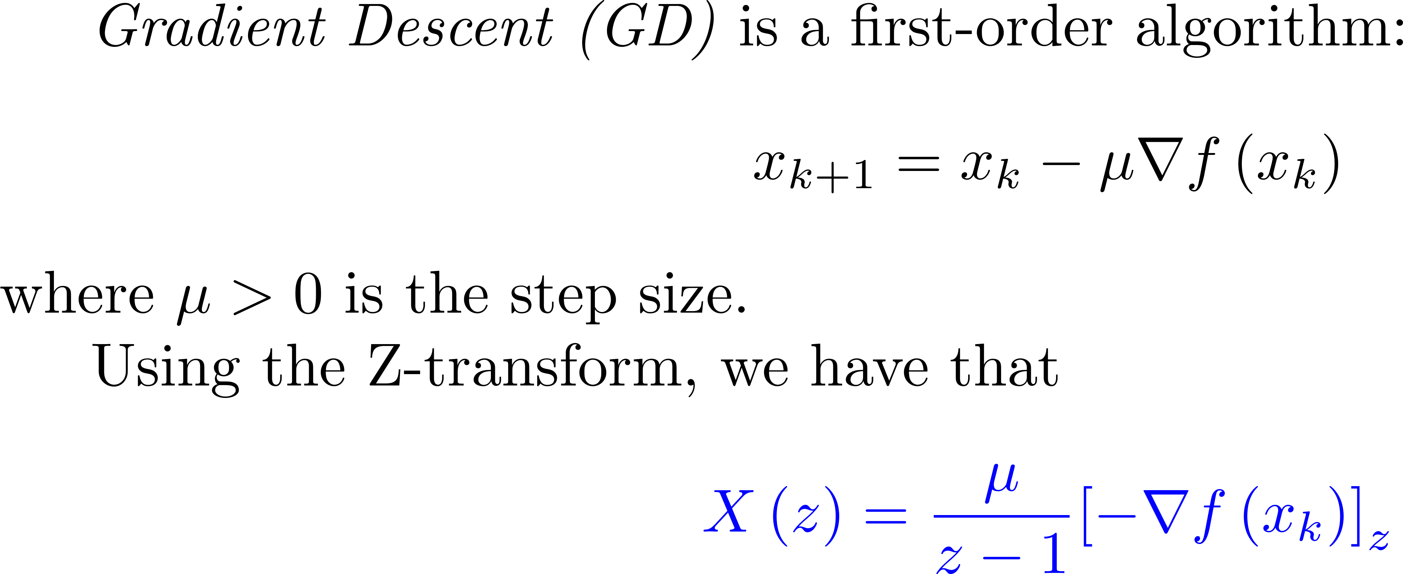
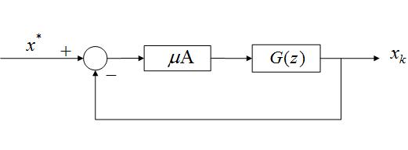
Control system point of view in iteration axis
Integrator in the forward loop is to eliminate the tracking error for a constant reference signal (Internal Model Principle).
Momentum (heavy ball) – low pass filtering
Nesterov accelerated (NAGD) – lead-lag filtering

Slide 15
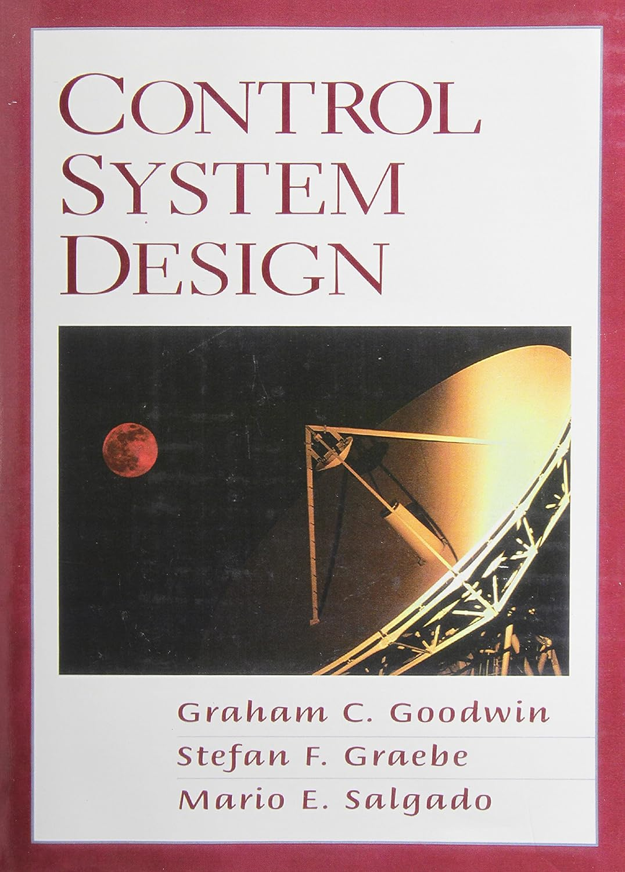

Chapter 10
Architectural Issues in SISO Control
Notes:
<<<10.1>>>
###SISO Control Architecture###

Slide 16

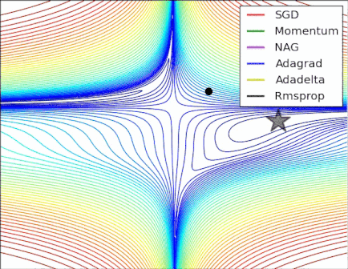
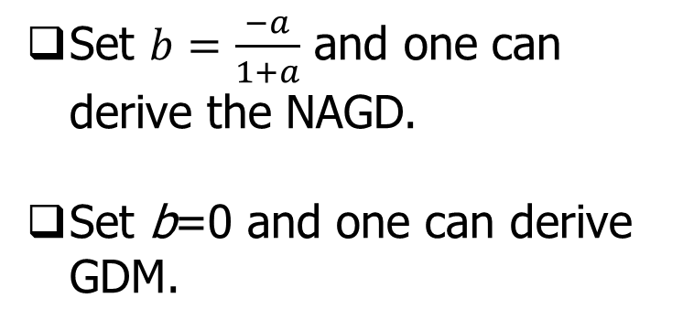

NAGD: Nesterov Accelerated GD
Set $b=\frac{−a}{1+a}$ and one can derive the NAGD.
Set b=0 and one can derive GDM.
https://stats.stackexchange.com/questions/179915/whats-the-difference-between-momentum-based-gradient-descent-and-nesterovs-acc

Slide 17
Issues in standard ML methods
standard ML methods—especially those based on gradient-based optimization—often lack rigorous guarantees on
  convergence,
  robustness, and
  stability when faced with large-scale, complex, or adversarial environments.

Slide 18
What CT4ML can offer?
By bridging control theory and ML, the research aims to produce algorithms that are both
  high-performing and
  provably stable,
  robust, and
  efficient.

Slide 19
What CT4ML covers?
ML algorithms can be viewed as dynamical systems and thus analyzed or even redesigned using control-theoretic tools.
  Analysis: How control-theoretic frameworks (e.g., Lyapunov methods, dissipativity, integral quadratic constraints) can provide formal guarantees and performance bounds for ML algorithms.
  Design: How insights from robust control, feedback design, and system-level synthesis can inspire or improve the design of ML algorithms—particularly optimization methods used in training large neural networks or distributed learning systems.

Slide 20
CT4ML opportunities
The convergence of control theory and machine learning stands at an important juncture. By modeling ML algorithms as dynamical systems, researchers gain a wealth of tools—Lyapunov stability, passivity, dissipativity, IQCs—that provide mathematically rigorous ways to evaluate, guarantee, and enhance algorithmic performance. On the design side, classical feedback and robust control paradigms inspire new optimization strategies, offering potential breakthroughs in large-scale, reliable machine learning.
As the field matures, one can expect:
  Greater integration of control-based safety and robustness measures in reinforcement learning for real-world autonomous systems.
  More sophisticated “controller-inspired” updates in training deep neural networks to improve stability and accelerate convergence.
  Scalable, numerically efficient versions of robust control analyses (e.g., IQCs, LMIs) that handle very large or high-dimensional ML models.
  Interdisciplinary collaborations, where engineers, mathematicians, and computer scientists collectively develop the next generation of safe, robust, and efficient machine learning techniques—fulfilling the promise of AI in domains where reliability is paramount.

Slide 21
Outline
Why CT4ML
CT4ML Syllabus
Looking into the Future

Slide 22









MAD: Classic Control Systems Design
$$d$$
$$z$$
r
$$+$$
$$e$$
Controller
Plant
$$y$$
$$Δ$$
$$−$$
Plant
H
$$z$$
$$w$$
MAD Methodology (Kevin L. Moore):
What do I know?
What do I Have?
What do I want?
Performance assessment:
How robust?
How optimal?
How smart?
M: Modelling
A: Analysis
D: Design

Slide 23
MAD for Machine Learning?
M
  ML of DS (scientific ML, physics-informed, PDE –disciplined, complexity-informed, tail-index-aware, loss-landscape roughness aware …)
A
  ML by DS (control theory, Lyapunov redesign, nonlinear/adaptive, robust/optimal, finite-time, variable structure, safety-aware, attack-aware )
D
  ML for DS (control theory, again)

Slide 24
MAD in control to ML
(M) Nonlinear Dynamic System view of ML
(A) ML algorithm analysis via control theory
(D) ML algorithm design via control theory

Slide 25
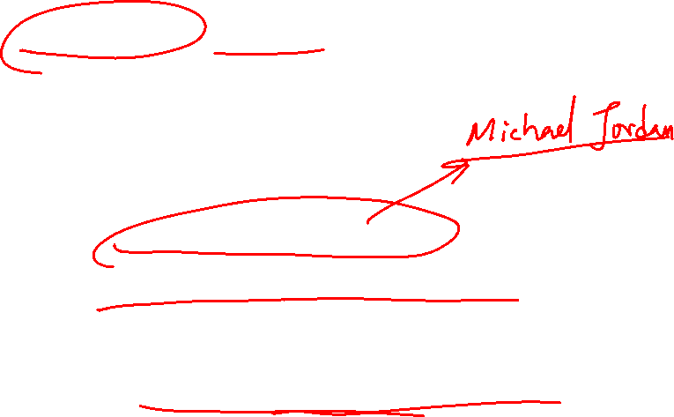
Reflection 沉思：
(Machine) Learning is now a hot research topic;
How to learn efficiently (optimally) is always important;
The key for learning is the optimization method;
Thus designing an efficient optimization method is the most important topic now
  What is the optimal way to optimize?
  What is the more optimal way to optimize?
ML core is optimization, can we demand “More Optimal Machine Learning” (i.e., DL with minimum/smallest labelled data) ?

Slide 26
NAGD: Nesterov Accelerated GD
Set $b=\frac{−a}{1+a}$ and one can derive the NAGD.
Set b=0 and one can derive GDM.
https://stats.stackexchange.com/questions/179915/whats-the-difference-between-momentum-based-gradient-descent-and-nesterovs-acc

Slide 27
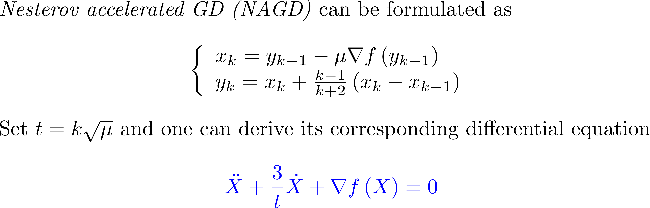
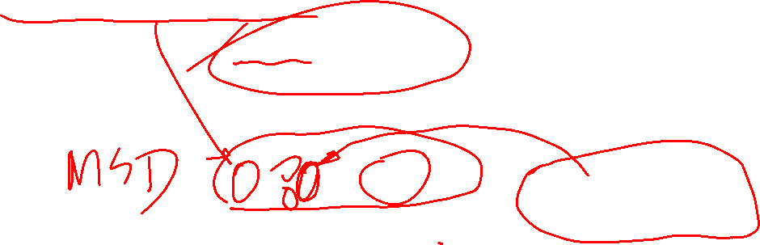
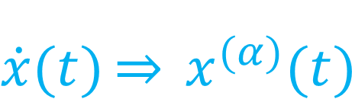
Review of Michael Jordan’s work:
$$\dot{x}(t)\underset{⇒}{} x^{(α)}{(t)}^{}$$
analyze the iteration algorithm in the continuous-time domain.
one can use Lyapunov method or variational method to analyze
Exciting new Fact: Optimization algorithms can be systematically synthesized using Lagrangian mechanics (E-L) EOM
Fractional-order damping “More Optimal”? (Better than the best) Fractional calculus of variation (FOCV), FO E-L equation
Go “fractional” to be more optimal !

Slide 28
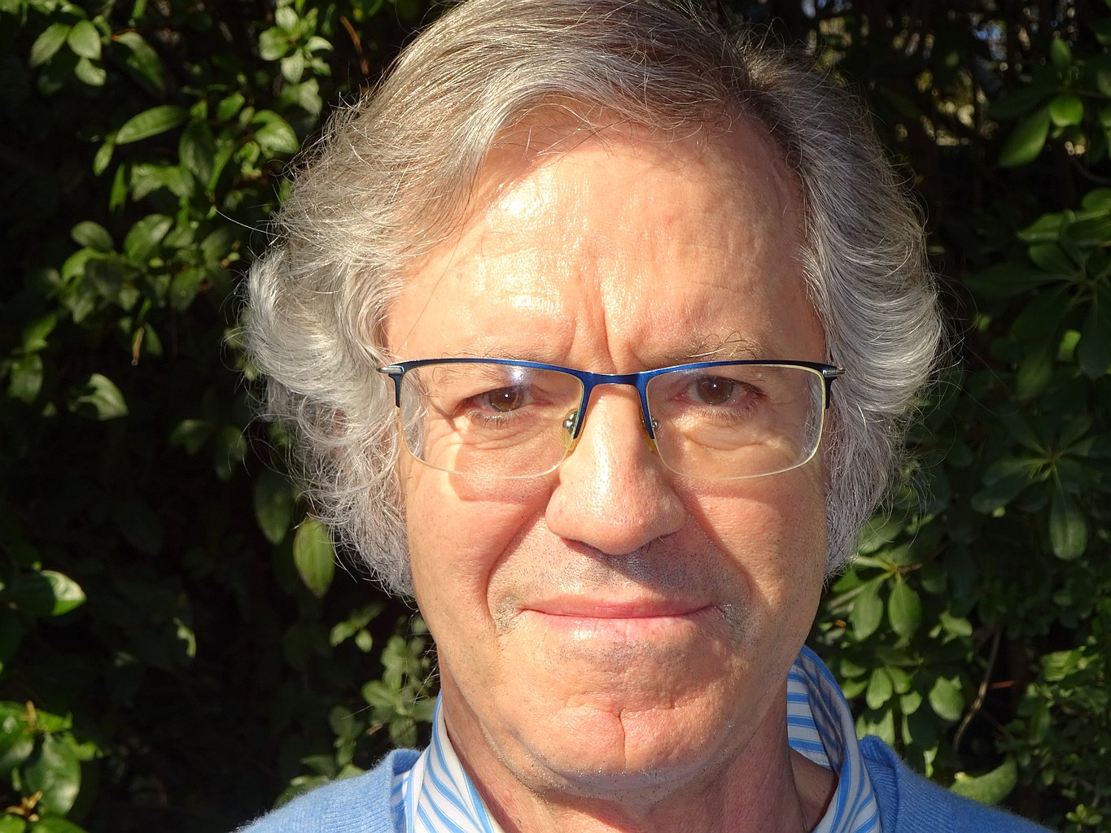
From Ravine to Nesterov to Ravine
2022 Hedy Attouch
1949-2023
https://euromathsoc.org/magazine/articles/194

Slide 29
Dynamical systems viewpoint on optimization
Attouch was a leading figure in treating optimization algorithms as discretizations of dissipative dynamical systems.
Heavy ball with friction and inertial dynamics
  With Goudou and Redont, he analyzed the heavy ball with friction method (second-order ODE
  (\ddot x + \lambda \dot x + \nabla \Phi(x) = 0)) as a tool to explore local minima and showed convergence properties in both continuous and discrete time. (AIMS)
  With various coauthors, he studied Newton-like inertial systems, multi-scale couplings, and Tikhonov-type regularization dynamics, linking asymptotic behavior of ODEs/inclusions to minimization of possibly nonsmooth, nonconvex energies. (AIMS)

Slide 31
A roadmap – from variational principle to machine learning
CoV => OCP => PMP => TPBVP => NN BP algorithm (Le Cunn 1988) => GD => Optimization => Machine Learning

Slide 32
M

Slide 33
A

Slide 34
D

Slide 38
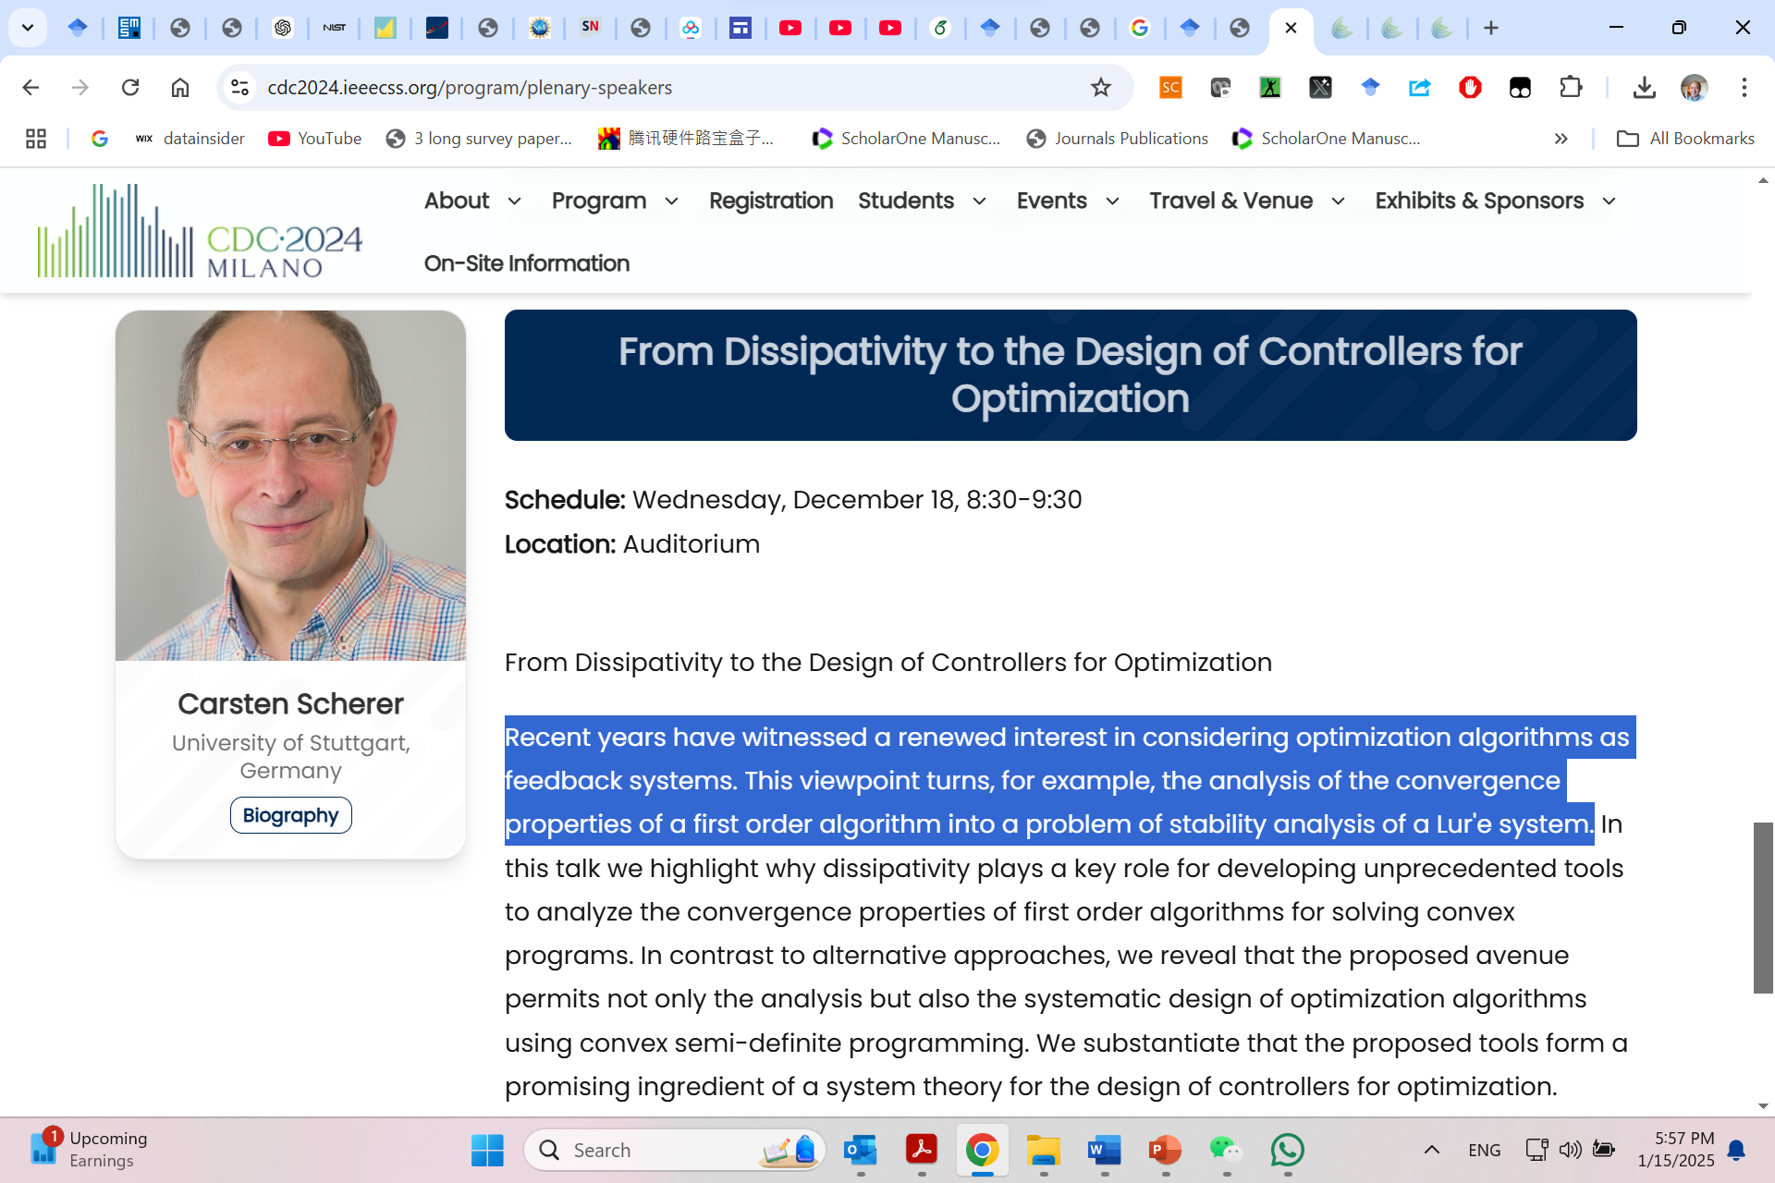
https://www.ieeecss.org/presentation/conference-plenary-lecture/dissipativity-design-controllers-optimization

Slide 43
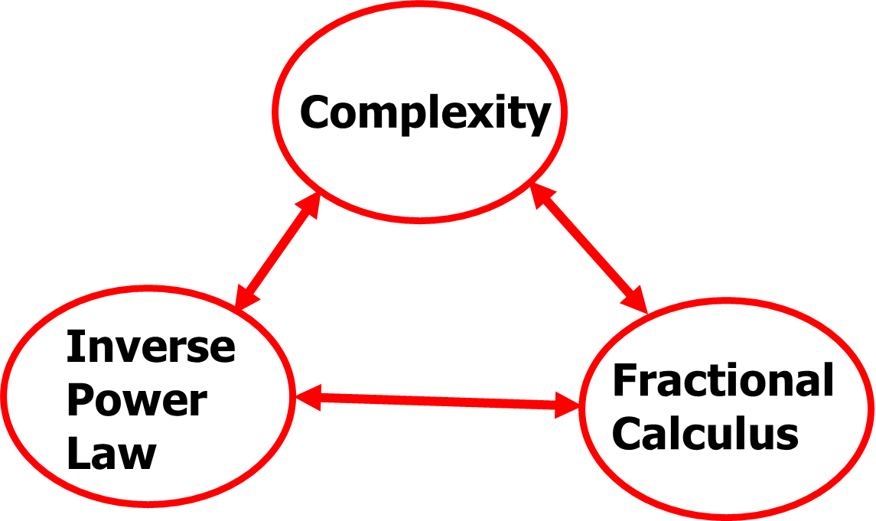
(algebraic) tail
Statistical sense (PDF, ACF …)
Spectral sense
Relaxation sense (aging, rehabilitation, healing)
…

Slide 44
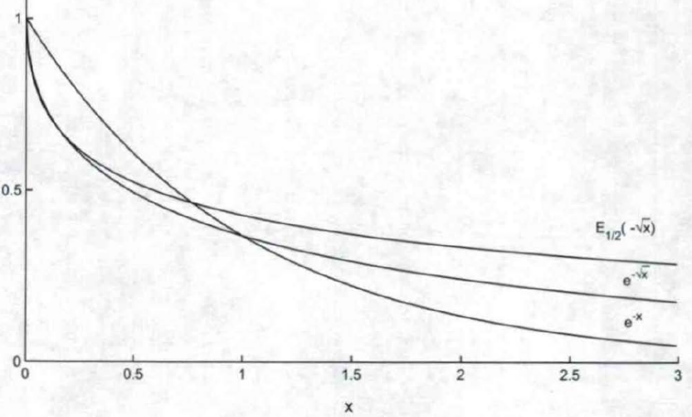
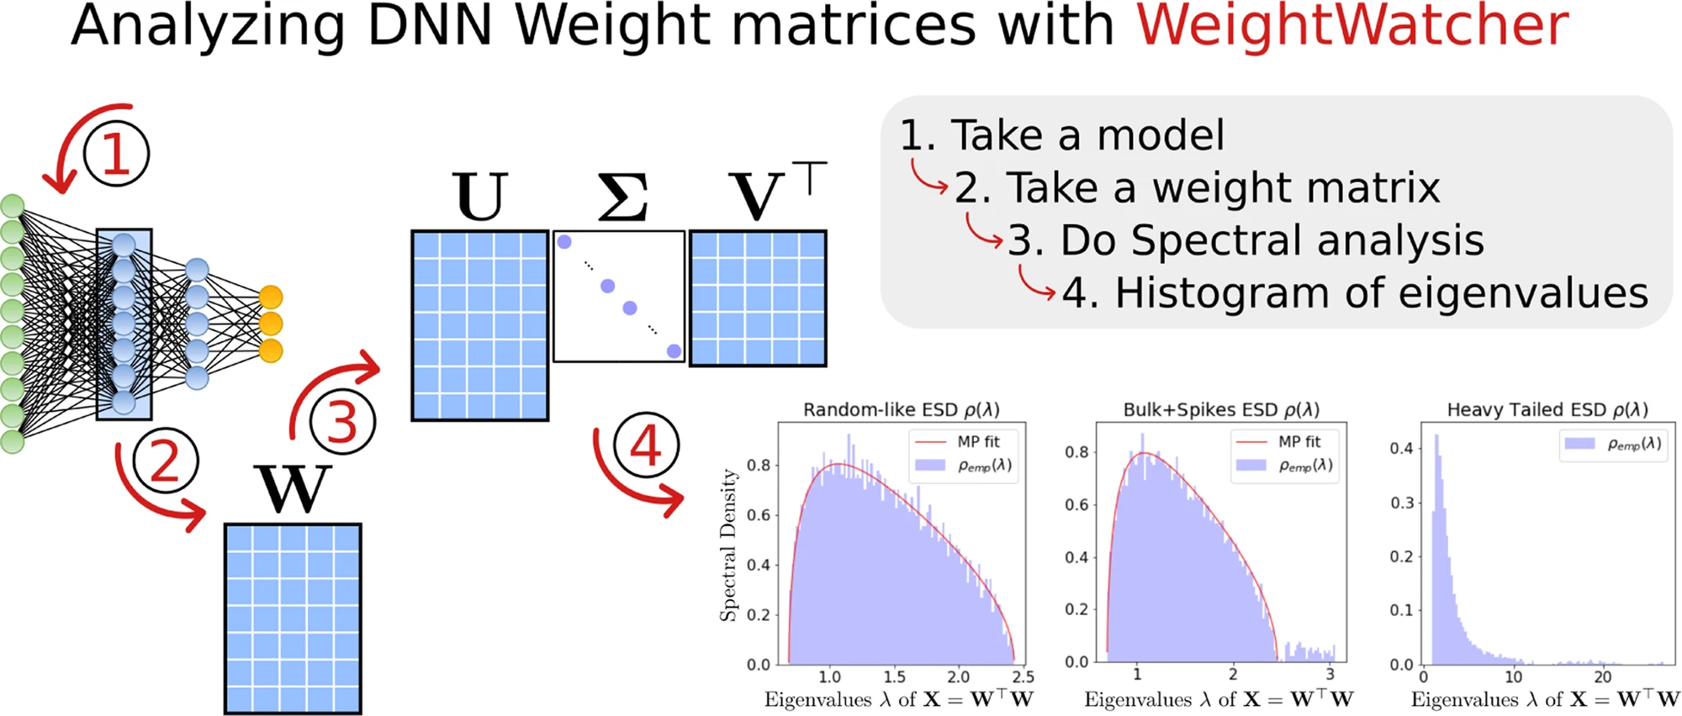
Tails matter
Tail MATTERS!
https://weightwatcher.ai/ Charles Martin

Slide 45
Outline
About UC Merced
Why CT4ML
CT4ML Syllabus
Looking into the Future

Slide 46

Fractional Order
FOSysDO ??
https://www.sysdo2024.de/en/index.php/

Slide 47
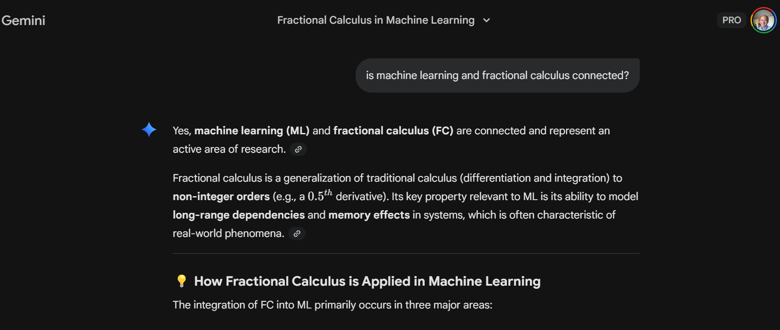

Slide 48
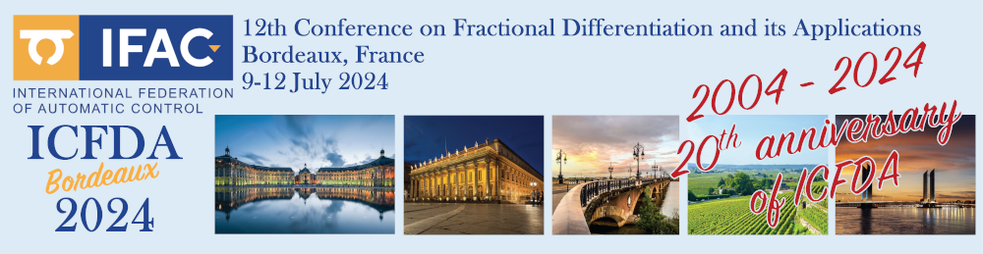
https://youtu.be/WJjeT3UhJdA
Applied Fractional Calculus in Big Data and Machine Learning (AFC4BD+ML)
YangQuan Chen, Ph.D., Director,
MESA (Mechatronics, Embedded Systems and Automation)Lab
ME/EECS/SNRI/HSRI/CITRIS, School of Engineering,
University of California, Merced
E: yqchen@ieee.org; or, yangquan.chen@ucmerced.edu
T: (209)228-4672; O: SRE-327; Lab: Castle #22 (T: 228-4398)
July 9th, 2024. Tuesday 1:30pm
In person ICFDA2024 pre-conference tutorial (4 hours) on Applied Fractional Calculus in Big Data and Machine Learning (AFC4BD+ML)

Slide 49
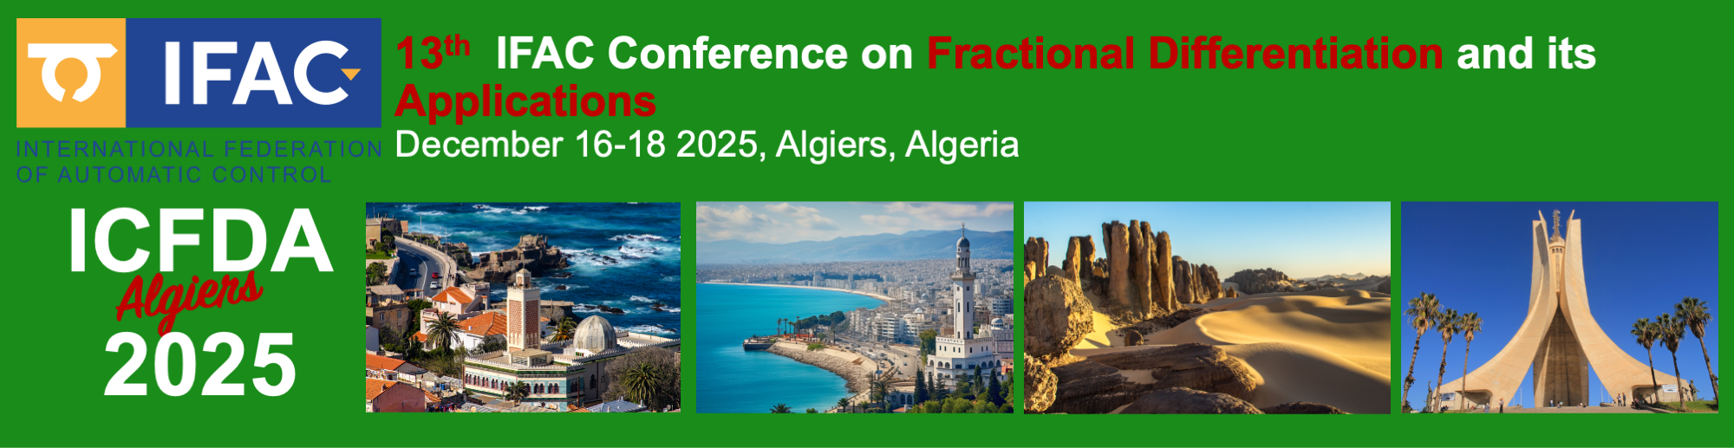
Applied Fractional Calculus in Big Data & Machine Learning (AFC4BD+ML) II
YangQuan Chen, Ph.D., Director, (yqchen@ieee.org)
MESA (Mechatronics, Embedded Systems and Automation)Lab, Mechanical & Aerospace Engineering Dept.,
University of California, Merced
Dec. 17th, 2025. Wednesday 1:30pm-6pm
In person ICFDA2025 tutorial (4 hours) on Applied Fractional Calculus in Big Data and Machine Learning (AFC4BD+ML) (II)

Slide 50

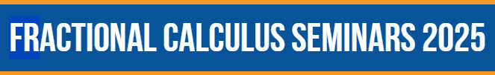
Roughness-informed machine learning by fractal and fractional calculi
YangQuan Chen, Ph.D., Director,
MESA (Mechatronics, Embedded Systems and Automation)Lab
MAE/EECS, School of Engineering,
University of California, Merced
E: yqchen@ieee.org; or, yangquan.chen@ucmerced.edu
T: (209)228-4672; O: SRE-327; Lab: Castle #22 (T: 228-4398)
6:00am-7:00am Friday, Dec. 5th, 2025
online

Slide 52
Work in prog. (presented @ ICFDA2025)

Slide 53
FOCT4ML
Coming

Slide 54
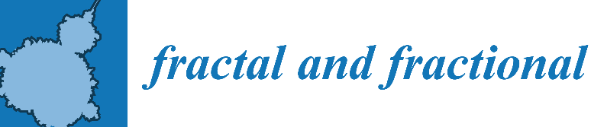
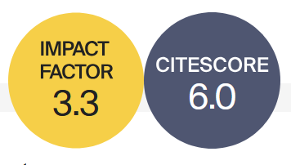




Basic Information
Rapid Publication
Fractal and Fractional (ISSN: 2504-3110) is an international, scientific, peer-reviewed, open access journal, publishing studies related to fractals and fractional calculus and their applications in different fields of science and engineering.
41 Days
Median Processing Time
Editor-in-Chief: Prof. Dr. Carlo Cattani
University of Tuscia, Italy
19.9 Days
Submission to First Decision
Impact Factor 3.3; CiteScore 6.0
2.7 Days
Acceptance to Publication
WoS Category | Mathematics, Interdisciplinary Applications 22/136 (Q1) Top 10%
CiteScore Category | Analysis 8/198 (Q1) Top 10% Statistics and Probability 23/293 (Q1) Top 10% Statistical and Nonlinear Physics 10/61 (Q1)
Journal Homepage

Slide 55
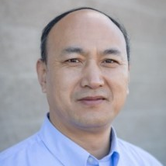
Section “Optimization, Big Data, and AI/ML”
Open Call for Submissions and Editorial Board Members
Aims and Scope
“Optimization, Big Data, and AI/ML” is a Section of the journal Fractal and Fractional, which publishes advanced theoretical studies and practical applications on the topics related to optimization, machine learning, and big data involving the use of fractional calculus (FC), the concept of fractal, as well as general fractional-order thinking (FOT).
Section Editor-in-Chief:
Prof. Dr. Yangquan Chen
University of California Merced, USA
https://www.mdpi.com/journal/fractalfract/sections/Optimization_Big_Data_AIML

Slide 56
https://sciforum.net/event/IOCFF2026
13–15 April 2026
Online (Registration is free of charge! )
Important Dates:
Deadline for abstract submission: 12 December 2025
Notification of acceptance: 12 February 2026
Registration deadline: 8 April 2026
The Topics of Interest:
S1. Recent Advances in Fractional-Order Differential and Integral Operators
S2. Fractional Calculus and Its Applications in Engineering Systems
S3. Numerical Methods for Fractional Calculus
S4. Fractional Calculus in Complex and Nonlinear Dynamical Systems
S5. Fractional Calculus in Machine Learning: Applications and Challenges
S6. Fractal Geometry: Mathematical Foundations and Real-World Applications

