Slide 1

Control Theory for Machine Learning: An Overview
YangQuan Chen, Ph.D,
Professor, Mechanical and Aerospace Engineering Dept.,
Director, MESA (Mechatronics, Embedded Systems & Automation)Lab
University of California, Merced
E: yqchen@ieee.org; ychen53@ucmerced.edu W:
http://mechatronics.ucmerced.edu; methane.ucmerced.edu; TheEdgeAI.com
http://mechatronics.ucmerced.edu/ct4ml /ci-ml /fc4fl
4/17/2026, 11:35am-11:50pm @ California State University, Monterey Bay

Slide 2
Thank you
Dr. Luis Cabrales Arriaga
Dr. Prashanta Pokharel
Dr. Haoyu Niu
All of you for coming!

Slide 3
Outline
Why CT4ML
CT4ML Syllabus
Looking into the Future

Slide 4
CT4ML why?
ML4CT vs. CT4ML
Two sides of a coin
Courage / Braveness
Soldiers versus Researchers
So CT4ML needs some courage from you

Slide 5
what is the earliest paper on using neural networks in (for) control (ML4CT)?
Who/when/where (conference): Bernard Widrow, “Pattern Recognition and Adaptive Control.” Presented at the IRE–AIEE Joint Automatic Control Conference, New York, NY, June 27–29, 1962. (Widrow’s publications list records this conference paper.) www-isl.stanford.eduEarliest
journal version: Bernard Widrow, IEEE Transactions on Applications and Industry, Sept. 1964. The paper explicitly states that “a digital controller made of adaptive neurons comprises a pattern-recognizing control system,” tying ADALINE/MADALINE neural nets directly to control. isl.stanford.eduEarliest
experimental demo (for context): An ADALINE controller balancing an inverted pendulum (“broom-balancer”) was built at Stanford in 1963; Widrow later documented it in 1987. www-isl.stanford.edu

Slide 6
what is the earliest paper on using control theory for machine learning (CT4ML) or optimization?
Earliest “control for optimization”: Extremum seeking—a feedback controller that optimizes an unknown map in real time—goes back to Maurice Leblanc (1922) in electric railways (max-power transfer). Modern surveys trace the field’s origin to this 1922 paper. people.en
Earliest explicit ML training with control/adjoint ideas: Werbos’s 1974 PhD thesis formulates backpropagation (ordered derivatives) in a dynamic-systems/optimal-control style and is widely cited as the first modern ML application. werbos.com
Roots of “control for ML (supervised NNs)” via adjoints: The gradient/adjoint machinery of optimal control used today in backpropagation appears in Kelley (1960) and Bryson (1961–62). A classic note by Dreyfus (1990) shows that standard backprop is exactly the Kelley–Bryson optimal-control gradient applied to layered networks. perceptrondemo.com+2Gwern+2

Slide 7
who, when, and where this was said "machine learning is nothing but statistics, optimization and control theory"?
“ML = statistics + optimization.” This framing has been popular for years in optimization/ML circles. For example, Ben Recht (Berkeley) writes: “The core of contemporary machine learning consists of solving large-scale optimization problems that arise from statistical models.” People @ EECS (Stephen Boyd’s materials likewise tie modern ML tightly to convex optimization and statistics, though not with your exact wording. Stanford University+1)

Slide 8
“…and control theory.”
The control piece commonly appears when people discuss reinforcement learning and decision making. You’ll find widely used phrasings like “Reinforcement Learning: Machine Learning Meets Control Theory” in tutorials and lecture series, and reviews that explicitly connect RL and optimal control.

Slide 9
Controls – 7 levels
I: entry level first control course (Routh to Youla)
II: linear systems (MIMO, LTI/LTV)
III: nonlinear control (Lyapunov, passivity, SGT)
IV: robust and optimal (LFT, SSV, DK, Gap Metric)
V: CoV/optimal control (PMP) Pontryagin
VI: Stochastic/data-driven/ML(NN) control
VII: PDE/DPS, multi-agent cooperative, distributed sensing and actuation control

Slide 10
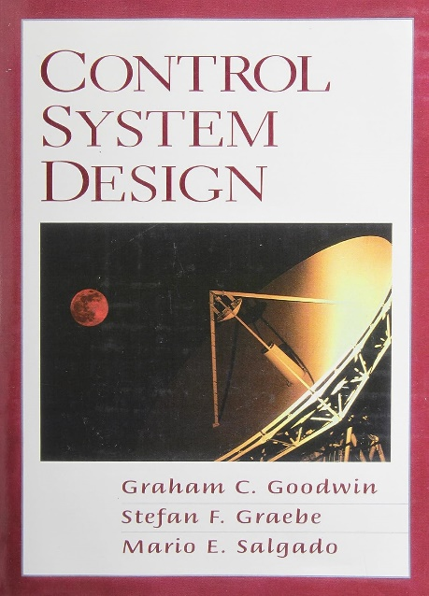
Control-I SISO
https://ctms.engin.umich.edu/CTMS/?aux=Home
http://www.csd.elo.utfsm.cl/index.html
http://ndl.ethernet.edu.et/bitstream/123456789/2287/1/15pdf.pdf

Slide 11
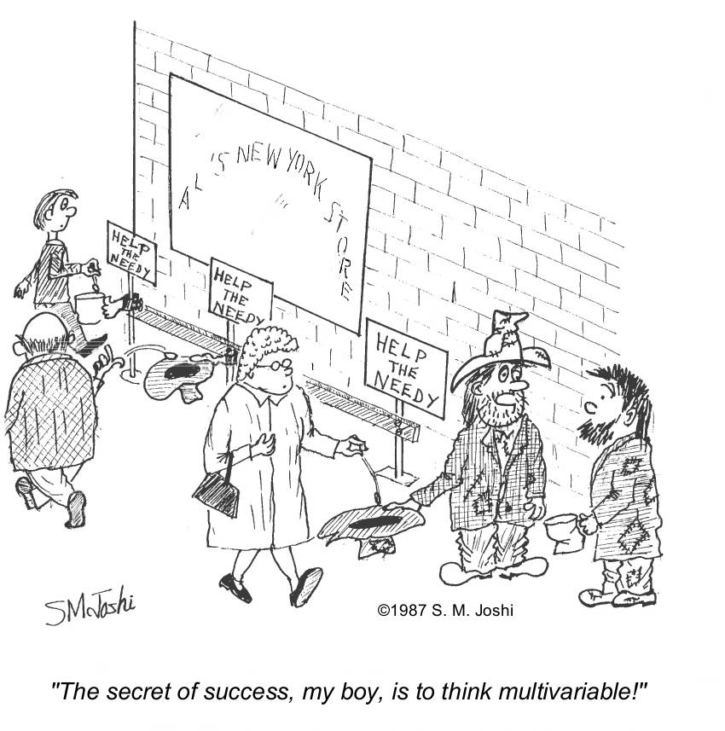
Control-II MIMO

Slide 12
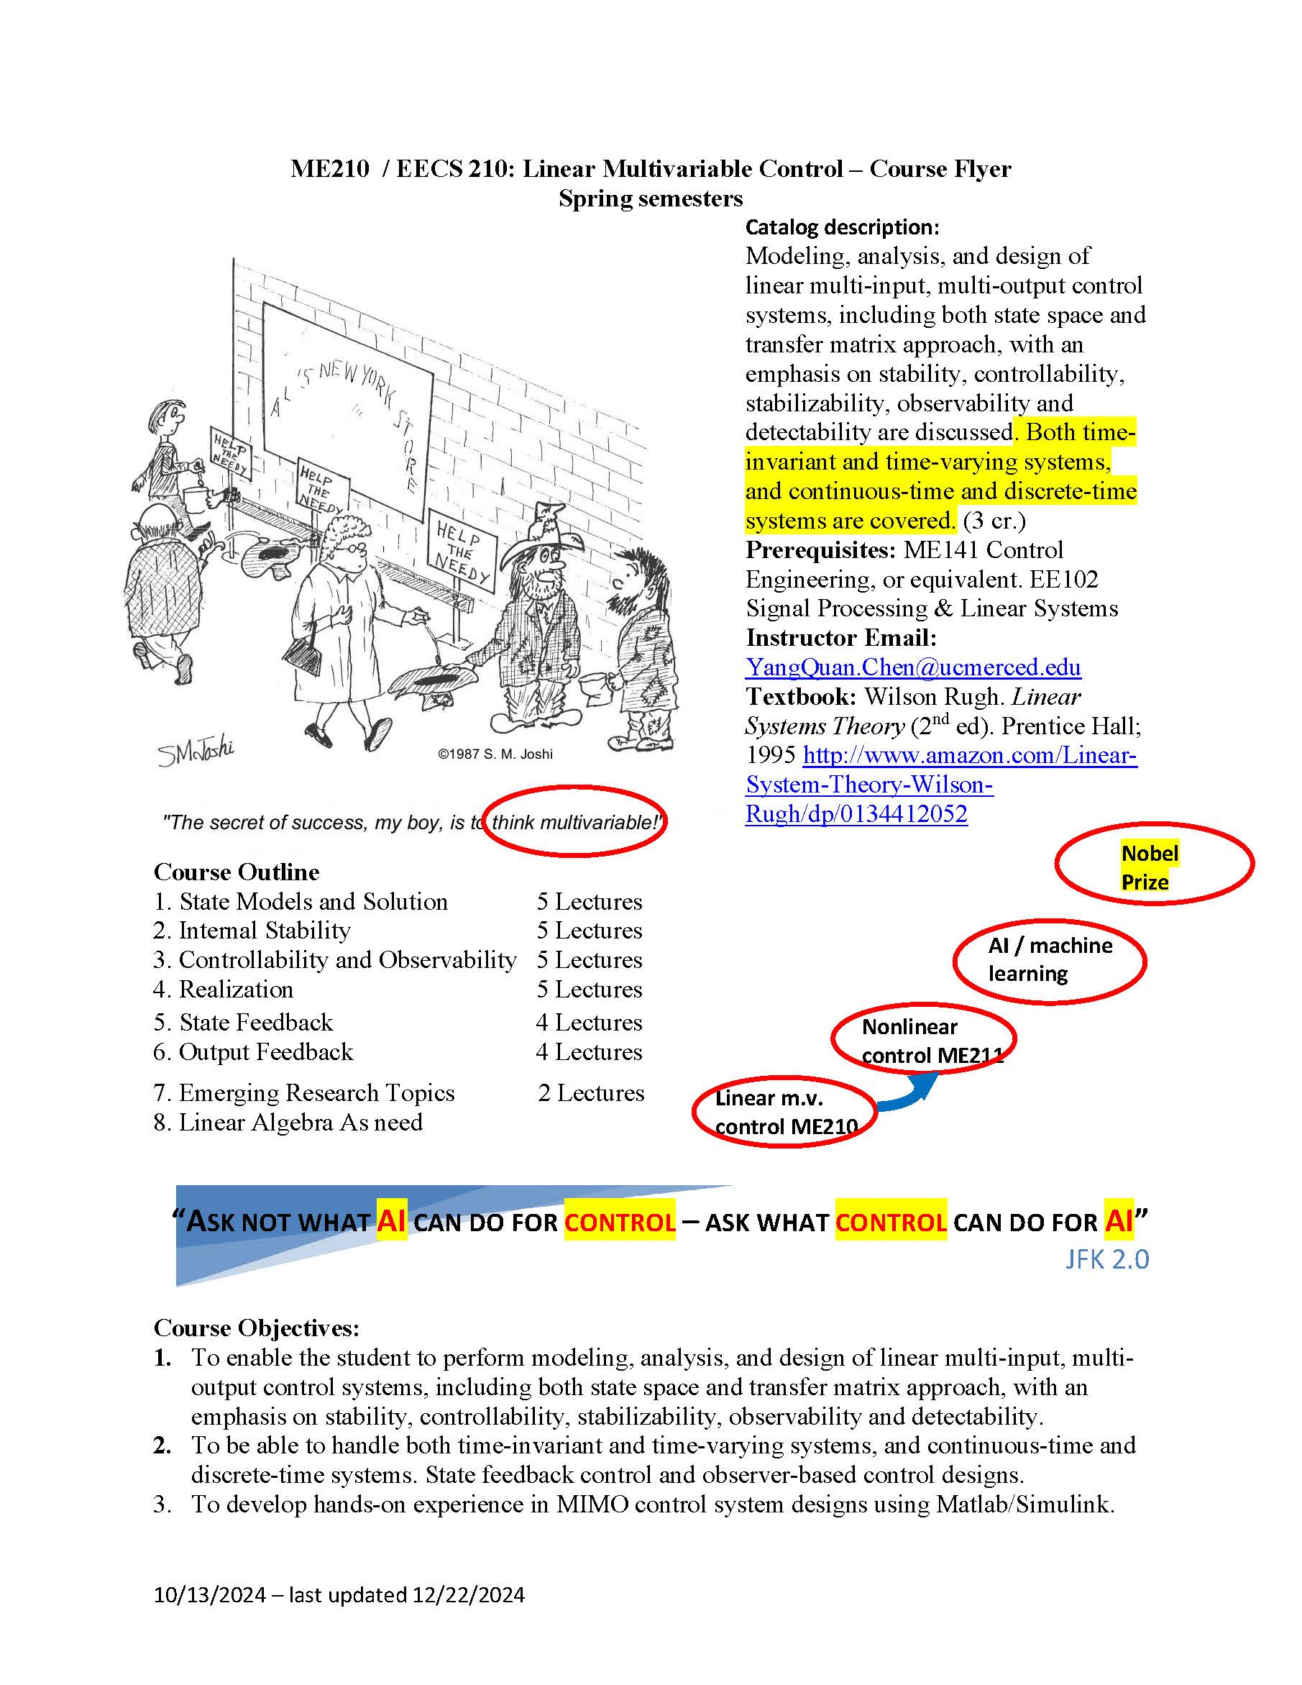

Slide 13
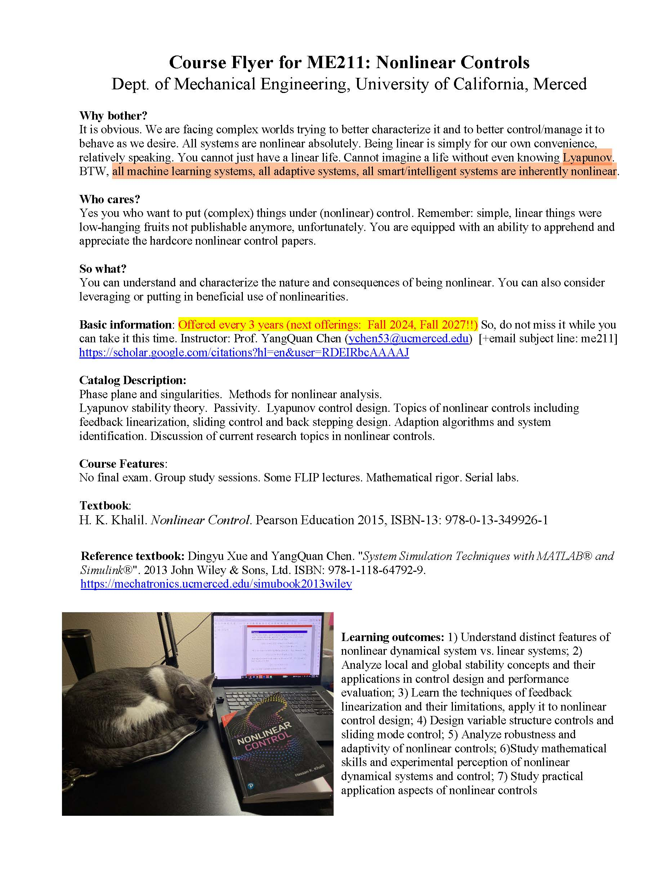
Control-III Nonlinear

Slide 14
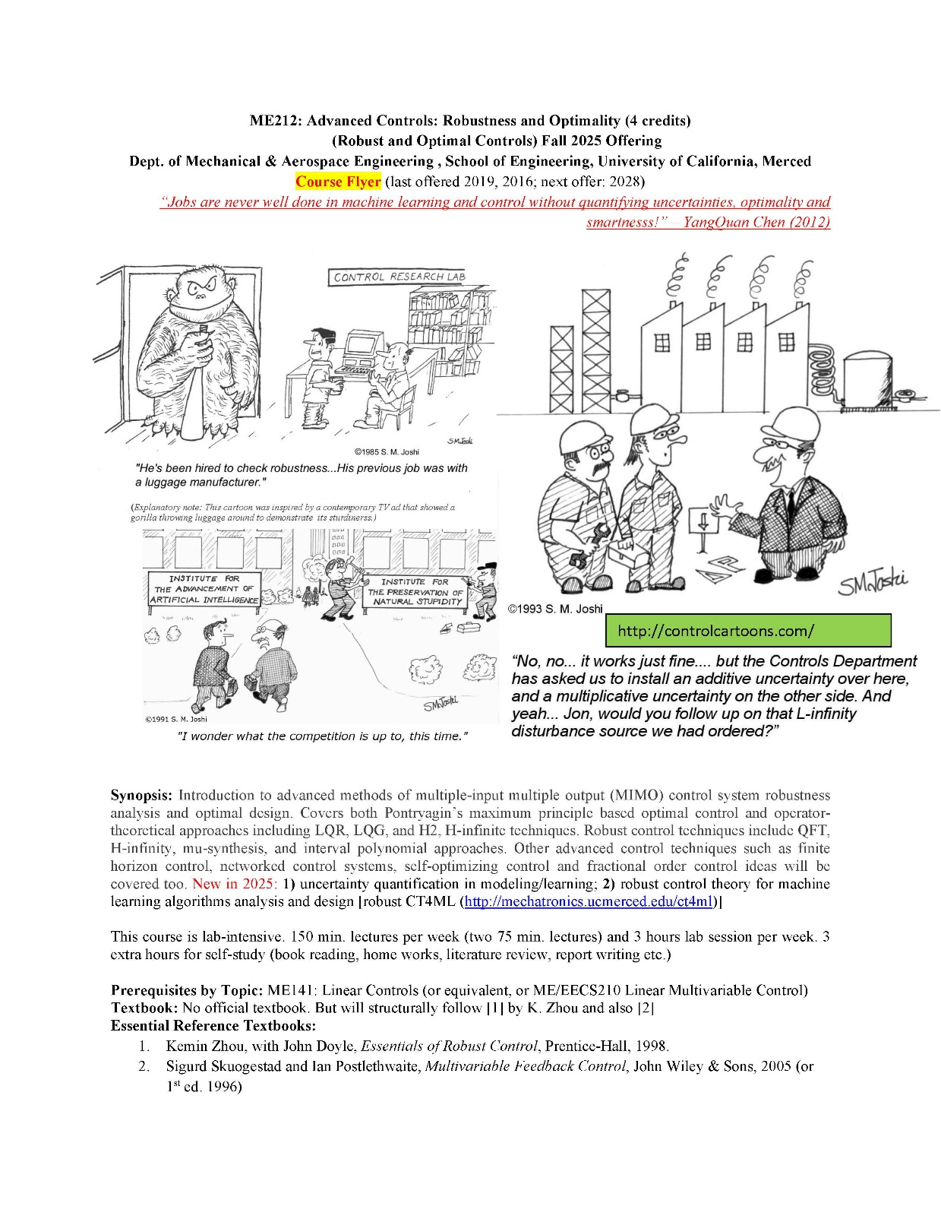
Control-IV Robust

Slide 15
Textbooks:
Graham C. Goodwiny, Stefan F. Graebe, Mario E. Salgado. Control System Design. Pearson (October 6, 2000). 996 pages. http://www.csd.elo.utfsm.cl/index.html
Wilson Rugh. Linear Systems Theory (2nd edition). Prentice Hall; 2 edition (August 13, 1995) http://www.amazon.com/Linear-System-Theory-Wilson-Rugh/dp/0134412052
Hassan K. Khalil. Nonlinear Control. 1/E. Pearson Education 2015. ISBN-10: 0-13-349926-X; ISBN-13: 978-0-13-349926-1
Kemin Zhou, Essentials of Robust Control with John C. Doyle, Prentice Hall 1998, 411 pp. Paper back. ISBN 0-13-525833-2
CoV, OCP: Bryson, A.E.; Ho, Y.C. (1975). Applied optimal control. Washington, DC: Hemisphere. ISBN 978-0-89116-228-5.

Slide 16
ML is nothing but
Optimization
Statistics
Control theory (CT)

Slide 17
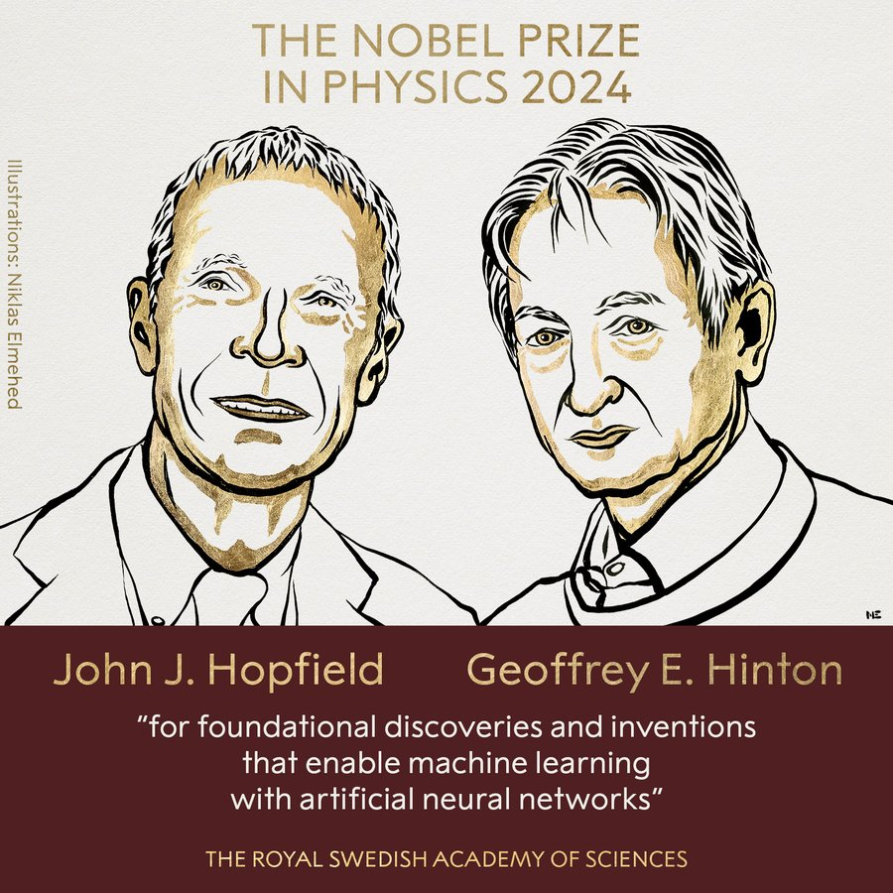

Slide 18
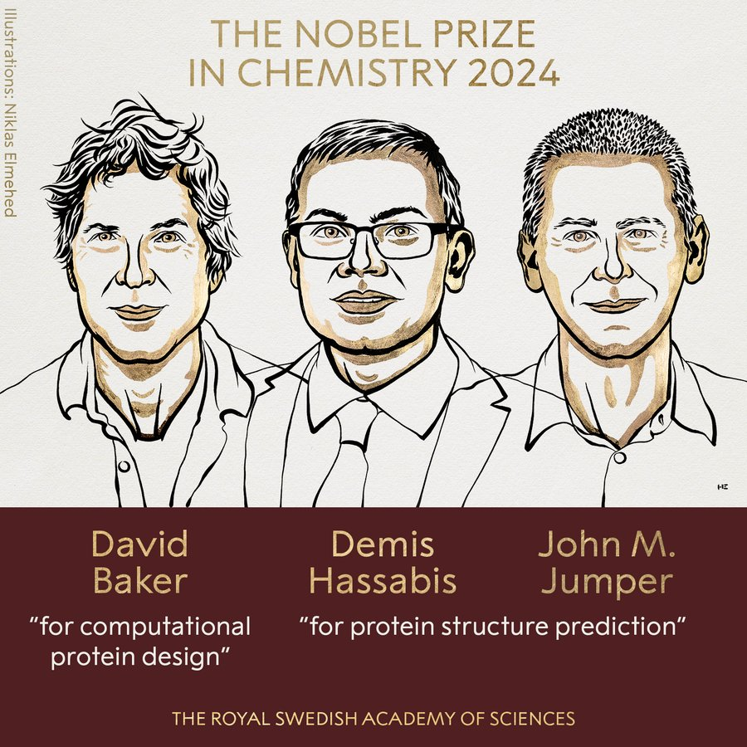

Slide 19
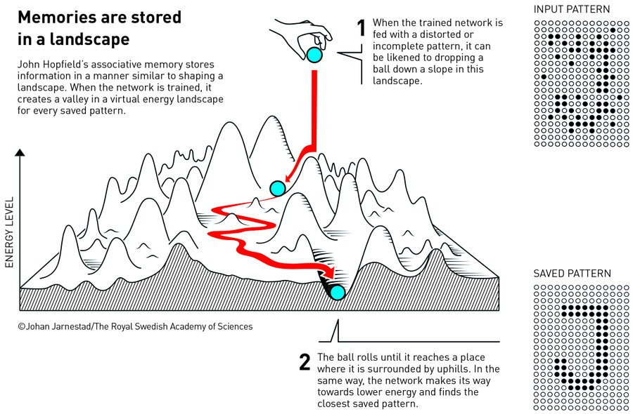

Slide 20
JFK and Control/AI
“Ask not what your country can do for you – ask what you can do for your country,” (1/20/1961)
“Ask not what AI can do for control – ask what control can do for AI” – taken by SysDO2024, and CDC24 plenary talk title 12/16/24 Paulo Tabuada UCLA
https://ieeecss.org/presentations

Slide 21
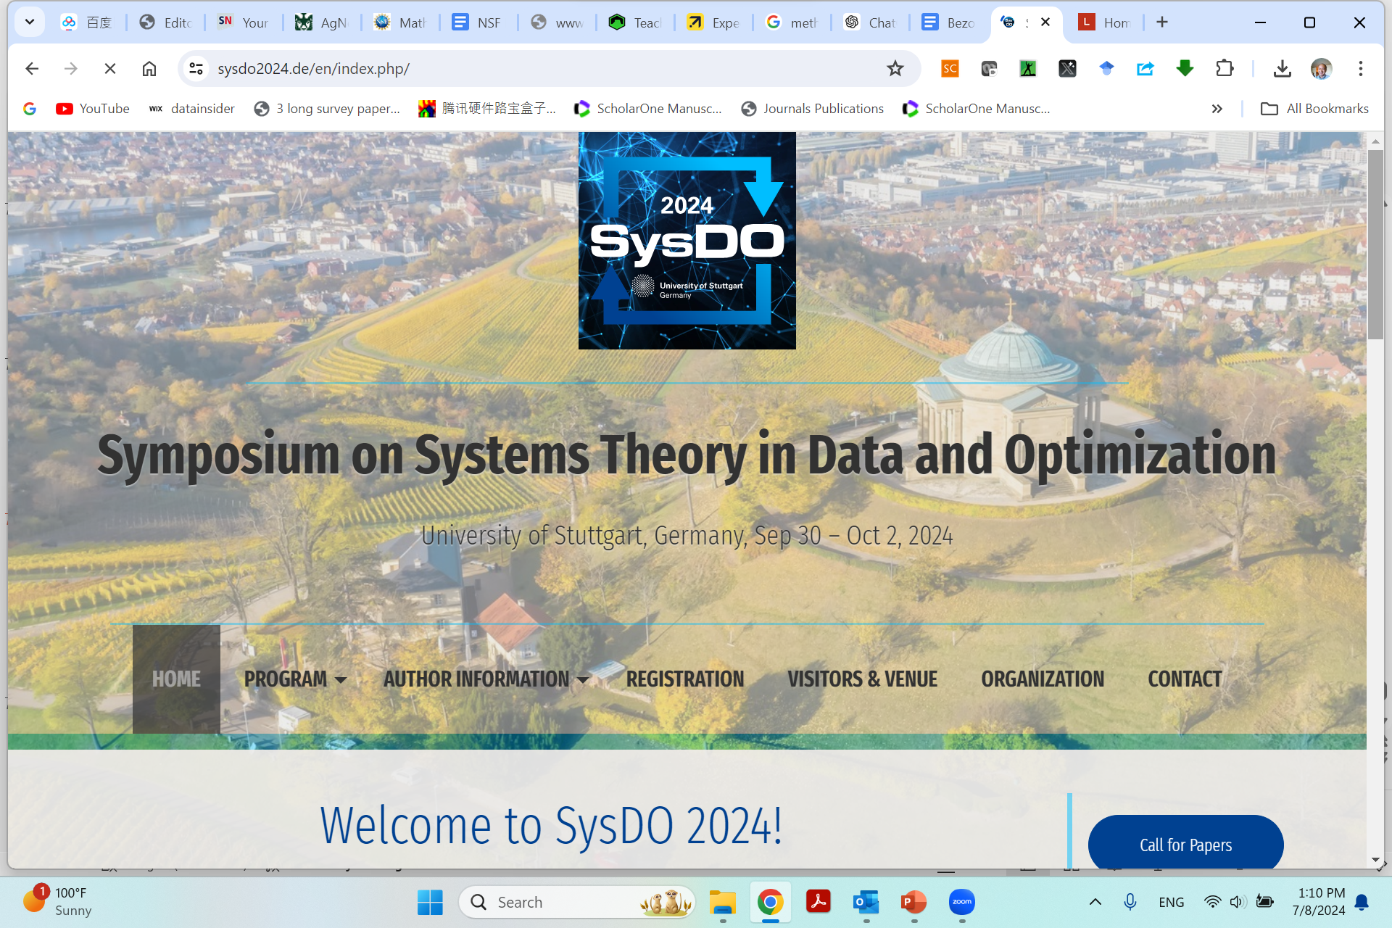
https://www.sysdo2024.de/en/index.php/

Slide 22
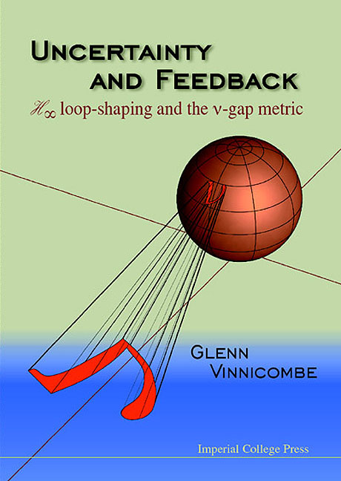
What control community can/should offer to AI/ML community?
“The Three Musketeers”
Internal model principle (IMP)
Nu-Gap metric
Model discrimination (Maciejowski, 1979, Automatica 15:5) https://doi.org/10.1016/0005-1098(79)90006-2
https://www.ifac2020.org/program/workshops/machine-learning-meets-model-based-control.html Eric Kerrigan, Imperial College London, UK

Slide 23
https://www.ifac2020.org/program/workshops/index.html
Full day tutorial workshops
Advanced Topics in PID Control System Design, Automatic Tuning and Applications
Analysis and Control for Resilience of Discrete Event Systems
Analysis, Control, and Learning of Dynamic Ensemble and Population Systems
Bayesian and Kernel-Based Methods in Learning Dynamical Systems
Data Analytics and Machine Learning for Industrial Alarm Monitoring
Data-based Methods for Interconnected Systems: Theory and Algorithms
Distributed Optimization for Control and Learning. From Theory to Numerical Software Tools
Input-to-state stability and control of infinite-dimensional systems
Machine Learning meets Model-based Control
Model Predictive Control of Hybrid Dynamical Systems
Set-based methods in estimation and control

Slide 24
Machine Learning meets Model-based Control
Speakers
Alberto Bemporad, IMT School of Advanced Studies Lucca, Italy
Francesco Borrelli, University of California Berkeley, USA
Jay H. Lee, Korea Advanced Institute of Science and Technology, South Korea
Eric Kerrigan, Imperial College London, UK
Matthias Müller, Leibniz University Hannover, Germany
Sergio Lucia, TU Berlin, Germany
Michal Kvasnica, Slovak University of Technology in Bratislava, Slovakia
Ugo Rosolia, Caltech, USA
Melanie Zeilinger, ETH Zürich, Switzerland

Slide 25
Machine Learning: A New ICE (Identification, Control, Estimation) Age? Alberto Bemporad
Learning Predictive Control and Dynamic Programming, Francesco Borrelli and Ugo Rosolia
Reinforcement Learning – Model-Based or Model-Free?, Jay H. Lee
What the machine should learn about models for control, Eric Kerrigan
Data- and learning-based model predictive control, Matthias Müller
Efficient design and probabilistic validation approximate robust MPC controllers based on deep learning, Sergio Lucia
Learning more from less data: when quality trumps quantity, Michal Kvasnica
Towards Safe Learning in Complex Control Systems, Melanie Zeilinger

Slide 26
What the machine should learn about models for control, Eric Kerrigan
We revisit, with 20/20 hindsight, three fundamental concepts from the control theory literature, viewed through a machine learning lens from 2020. Within the control community, these concepts are known to various degrees, depending on which group you talk to. Outside of control, these concepts are either absent or only partially formed. The first result to call to mind is the internal model principle of control, which states that a controller can only reject a disturbance if the feedback path contains an internal model of the dynamic structure of the disturbance. The second is the concept of the gap metric, which measures how close two systems are from a feedback, rather than open-loop, perspective. The third, and least widely known, is an extension of algorithmic information theory that allows one to measure the informativeness of a model, particularly if the system is "badly-defined" [Maciejowski, Automatica, 1979]. These three ideas should be reintroduced, to the control community and beyond, if we are aiming to understand fundamental trade-offs between complexity, robustness and performance when designing learning-based controllers.

Slide 27
What control community can/should offer to AI/ML community?
“The Three Musketeers”
Internal model principle (IMP)
Nu-Gap metric
Model discrimination (Maciejowski, 1979, Automatica 15:5) https://doi.org/10.1016/0005-1098(79)90006-2
https://www.ifac2020.org/program/workshops/machine-learning-meets-model-based-control.html Eric Kerrigan, Imperial College London, UK

Slide 28
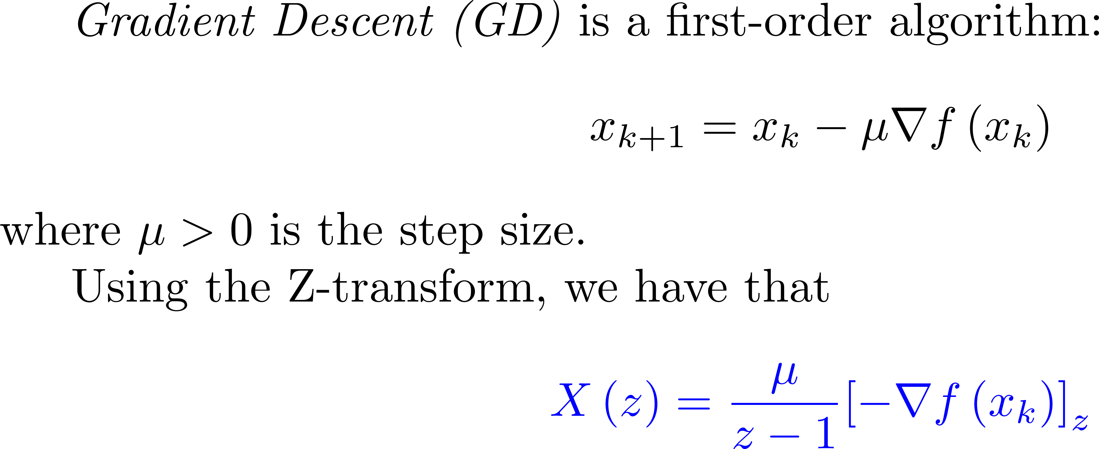
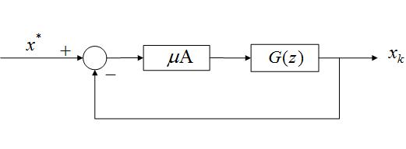
Control system point of view in iteration axis
Integrator in the forward loop is to eliminate the tracking error for a constant reference signal (Internal Model Principle).

Slide 29

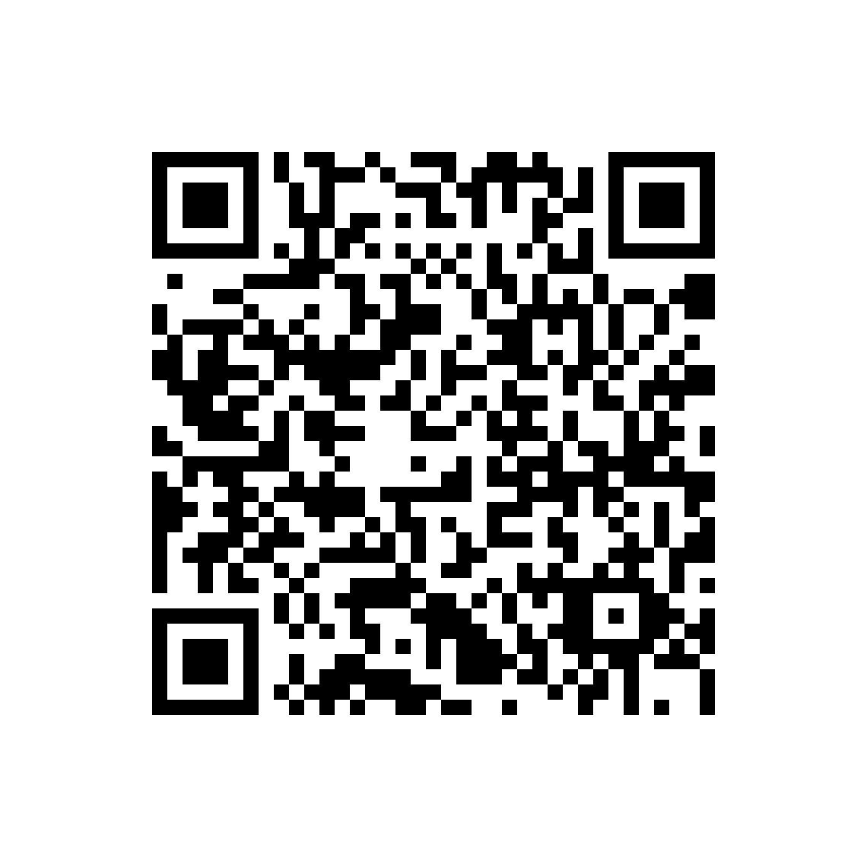
Chapter 10
Architectural Issues in SISO Control
Notes:
<<<10.1>>>
###SISO Control Architecture###

Slide 30
Issues in standard ML methods
standard ML methods—especially those based on gradient-based optimization—often lack rigorous guarantees on
convergence,
robustness, and
stability when faced with large-scale, complex, or adversarial environments.

Slide 31
What CT4ML can offer?
By bridging control theory and ML, the research aims to produce algorithms that are both
high-performing and
provably stable,
robust, and
efficient.

Slide 32
What CT4ML covers?
ML algorithms can be viewed as dynamical systems and thus analyzed or even redesigned using control-theoretic tools.
Analysis: How control-theoretic frameworks (e.g., Lyapunov methods, dissipativity, integral quadratic constraints) can provide formal guarantees and performance bounds for ML algorithms.
Design: How insights from robust control, feedback design, and system-level synthesis can inspire or improve the design of ML algorithms—particularly optimization methods used in training large neural networks or distributed learning systems.

Slide 33
CT4ML opportunities
The convergence of control theory and machine learning stands at an important juncture. By modeling ML algorithms as dynamical systems, researchers gain a wealth of tools—Lyapunov stability, passivity, dissipativity, IQCs—that provide mathematically rigorous ways to evaluate, guarantee, and enhance algorithmic performance. On the design side, classical feedback and robust control paradigms inspire new optimization strategies, offering potential breakthroughs in large-scale, reliable machine learning.
As the field matures, one can expect:
Greater integration of control-based safety and robustness measures in reinforcement learning for real-world autonomous systems.
More sophisticated “controller-inspired” updates in training deep neural networks to improve stability and accelerate convergence.
Scalable, numerically efficient versions of robust control analyses (e.g., IQCs, LMIs) that handle very large or high-dimensional ML models.
Interdisciplinary collaborations, where engineers, mathematicians, and computer scientists collectively develop the next generation of safe, robust, and efficient machine learning techniques—fulfilling the promise of AI in domains where reliability is paramount.

Slide 34
Outline
Why CT4ML
CT4ML Syllabus
Looking into the Future

Slide 35









MAD: Classic Control Systems Design
$$d$$
$$z$$
r
$$+$$
$$e$$
Controller
Plant
$$y$$
$$Δ$$
$$−$$
Plant
H
$$z$$
$$w$$
MAD Methodology (Kevin L. Moore):
What do I know?
What do I Have?
What do I want?
Performance assessment:
How robust?
How optimal?
How smart?
M: Modelling
A: Analysis
D: Design

Slide 36
MAD for Machine Learning?
M
ML of DS (scientific ML, physics-informed, PDE –disciplined, complexity-informed, tail-index-aware, loss-landscape roughness aware …)
A
ML by DS (control theory, Lyapunov redesign, nonlinear/adaptive, robust/optimal, finite-time, variable structure, safety-aware, attack-aware )
D
ML for DS (control theory, again)

Slide 37
MAD in control to ML
(M) Nonlinear Dynamic System view of ML
(A) ML algorithm analysis via control theory
(D) ML algorithm design via control theory

Slide 38
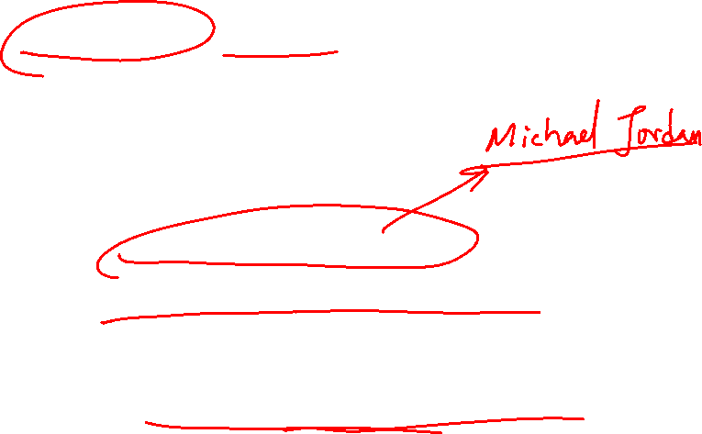
Reflection 沉思：
(Machine) Learning is now a hot research topic;
How to learn efficiently (optimally) is always important;
The key for learning is the optimization method;
Thus designing an efficient optimization method is the most important topic now
What is the optimal way to optimize?
What is the more optimal way to optimize?
ML core is optimization, can we demand “More Optimal Machine Learning” (i.e., DL with minimum/smallest labelled data) ?

Slide 39
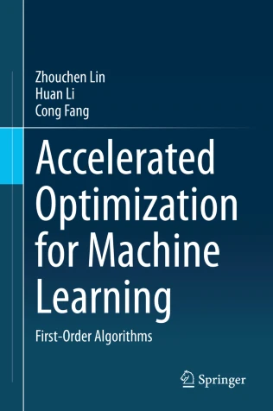
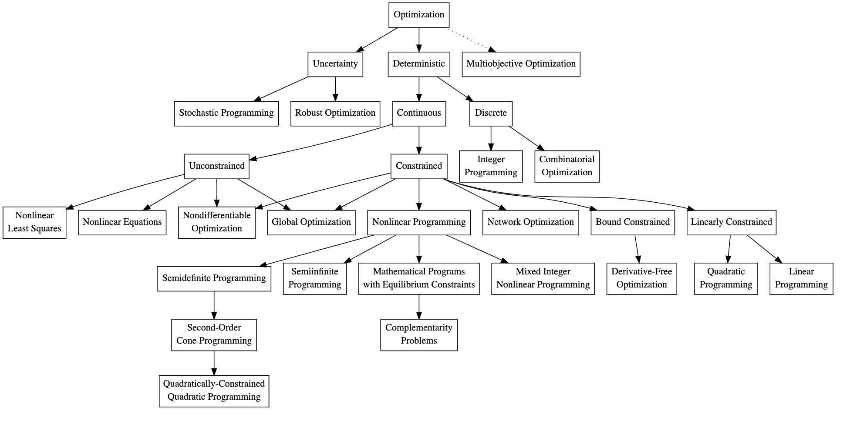
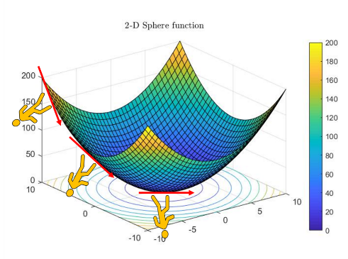
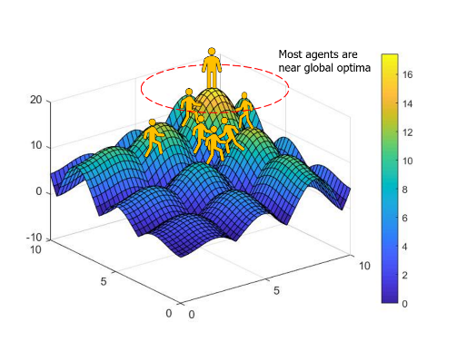
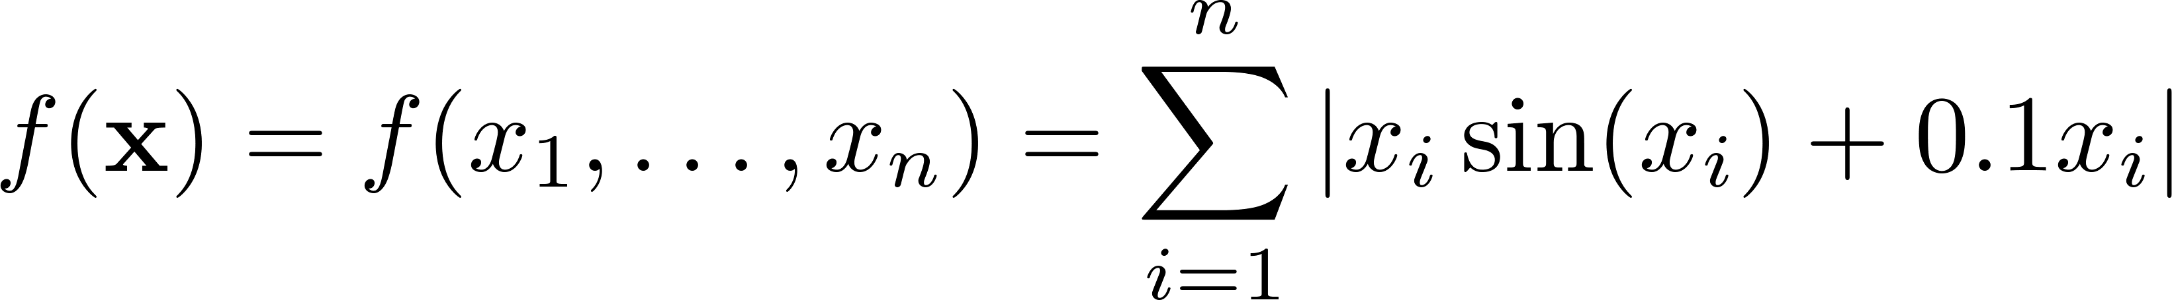
2-D Alpine function
Derivative-free: Direct Search, NM, PSO
Gradient-based: GD and its variants
https://math.stackexchange.com/questions/3664716/taxonomy-overview-of-optimization-methods

Slide 40

GD and SGD

Slide 41

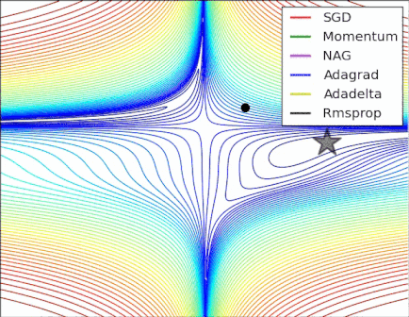
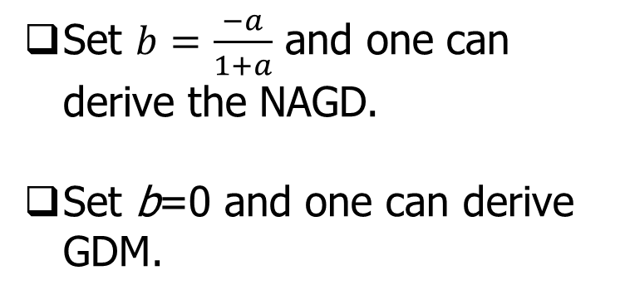

NAGD: Nesterov Accelerated GD
Set $b=\frac{−a}{1+a}$ and one can derive the NAGD.
Set b=0 and one can derive GDM.
https://stats.stackexchange.com/questions/179915/whats-the-difference-between-momentum-based-gradient-descent-and-nesterovs-acc

Slide 42
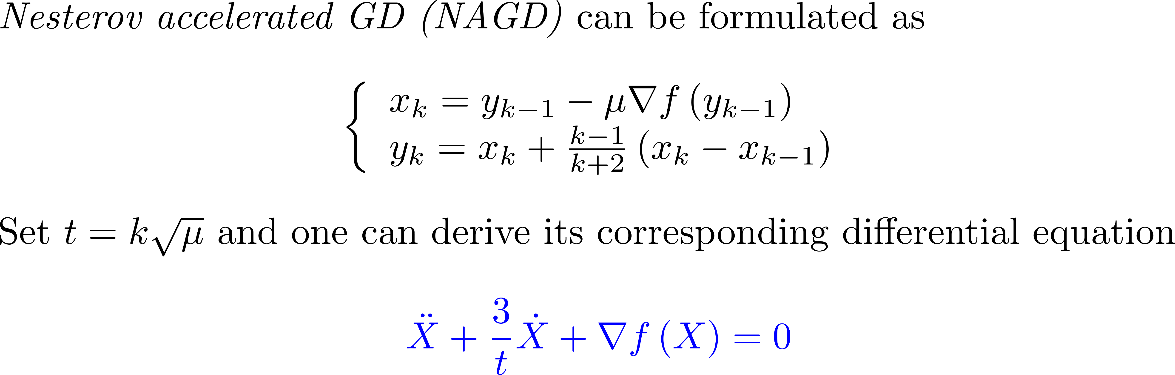
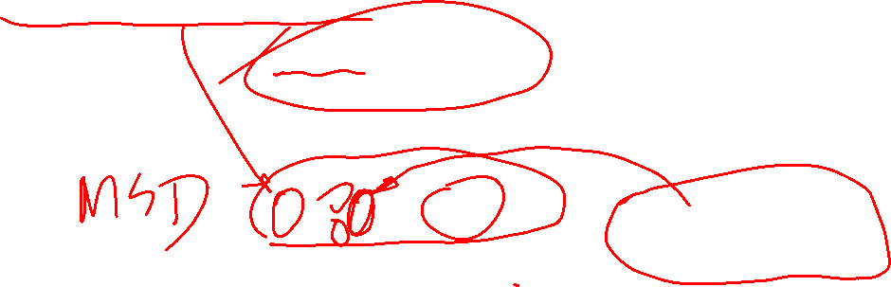
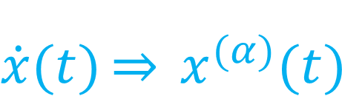
Review of Michael Jordan’s work:
$$\dot{x}(t)\underset{⇒}{} x^{(α)}{(t)}^{}$$
analyze the iteration algorithm in the continuous-time domain.
one can use Lyapunov method or variational method to analyze
Exciting new Fact: Optimization algorithms can be systematically synthesized using Lagrangian mechanics (E-L) EOM
Fractional-order damping “More Optimal”? (Better than the best) Fractional calculus of variation (FOCV), FO E-L equation
Go “fractional” to be more optimal !

Slide 43
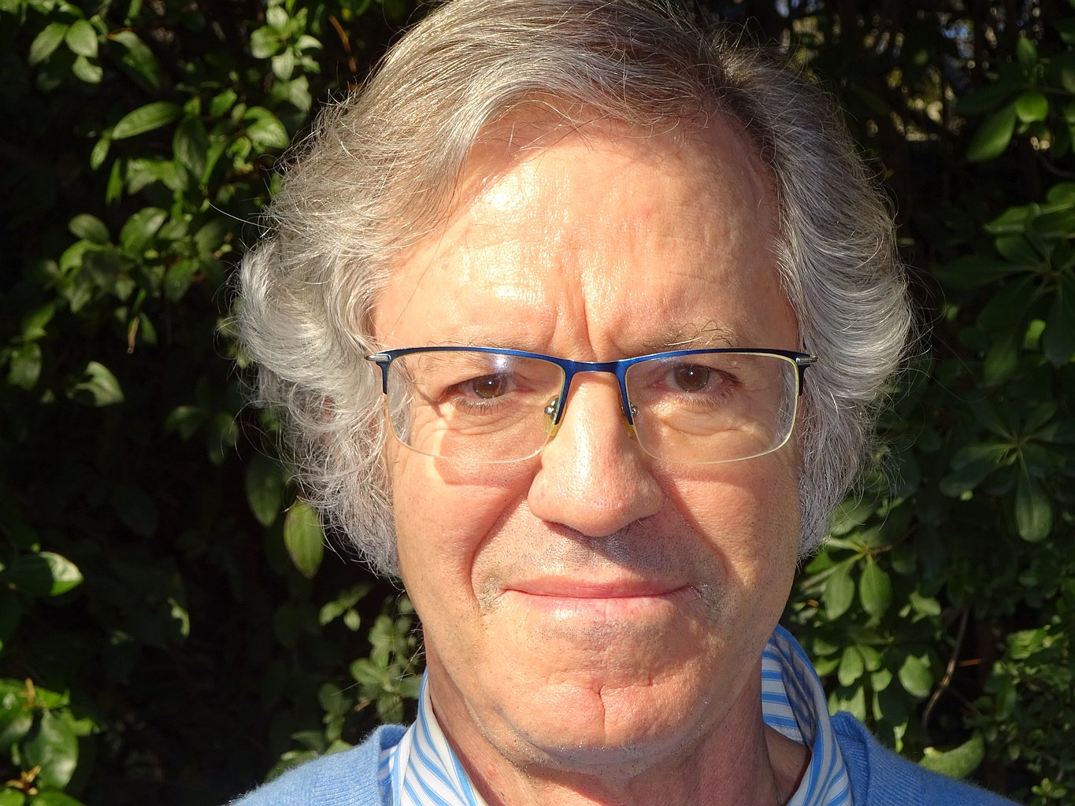
From Ravine to Nesterov to Ravine
2022 Hedy Attouch
1949-2023
https://euromathsoc.org/magazine/articles/194

Slide 44
Dynamical systems viewpoint on optimization
Attouch was a leading figure in treating optimization algorithms as discretizations of dissipative dynamical systems.
Heavy ball with friction and inertial dynamics
With Goudou and Redont, he analyzed the heavy ball with friction method (second-order ODE (\ddot x + \lambda \dot x + \nabla \Phi(x) = 0)) as a tool to explore local minima and showed convergence properties in both continuous and discrete time. (AIMS)
With various coauthors, he studied Newton-like inertial systems, multi-scale couplings, and Tikhonov-type regularization dynamics, linking asymptotic behavior of ODEs/inclusions to minimization of possibly nonsmooth, nonconvex energies. (AIMS)

Slide 46
A roadmap – from variational principle to machine learning
CoV => OCP => PMP => TPBVP => NN BP algorithm (Le Cunn 1988) => GD => Optimization => Machine Learning

Slide 47
M

Slide 48
A

Slide 49
D

Slide 53
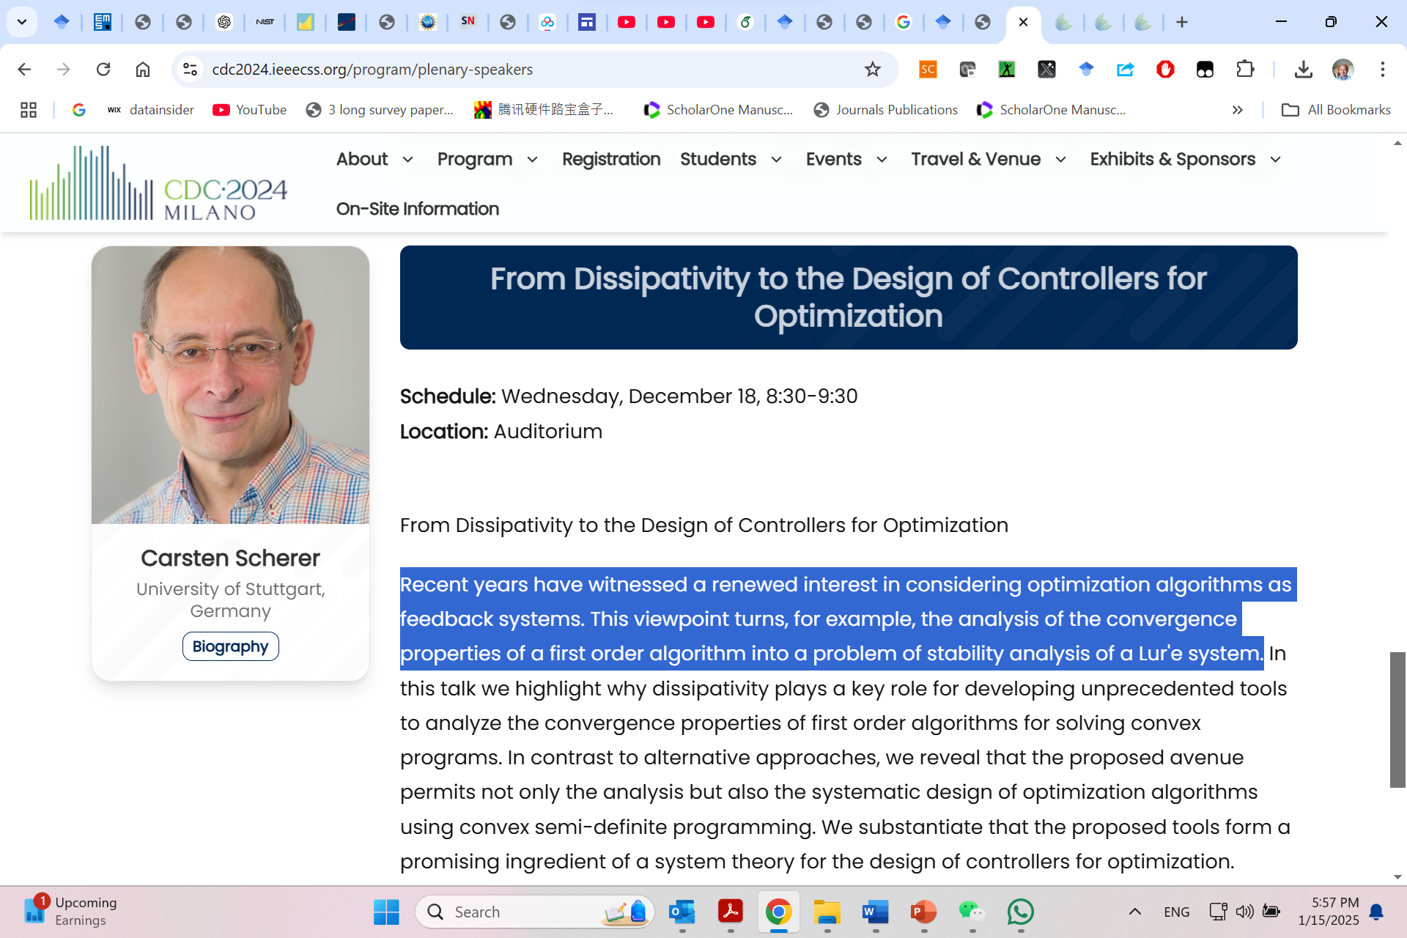
https://www.ieeecss.org/presentation/conference-plenary-lecture/dissipativity-design-controllers-optimization

Slide 58
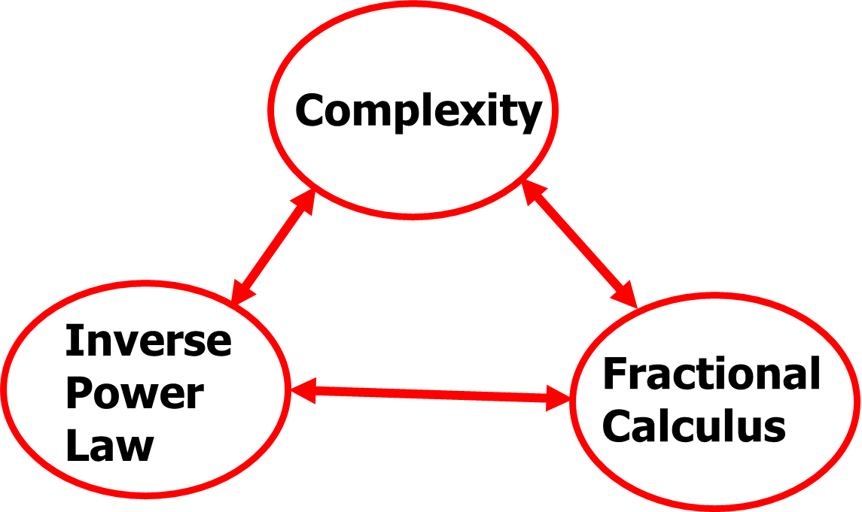
(algebraic) tail
Statistical sense (PDF, ACF …)
Spectral sense
Relaxation sense (aging, rehabilitation, healing)
…

Slide 59
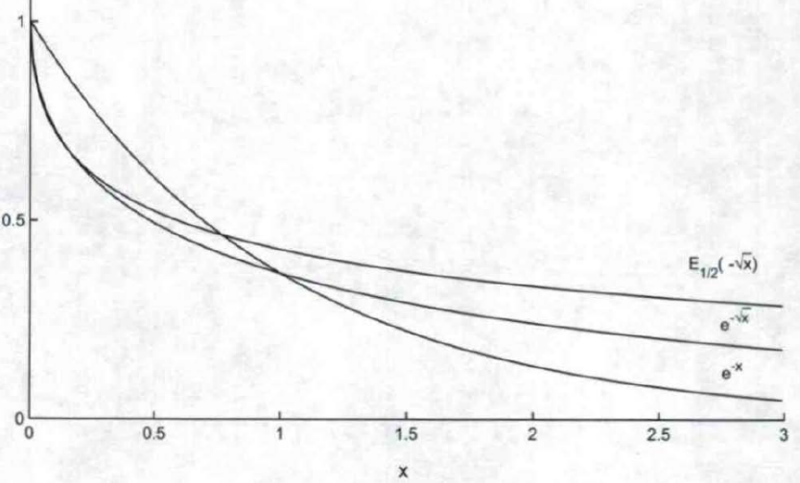
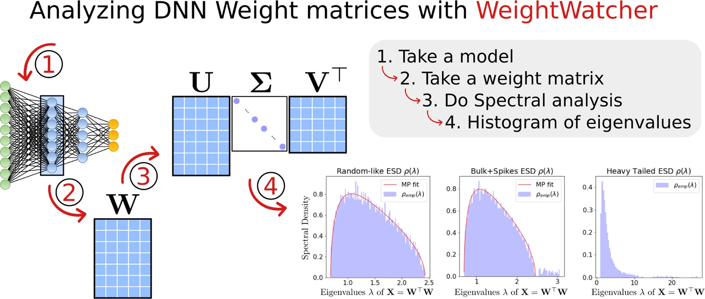
Tails matter
Tail MATTERS!
https://weightwatcher.ai/ Charles Martin

Slide 60
Outline
About UC Merced
Why CT4ML
CT4ML Syllabus
Looking into the Future

Slide 61

Fractional Order
FOSysDO ??
https://www.sysdo2024.de/en/index.php/

Slide 62
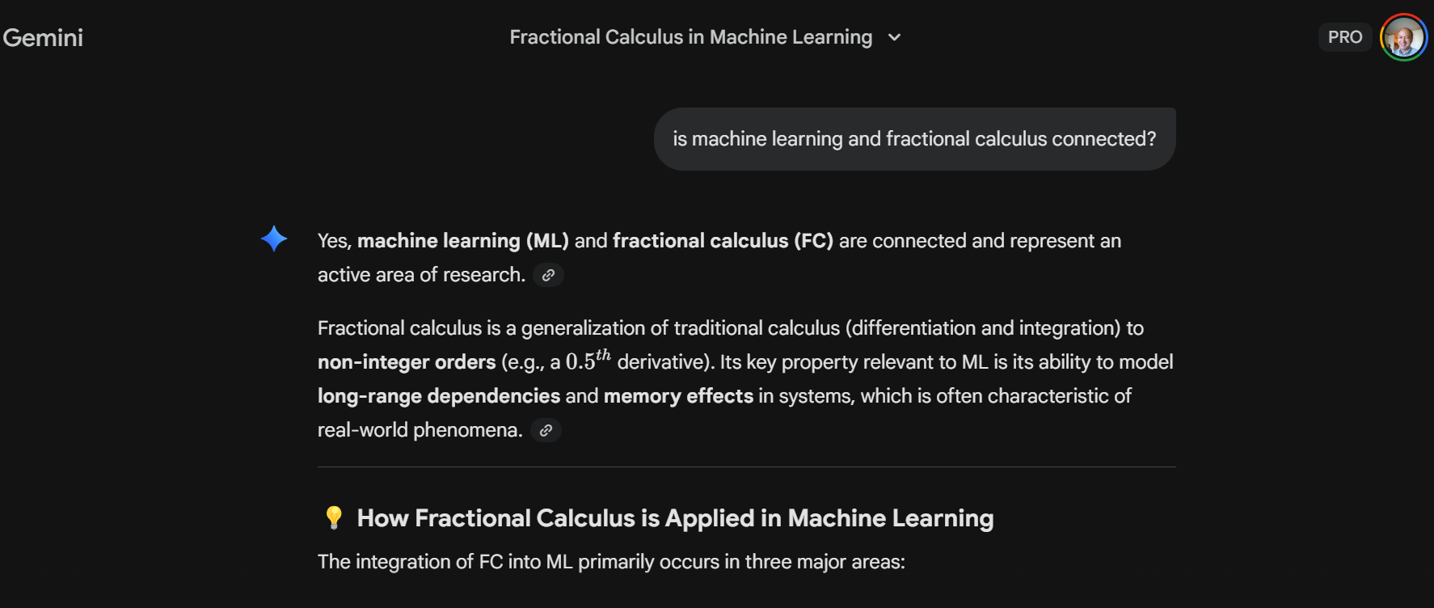

Slide 63
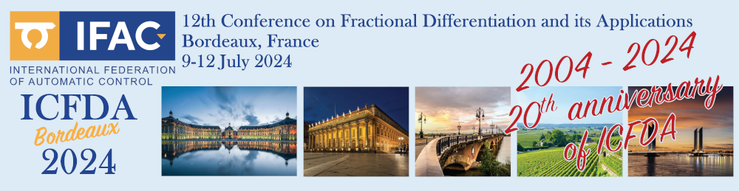
https://youtu.be/WJjeT3UhJdA
Applied Fractional Calculus in Big Data and Machine Learning (AFC4BD+ML)
YangQuan Chen, Ph.D., Director,
MESA (Mechatronics, Embedded Systems and Automation)Lab
ME/EECS/SNRI/HSRI/CITRIS, School of Engineering,
University of California, Merced
E: yqchen@ieee.org; or, yangquan.chen@ucmerced.edu
T: (209)228-4672; O: SRE-327; Lab: Castle #22 (T: 228-4398)
July 9th, 2024. Tuesday 1:30pm
In person ICFDA2024 pre-conference tutorial (4 hours) on Applied Fractional Calculus in Big Data and Machine Learning (AFC4BD+ML)

Slide 64
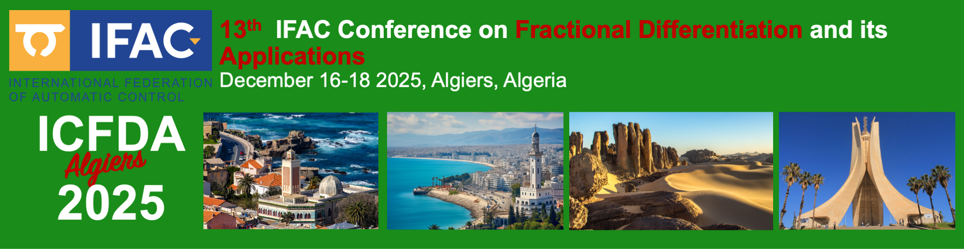
Applied Fractional Calculus in Big Data & Machine Learning (AFC4BD+ML) II
YangQuan Chen, Ph.D., Director, (yqchen@ieee.org)
MESA (Mechatronics, Embedded Systems and Automation)Lab, Mechanical & Aerospace Engineering Dept.,
University of California, Merced
Dec. 17th, 2025. Wednesday 1:30pm-6pm
In person ICFDA2025 tutorial (4 hours) on Applied Fractional Calculus in Big Data and Machine Learning (AFC4BD+ML) (II)

Slide 65

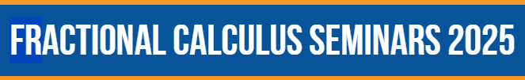
Roughness-informed machine learning by fractal and fractional calculi
YangQuan Chen, Ph.D., Director,
MESA (Mechatronics, Embedded Systems and Automation)Lab
MAE/EECS, School of Engineering,
University of California, Merced
E: yqchen@ieee.org; or, yangquan.chen@ucmerced.edu
T: (209)228-4672; O: SRE-327; Lab: Castle #22 (T: 228-4398)
6:00am-7:00am Friday, Dec. 5th, 2025
online

Slide 67
Work in prog. (presented @ ICFDA2025)

Slide 68
FOCT4ML
Coming

Slide 69

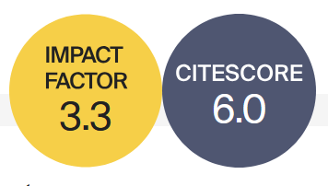




Basic Information
Rapid Publication
Fractal and Fractional (ISSN: 2504-3110) is an international, scientific, peer-reviewed, open access journal, publishing studies related to fractals and fractional calculus and their applications in different fields of science and engineering.
41 Days
Median Processing Time
Editor-in-Chief: Prof. Dr. Carlo Cattani
University of Tuscia, Italy
19.9 Days
Submission to First Decision
Impact Factor 3.3; CiteScore 6.0
2.7 Days
Acceptance to Publication
WoS Category | Mathematics, Interdisciplinary Applications 22/136 (Q1) Top 10%
CiteScore Category | Analysis 8/198 (Q1) Top 10% Statistics and Probability 23/293 (Q1) Top 10% Statistical and Nonlinear Physics 10/61 (Q1)
Journal Homepage

Slide 70
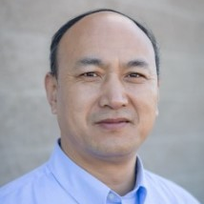
Section “Optimization, Big Data, and AI/ML”
Open Call for Submissions and Editorial Board Members
Aims and Scope
“Optimization, Big Data, and AI/ML” is a Section of the journal Fractal and Fractional, which publishes advanced theoretical studies and practical applications on the topics related to optimization, machine learning, and big data involving the use of fractional calculus (FC), the concept of fractal, as well as general fractional-order thinking (FOT).
Section Editor-in-Chief: Prof. Dr. Yangquan Chen
University of California Merced, USA
https://www.mdpi.com/journal/fractalfract/sections/Optimization_Big_Data_AIML

Slide 71
https://sciforum.net/event/IOCFF2026
13–15 April 2026
Online (Registration is free of charge! )
Important Dates:
Deadline for abstract submission: 12 December 2025
Notification of acceptance: 12 February 2026
Registration deadline: 8 April 2026
The Topics of Interest:
S1. Recent Advances in Fractional-Order Differential and Integral Operators
S2. Fractional Calculus and Its Applications in Engineering Systems
S3. Numerical Methods for Fractional Calculus
S4. Fractional Calculus in Complex and Nonlinear Dynamical Systems
S5. Fractional Calculus in Machine Learning: Applications and Challenges
S6. Fractal Geometry: Mathematical Foundations and Real-World Applications

