Slide 1







“AVIRIS-NG-like smart virtual remote sensing via spectra-aware physics informed GANS”
Sachin Giri, Rafal Krzysiak, Derek Hollenbeck, YangQuan Chen
Sachin Giri
Electrical Engineering and Computer Science (EECS),
University of California, Merced
sachingiri@ucmerced.edu | www.sachingiri03.com.np
Aug 18, 2025 | IDETC-CIE 2025 |Anaheim, CA
S. Giri |IDETC-CIE 2025| Anaheim, CA

Slide 2
Outline
  Motivation
  Problem Statement
  Methods
    AVIRIS-NG
    USGS spectral library
    Hyperspectral image model
    Matched Filter
    Network Architecture
    Loss functions
  Experiment
  Results/Discussion
  Conclusion
S. Giri |IDETC-CIE 2025| Anaheim, CA
1

Slide 3
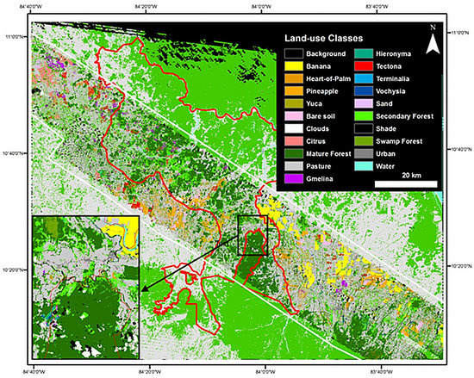
Motivation
Hyper spectral Remote Sensing
  NASA’s Airborne Visible Infrared Imaging Spectrometer - Next Generation (AVIRIS-NG):
  High-resolution,425 bands (380–2510 nm).
  Applications in crop detection, land classification, environmental monitoring, GHG emission mapping.
Challenges
  Expensive costs, logistics, and human resources
  Difficult to launch Frequent missions.
  Lack of physics in existing HSI generation methods
Opportunities
  No synthetic AVIRIS-NG data availability.
  AI + Physics → create realistic, low-cost AVIRIS-NG replicas.
  Rising demand of dataset curation, not just architecture modifications, “Data is key for better model, Data is future ”
Image Credit: https://doi.org/10.3390/rs70505660
S. Giri |IDETC-CIE 2025| Anaheim, CA
2

Slide 4
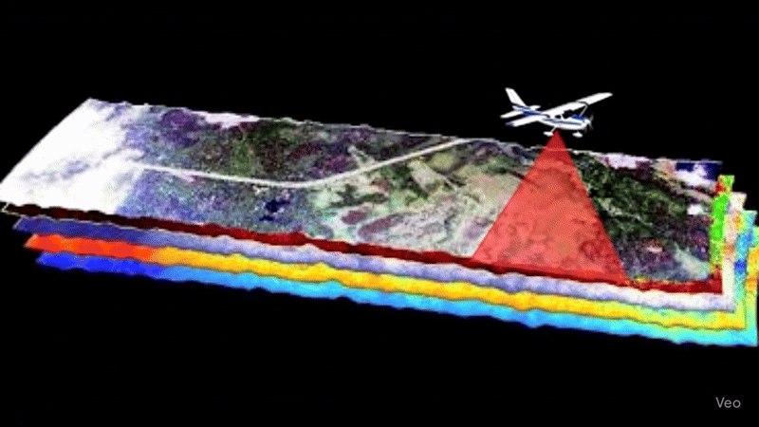
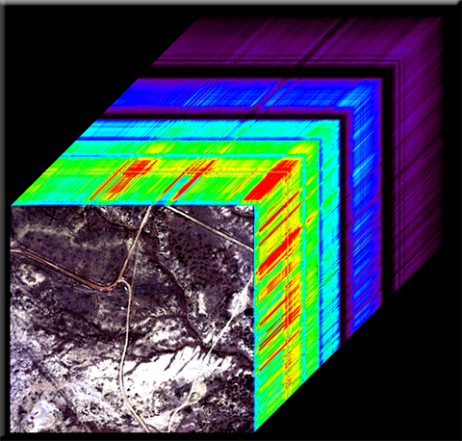
Problem Statement
The Challenge: Costly & Inefficient Data Collection
  High Cost & Labor
  Need for Repetition, Dynamic environment and geographical changes
Our Objective: A Virtual Sensor Replica
  Goal:
    To create synthetic, physical spectra aware virtual replicas of AVIRIS-NG hyperspectral images
  Impact:
    efficient simulation and analysis of sensor performance for wide variety of environment applications
Flight mission for AVIRIS-NG
Virtual Replica
S. Giri |IDETC-CIE 2025| Anaheim, CA
3

Slide 5
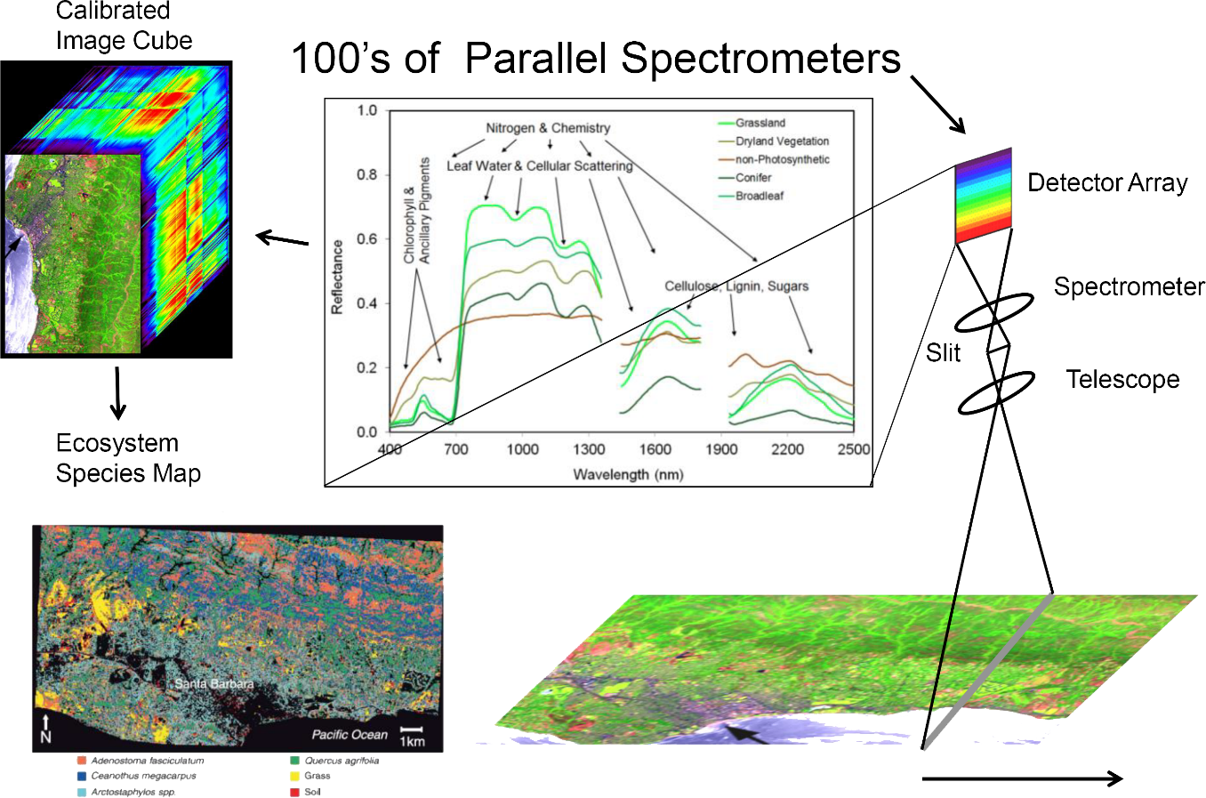
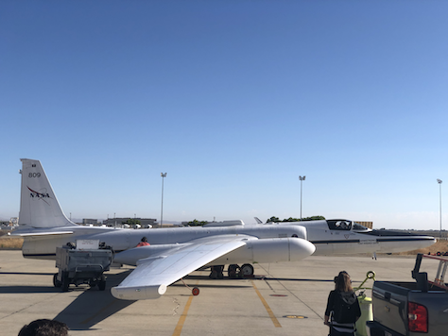
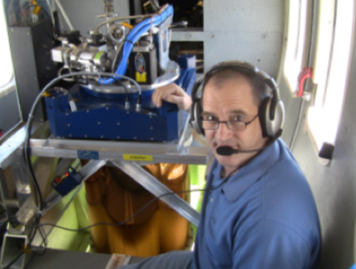
Methods
AVIRIS-NG
  NASA’s Airborne Visible Infrared Imaging Spectrometer - Next Generation (AVIRIS-NG), a push broom spectral mapping system
  wavelength range from 380 nanometer (nm) to 2510 nm , 5 nm spectral resolution, 425 bands.
  The spatial resolution is 3 to 8 meter.
  AVIRIS-NG L2 data [15] is a product that provides ortho corrected and atmospherically corrected surface reflectance data.
  We use the total of 8 bands, three visible bands (460 nm, 550 nm, 640 nm) , and five shortwave infrared (SWIR) bands (2004 nm, 2109 nm, 2310 nm, 2350 nm, 2360 nm)
Image Credit: NASA
[15] ORNL DAAC. “AVIRIS-NG L2 Surface Reflectance Data Product.” URL: https://daac.ornl.gov/AVIRIS/guides/AVIRIS-NG_L2_Reflectance.html.
S. Giri |IDETC-CIE 2025| Anaheim, CA
4

Slide 6
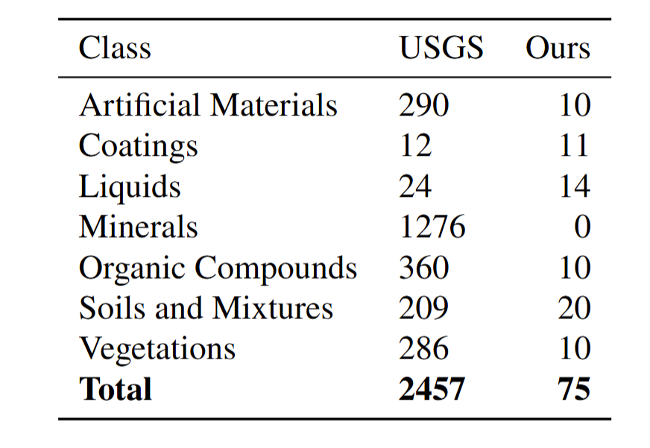
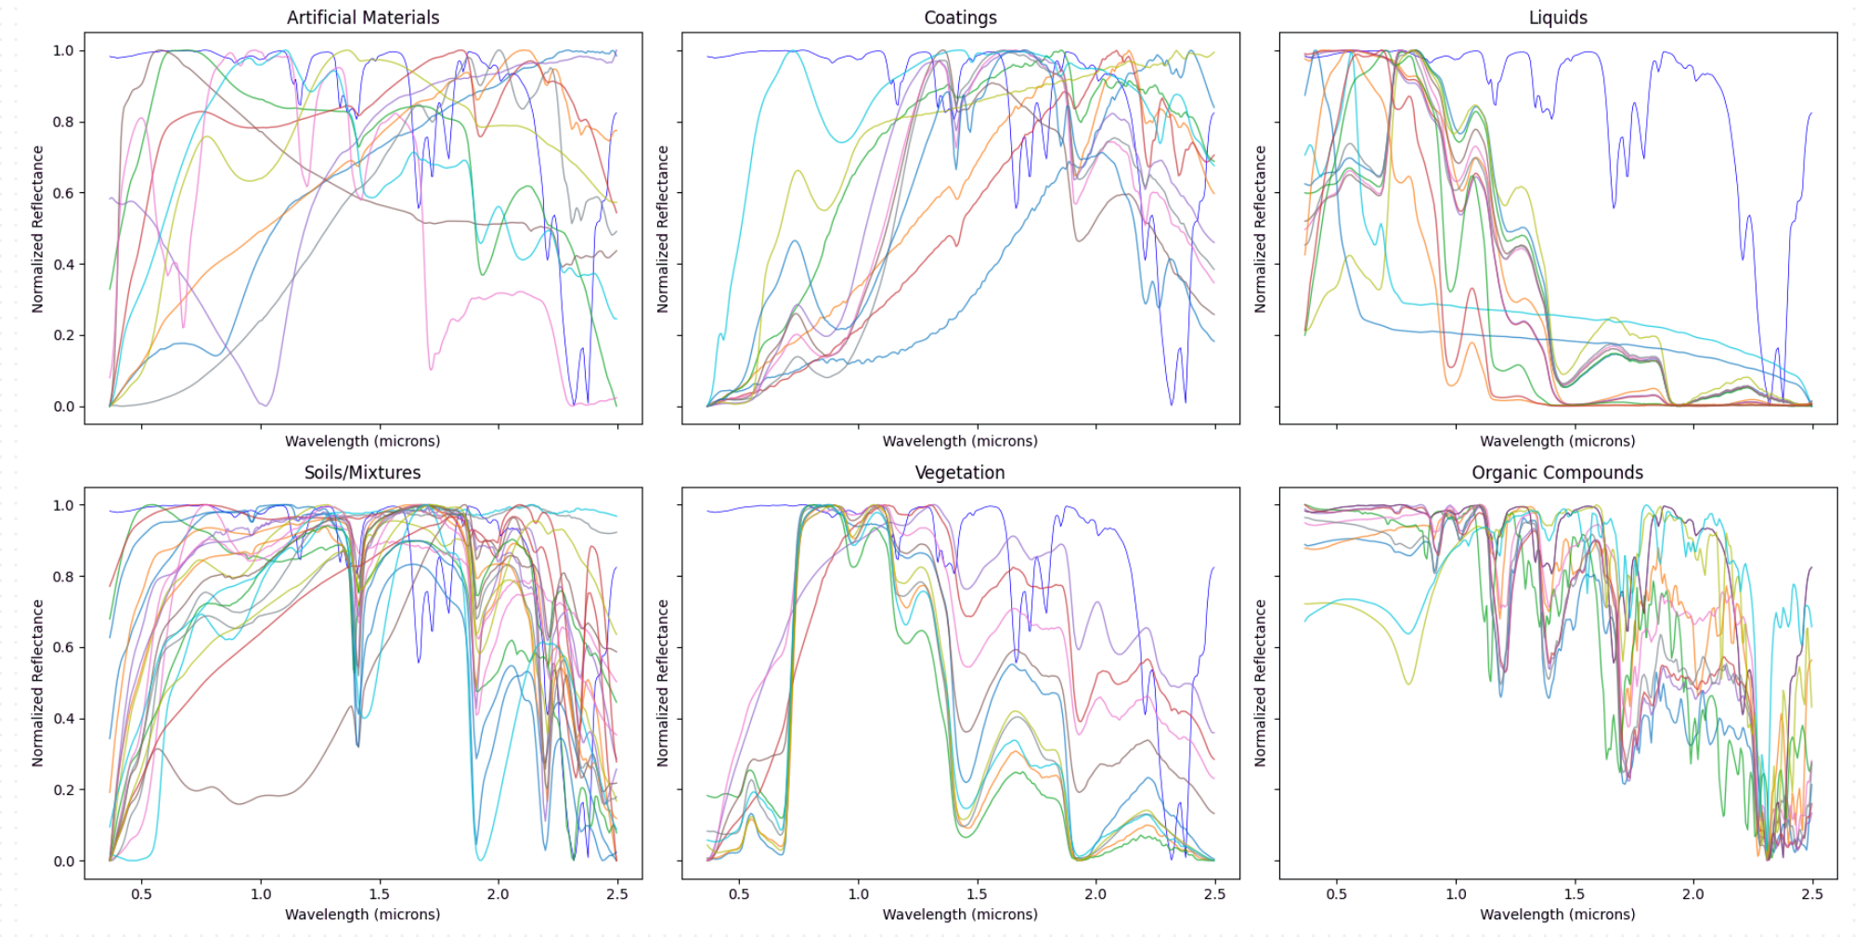
Methods
Spectral library
  United States Geological Survey (USGS) spectral library version 7b [16] provides the spectral signatures for 7 different classes.
  Based on the geography, vegetation, landscape, roads and buildings and other site features, 75 types of materials.
  10 different desert vegetation and hydrocarbons including methane, ethane, propane, etc.
  Reflectance signatures are linearly interpolated across 8 bands of the AVIRIS-NG images
[16] Kokaly, Raymond F., Clark, Roger N., Swayze, Gregg A.,Livo, K. Eric, Hoefen, Todd M., Pearson, Neil C., Wise,Richard A., Benzel, William M., Lowers, Heather A.,Driscoll, Rhonda L. and Klein, Andrew J. “USGS SpectralLibrary Version 7.” U.S. Geological Survey (2017). URLhttps://doi.org/10.3133/ds1035.
S. Giri |IDETC-CIE 2025| Anaheim, CA
5

Slide 7


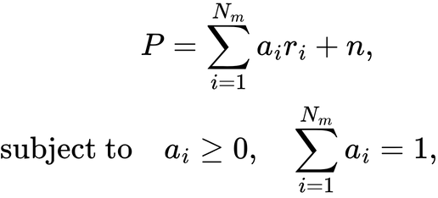



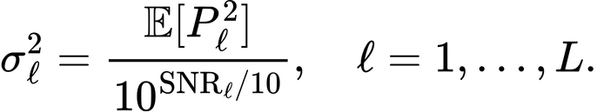


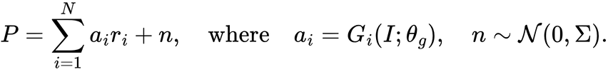
Methods
Hyperspectral Image model
  Linear Mixing Model
  Each pixel , with ‘L’ number of spectral bands with a mixture of endmembers (materials):
- abundance of material ‘i’
- spectral signature of material ‘i’
- noise and modeling errors
  Gaussian noise, ,based on AVIRIS-NG sensor specifications in NASA’s COMEX Final Report [17],
  Band-dependent variance, ,based on SNR:
  Conservative empirical SNR values are used to account for surface variability, reflectance darkening, and atmospheric distortion
RGB Bands – 45 dB | SWIR Bands - 38, 35, 35, 33, and 33 dB
  Generator uses RGB Image “I” → produces abundance map , introduced by [10]
  Final Imaging model:
[17] NASA Airborne Science Program. “COMEX Final Report:CO2 and Methane Experiment (COMEX).” (2019).URL https://ntrs.nasa.gov/api/citations/20190025386/downloads/20190025386.pdf. NASA Technical Report,Document ID: 20190025386
[10] iu, Liqin, Li, Wenyuan, Shi, Zhenwei and Zou, Zhengxia.“Physics-informed hyperspectral remote sensing image syn-thesis with deep conditional generative adversarial net-works.” IEEE Transactions on Geoscience and RemoteSensing Vol. 60 (2022): pp. 1–15.
S. Giri |IDETC-CIE 2025| Anaheim, CA
6

Slide 8




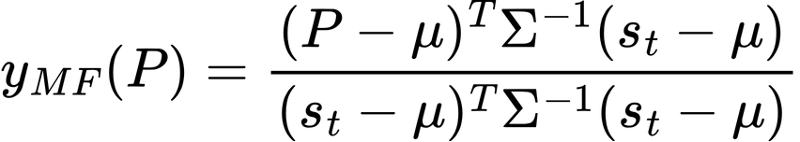
Methods
Matched Filter
  Matched filter (MF) [18] is an optimal linear filter, maximize the signal-to-noise ratio (SNR)for known signal from background noise.
  Widely applied in hyperspectral imaging, performs well in complex backgrounds and low SNR conditions
  Matched filter output for pixel P, with known target spectrum ,adjusted by background mean and covariance is computed as:
  is derived from a USGS spectral library
  We incorporate the physically-derived spectral information into GAN training with MF loss
[18] Turin, George. “An introduction to matched filters.” IRE Transactions on Information Theory Vol. 6 No. 3 (1960):pp. 311–329.
S. Giri |IDETC-CIE 2025| Anaheim, CA
7

Slide 9
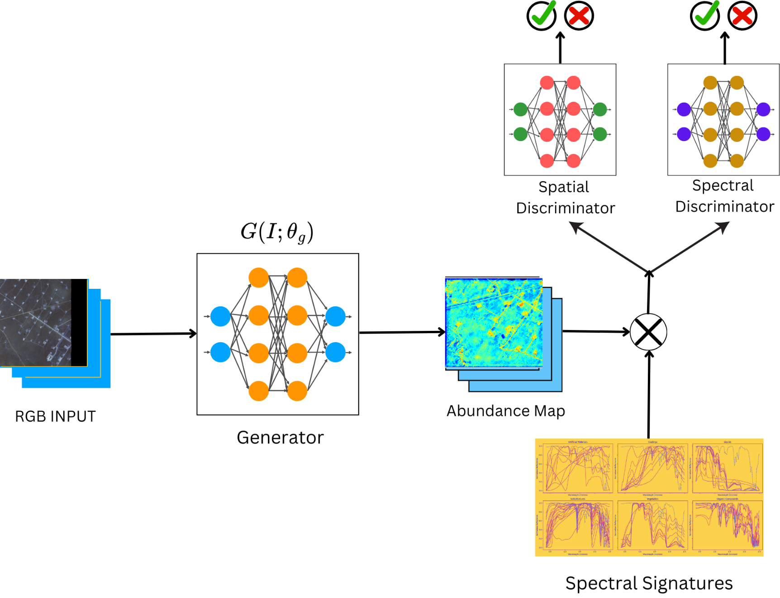
Methods
Network Architecture
  Framework: Generative Adversarial Network (GAN) [5] with Generator + Discriminators
  Input: RGB channels of hyperspectral image
  Generator:
    U-Net architecture[19] → outputs per-pixel abundance map
    Abundance × spectral signatures → reconstructs hyperspectral cube with final imaging model
  Discriminators:
    Spatial discriminator → enforces spatial authenticity Spectral discriminator → enforces spectral fidelity
[5] Goodfellow, Ian, Pouget-Abadie, Jean, Mirza, Mehdi, Xu,Bing, Warde-Farley, David, Ozair, Sherjil, Courville, Aaronand Bengio, Yoshua. “Generative adversarial networks.”Communications of the ACM Vol. 63 No. 11 (2020): pp.139–144.
[19] Ronneberger, Olaf, Fischer, Philipp and Brox, Thomas. “U-net: Convolutional networks for biomedical image segmen-tation.” Medical Image Computing and Computer-AssistedIntervention–MICCAI 2015: 18th International Confer-ence, Munich, Germany, October 5-9, 2015, proceedings,part III 18: pp. 234–241. 2015. Springer.
S. Giri |IDETC-CIE 2025| Anaheim, CA
8

Slide 10


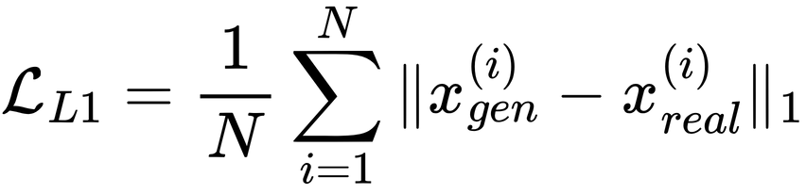
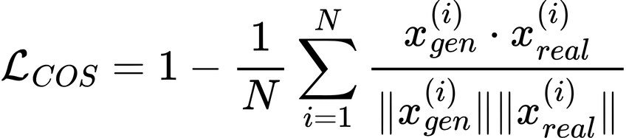
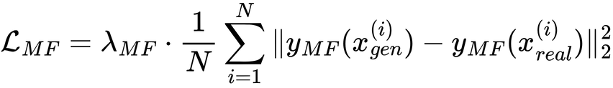
Methods
Loss Functions
  and be the generated and real hyperspectral images respectively, dimensions (C, H, W). C is the number of spectral channels, and H, W represent spatial dimensions. N is the batch size.
  L1 Loss
    evaluates pixel wise absolute differences between generated and real hyperspectral images
  Cosine Similarity Loss
    Measures the alignment between spectral vectors at each pixel location
  Matched Filter loss
    We selected 11 targets - sand, desert varnish, asphalt road, concrete road, sheet metal, painted aluminum, roof, water, black brush, juniper, methane.
[18] Turin, George. “An introduction to matched filters.” IRE Transactions on Information Theory Vol. 6 No. 3 (1960):pp. 311–329.
S. Giri |IDETC-CIE 2025| Anaheim, CA
9

Slide 11
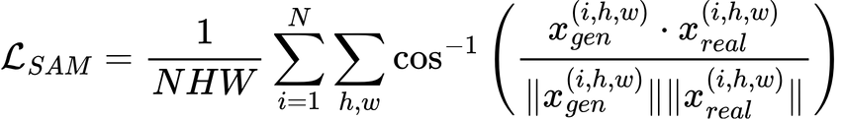
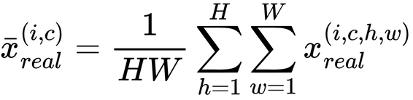
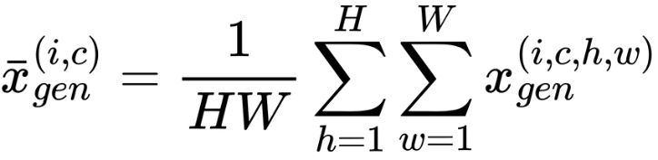
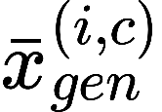
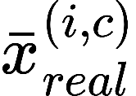
Methods
Loss Functions
  Spectral Angle Loss
    Spectral Angle Mapper (SAM) loss measures the spectral similarity between generated and real hyperspectral images
    Spectral Correlation Loss
      evaluates the correlation between spectral bands of the generated and real hyperspectral images,
      and are the mean intensities of the 𝑐-th channel for the 𝑖-th generated and real images
    Combined Generator Loss
S. Giri |IDETC-CIE 2025| Anaheim, CA
10

Slide 12
Methods
Loss Functions
    Discriminator Loss
    Uses Binary Cross Entropy (BCE) loss
    Spatial Discriminator Loss
      ensures spatial realism of generated hyperspectral images
    Spectral Discriminator Loss
      ensures spectral fidelity.
S. Giri |IDETC-CIE 2025| Anaheim, CA
11

Slide 13
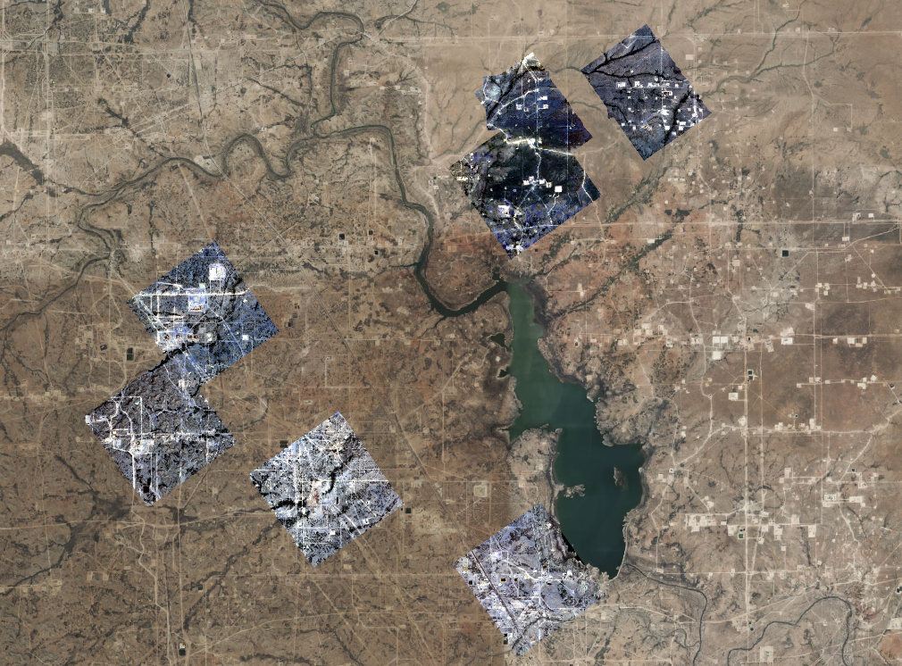
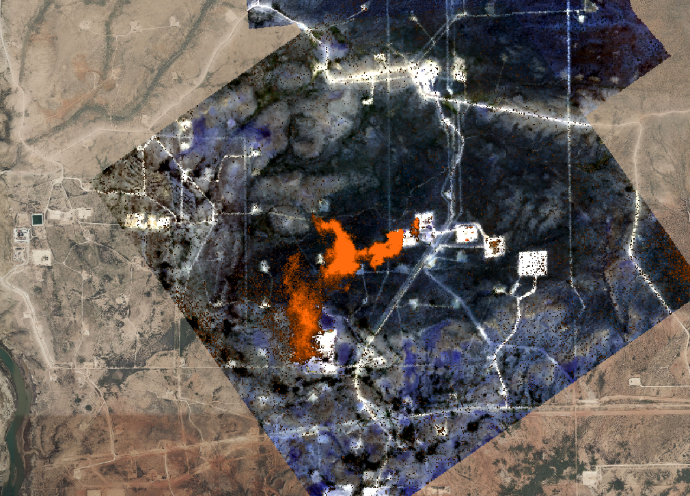
Experiment
Study Site
  Location: Carlsbad region, southeastern New Mexico, USA.
  Reason for Selection: Proximity to oil and gas extraction sites. Known methane emission sources
  Relevance: Aligns with goal of capturing methane plumes in generated hyperspectral replicas.
  Visualization:
    (a): Superimposed AVIRIS-NG flight data over desert setting.
    (b): Zoomed view showing roads, desert, sand, vegetation, buildings, and methane plume (orange).
(a)
(b)
S. Giri |IDETC-CIE 2025| Anaheim, CA
12

Slide 14
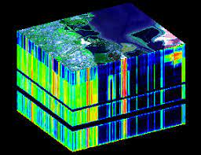
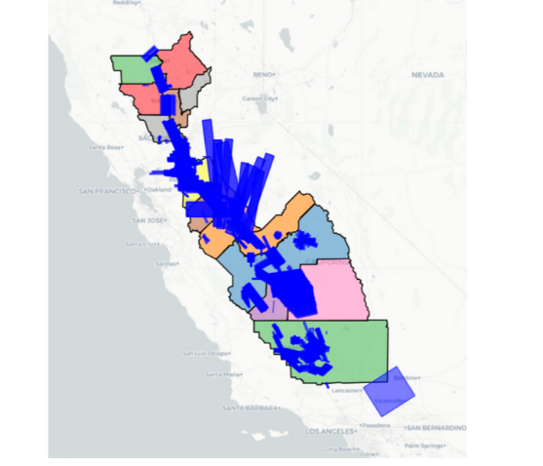
Experiment
Data Preprocessing
  Data Selection:
    Flight paths from 2019 (abundant methane emissions [14]).
    Extracted 8 bands (out of 425).
  Reason for Band Selection:
    Covers RGB (460, 550, 640 nm) and SWIR (2004, 2109, 2310, 2350, 2360 nm).
    Captures material signatures in selected flight paths.
    Reduces dataset complexity and computation time.
  Spatial Preprocessing:
    Resized to 512 × 512 pixels.
    Total 56 tiles (512 × 512 × 8).
    50 tiles for training, 6 tiles for testing.
  Input Preparation:
    RGB bands extracted and fed to generator network.
    Dataset size ≈ 0.5 GB.
[14] R˘užička, Vít, Mateo-Garcia, Gonzalo, Gómez-Chova, Luis,Vaughan, Anna, Guanter, Luis and Markham, Andrew. “Semantic segmentation of methane plumes with hyperspectral machine learning models.” Scientific Reports Vol. 13 No. 1(2023): p. 19999
S. Giri |IDETC-CIE 2025| Anaheim, CA
13

Slide 15
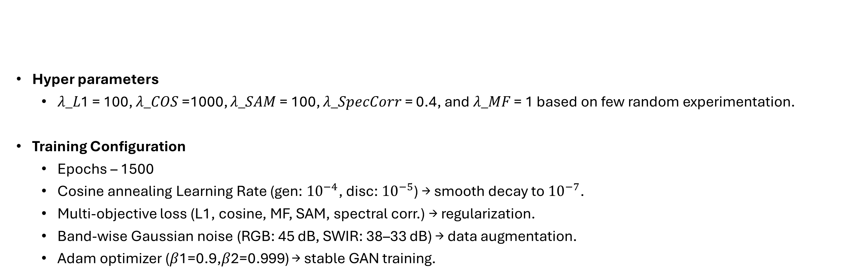
Experiment
  Hyper parameters
    𝜆_𝐿1 = 100, 𝜆_𝐶𝑂𝑆 =1000, 𝜆_𝑆𝐴𝑀 = 100, 𝜆_𝑆𝑝𝑒𝑐𝐶𝑜𝑟𝑟 = 0.4, and 𝜆_𝑀𝐹 = 1 based on few random experimentation.
  Training Configuration
    Epochs – 1500
    Cosine annealing Learning Rate (gen: ${10}^{−4}$, disc: ${10}^{−5}$) → smooth decay to ${10}^{−7}$.
    Multi-objective loss (L1, cosine, MF, SAM, spectral corr.) → regularization.
    Band-wise Gaussian noise (RGB: 45 dB, SWIR: 38–33 dB) → data augmentation.
    Adam optimizer (𝛽1=0.9,𝛽2=0.999) → stable GAN training.
Experimental Setup
S. Giri |IDETC-CIE 2025| Anaheim, CA
14

Slide 16
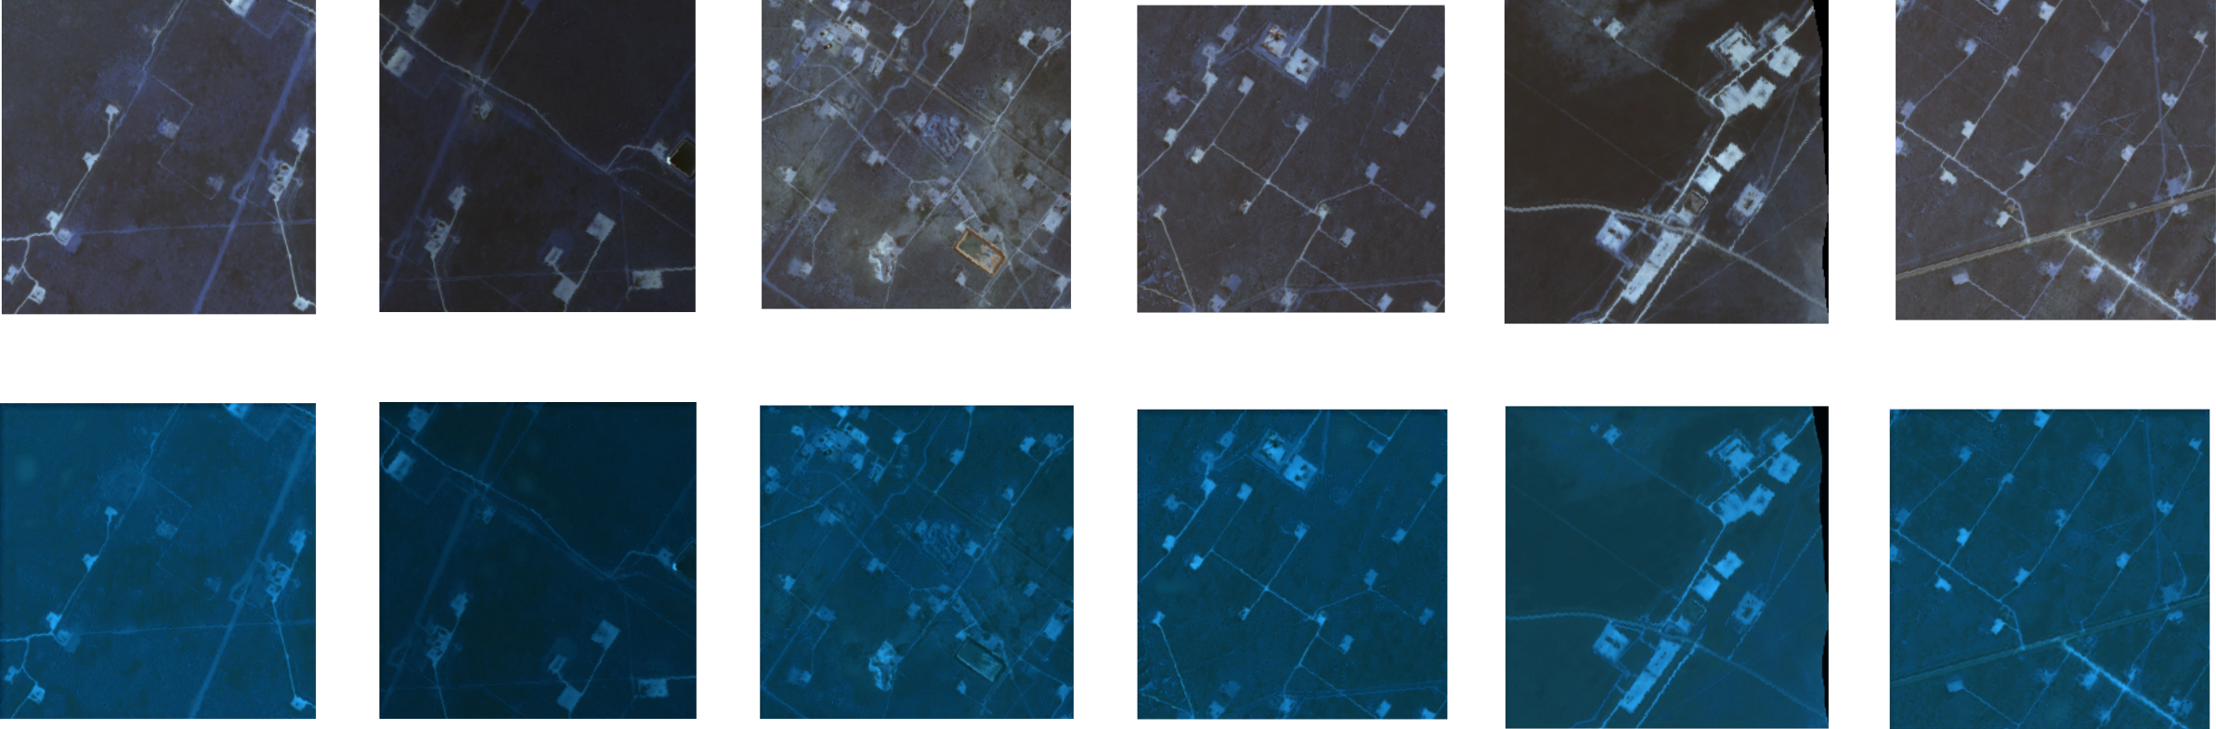
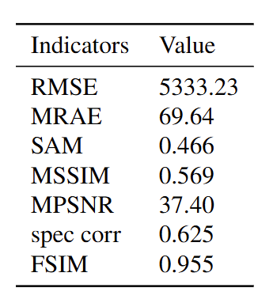
Experiment
Results and Discussions
  RMSE & MRAE → Indicate pixel-level reconstruction remains challenging due to high dimensionality, dynamic range of the data, noise added and the diversity of material types.
  SAM → Low angular error shows good spectral fidelity between generated and reference spectra.
  MSSIM → Moderate structural similarity, meaning spatial patterns are partly preserved.
  MPSNR → Acceptable signal-to-noise ratio, ensuring reconstruction quality is not degraded by noise.
  Spectral Correlation → Demonstrates preserved inter-band relationships critical for hyperspectral consistency.
  FSIM → Very high value, confirming excellent perceptual quality and retention of fine features.
  The model achieves strong spectral fidelity and perceptual consistency, with room for improvement in pixel-wise accuracy.
  A solid benchmark for lightweight AVIRIS-NG hyperspectral synthesis.
S. Giri |IDETC-CIE 2025| Anaheim, CA
15

Slide 17


Conclusion
Summary
Summary
  Proposed a physics-informed GAN framework for synthesizing AVIRIS-NG hyperspectral images.
  Leveraged RGB + SWIR bands, USGS spectral library(75 materials, including greenhouse gas), and matched filter loss for spectral fidelity.
  Achieved low SAM, high FSIM, and strong spectral correlation, confirming realistic spectral and perceptual reconstruction.
  Despite moderate RMSE/MRAE, results show physically plausible hyperspectral replicas.
  Curated dataset for AVIRIS-NG is proposed that uses only 8 selected spectral bands (from the original 425) to significantly reduce complexity and computation time, new benchmark dataset for HSI generation.
  Extend framework to all 425 AVIRIS-NG bands for full-spectrum synthesis.
  Apply advanced filtering techniques for improved reconstruction accuracy.
  Integrate material-specific filters (GHG, water, vegetation, etc.) for targeted detection.
  Explore scalability to real-time UAV/UGV deployment for field applications.
Future work
DATASET
TRAINED MODEL
S. Giri |IDETC-CIE 2025| Anaheim, CA
16

Slide 18
References
[1] Laboratory, Jet Propulsion. “AVIRIS-NG.” National Aeronautics and Space Administration (NASA). URL: https://avirisng.jpl.nasa.gov/index.html.
[2] Jakubowski, Marek K., Pogorzala, David, Hattenberger, Timothy J., Brown, Scott D., and Schott, John R. “Synthetic data generation of high-resolution hyperspectral data using DIRSIG.” Imaging Spectrometry XII, Vol. 6661, pp. 153–163, 2007.
[3] Chang, Yu-Cherng Channing, Ren, Hsuan, Chang, Chein-I, and Rand, Robert S. “How to design synthetic images to validate and evaluate hyperspectral imaging algorithms.” Algorithms and Technologies for Multispectral, Hyperspectral, and Ultraspectral Imagery XIV, Vol. 6966, pp. 489–499, 2008.
[4] Badole, Anushree, Panda, Santosh K., Roberts, Dar A., Wagle, Christine F., Jandt, Randi R., and Bhatt, Uma S. “A novel method to simulate AVIRIS-NG hyperspectral image from Sentinel-2 image for improved vegetation/wildfire fuel mapping, boreal Alaska.” International Journal of Applied Earth Observation and Geoinformation, Vol. 112, p. 102891, 2022.
[5] Goodfellow, Ian, Pouget-Abadie, Jean, Mirza, Mehdi, Xu, Bing, Warde-Farley, David, Ozair, Sherjil, Courville, Aaron, and Bengio, Yoshua. “Generative adversarial networks.” Communications of the ACM, Vol. 63, No. 11, pp. 139–144, 2020.
[6] Audebert, Nicolas, Le Saux, Bertrand, and Lefèvre, Sébastien. “Generative adversarial networks for realistic synthesis of hyperspectral samples.” IGARSS 2018: IEEE International Geoscience and Remote Sensing Symposium, pp. 4359–4362, 2018.
[7] Computational Intelligence Group, University of the Basque Country. “Hyperspectral Remote Sensing Scenes: Pavia Centre and University.” (2024). URL: https://www.ehu.eus/ccwintco/index.php/Hyperspectral_Remote_Sensing_Scenes#Pavia_Centre_and_University.
[8] Baumgardner, Marion, Biehl, Larry, and Landgrebe, David. “220 band AVIRIS hyperspectral image data set: June 12, 1992 Indian pine test site 3.”
[9] Pang, Li, Cao, Xiangyong, Tang, Datao, Xu, Shuang, Bai, Xueru, Zhou, Feng, and Meng, Deyu. “Hisgen: A foundation model for hyperspectral image generation.” arXiv preprint arXiv:2409.12470, 2024.
[10] Liu, Liqin, Li, Wenyuan, Shi, Zhenwei, and Zou, Zhengxia. “Physics-informed hyperspectral remote sensing image synthesis with deep conditional generative adversarial networks.” IEEE Transactions on Geoscience and Remote Sensing, Vol. 60, pp. 1–15, 2022.
[11] Kuo, Shiao Didi, Schott, John R., and Chang, Chia Y. “Synthetic image generation of chemical plumes for hyperspectral applications.” Optical Engineering, Vol. 39, No. 4, pp. 1047–1056, 2000.
[12] Thorpe, Andrew K., Frankenberg, Christian, Thompson, David R., Duren, Riley M., Aubrey, Andrew D., Bue, Brian D., Green, Robert O., Gerilowski, Konstantin, Krings, Thomas, Borchard, Jakob, et al. “Airborne DOAS retrievals of methane, carbon dioxide, and water vapor concentrations at high spatial resolution: application to AVIRIS-NG.” Atmospheric Measurement Techniques, Vol. 10, No. 10, pp. 3833–3850, 2017.
[13] Foote, Markus D., Dennison, Philip E., Thorpe, Andrew K., Thompson, David R., Jongaramrungruang, Siraput, Frankenberg, Christian, and Joshi, Sarang C. “Fast and accurate retrieval of methane concentration from imaging spectrometer data using sparsity prior.” IEEE Transactions on Geoscience and Remote Sensing, Vol. 58, No. 9, pp. 6480–6492, 2020.
[14] Růžička, Vít, Mateo-García, Gonzalo, Gómez-Chova, Luis, Vaughan, Anna, Guanter, Luis, and Markham, Andrew. “Semantic segmentation of methane plumes with hyperspectral machine learning models.” Scientific Reports, Vol. 13, No. 1, p. 19999, 2023.
[15] ORNL DAAC. “AVIRIS-NG L2 Surface Reflectance Data Product.” URL: https://daac.ornl.gov/AVIRIS/guides/AVIRIS-NG_L2_Reflectance.html.
[16] Kokaly, Raymond F., Clark, Roger N., Swayze, Gregg A., Livo, K. Eric, Hoefen, Todd M., Pearson, Neil C., Wise, Richard A., Benzel, William M., Lowers, Heather A., Driscoll, Rhonda L., and Klein, Andrew J. “USGS Spectral Library Version 7.” U.S. Geological Survey, 2017.
[17] NASA Airborne Science Program. “COMEX Final Report: CO2 and Methane Experiment (COMEX).” NASA Technical Report, Document ID: 20190025386, 2019. URL: https://ntrs.nasa.gov/api/citations/20190025386/downloads/20190025386.pdf.
[18] Turin, George. “An introduction to matched filters.” IRE Transactions on Information Theory, Vol. 6, No. 3, pp. 311–329, 1960.
[19] Ronneberger, Olaf, Fischer, Philipp, and Brox, Thomas. “U-Net: Convolutional networks for biomedical image segmentation.” MICCAI 2015: 18th International Conference on Medical Image Computing and Computer-Assisted Intervention, pp. 234–241, 2015. Springer.
S. Giri |IDETC-CIE 2025| Anaheim, CA
17

Slide 19
Summary
THANK YOU
S. Giri |IDETC-CIE 2025| Anaheim, CA
18

