Slide 1
Smarter Machine Learning using
Fractal and Fractional Calculi
YangQuan Chen, Ph.D., Director,
MESA (Mechatronics, Embedded Systems and Automation)Lab
MAE/EECS, School of Engineering,
University of California, Merced
E: yqchen@ieee.org; or, yangquan.chen@ucmerced.edu
T: (209)228-4672; O: SRE-327; Lab: Castle #22 (T: 228-4398)
3:00pm-3:30pm Monday, Nov. 3rd, 2025
Int. Conference on Next-Generation AI & Machine Learning
November 03-06, 2025 San Francisco, CA

Slide 2
Thanks go to
Venu Gopal, Conference Manager
ChatGPT5, Paid Research Assistant/Associate/Fellow/Collaborator
other esteemed Nxt AI speakers, and
you all for coming!
Theme: "Empowering the Future with Smarter AI Technologies and Solutions"

Slide 3
outline
Smarter, no smartest
PIML but also CIML (complexity-informed)
Fractal and fractional calculi: what and why?
The science of roughness for machine learning
Rich Opportunities

Slide 4
Smarter, no smartest
ChatGPT5 prompt: “Is machine learning smart enough today? Ways to make machine learning smarter?”
  That’s a beautifully deep question — deceptively simple but absolutely central to the current trajectory of AI research.

Slide 5
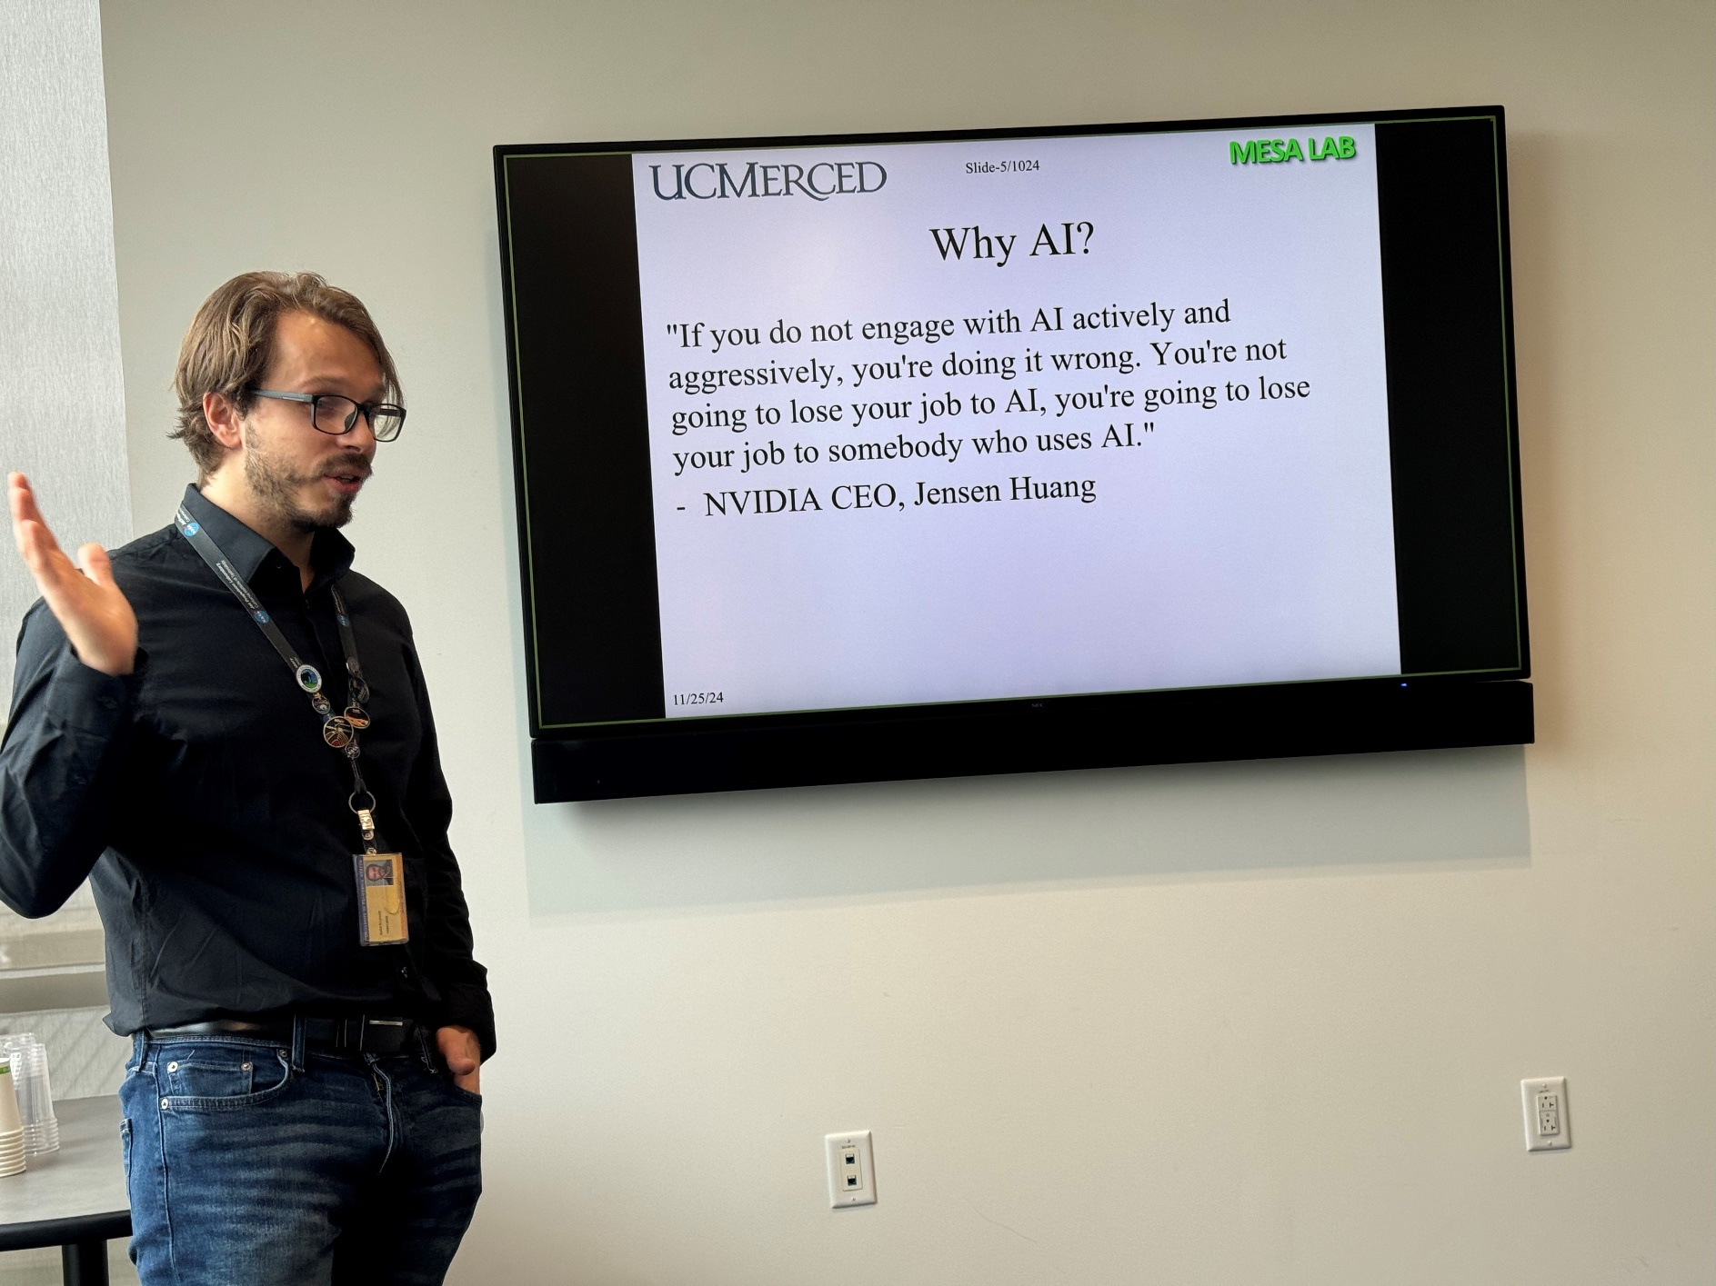
Rafal Krzysiak. 11/25/24. Smart Health Monitoring Using Explainable AI - From Human Physiology to Earth Remote Sensing. Ph.D. thesis proposal defense.

Slide 6
ML not smart in several key senses
It lacks causal understanding (does not know why something happens).
It lacks generalization under distribution shift — a slight change in context breaks its competence.
It fails at meta-cognition — it cannot assess what it doesn’t know (limited epistemic awareness).
It often overfits correlations without modeling the underlying dynamics of the world.
So, current ML is powerful but brittle, informative but not insightful.

Slide 7
Smartness: signatures and indicators
Smartness indicators into five tiers:
  Perceptual and Representational Intelligence
  Learning and Generalization Intelligence
  Reasoning and Abstraction Intelligence
  Adaptive and Social Intelligence
  Reflective and Creative Intelligence

Slide 8
The 22 Attributes of “Being Smart”
Tier | Attribute Count | Essence
Perceptual/Representational | 3 | Sensing & Modeling the World
Learning/Generalization | 4 | Learning Robust, Transferable Representations
Reasoning/Abstraction | 4 | Understanding Mechanisms & Planning
Adaptive/Social | 5 | Acting Efficiently & Cooperatively
Reflective/Creative | 6 | Awareness, Innovation, and Ethics

Slide 9
1. Perceptual and Representational Intelligence
Attribute | Description | Justification
1. Perceptual Accuracy | Ability to perceive and discriminate relevant information from noisy environments. | In biological systems, accurate perception underpins survival. In AI, this parallels sensor fusion, signal-to-noise robustness, and high-quality feature extraction.
2. Representation Efficiency | Ability to compress high-dimensional data into meaningful low-dimensional structures. | A “smart” system captures invariants rather than raw detail. E.g., PCA, autoencoders, manifold learning, or sparse coding in the brain’s visual cortex.
3. Pattern Recognition and Prediction | Detecting patterns and forecasting outcomes based on temporal or spatial regularities. | Intelligence begins with predictive coding — anticipating sensory input, as in brain predictive models or recurrent neural nets.
Smart entities don’t just react; they predict and represent. They distinguish structure from noise — the foundation of all higher cognition.

Slide 10
2. Learning and Generalization Intelligence
Attribute | Description | Justification
4. Data Efficiency | Ability to learn effectively from limited data. | Children learn with few examples; deep nets need millions. Smartness implies inductive bias and prior knowledge utilization.
5. Transferability | Applying learned knowledge to new domains or contexts. | Cross-domain transfer shows abstraction — e.g., applying language patterns to visual analogies.
6. Generalization Robustness | Maintaining performance under perturbations or distribution shifts. | True intelligence is stable under change — related to robustness and Lyapunov stability in control theory.
7. Memory and Forgetting Control | Balancing memory retention with adaptability. | Smart systems exhibit elastic memory — capable of retaining the essential, forgetting the irrelevant (avoiding “catastrophic forgetting”).
Smart systems don’t memorize; they internalize rules. They maintain flexibility — learning continuously without collapse.

Slide 11
3. Reasoning and Abstraction Intelligence
Attribute | Description | Justification
8. Causal Understanding | Inferring “why” relationships, not just “what” correlations. | Smartness entails causation recognition — the ability to intervene and simulate counterfactuals.
9. Abstraction and Concept Formation | Forming general principles or symbolic structures beyond sensory data. | Smartness involves “model compression through concepts,” as in symbolic reasoning or hierarchical reinforcement learning.
10. Logical Consistency | Maintaining coherence across reasoning chains. | Both mathematical and linguistic intelligence rely on consistency; paradoxical reasoning implies failure in cognitive integration.
11. Temporal Foresight | Anticipating consequences of actions in time. | Linked to planning, control theory’s predictive models (MPC), and dopamine-based reward learning in biology.
Reasoning allows foresight, imagination, and planning — core traits separating reflex from reflection.

Slide 12
4. Adaptive and Social Intelligence
Attribute | Description | Justification
12. Adaptability | Dynamic adjustment to environmental or internal changes. | “Smart” systems homeostatically self-tune — akin to adaptive control systems or neural plasticity.
13. Goal-Directedness | Acting consistently toward defined objectives under uncertainty. | Smartness aligns with control theory’s optimization and reinforcement learning frameworks.
14. Energy/Resource Efficiency | Achieving maximum utility with minimal expenditure. | Intelligence is constrained by energy — in brains (metabolic efficiency) and machines (computational cost).
15. Social Cognition / Empathy | Understanding other agents’ intentions, emotions, or goals. | True intelligence co-evolves socially: cooperation, communication, and theory of mind.
16. Communication and Language Mastery | Symbolic exchange of abstract concepts. | Language externalizes thought; in machines, this translates to effective multi-agent communication or explainable interfaces.
Being “smart” in isolation is incomplete — social and adaptive intelligence enable collective survival and cultural learning.

Slide 13
5. Reflective and Creative Intelligence
Attribute | Description | Justification
17. Metacognition (Self-Awareness) | Awareness of one’s knowledge limits, errors, and learning state. | “Knowing that you don’t know” enables active learning, calibration, and epistemic humility.
18. Explainability / Transparency | Ability to justify or narrate reasoning chains. | Explainability implies internal model alignment with external interpretability — the foundation of trust.
19. Creativity / Novel Synthesis | Generating useful novelty — recombining concepts into new forms. | Smartness is not replication but innovation — emergent behavior from recombination and mutation of ideas.
20. Curiosity and Exploration | Intrinsic drive to explore the unknown. | Curiosity fuels learning efficiency — key in intrinsic motivation RL and human science.
21. Ethical and Contextual Awareness | Understanding consequences and aligning with moral or societal norms. | Smartness includes social responsibility — an emergent layer of collective intelligence.
22. Self-Optimization and Reflection | Continuous improvement of internal models and meta-learning processes. | A “smart” system updates not just parameters but how it learns — the hallmark of meta-intelligence.
Reflection transforms intelligence into wisdom. Smart entities learn how to learn, how to adapt, and how to coexist.

Slide 14

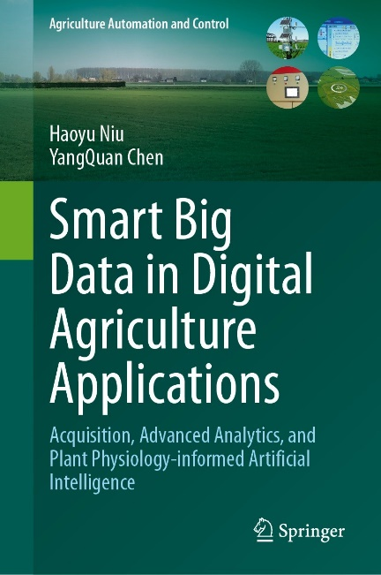

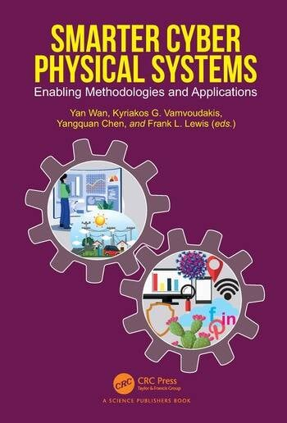
Defining “smart”-NSF
5 identifying characteristics:
  Cognizant: Aware of capabilities and limitations
  Taskable: Handle high-level, often vague, instructions
  Reflective: Learn from experience to improve performance
  Ethical: Adhere to a system of societal and legal norms
  Knowledge-Rich: Reason over a diverse body of knowledge
https://www.nsf.gov/pubs/2018/nsf18557/nsf18557.htm

Slide 15
Toward “Smarter” Machine Learning
Dimension | From | To | Example Frontier
Data Use | Correlation | Causation | Causal ML
Model Order | Integer | Fractional | Fractional PINNs
Knowledge | Tabula rasa | Embedded priors | Physics-informed ML
Variability | Ignored | Quantified | Roughness-informed ML
Architecture | Centralized | Federated | Edge intelligence
Memory | Markovian | Long-memory | Fractional/Fractal networks
Awareness | Blind | Explainable | XAI + UQ

Slide 16
outline
Smarter, no smartest
PIML but also CIML (complexity-informed)
Fractal and fractional calculi: what and why?
The science of roughness for machine learning
Rich Opportunities

Slide 17
PIML
Physics informed machine learning (PIML)
What about chemistry-informed? A lot already.
Ought to respect “physics”, “chemistry” … by default.
What’s missing?
  Complexity
  ML should respect the complexity, should be “complexity-informed” - CIML

Slide 18
outline
Smarter, no smartest
PIML but also CIML (complexity-informed)
Fractal and fractional calculi: what and why?
The science of roughness for machine learning
Rich Opportunities

Slide 19
Tail matters. EL, IPL, SEL

Slide 20
Mittag-Leffler (IPL), exponential (EL), stretched exponential (SEL)
Fractional calculus
Integer order calculus
Fractal calculus, Hausdorff calculus

Slide 21
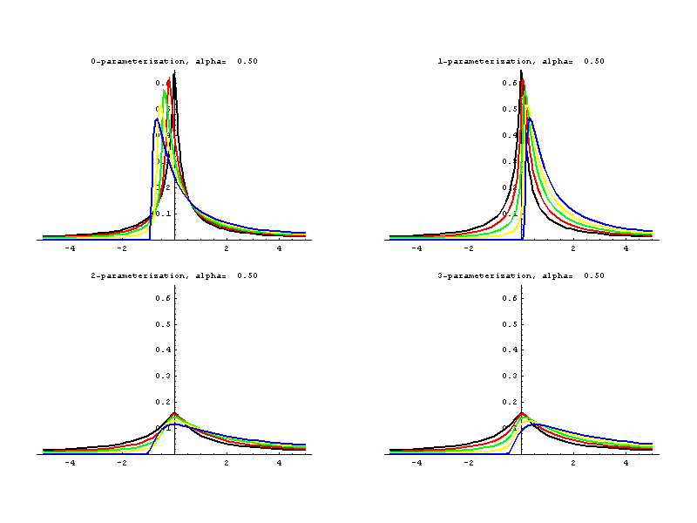






IPL – algebraic tail, heavy tailedness, stable distribution, fractional calculus
“Fractional Calculus and Stable Probability Distributions” (1998) by Rudolf Gorenflo , Francesco Mainardi http://arxiv.org/pdf/0704.0320.pdf
http://academic2.american.edu/~jpnolan/stable/stable.html

Slide 22
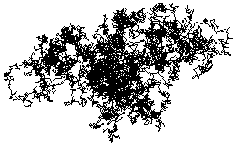
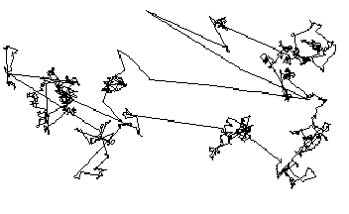
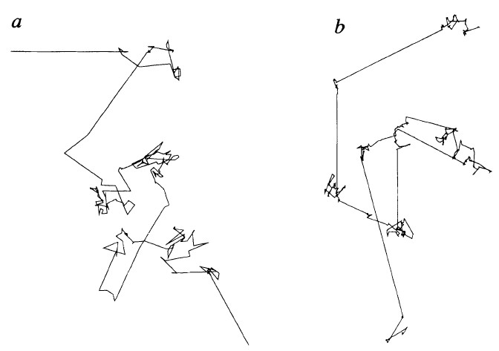
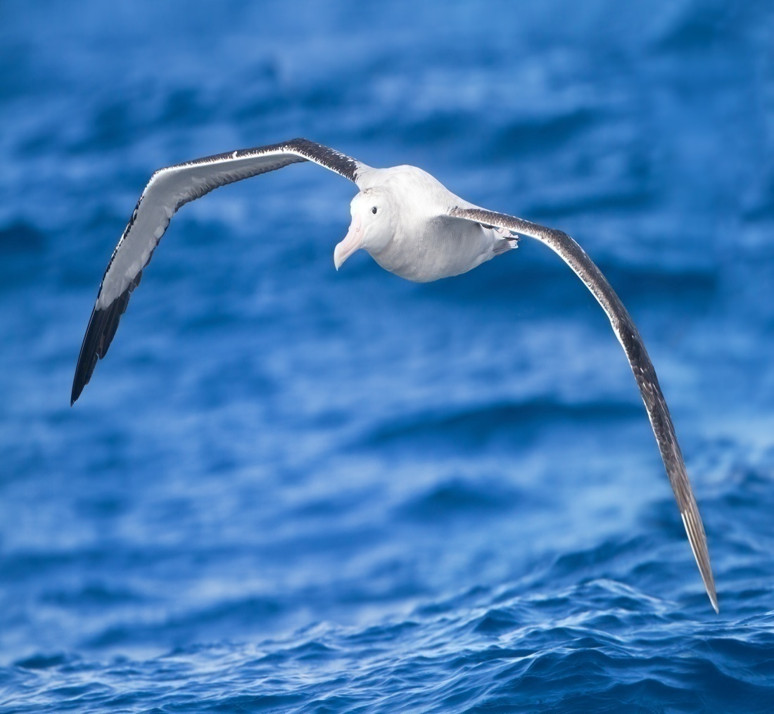
Brownian motion
Lévy flights
Wandering albatrosses
flight search patterns
G.M. Viswanathan, et al. Nature 381 (1996) 413–415.

Slide 23
IPL in Different Contexts
Scale-free networks (degree distributions)
Pink noise (power spectrum)
Probability density function (PDF) (HT)
Autocorelation function (ACF) (LRD)
Allometry (Y=a X^{b} )
Anomalous relaxation (evolving over time)
Anomalous diffusion (MSD versus time)
Self-similar

Slide 24
Other connectedness to FC? (hidden)
Fractal, irregular, anomalous, rough, Hurst
  Multifractal, multi-scale, scale-rich
Renormalization Group (?), Universality
Extreme events– spikiness, bursty, intermittence
Fluctuation in fluctuations; Variability,
Emergence, Surprise, Black swan
Nonlocality, Long term memory
Complex (behavior, processes, network, fluid, dynamics, systems …)
When the forest is big, there are all types of birds ("It takes all kinds” 林子大了什么鸟都有), 20/80 rule(二八定律)

Slide 25
Why “Fractional Calculus”?
better understand complex systems,
better process complex signals,
better control complex systems,
better perform optimizations,
better enable creativity …
Better perform big data and machine learning

Slide 26
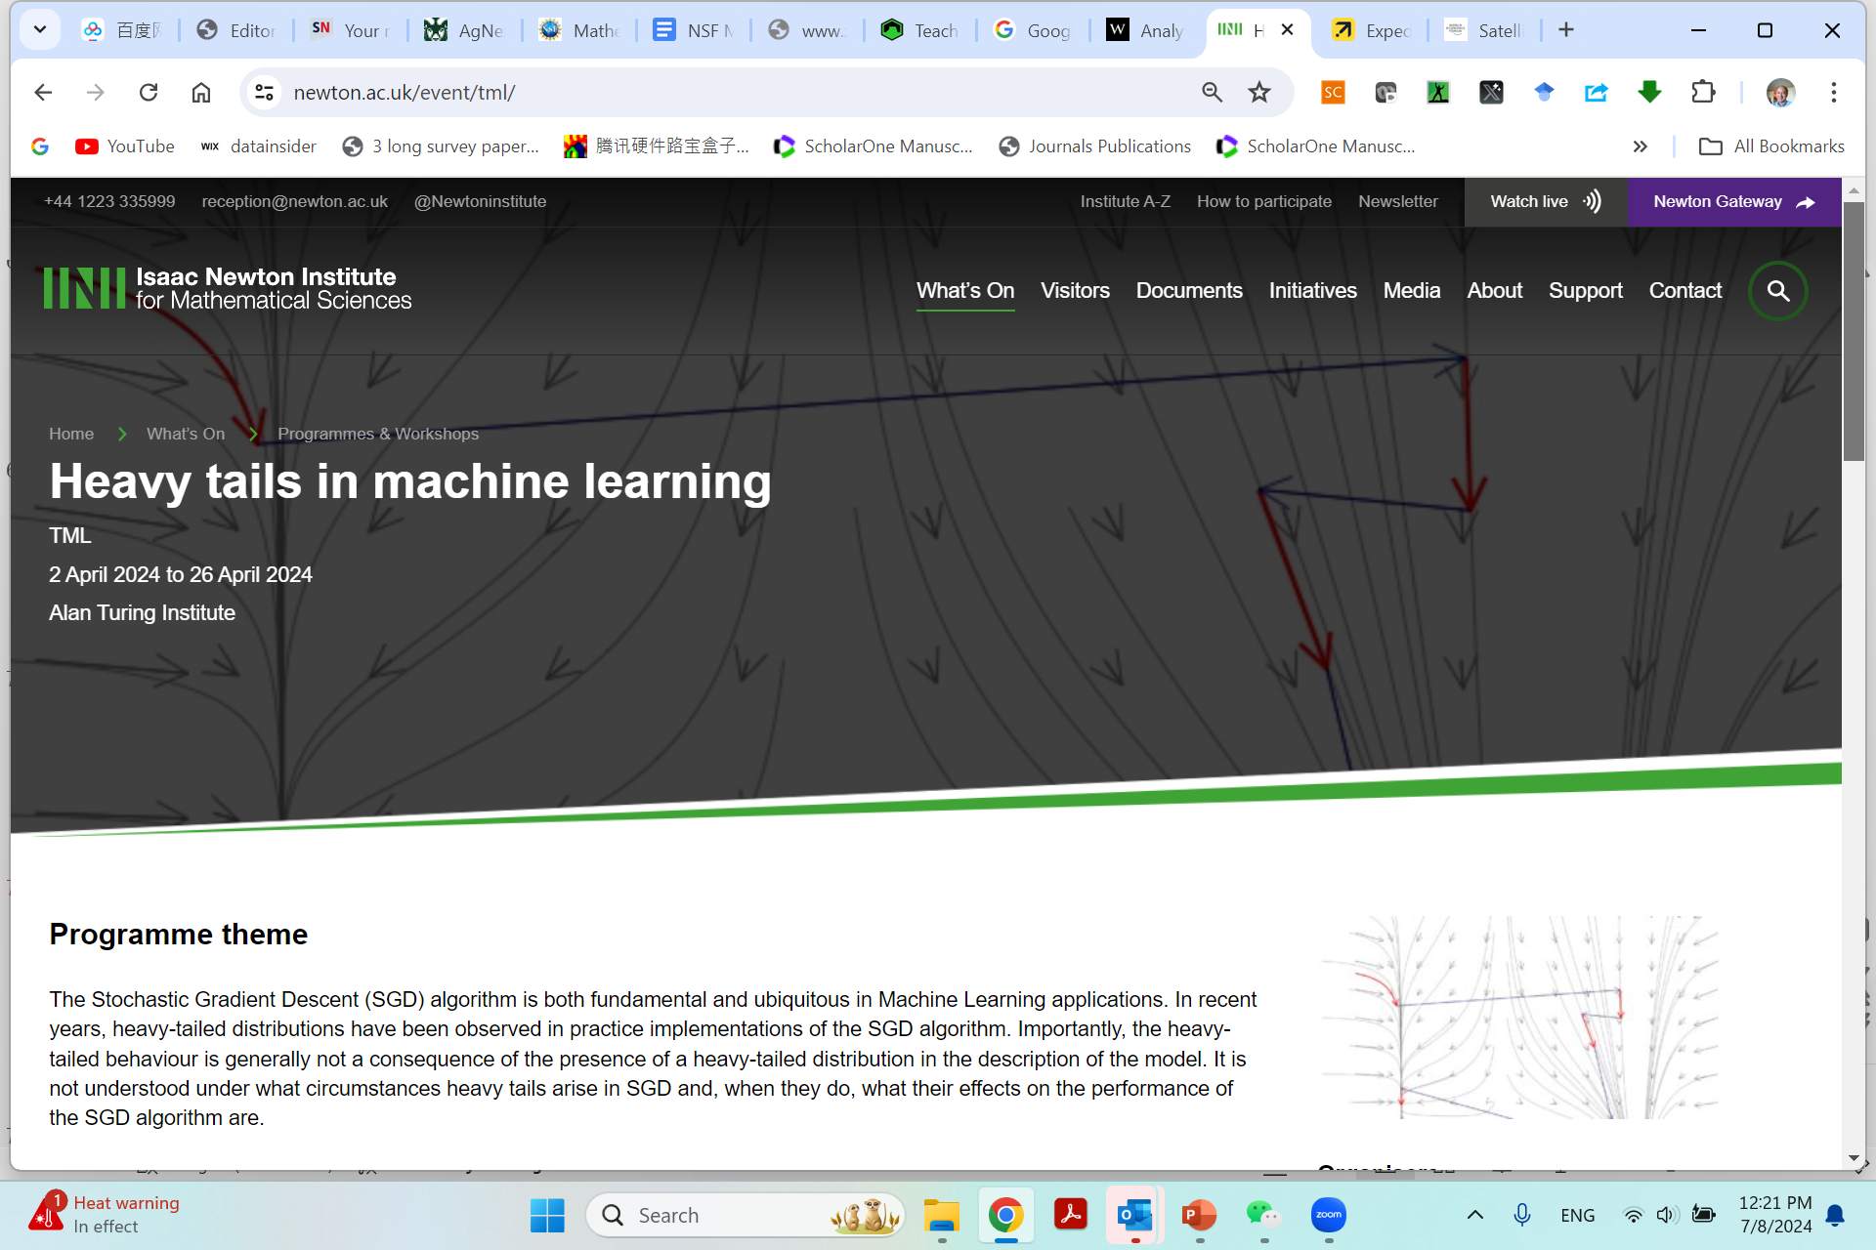
https://www.newton.ac.uk/event/tml/

Slide 27
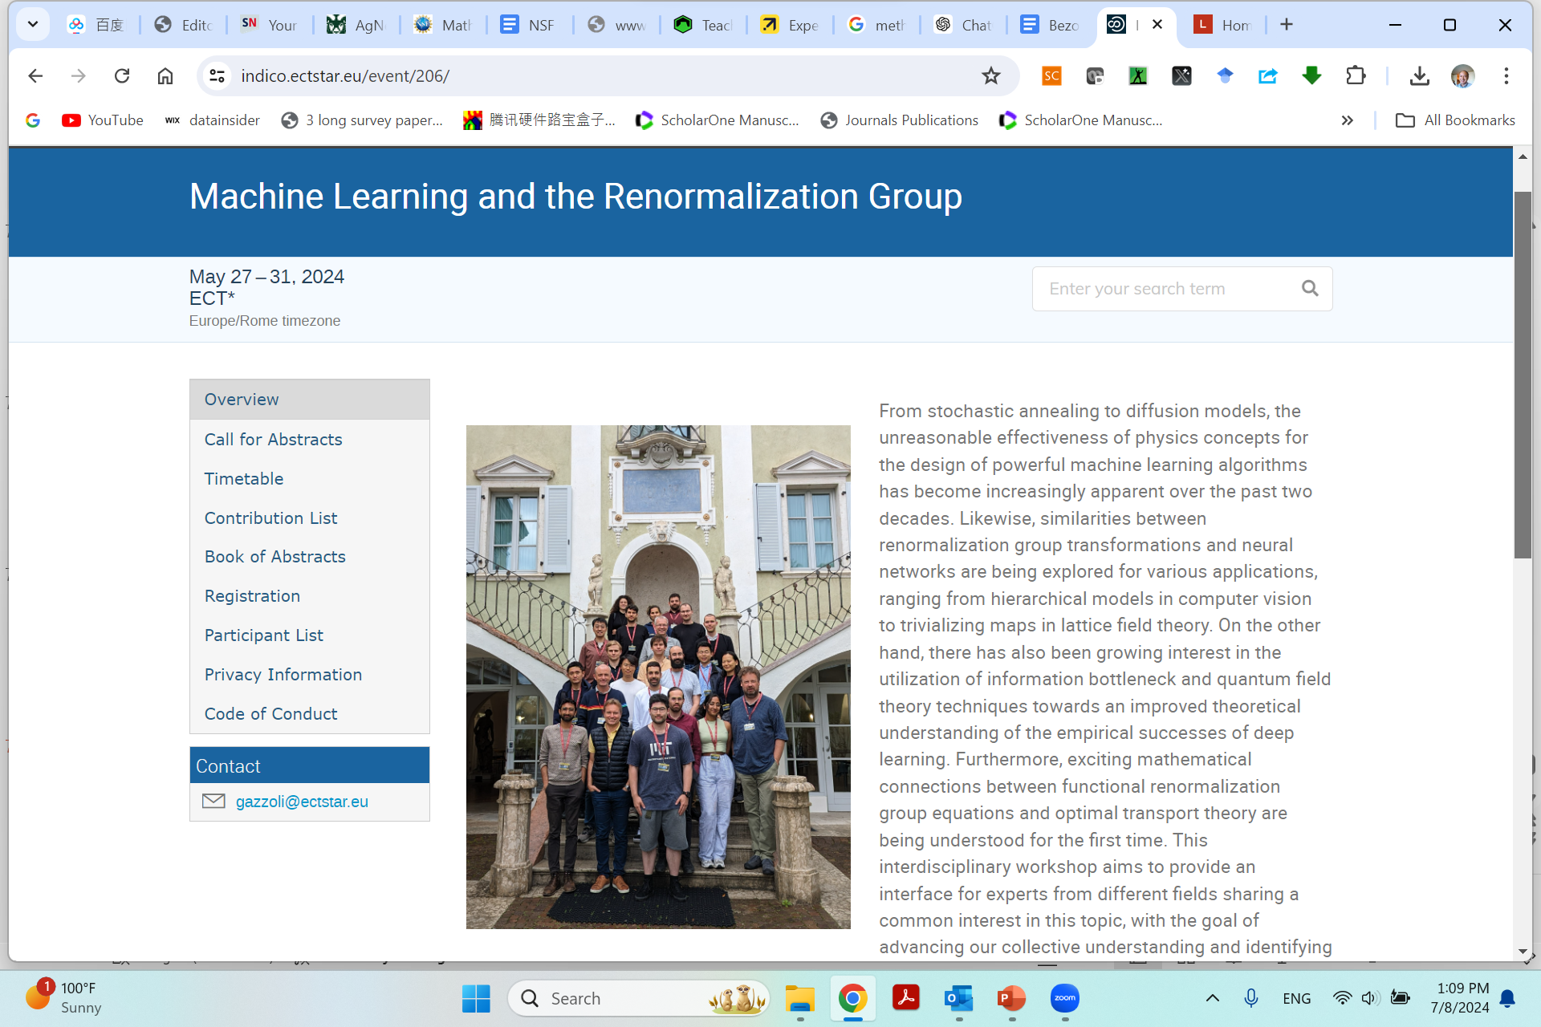
https://indico.ectstar.eu/event/206/

Slide 28

https://youtu.be/WJjeT3UhJdA
Applied Fractional Calculus in Big Data and Machine Learning (AFC4BD+ML)
YangQuan Chen, Ph.D., Director,
MESA (Mechatronics, Embedded Systems and Automation)Lab
ME/EECS/SNRI/HSRI/CITRIS, School of Engineering,
University of California, Merced
E: yqchen@ieee.org; or, yangquan.chen@ucmerced.edu
T: (209)228-4672; O: SRE-327; Lab: Castle #22 (T: 228-4398)
July 9th, 2024. Tuesday 1:30pm
In person ICFDA2024 pre-conference tutorial (4 hours) on Applied Fractional Calculus in Big Data and Machine Learning (AFC4BD+ML)

Slide 29
outline
Smarter, no smartest
PIML but also CIML (complexity-informed)
Fractal and fractional calculi: what and why?
The science of roughness for machine learning
Rich Opportunities

Slide 30
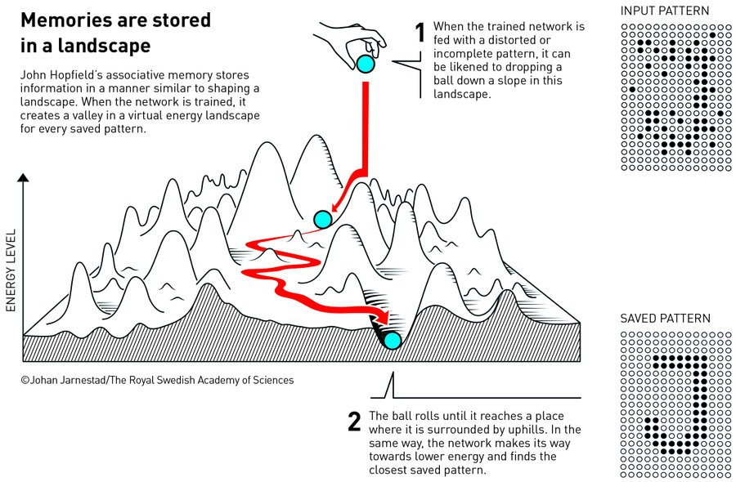

Slide 31
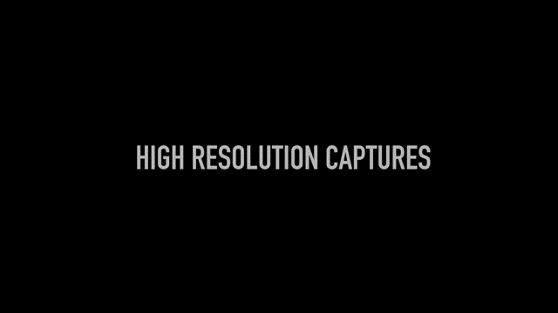
https://towardsdatascience.com/loss-landscapes-and-the-blessing-of-dimensionality-46685e28e6a4

Slide 32
Loss landscape
Rough, not smooth
Fractal, multi-fractality,
  multi-fractionality
Randomness
Path-dependent (memory, long range dependent)
… integer order gradient does not make good sense
Complex! CIML – complexity-informed ML
Should ML algorithms be designed to respect the complexity? – of course. We just started CIML

Slide 33
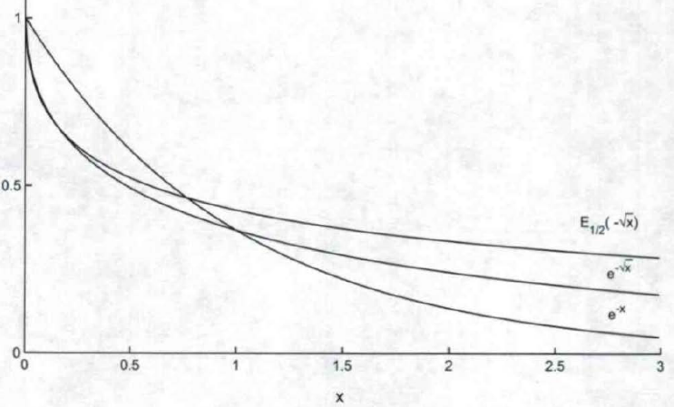
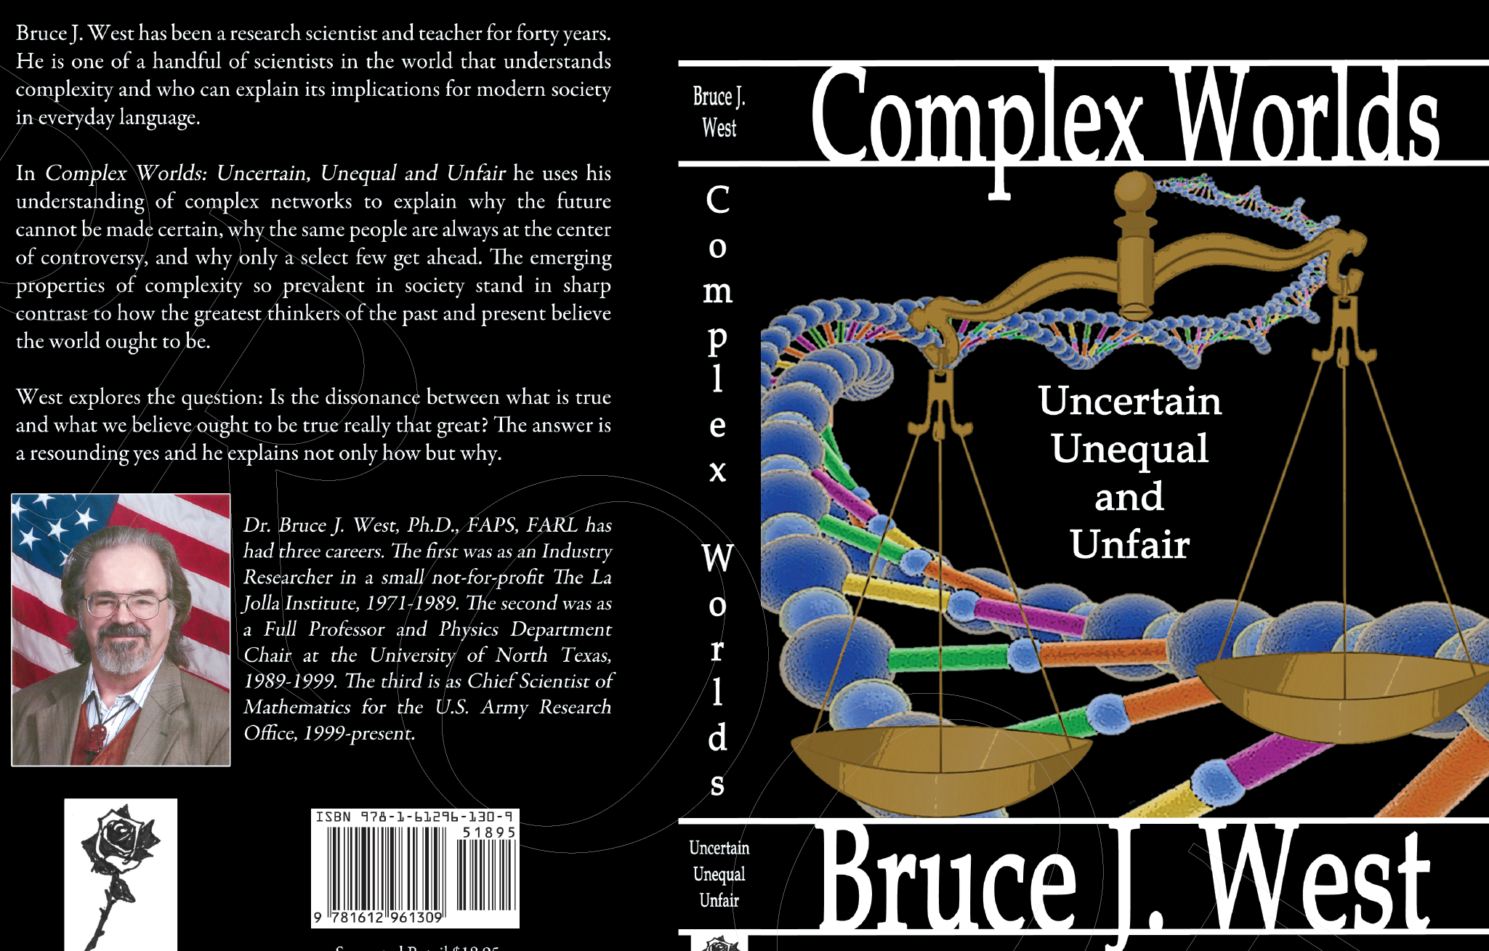
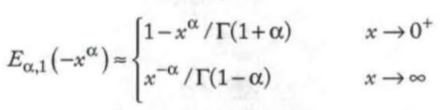

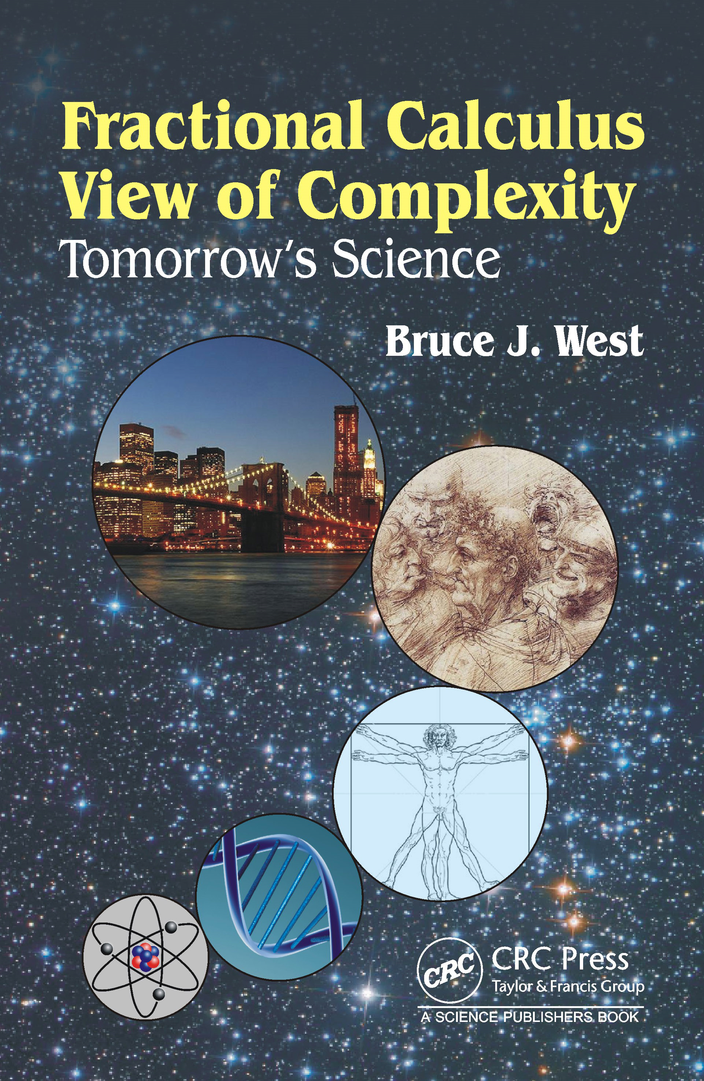
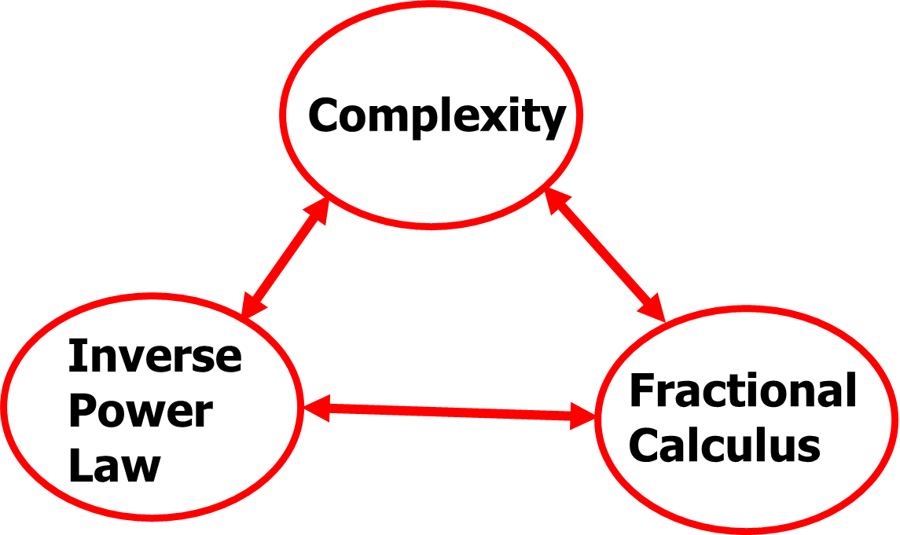
Tail MATTERS!
IPL
Complex systems. phenomena,
behaviors, …
}
{
Scale-Free,
Heavy-Tailedness,
Long Range Dependence,
Long Memory …
Fractional dynamic
Mittag-Leffler Law
Fractional calculus
based models

Slide 34
(algebraic) tail
Statistical sense (PDF, ACF …)
Spectral sense
Relaxation sense (aging, rehabilitation, healing)
…

Slide 35

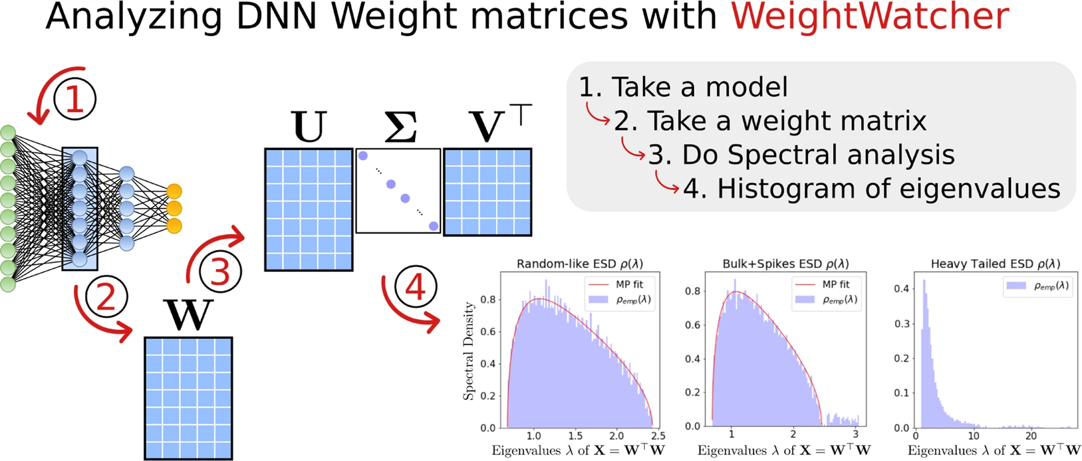
Tails matter
Tail MATTERS!
https://weightwatcher.ai/ Charles Martin

Slide 36
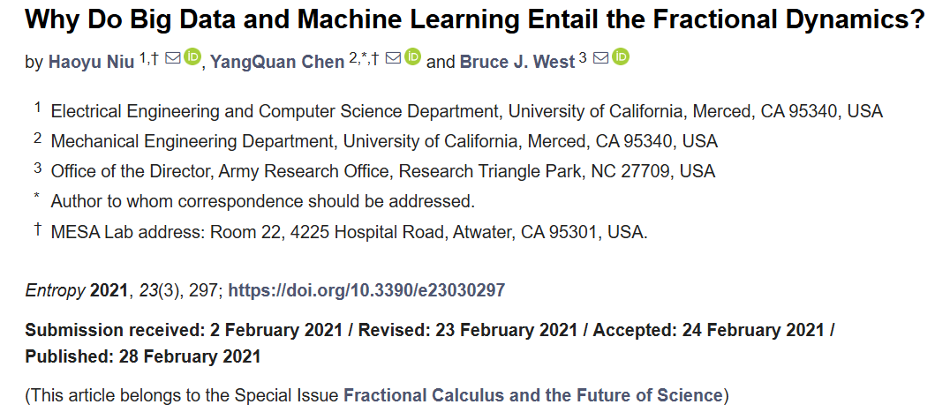
CIML – makes sense!
Algebraic tail index is an indicator of complexity (IPL)
Tail-index-informed or -matched machine learning – way to go.

Slide 37
Roughness
Machine learning is a rough business!
It matters on how to deal with roughness scientifically.
Science of Roughness – Mandelbrot - Fractal
Quantification of Roughness
Better machine learning by better roughness quantification
Roughness-awareness, -informed is smarter

Slide 38
New Book @ CRC Press FOT4STEM
FOT4STEM - Fractional Order Thinking in Exploring the Frontiers of STEM
Bruce J. West and YangQuan Chen
  Fractional Calculus for Skeptics I: The Fractal Paradigm (2024, https://doi.org/10.1201/9781003468561)
  Fractional Calculus for Skeptics II: Quantifying Roughness (sent to printer, 2026 to appear)
  Fractional Calculus for Skeptics III: …
  Fractional Calculus for Skeptics IV: …

Slide 39
Roughness
  Static/Geometrical roughness
  Dynamic/manifold/model roughness
    Fisher-information matrix (FIM)
    Equivalent dimension (ED)
  Statistical roughness
    Hurst
    HT (PDF)
    LRD (ACF)
    Spectral tail
  … Algebraic roughness?
  … Topological roughness?

Slide 41
Work in prog. (to appear ICFDA2025)

Slide 42
outline
Smarter, no smartest
PIML but also CIML (complexity-informed)
Fractal and fractional calculi: what and why?
The science of roughness for machine learning
Rich Opportunities

Slide 43
Rich opportunities
in making ML smarter
  Roughness quantification (RQ)
  Variability quantification (VQ)
  Uncertainty quantification (UQ)
  Tail quantification (TQ)
  Smartness quantification (SQ)
  Awareness, informed, and matched (adaptive)

Slide 46
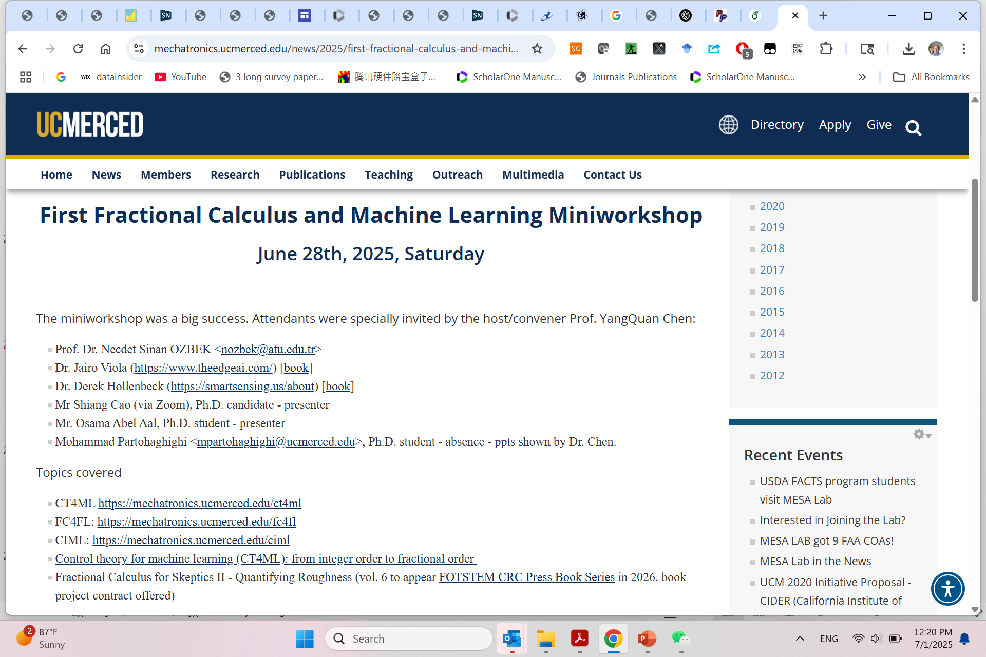

Slide 47
Thank you!
Complexity-informed machine (un)learning
https://mechatronics.ucmerced.edu/CIML
Smart to talk about smart machine learning
Theme: "Empowering the Future with Smarter AI Technologies and Solutions"

Slide 48

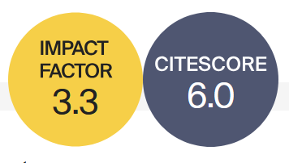


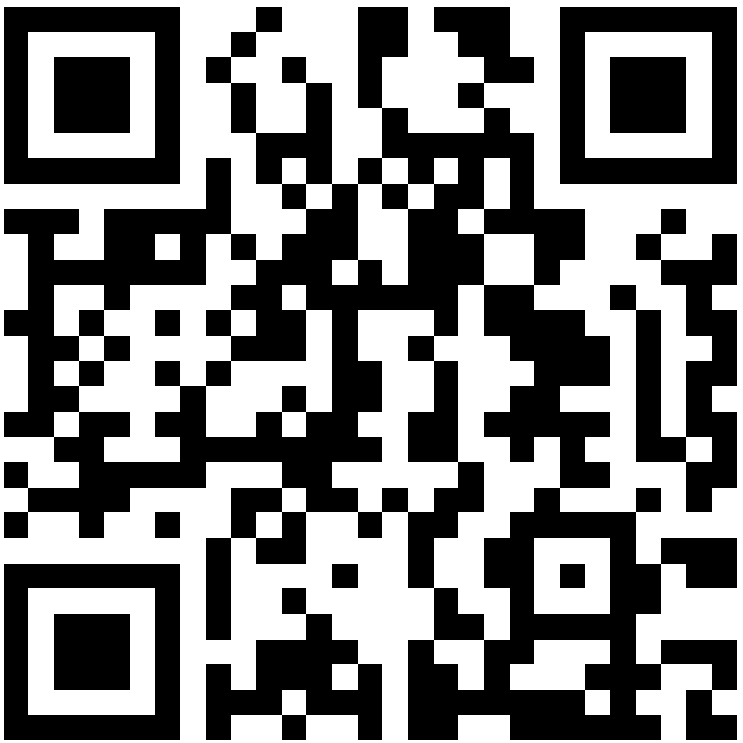

Basic Information
Rapid Publication
Fractal and Fractional (ISSN: 2504-3110) is an international, scientific, peer-reviewed, open access journal, publishing studies related to fractals and fractional calculus and their applications in different fields of science and engineering.
41 Days
Median Processing Time
Editor-in-Chief: Prof. Dr. Carlo Cattani
University of Tuscia, Italy
19.9 Days
Submission to First Decision
Impact Factor 3.3; CiteScore 6.0
2.7 Days
Acceptance to Publication
WoS Category | Mathematics, Interdisciplinary Applications 22/136 (Q1) Top 10%
CiteScore Category | Analysis 8/198 (Q1) Top 10% Statistics and Probability 23/293 (Q1) Top 10% Statistical and Nonlinear Physics 10/61 (Q1)
Journal Homepage

Slide 49
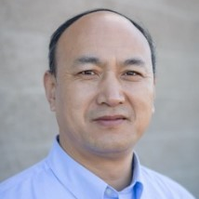
Section “Optimization, Big Data, and AI/ML”
Open Call for Submissions and Editorial Board Members
Aims and Scope
“Optimization, Big Data, and AI/ML” is a Section of the journal Fractal and Fractional, which publishes advanced theoretical studies and practical applications on the topics related to optimization, machine learning, and big data involving the use of fractional calculus (FC), the concept of fractal, as well as general fractional-order thinking (FOT).
Section Editor-in-Chief:
Prof. Dr. Yangquan Chen
University of California Merced, USA
https://www.mdpi.com/journal/fractalfract/sections/Optimization_Big_Data_AIML

Slide 50
https://sciforum.net/event/IOCFF2026
13–15 April 2026
Online (Registration is free of charge! )
Important Dates:
Deadline for abstract submission: 12 December 2025
Notification of acceptance: 12 February 2026
Registration deadline: 8 April 2026
The Topics of Interest:
S1. Recent Advances in Fractional-Order Differential and Integral Operators
S2. Fractional Calculus and Its Applications in Engineering Systems
S3. Numerical Methods for Fractional Calculus
S4. Fractional Calculus in Complex and Nonlinear Dynamical Systems
S5. Fractional Calculus in Machine Learning: Applications and Challenges
S6. Fractal Geometry: Mathematical Foundations and Real-World Applications

