Slide 1
Cal Maritime Academy, Vallejo, CA Applied Fractional Calculus Workshop Series
Tomas Oppenheim
MESA (Mechatronics, Embedded Systems and Automation)Lab
School of Engineering,
University of California, Merced
E: toppenheim@ucmerced.edu Phone: 310-853-9234
Lab: CAS Eng 820 (T: 228-4398)
July 28, 2014. Monday 4:00-6:00 PM
Applied Fractional Calculus Workshop Series @ MESA Lab @ UCMerced

Slide 2
Outline
Cal Maritime Academy
Campus Overview
Courses I will Teach
Future Plans

Slide 3
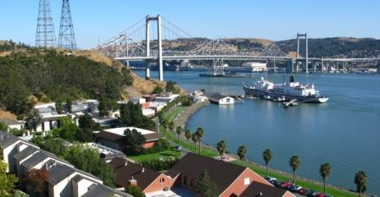
Cal Maritime Academy

Slide 4
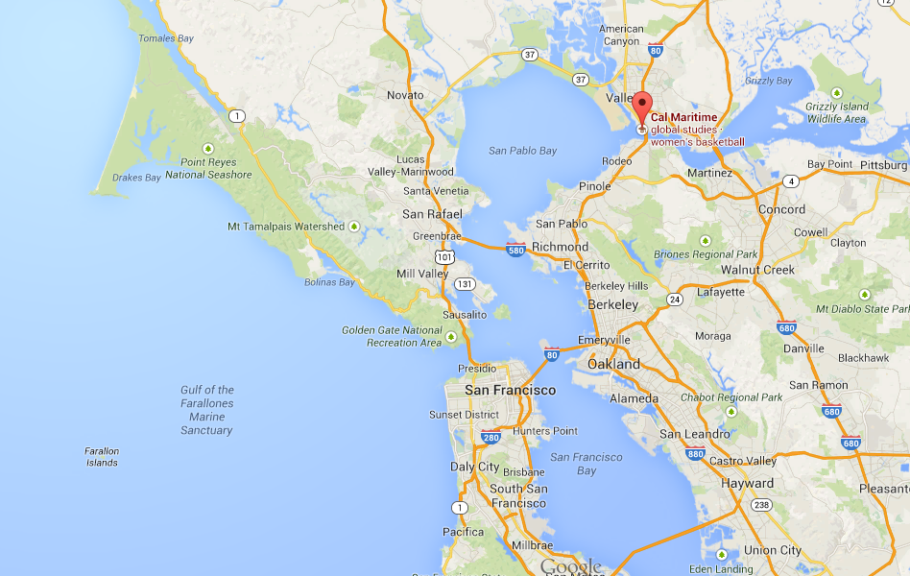
Cal Maritime Academy

Slide 5
Campus Overview
B.S. in Business Administration - International Business and Logistics
B.S. in Facilities Engineering Technology
B.A. in Global Studies & Maritime Affairs
B.S. in Marine Engineering Technology*
B.S. in Marine Transportation*
B.S. in Mechanical Engineering*
*Major includes a U.S. Coast Guard-issued unlimited license.
Quality, personalized teaching is provided with a student-to-faculty ratio of 14 to 1 and average class size of 22.
1100 Undergraduate Students

Slide 6
Courses I will Teach
Intro to Engineering Programming – MATLAB
Statics
Instrumentation and Measurement Systems
Intro to Materials Science

Slide 7
Future Plans
YEAR 1: teach to obtain tenure track
YEAR 2: teach and pursue research on side for tenure track position: open ended

