Slide 1
PEM fuel cell fractional order modeling and identification
Tiebiao Zhao
MESA (Mechatronics, Embedded Systems and Automation)Lab
School of Engineering,
University of California, Merced
E: tzhao3@ucmerced.edu Phone:2092015212
Lab: CAS Eng 820 (T: 228-4398)
Sep. 8, 2014. Monday 4:00-6:00 PM
Applied Fractional Calculus Workshop Series @ MESA Lab @ UCMerced

Slide 2
Outline
Equivalent electrical circuit model
Fractional order model of fuel cell
Identification of fractional order model’s parameters
Experimentation and results

Slide 3
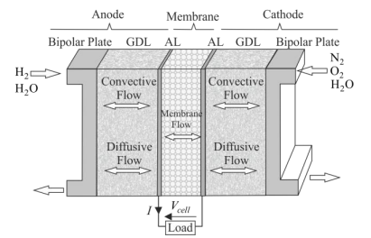
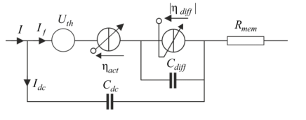
Equivalent electrical circuit model

Slide 4
The linearized model
The phase shift at high frequencies is
multiple of 90, the fuel cell impedance at high frequencies is characterized by a phase shift of 45°

Slide 5
Fractional model
Gas diffusion phenomena
Warburg impedance

Slide 6
The Warburg impedance is then given by:
Taylor series approximation
Fractional transfer function

Slide 7
Identification of fractional order model’s parameters
The first one involves having a prior knowledge of derivation orders and therefore estimating only the coefficients of the derivative operators by Least Square method for example
The second approach consists in estimating the coefficients and orders of the derivative operators, when unknown, by non-linear algorithms.
The third method estimates the derivative operators coefficients and only one derivation order named “commensurate fractional order”, as all other orders are integer multiples of the commensurate order.

Slide 8
Least square method adapted to fractional order model
Discretization of the continuous time fractional model
Linear formulation of the model by a change of variables
Estimation of the new parameters using the least square method
Return to the initial parameters by reversing the variable change

Slide 9
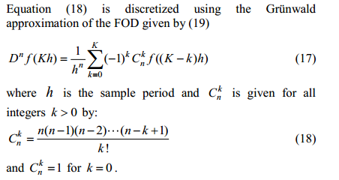
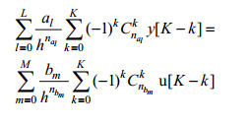
Model discretization

Slide 10
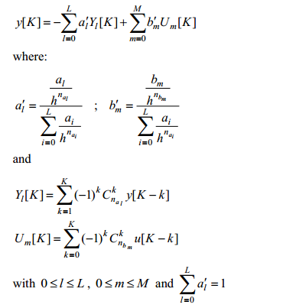
Linear form of the model

Slide 11
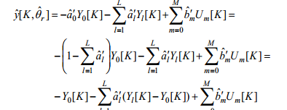
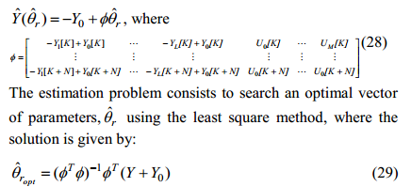
Parametric estimation

Slide 12
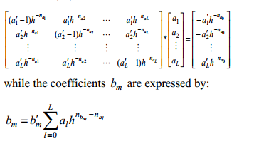
Inversion of the variable change

Slide 13
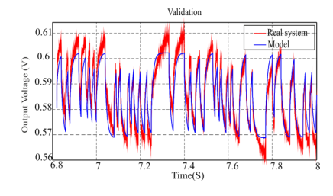
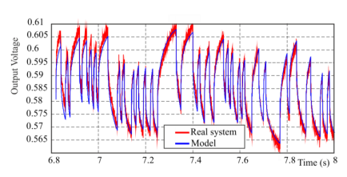
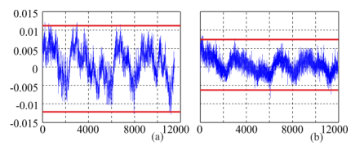
Experiments

Slide 14
Future work
Modeling on Lipo battery
Try different order
Time-varying fractional order model of battery

