Slide 1

Optimal way to optimize using optimized randomness and its connection to fractional calculus
Presenter: YangQuan Chen, Ph.D., Director,
Joint work with Jiamin Wei, Ph.D. Candidate
MESA (Mechatronics, Embedded Systems and Automation)Lab
ME/EECS/SNRI/HSRI/CITRIS, School of Engineering,
University of California, Merced
E: yqchen@ieee.org; or, yangquan.chen@ucmerced.edu
T: (209)228-4672; O: SE2-273; Lab: Castle #22 (T: 228-4398)
Hohai University, Thursday, August 8th, 2019

Slide 2
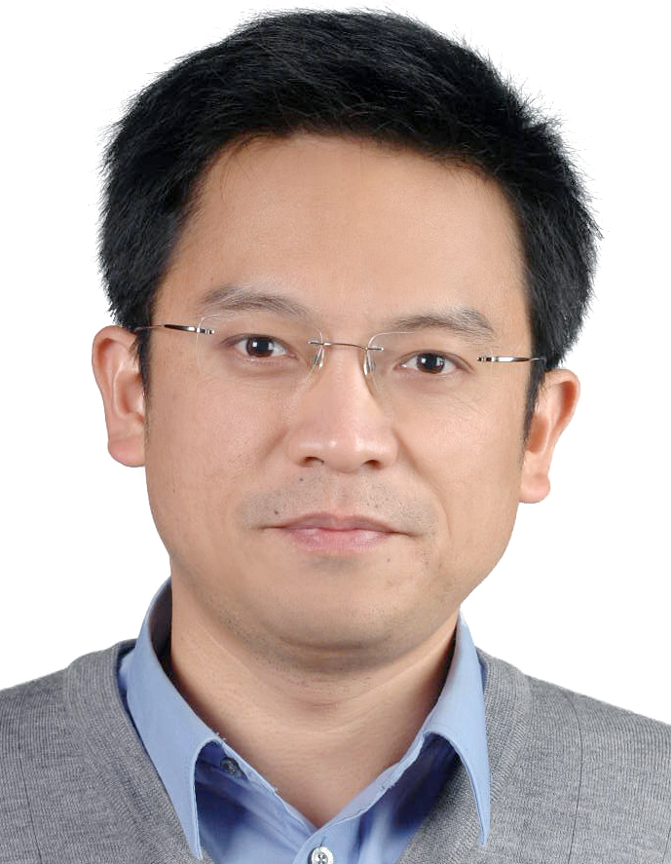
Wen Chen did not really leave us!

Slide 3
Thanks go to
Hongguang Sun for organizing this event
You all for coming!

Slide 4
Outline
Background
Optimal randomness in swarm-based search
Heavytailedness and its connection to fractional calculus
Conclusions & future topics

Slide 5
1. Background
Optimization has become more and more important in almost every discipline so far.
In practice, sophisticated optimization tools are required to solve certain optimization problems.
A lot of algorithms have been designed:
gradient-based algorithms,
simplex methods,
evolutionary algorithms,
swarm-based search algorithms.

Slide 6
GD and SGD

Slide 7

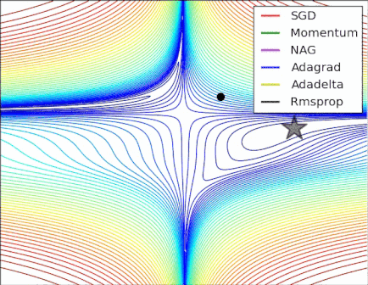
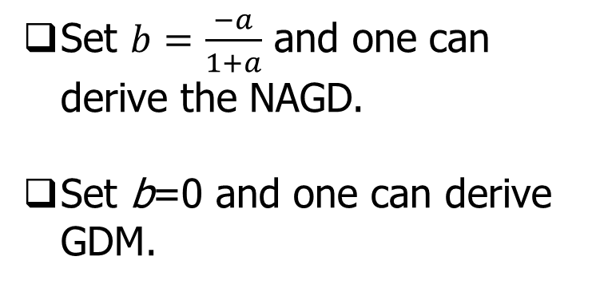
NAGD: Nesterov Accelerated GD
Set $b=\frac{−a}{1+a}$ and one can derive the NAGD.
Set b=0 and one can derive GDM.
https://stats.stackexchange.com/questions/179915/whats-the-difference-between-momentum-based-gradient-descent-and-nesterovs-acc

Slide 8
1. Background
Swarm-based search algorithms are based on swarm intelligence (SI), to imitate the various features of biological systems.
Swarm-based search algorithms have drawn excellent interest from scientists over the past two decades in the areas of optimization (complex and highly non-linear), data mining, machine learning.
Photos are from internet

Slide 9
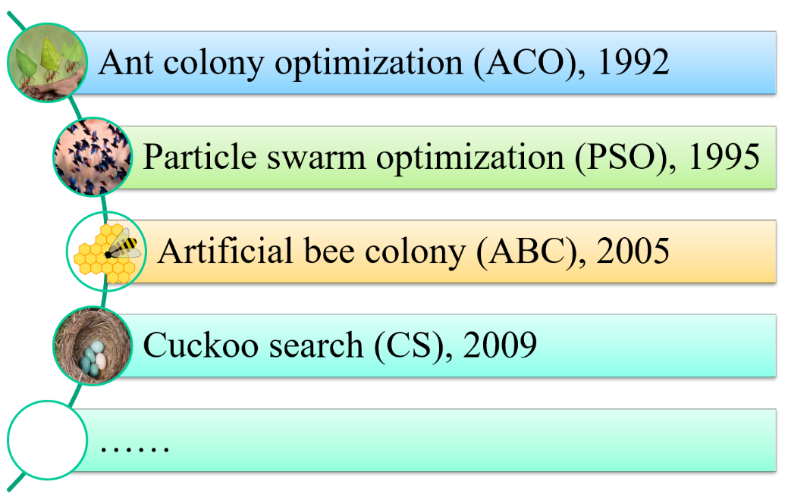
1. Background
The inspiration of swarm-based searches usually comes from nature, particularly biological systems.
For example,
ant colonies,
bird flocking,
foraging behavior of honey bee swarm,
brooding parasitism of cuckoo species.
Photos are from internet

Slide 10
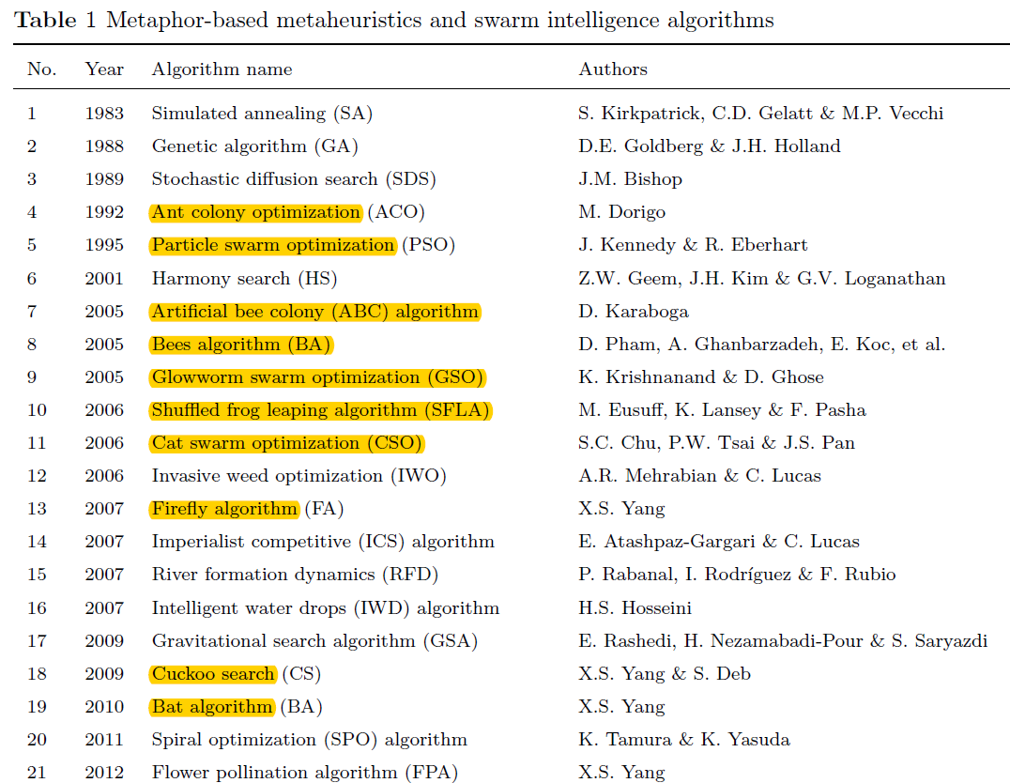
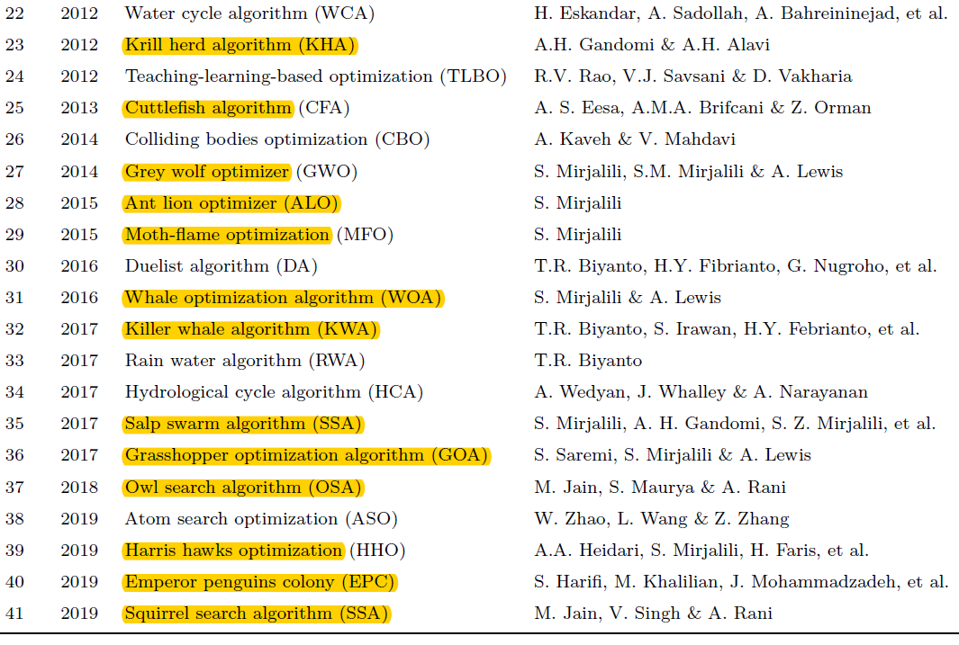
1. Background
Almost 22 kinds of swarm-based search algorithms so far using animal analogies.

Slide 11
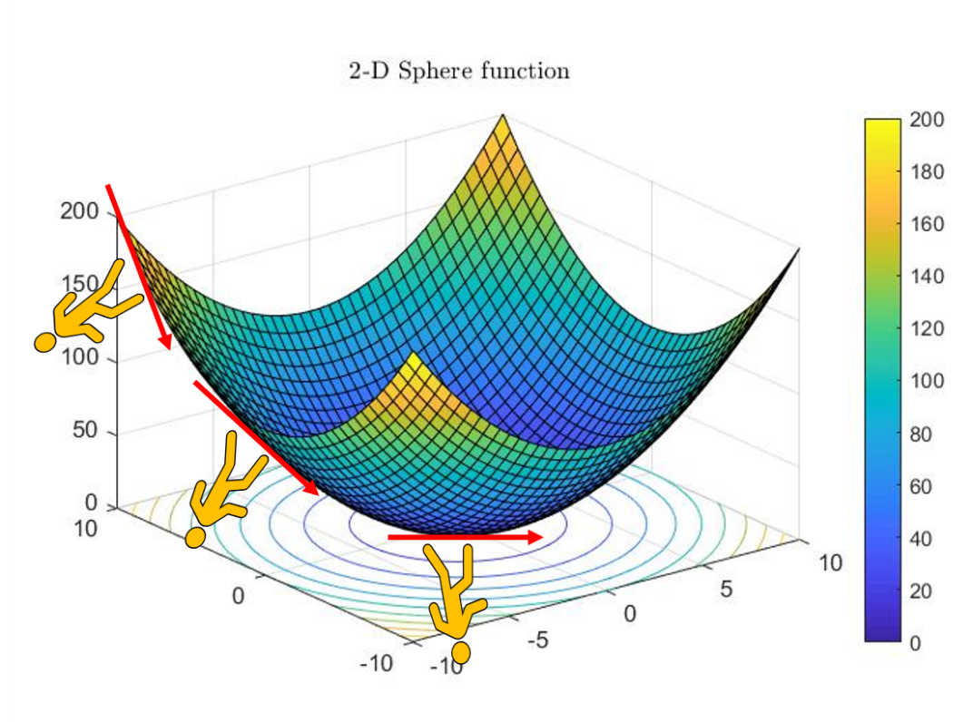
1. Background
Single agent search vs. swarm-based search
How can single agent searching find global optima using gradient descent?

Slide 12
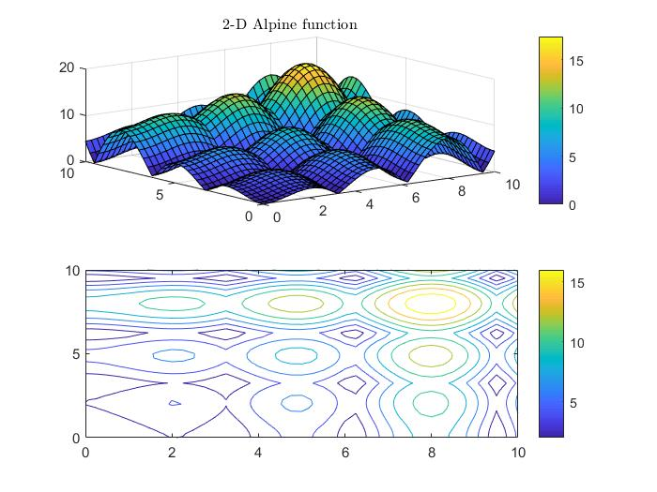
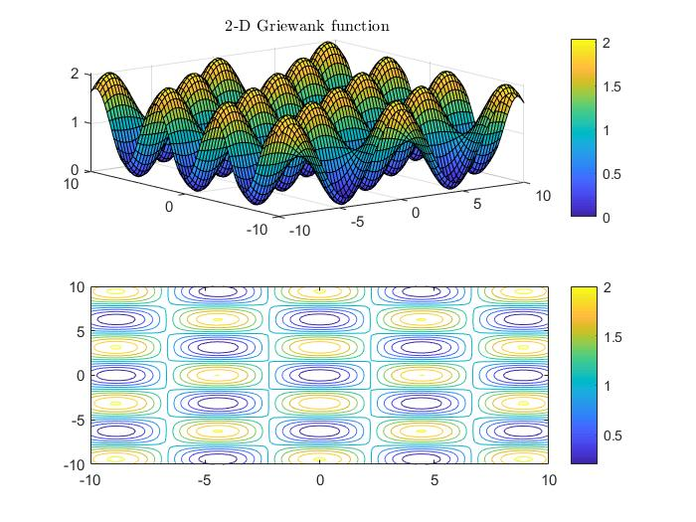
1. Background
Individual search vs. swarm-based search
What about these multi-modal, shifted, rotated, noisy and even discontinuous functions?

Slide 13
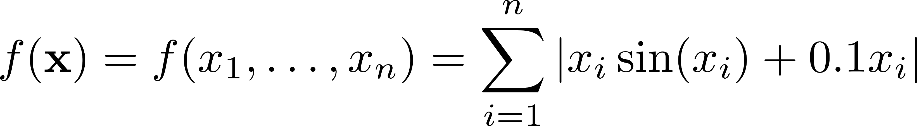
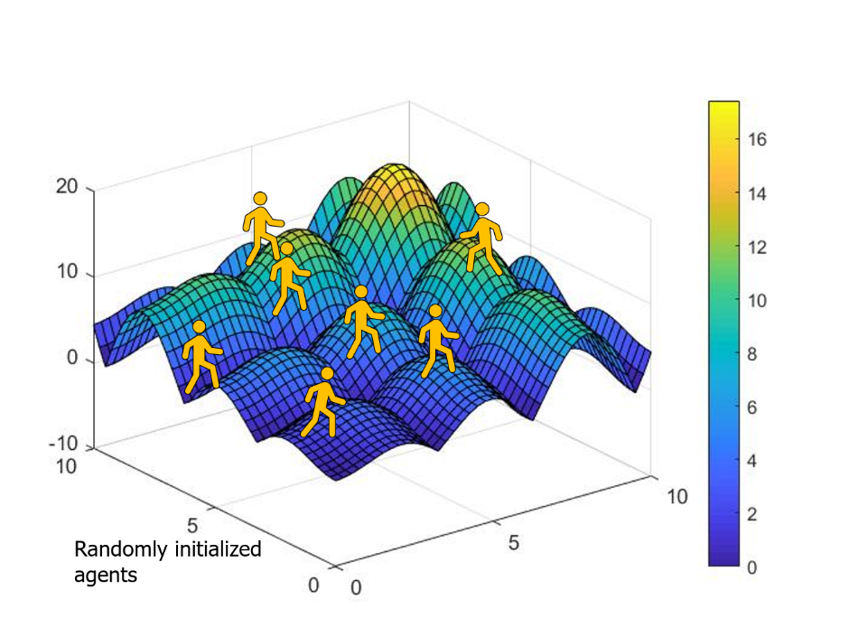
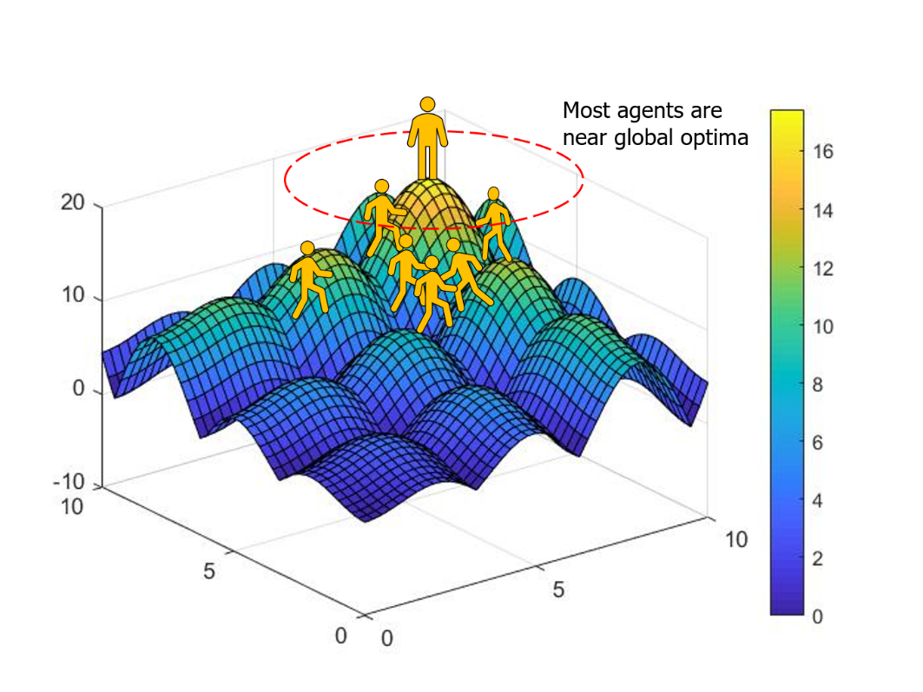
1. Background
Single agent search vs. swarm-based search
Take 2-D Alpine function for example.

Slide 14
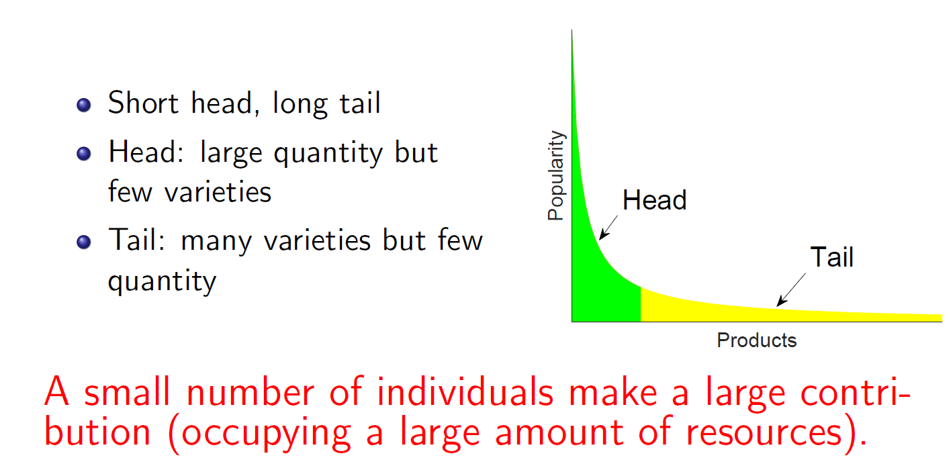
1. Background (continued)
What is the heavy-tailed distribution?

Slide 15
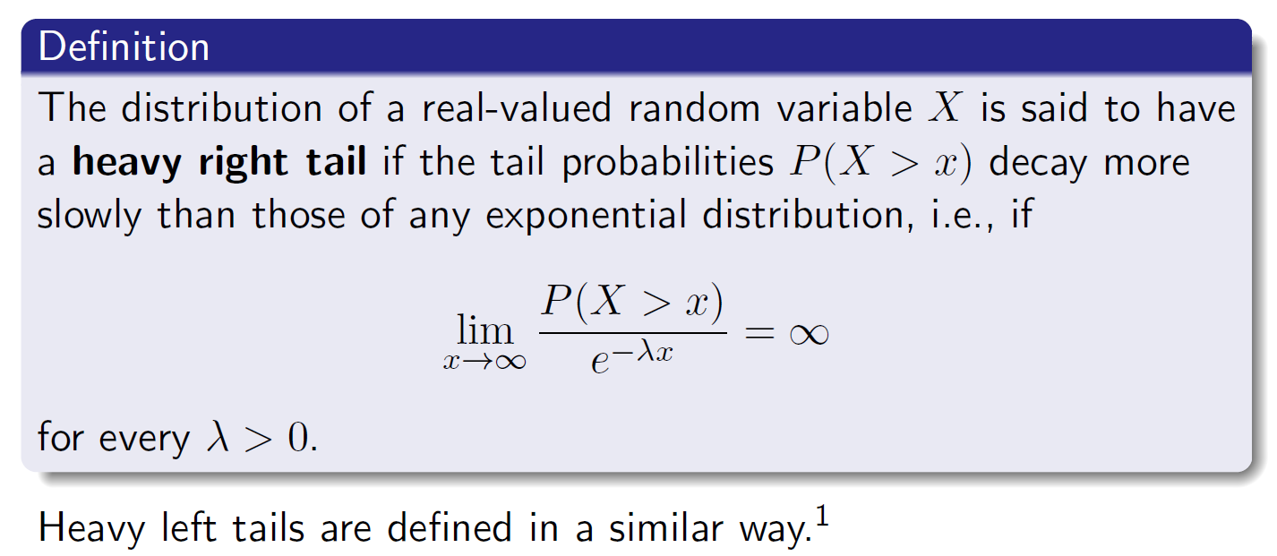
1. Background
Heavy tailed distribution
[1] Foss S, Korshunov D, Zachary S. An introduction to heavy-tailed and subexponential distributions[M]. New York: Springer, 2011.

Slide 16
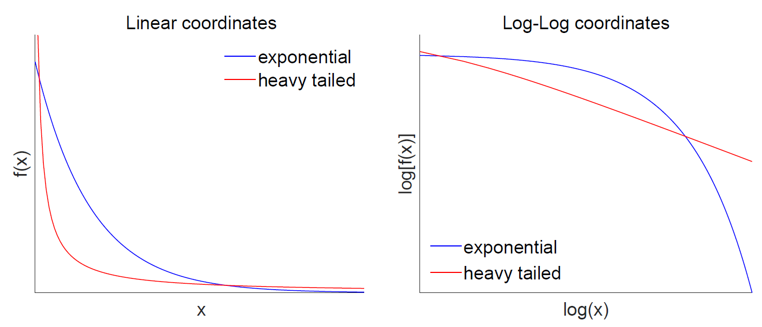
1. Background
Image of pdf

Slide 17
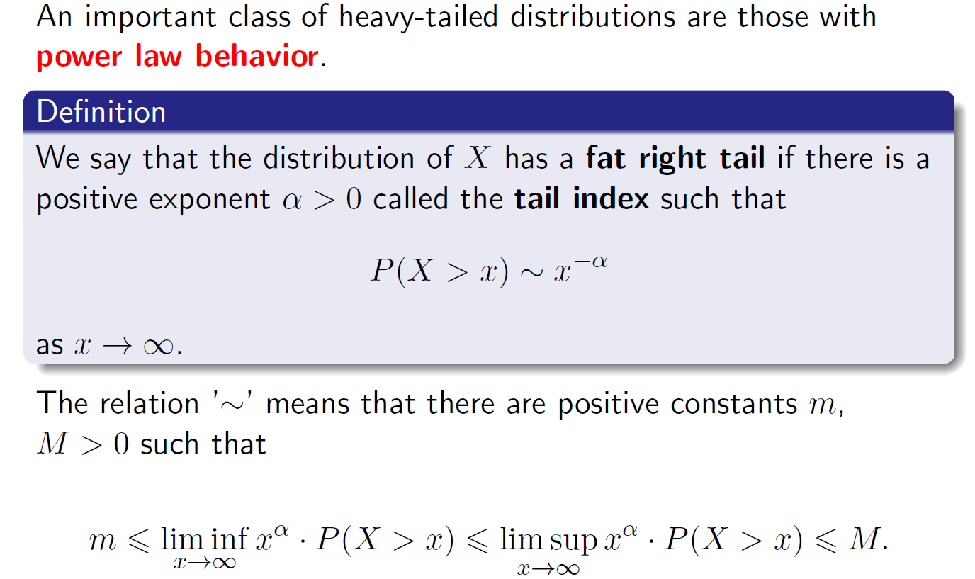
1. Background

Slide 18
1. Background
There are several commonly used heavy-tailed distributions:
Mittag-Leffler distribution
Pareto distribution.
Cauchy distribution
Weibull distribution
Burr distribution
lognormal distribution

Slide 19
micro
particle
inorganic
organic
life
CTRW etc
evolution
macro
F.C. and H.T. are mathematical substrates
cosmos
For both evolution (time) axis and scale axis axis

Slide 20
Key Take-home Messages
For all living matters, stochasticity contributes to the overall variations/variabilities and heavytailedness (HT) provides more variations/diversity for better chances in evolution (axis);
Intelligence is the consequence of the natural selection that (slowly) optimizes the foraging pattern towards HT, e.g., Lévy flight – an optimized randomness;
For the “new equation for AI”, HT must play a role so to provide more options and freedom in the future;
The cosmos universe is fractal. Non-Gaussian or algebraic tail or HT, lies in and across all scales.
From small particles to cosmos universe, from none-life to living matters, F.C. and H.T. are essential help for us to better understand them.

Slide 21
Outline
Background
Optimal randomness in swarm-based search
Heavytailedness and its connection to fractional calculus
Conclusions & future topics

Slide 22
2. Optimal randomness in swarm-based search
Exploration and exploitation are two important components in swarm-based search.
“Exploring unknown actions to gain more information versus exploiting the information already collected.” (Mohri et al., 2014, p.8)

Slide 23
2. Optimal randomness in swarm-based search
Exploration is often achieved by randomization or random numbers in terms of some predefined probability distributions.
Exploitation uses local information such as gradients to search local regions more intensively, and such intensification can enhance the rate of convergence.
What is the optimal randomness?
[1] Blum C, Roli A. Metaheuristics in combinatorial optimization: Overview and conceptual comparison[J]. ACM computing surveys (CSUR), 2003, 35(3): 268-308.
[2] Yang X S, He X S. Mathematical foundations of nature-inspired algorithms[J]. 2019.

Slide 24
2. Optimal randomness in swarm-based search
A Lévy flight, named for French mathematician Paul Lévy, is a random walk in which the step-lengths have a probability distribution that is heavy-tailed.
[1] Blum C, Roli A. Metaheuristics in combinatorial optimization: Overview and conceptual comparison[J]. ACM computing surveys (CSUR), 2003, 35(3): 268-308.

Slide 25
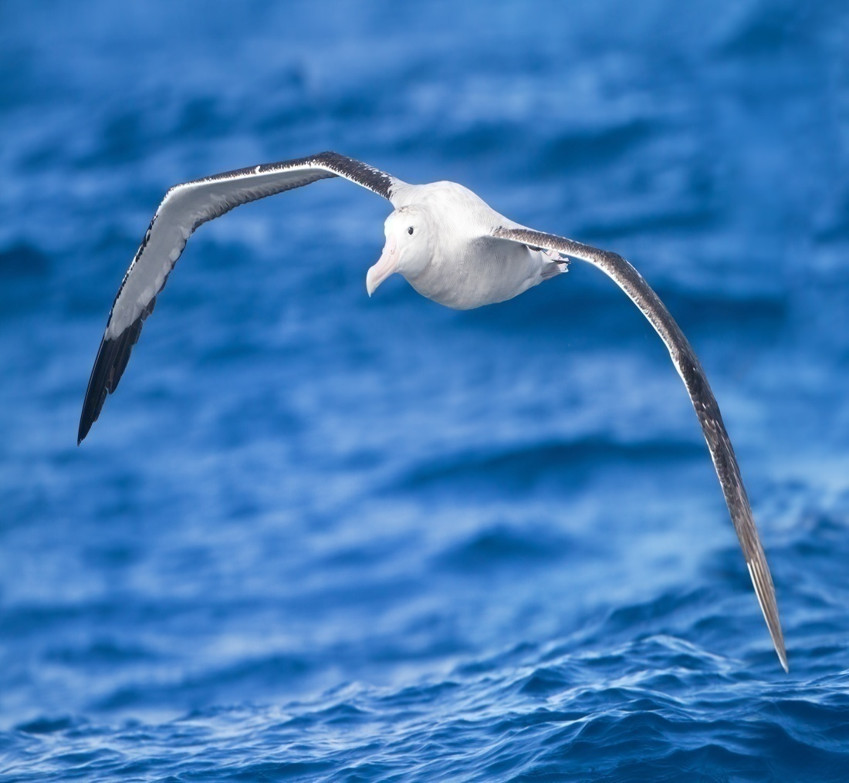
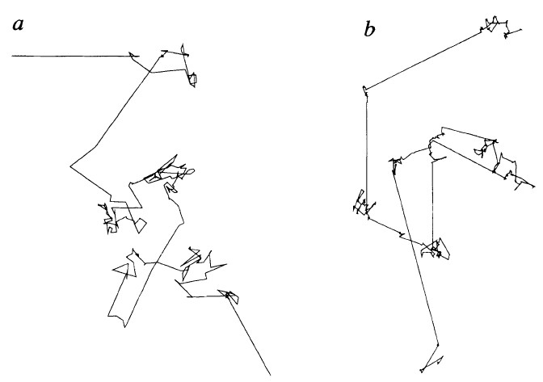
Lévy flight is optimized randomness for albatross via millions of year evolution or slow optimization
flight search patterns
Wandering albatrosses
G.M. Viswanathan, et al. Nature 381 (1996) 413–415.

Slide 26
Lévy flight is optimized randomness for albatross via millions of year evolution or slow optimization
Can it be more optimal?
flight search patterns
Wandering albatrosses
G.M. Viswanathan, et al. Nature 381 (1996) 413–415.

Slide 27
2. Optimal randomness in swarm-based search
Some literatures using Lévy flights:
Ilya Pavlyukevich (2007) used Lévy flights to solve a problem of non-convex stochastic optimization, due to big jumps of the Lévy flights process.
Toby J. Richer (2006) presented the Lévy particle warm by incorporating the Lévy distribution into PSO.
Xin-She Yang and Suash Deb (2009) proposed cuckoo search algorithm in combination of Lévy flights.
[1] Pavlyukevich I. Lévy flights, non-local search and simulated annealing[J]. Journal of Computational Physics, 2007, 226(2): 1830-1844.
[2] Richer T J, Blackwell T M. The Lévy particle swarm[C]//2006 IEEE International Conference on Evolutionary Computation. IEEE, 2006: 808-815.
[3] Yang X S, Deb S. Cuckoo search via Lévy flights[C]//2009 World Congress on Nature & Biologically Inspired Computing (NaBIC). IEEE, 2009: 210-214.

Slide 28
2.1 Cuckoo search
Cuckoo search (CS) is one of the swarm-based algorithms inspired by nature, created by Xin-She Yang and Suash Deb in 2009.
CS is inspired by the intriguing brood parasitism behaviors of some species of cuckoos. This algorithm is enhanced by Lévy flights instead of simple isotropic random walks.
[1] Yang X S, Deb S. Cuckoo search via Lévy flights[C]//2009 World Congress on Nature & Biologically Inspired Computing (NaBIC). IEEE, 2009: 210-214.

Slide 29
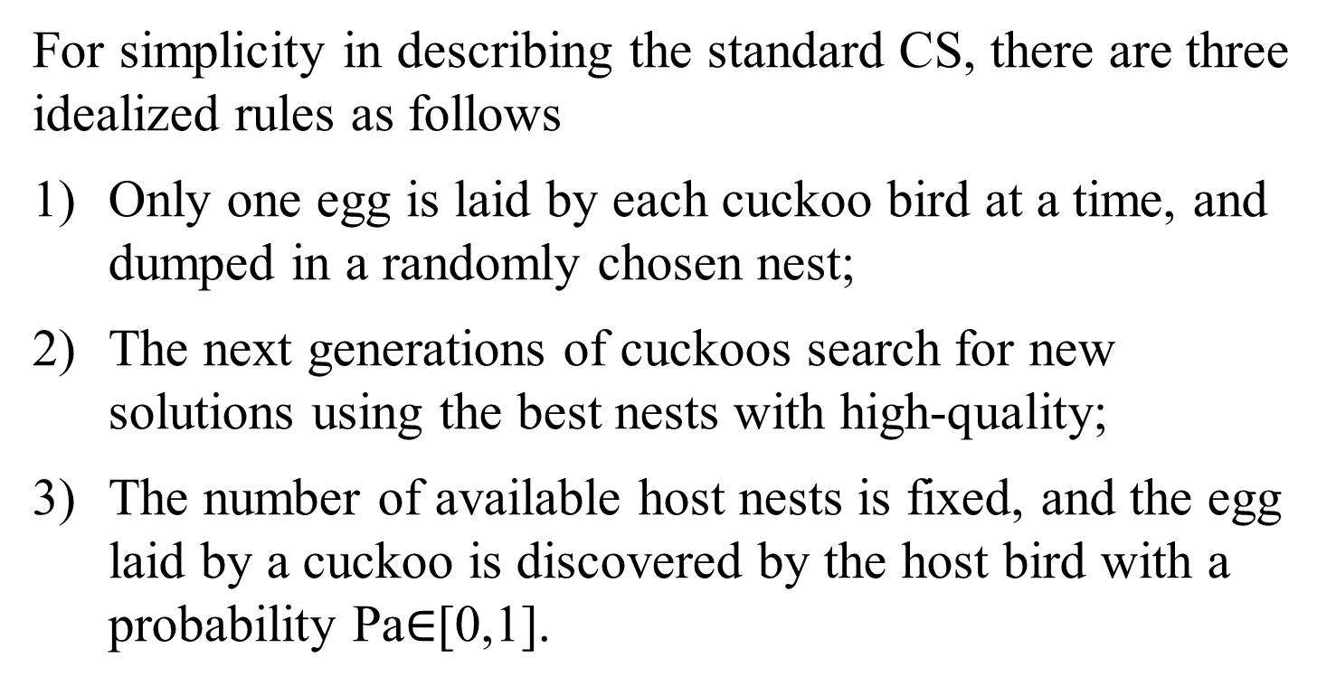
2.1 Cuckoo search
For simplicity in describing the standard CS, there are three idealized rules as follows
Only one egg is laid by each cuckoo bird at a time, and dumped in a randomly chosen nest;
The next generations of cuckoos search for new solutions using the best nests with high-quality;
The number of available host nests is fixed, and the egg laid by a cuckoo is discovered by the host bird with a probability Pa$∈$[0,1].
[1] Yang X S, Deb S. Cuckoo search via Lévy flights[C]//2009 World Congress on Nature & Biologically Inspired Computing (NaBIC). IEEE, 2009: 210-214.

Slide 30
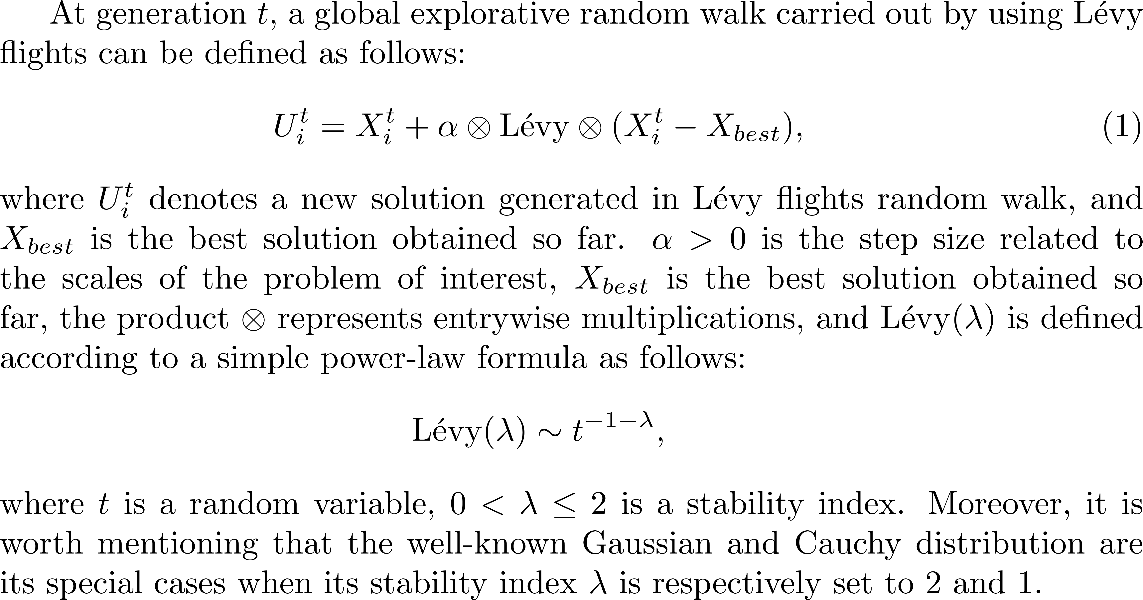
2.1 Cuckoo search
2.1.1 Global Random Walk

Slide 31
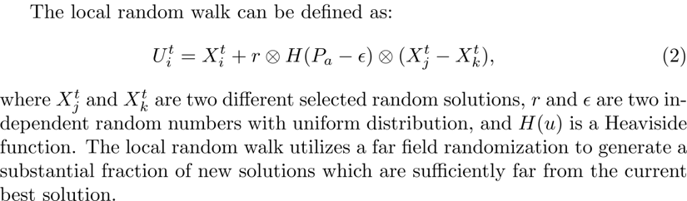
2.1 Cuckoo search
2.1.2 Local Random Walk

Slide 32
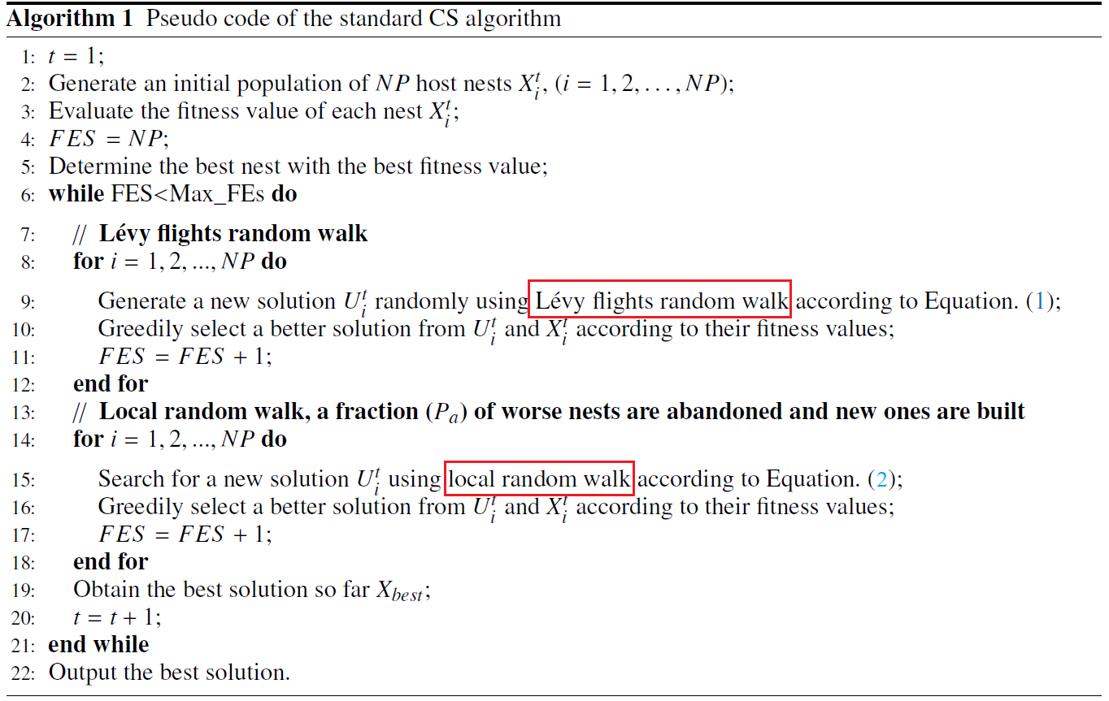
2.1 Cuckoo search pseudocode

Slide 33
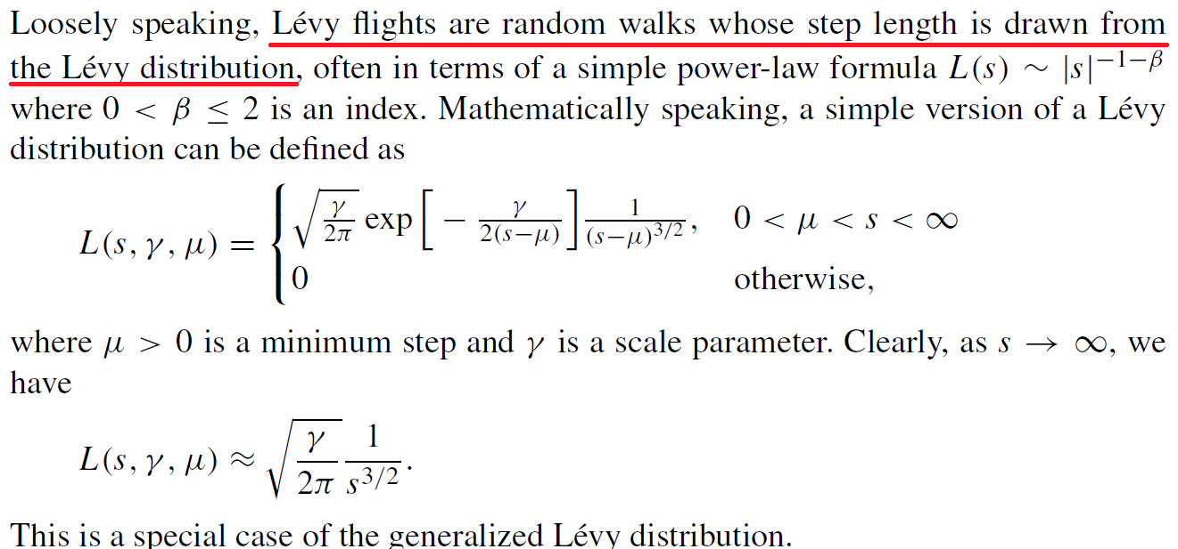
2.1 Cuckoo search
Lévy flights and Lévy distribution
[1] Yang X S. Nature-inspired optimization algorithms[M]. Elsevier, 2014.

Slide 34
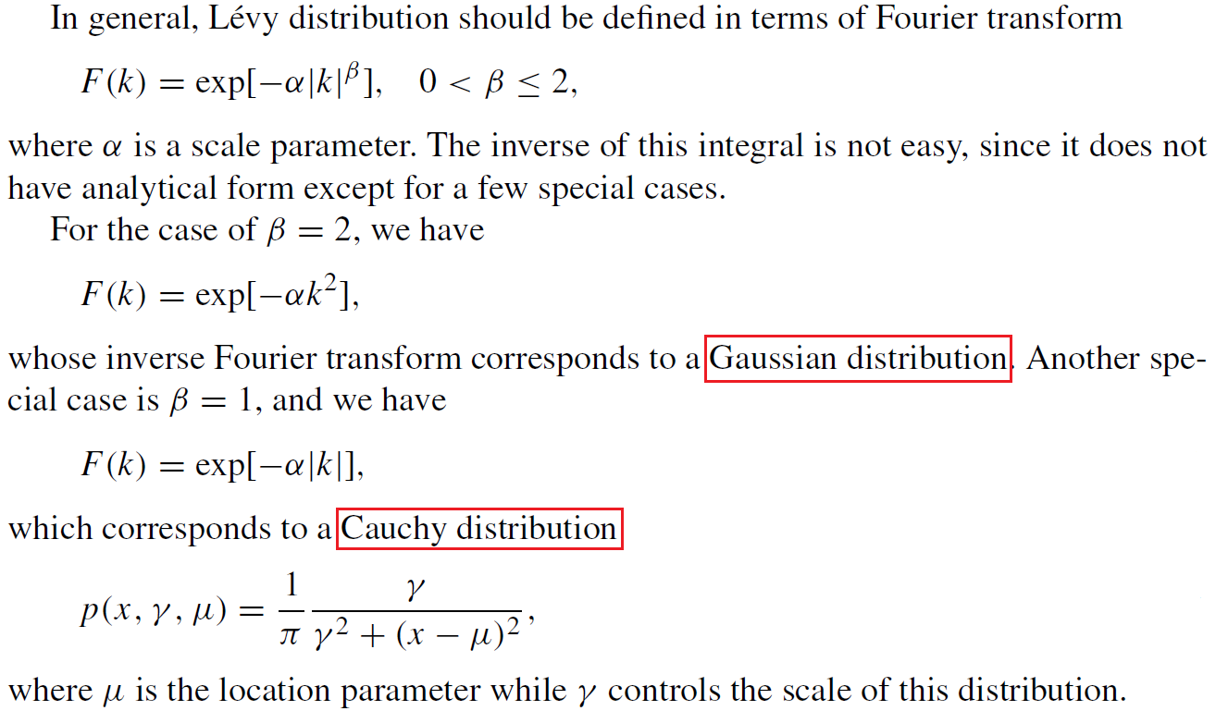
2.1 Cuckoo search
Lévy flights and Lévy distribution
[1] Yang X S. Nature-inspired optimization algorithms[M]. Elsevier, 2014.

Slide 35
2.2 Randomness-enhanced CS algorithms
Motivations
A strategy of random foraging in circumstances where there is no priori information at the location of food sources might indeed be expected to be optimal, but it is surprising that many biological searchers actually follow a Lévy, or scale-free distribution of steps.
More exactly, we have to say that the foragers should move following a heavy-tailed distribution since Lévy distribution is a simple heavy-tailed distribution which is easy to analyze.
In this study, CS is taken as a representative method of swarm-based optimization algorithms, and the results can be generalized to other swarm-based search algorithms.

Slide 36
2.2 Randomness-enhanced CS algorithms
Heavy-tailed distributions in CS
We mainly focus on the discussion of the impact of different heavy-tailed distributions on the performance of cuckoo search.
Four randomness-enhanced cuckoo search algorithms are proposed:
CS with the Mittag-Leffler distribution, CSML;
CS with the Pareto distribution, CSP;
CS with the Cauchy distribution, CSC;
CS with the Weibull distribution, CSW.

Slide 37
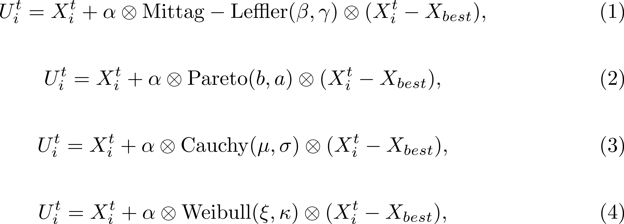
2.2 Randomness-enhanced CS algorithms
The afore-mentioned four different heavy-tailed probability distributions are respectively used to be integrated into CS instead of Lévy flights in the global explorative random walk.

Slide 38
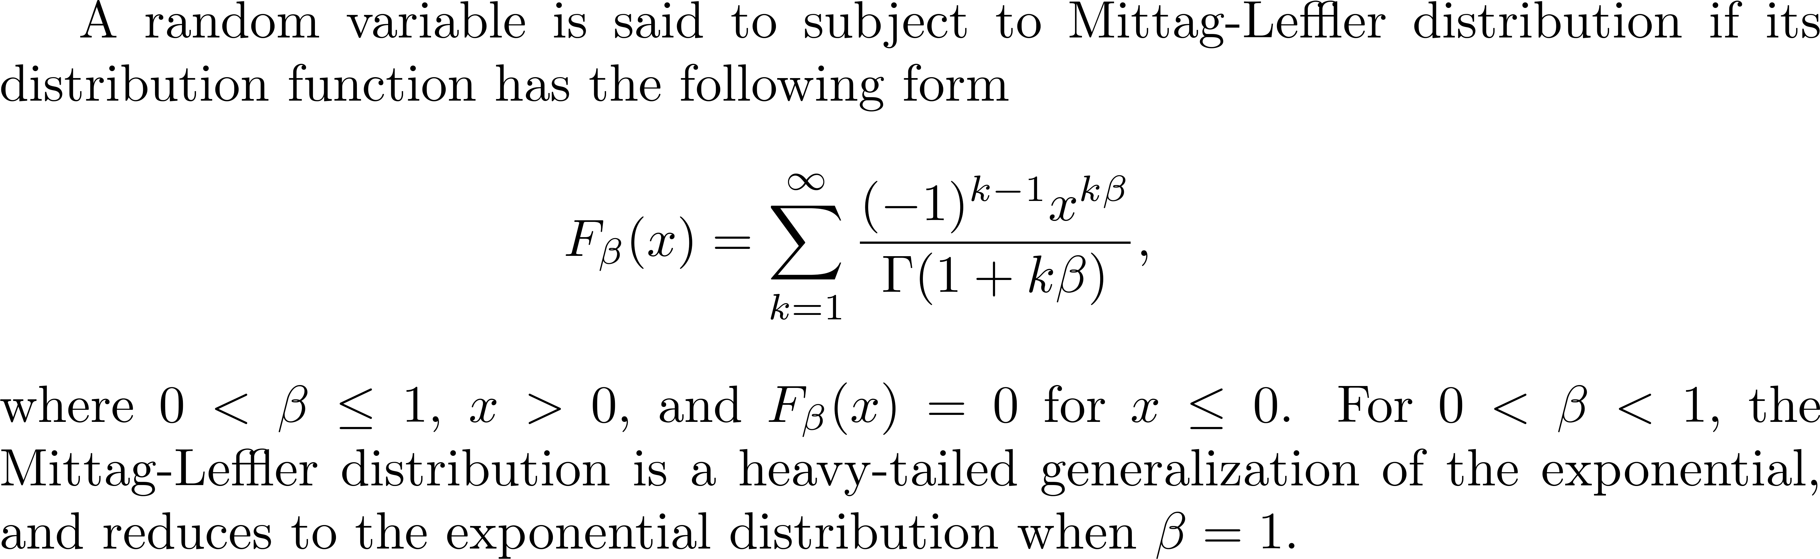
2.2 Randomness-enhanced CS algorithms
Heavy-tailed distributions in CS
Mittag-Leffler distribution

Slide 39
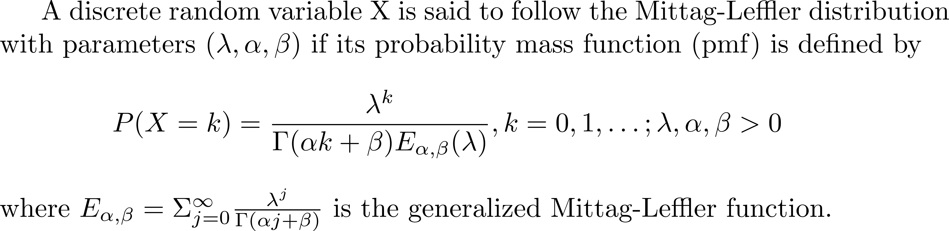
2.2 Randomness-enhanced CS algorithms
Heavy-tailed distributions in CS
Mittag-Leffler distribution
[1] Chakraborty S, Ong S H. Mittag-Leffler function distribution-A new generalization of hyper-Poisson distribution[J]. Journal of Statistical Distributions and Applications, 2017, 4(1): 8.

Slide 40
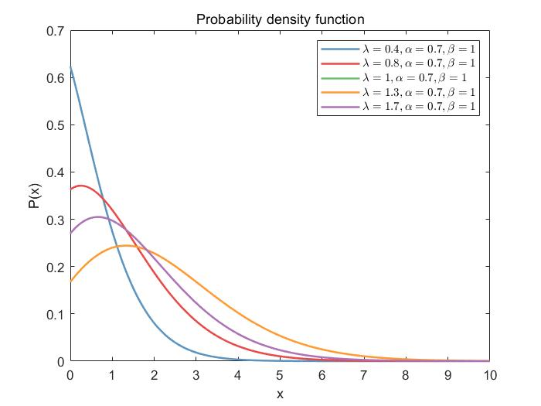
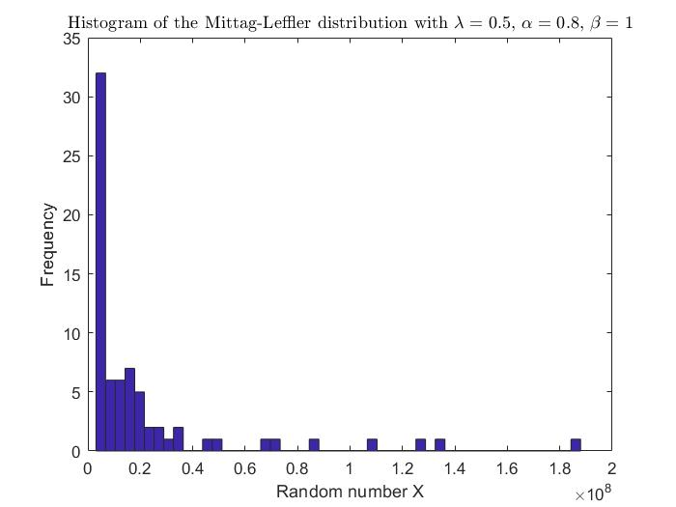
2.2 Randomness-enhanced CS algorithms
Mittag-Leffler distribution

Slide 41
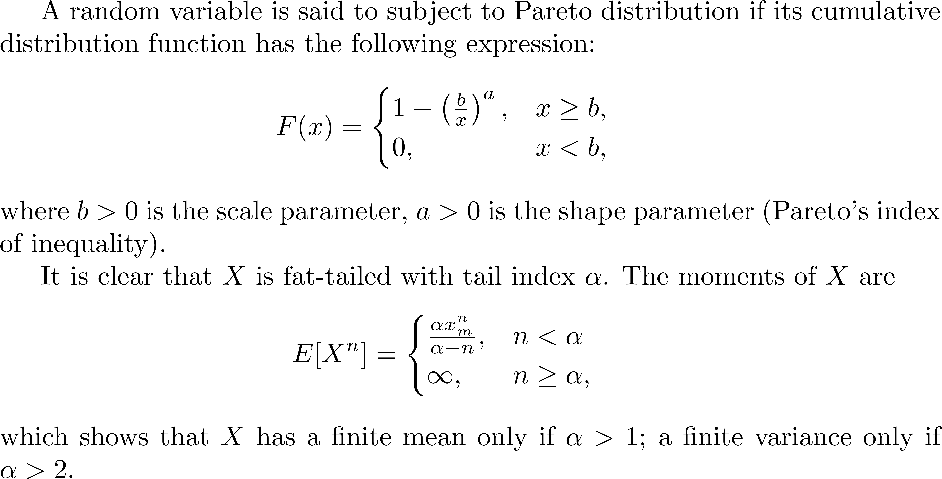
2.2 Randomness-enhanced CS algorithms
Heavy-tailed distributions in CS
Pareto distribution

Slide 42
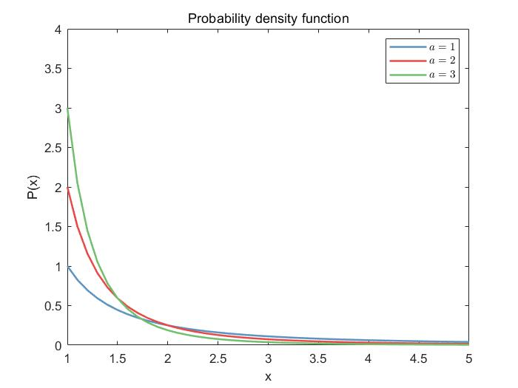
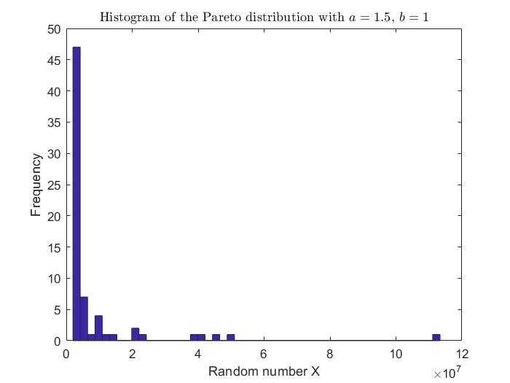
2.2 Randomness-enhanced CS algorithms
Pareto distribution

Slide 43
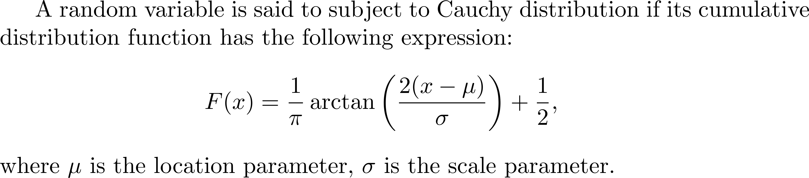
2.2 Randomness-enhanced CS algorithms
Heavy-tailed distributions in CS
Cauchy distribution

Slide 44
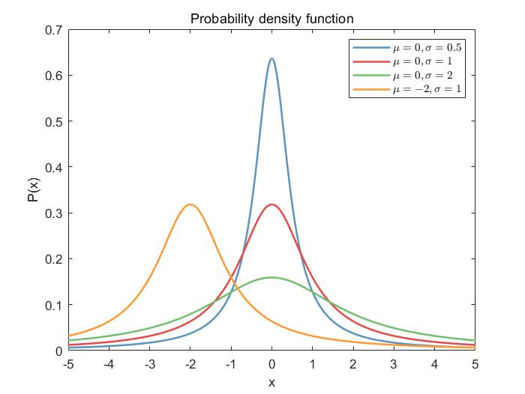
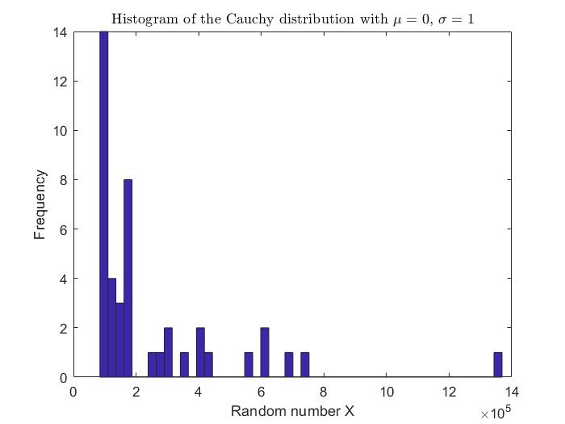
2.2 Randomness-enhanced CS algorithms
Cauchy distribution

Slide 45
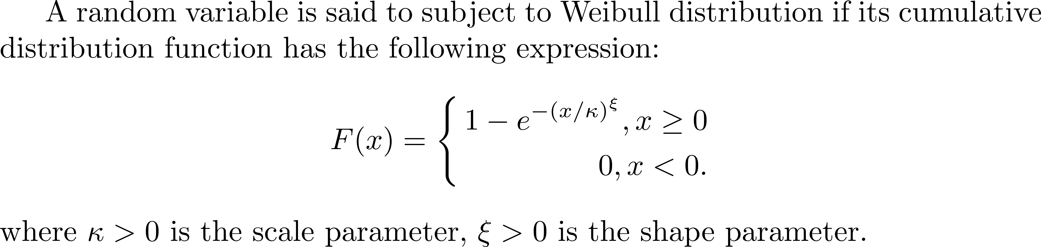
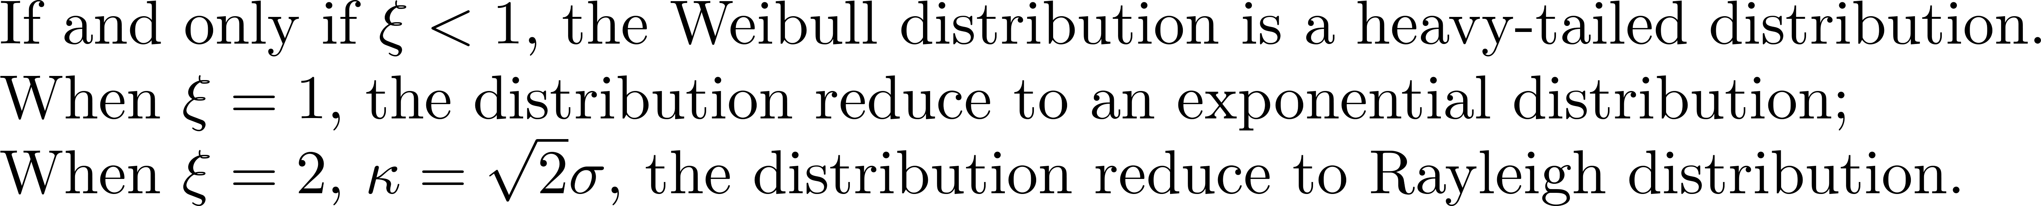
2.2 Randomness-enhanced CS algorithms
Heavy-tailed distributions in CS
Weibull distribution

Slide 46
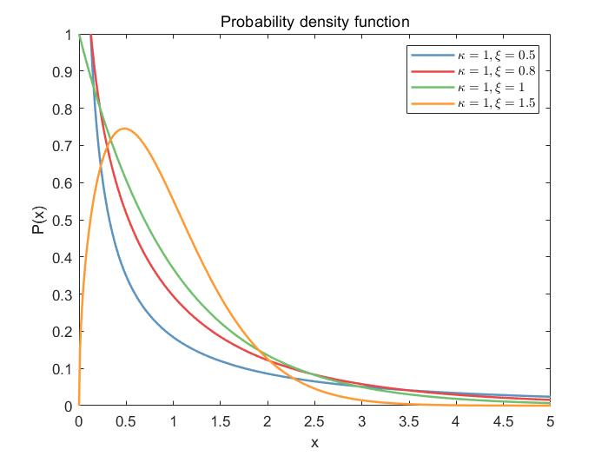
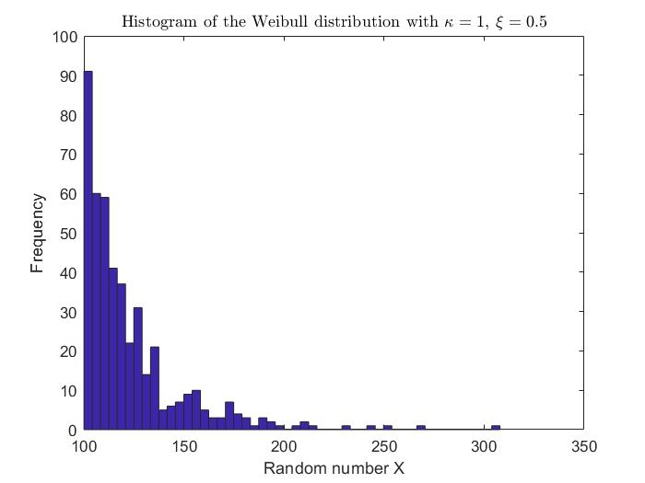
2.2 Randomness-enhanced CS algorithms
Weibull distribution

Slide 47
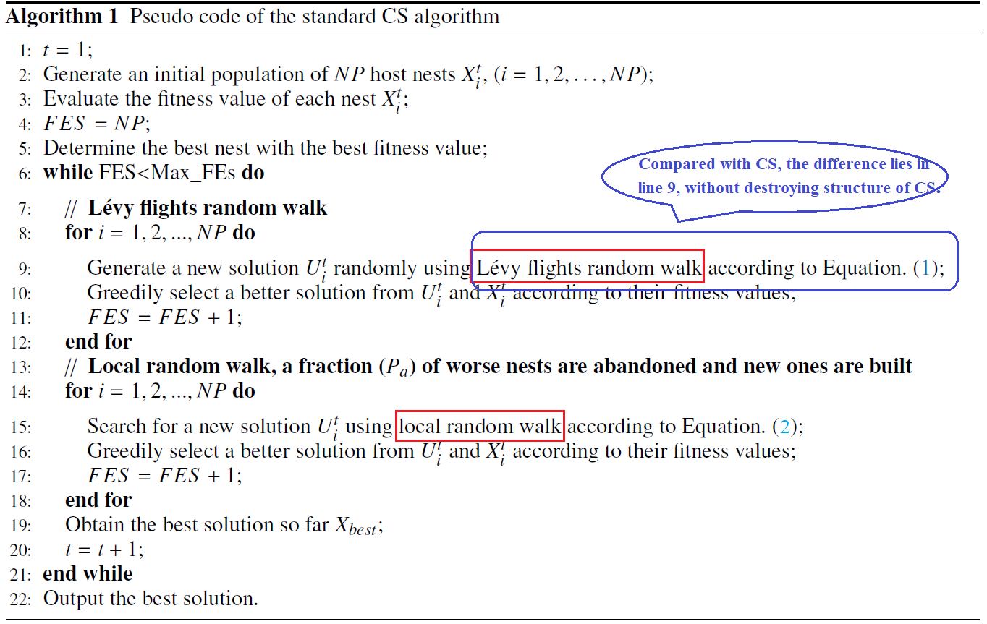
2.2 Randomness-enhanced CS algorithms

Slide 48
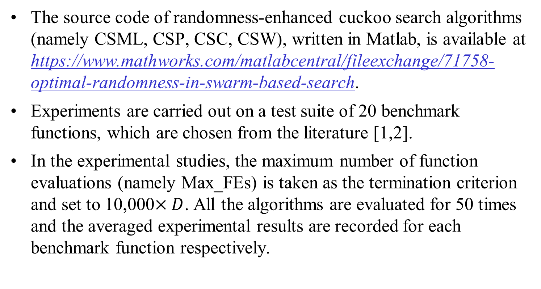
2.3 Experimental results
The source code of randomness-enhanced cuckoo search algorithms (namely CSML, CSP, CSC, CSW), written in Matlab, is available at https://www.mathworks.com/matlabcentral/fileexchange/71758-optimal-randomness-in-swarm-based-search.
Experiments are carried out on a test suite of 20 benchmark functions, which are chosen from the literature [1,2].
In the experimental studies, the maximum number of function evaluations (namely Max_FEs) is taken as the termination criterion and set to 10,000$×D$. All the algorithms are evaluated for 50 times and the averaged experimental results are recorded for each benchmark function respectively.
[1] Noman N, Iba H. Accelerating differential evolution using an adaptive local search[J]. IEEE Transactions on evolutionary Computation, 2008, 12(1): 107-125.
[2] Suganthan P N, Hansen N, Liang J J, et al. Problem definitions and evaluation criteria for the CEC 2005 special session on real-parameter optimization[J]. KanGAL report, 2005, 2005005: 2005.

Slide 49
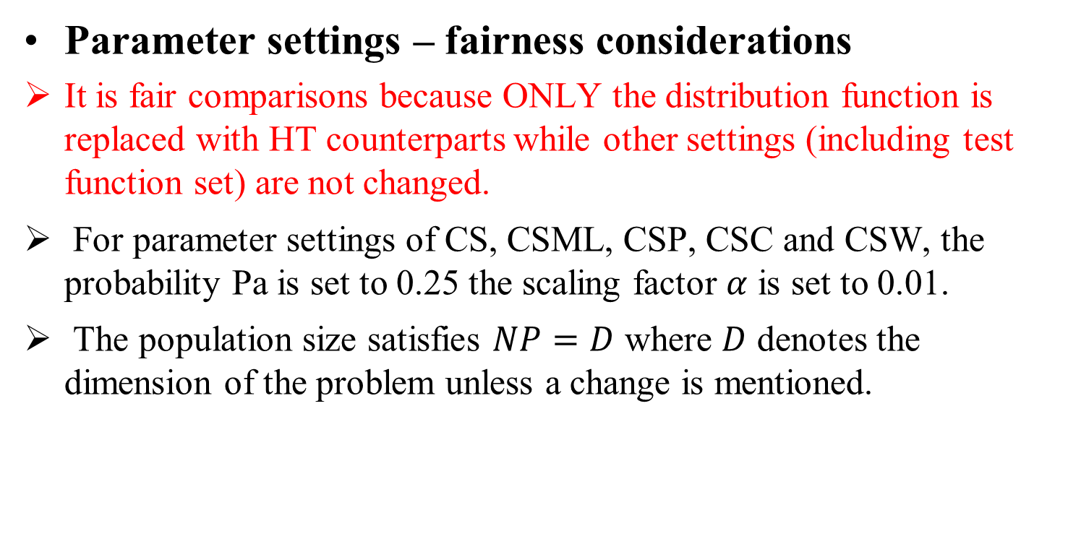
2.3 Experimental results
Parameter settings – fairness considerations
It is fair comparisons because ONLY the distribution function is replaced with HT counterparts while other settings (including test function set) are not changed.
For parameter settings of CS, CSML, CSP, CSC and CSW, the probability Pa is set to 0.25 the scaling factor $α$ is set to 0.01.
The population size satisfies $NP=D$ where $D$ denotes the dimension of the problem unless a change is mentioned.

Slide 50
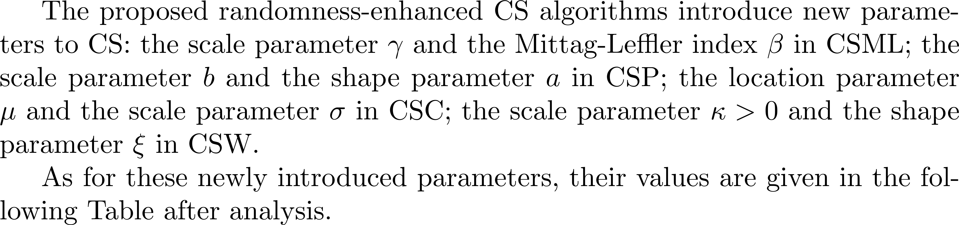
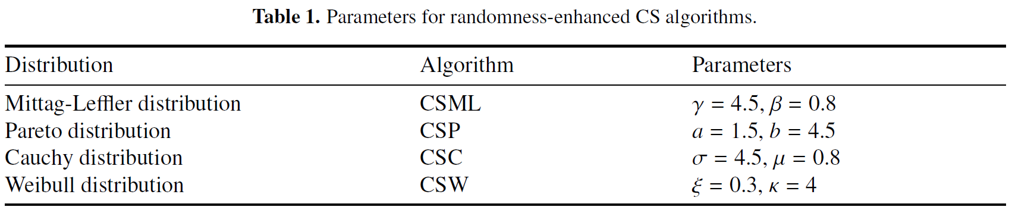
2.3 Experimental results
Parameter settings

Slide 51
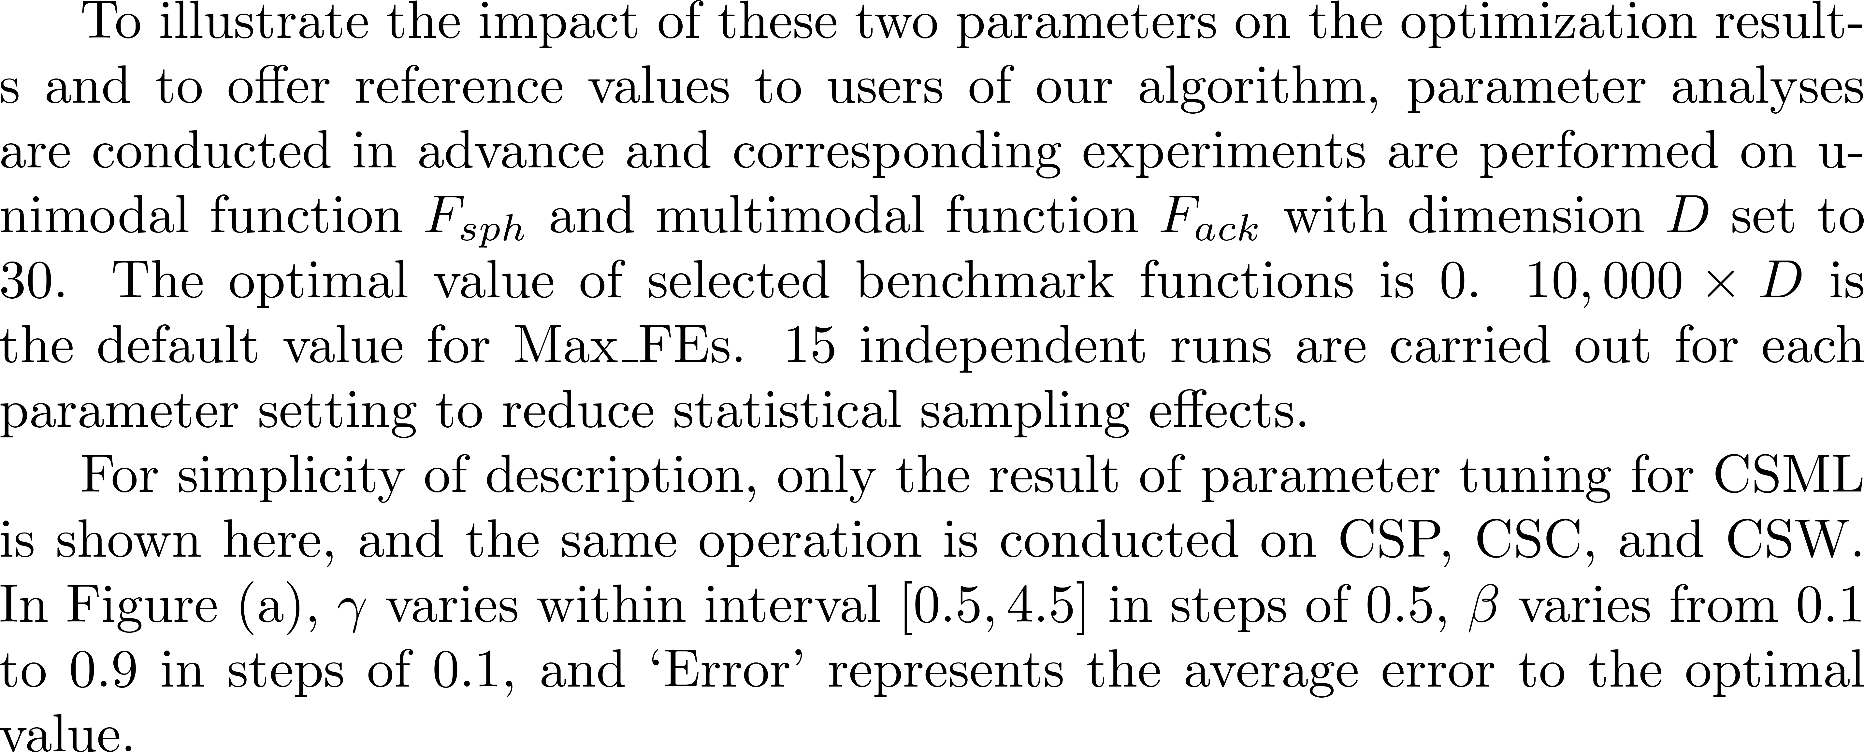
2.3 Experimental results
Parameter analysis

Slide 52
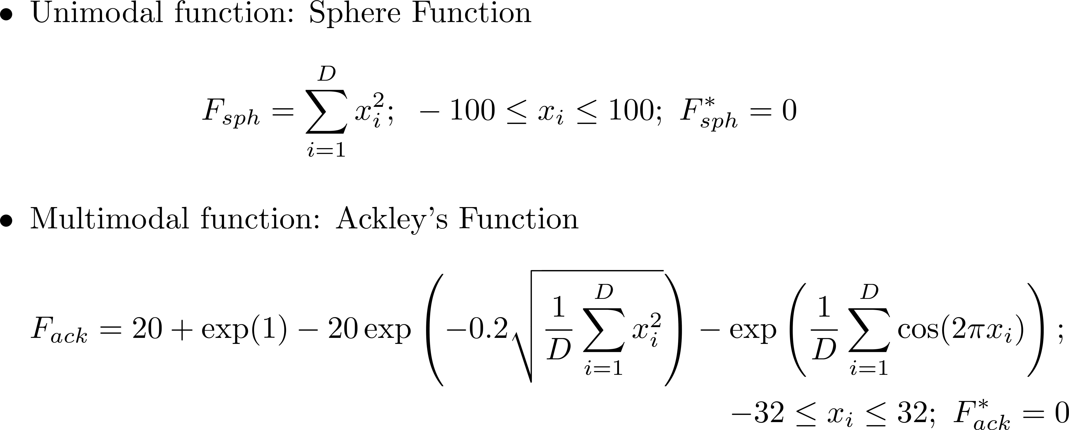
2.3 Experimental results
Parameter analysis

Slide 53
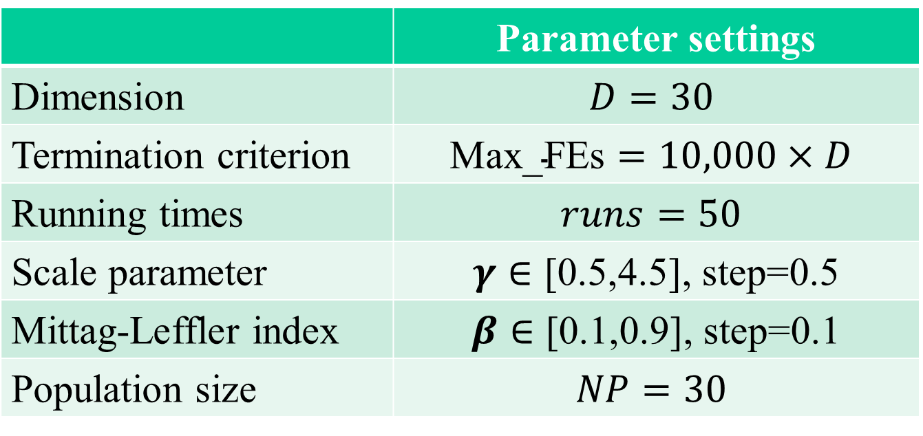
2.3 Experimental results
Parameter analysis
 | Parameter settings
Dimension | $$D=30$$
Termination criterion | $$\text{Max}\text{_}\text{FEs}=10,000×D$$
Running times | $$runs=50$$
Scale parameter | $γ∈\text{[0.5,4.5]}$, step=0.5
Mittag-Leffler index | $β∈\text{[0.1,0.9]}$, step=0.1
Population size | $$NP=30$$

Slide 54
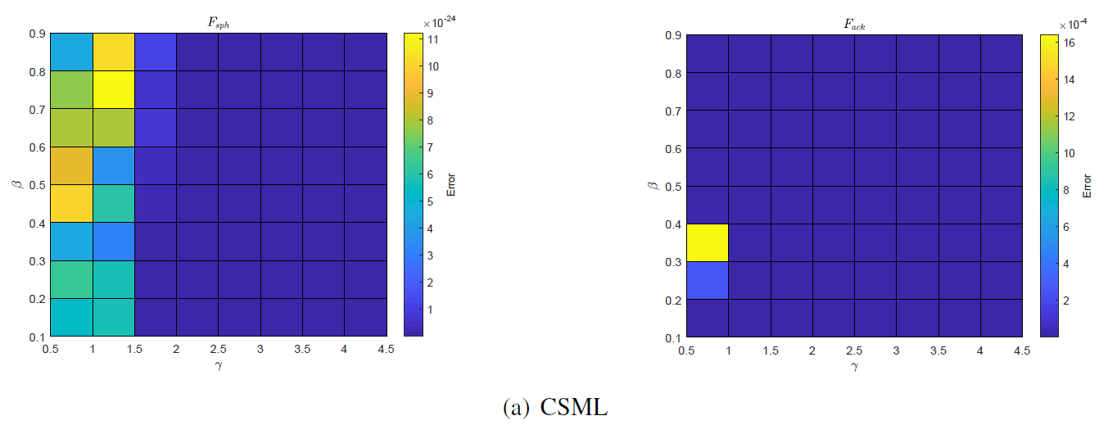
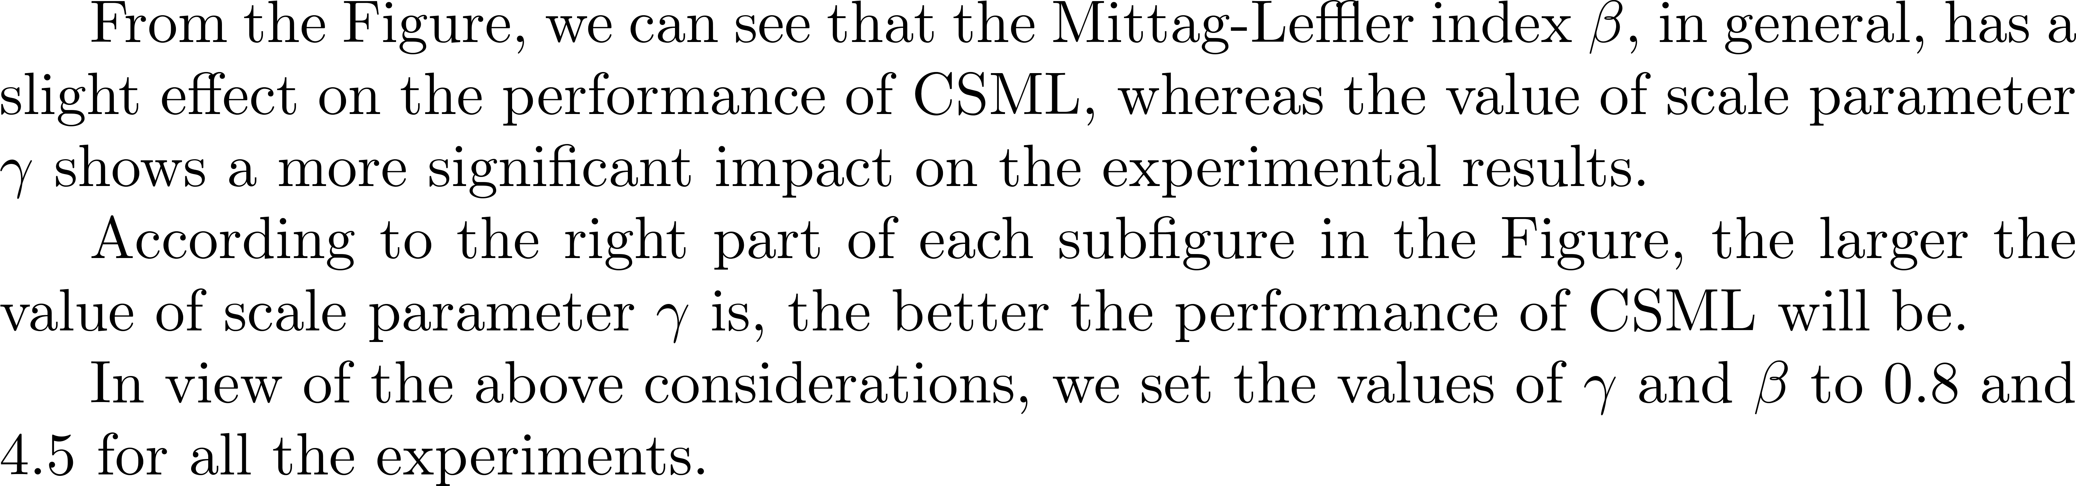
Parameter analysis

Slide 55
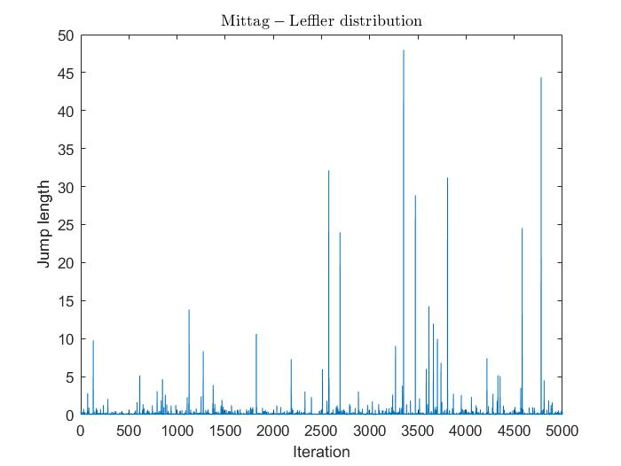



4 HT distributions – sample paths

Slide 56


2.3 Experimental results

Slide 57


Slide 58


Slide 59
Outline
Background
Optimal randomness in swarm-based search
Heavytailedness and its connection to fractional calculus
Conclusions & future topics

Slide 60
3.1 Introduction
Fractional calculus is a rapidly growing field of research, at the interface between probability, differential equations, and mathematical physics.
In many real world applications, particles follow a heavy-tailed jump distribution, and a different model emerges, i.e., anomalous diffusion.
Fractional calculus is used to model anomalous diffusion, in which a cloud of particles spreads in a different manner than traditional diffusion.

Slide 61

3.2 The traditional diffusion model

Slide 62

3.2 The traditional diffusion model

Slide 63

3.2 The traditional diffusion model

Slide 64

3.2 The traditional diffusion model

Slide 65

3.2 The traditional diffusion model

Slide 66

3.2 The traditional diffusion model

Slide 67
3.2 The traditional diffusion model
The random walk limit of traditional diffusion is a Brownian motion, whose probability densities solve the diffusion equation.
This is the link between (integer-order) differential equations and probability.
The central limit theorem of probability ensures that this same bell-shaped curve will eventually emerge from any random walk with finite variance jumps, so that this diffusion model can be considered universal.

Slide 68
3.3 Fractional Diffusion
Anomalous diffusion is often observed in real data.
The “particles” might be pollutants in ground water, stock prices, sound waves, proteins crossing a cell boundary, or animals invading a new ecosystem.
In many real world applications, particles follow a heavy-tailed jump distribution, and a different model emerges.
The anomalous diffusion can manifest in asymmetric densities, heavy tails, sharp peaks, and/or different spreading rates.

Slide 69

3.3 Fractional Diffusion

Slide 70

3.3 Fractional Diffusion

Slide 71

3.3 Fractional Diffusion

Slide 72


3.3 Fractional Diffusion

Slide 73

3.3 Fractional Diffusion

Slide 74

3.3 Fractional Diffusion
A heavy-tailed version of the central limit theorem leads to a stable distribution.
Random walks with heavy tails converge to an $α−$stable Lévy motion. If $0<α<1$, then no centering is needed. If $1<α<2$, we can center to zero expectation.
Fractional derivatives are related to heavy tailed random walks. Fractional derivatives in space model super-diffusion, related to long power-law particle jumps. Fractional derivatives in time model sub-diffusion, related to long power-law waiting times between particle jumps.

Slide 75

3.3 Fractional Diffusion
[1] Meerschaert M M, Sikorskii A. Stochastic models for fractional calculus[M]. Walter de Gruyter, 2011.

Slide 76
Outline
Background
Optimal randomness in swarm-based search
Heavytailedness and its connection to fractional calculus
Conclusions & future topics

Slide 77
Conclusions:
In swarm based search (such as CS – cuckoo search) using randomness with different heavy-tailed distributions, the search performance can be further optimized beyond Lévy flights.
The connection of heavytailedness and fractional calculus. It is hoped that this talk will open new investigations in new optimal ways to optimize using optimized randomness with the help of fractional calculus in this Big Data and Machine Learning era.

Slide 78
Future opportunities
Optimal randomness in learning machine.
Enhancing swarm-based search algorithms with fractional calculus.
Do not forget to ask what is the “optimal randomness”!
It will lead you to the real top.

Slide 79

人工智能：
人工然后智能
Artificial then intelligent
学习（算法）很重要
不然会累死人的
Learning algorithm is important, or we will tire to death

Slide 80


Stable Distributions
α=2: Gaussian
α=1, β=0: Cauchy
α=1.5,β=1: Levy
http://academic2.american.edu/~jpnolan/stable/stable.html

Slide 81






Connection to FC via PDF
“Fractional Calculus and Stable Probability Distributions” (1998) by Rudolf Gorenflo , Francesco Mainardi http://arxiv.org/pdf/0704.0320.pdf

Slide 82
Thanks for your attention!
Q&A

