Slide 1
Fractional Calculus Day @ UC Merced
YangQuan Chen, Ph.D., Director,
MESA (Mechatronics, Embedded Systems and Automation)Lab
MEAM/EECS, School of Engineering,
University of California, Merced
E: yqchen@ieee.org; or, yangquan.chen@ucmerced.edu
T: (209)228-4672; O: SE1-254; Lab: Castle #22 (T: 228-4398)
Castle Research Facility, UC Merced
June 12, 2013

Slide 2
WELCOME!
I’m very glad you are here!

Slide 3
Welcome and Introduction
History
  2005, 2007, 2009, 2011 Utah State University
  2013 UC Merced
  FC Day @ xxx is spreading as chain reactions …
    http://people.tuke.sk/igor.podlubny/FC-Day-at-TUKE/
    http://people.tuke.sk/igor.podlubny/FC-Day-at-IST-20120703/
    http://mechatronics.ece.usu.edu/foc/event/FOC_Day@USU/index.html

Slide 4
“Fractional Calculus”: What and Why?
Differentiation and integration of non-integer orders;
  Real power of Laplace operator “s” – such as 1/s^{0.5} , known as “half-order integrator”
Tremendous potential in engineering applications and science discoveries.
  Connecting lots of dots when things are “complex” or “anomalous”. See a talk: https://vimeo.com/61141696

Slide 5

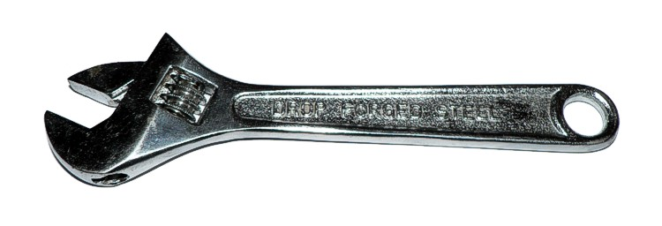
Conclusion of Talk
Integer-Order Calculus
Fractional-Order Calculus
Slide credit: Richard L. Magin, ICCC12
Notes:
5

Slide 6
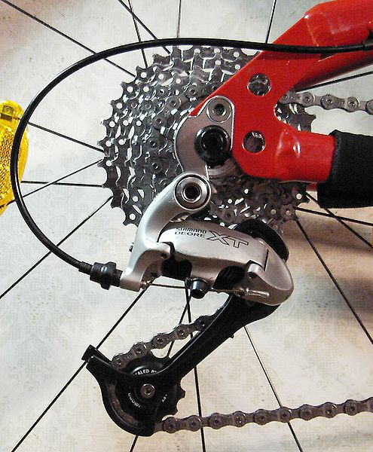
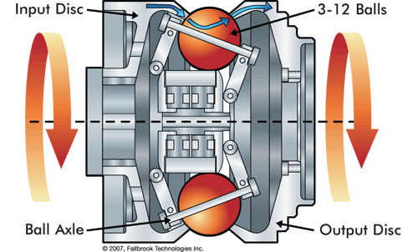
Earth/moon
Integer-Order Calculus
Fractional-Order Calculus
Discrete gears vs. constantly-variable transmission
http://spectrum.ieee.org/energywise/energy/renewables/could-mechanics-best-power-electronics-in-evs
Slide credit: Calvin Coopmans, 2/28/2013 email comment

Slide 7
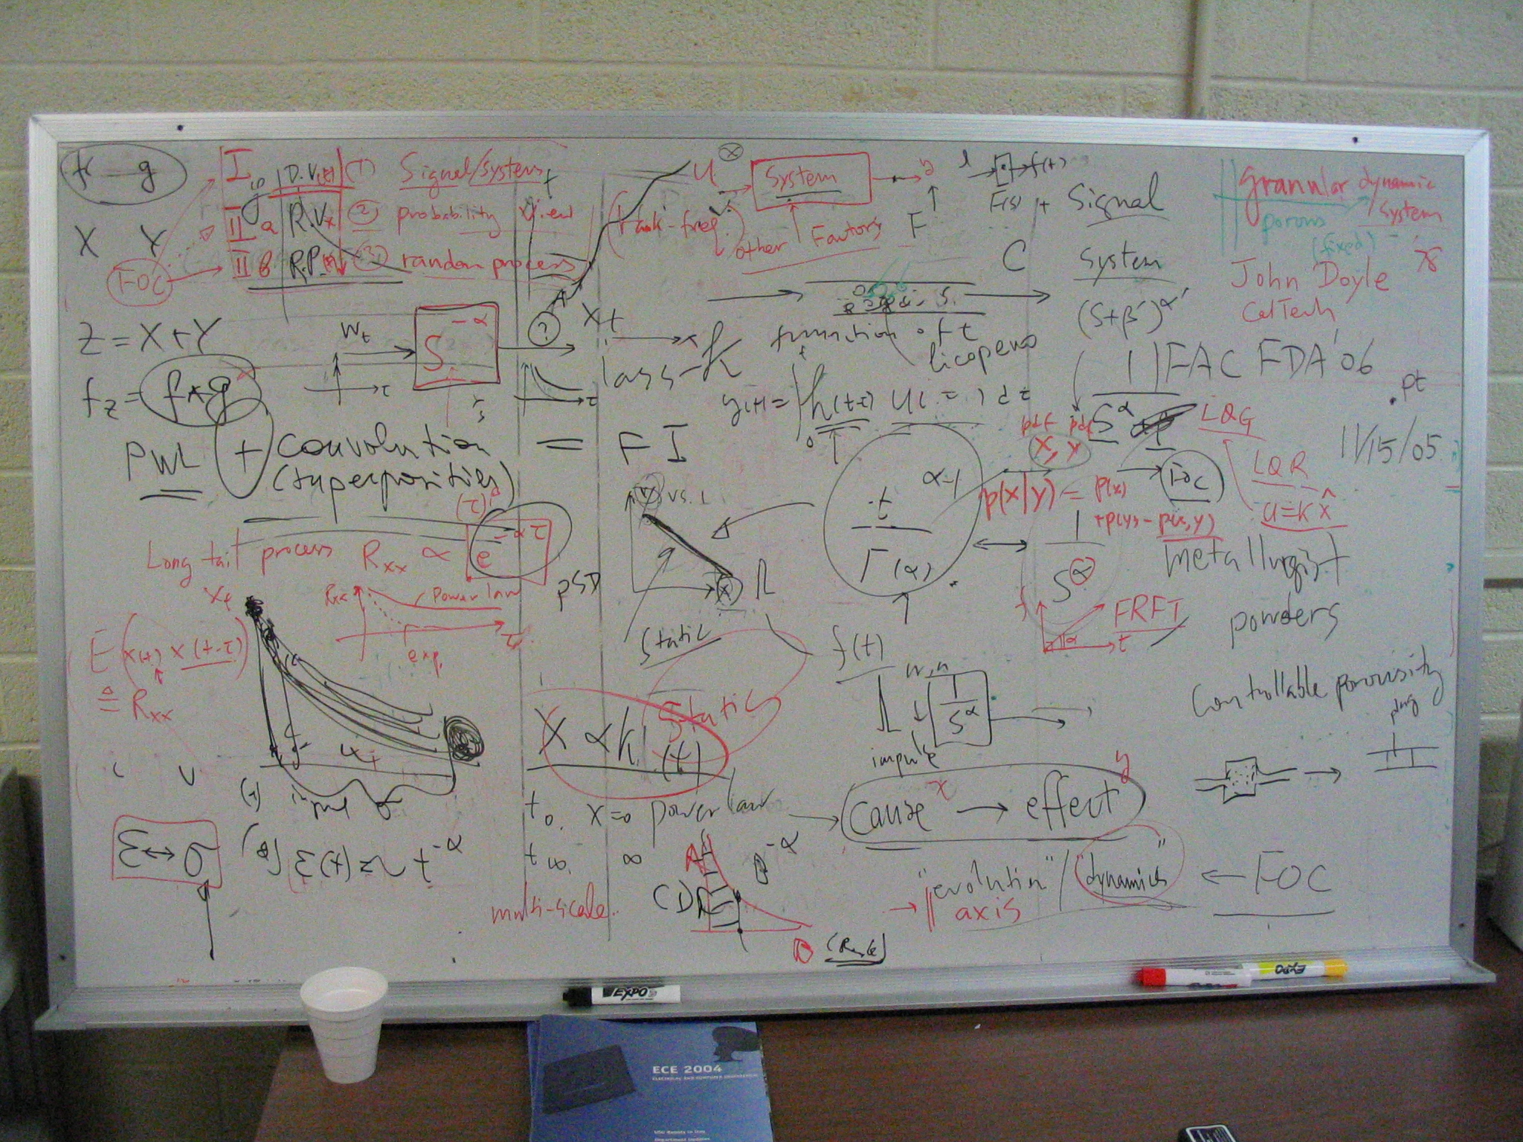
A snap shot of discussion board of Igor Podlubny and YangQuan Chen in Sept. 2005

Slide 8
MESA Research Areas/Strengths
Unmanned Aerial Systems and UAV-based Personal Remote Sensing (PRS)
Cyber-Physical Systems (CPS)
Modeling and Control of Renewable Energy Systems
Mechatronics
Applied Fractional Calculus (AFC)

Slide 9
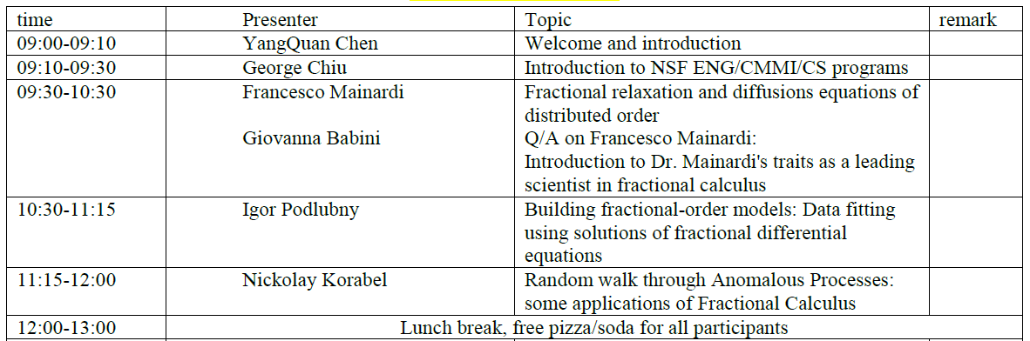

Slide 10
