Slide 1
Energy optimization by fractional order extremum-seeking:
Three classes of methods and experimental comparison for photovoltaic and lighting systems
Chun Yin
MESA Lab
University of California, Merced
06/12/2013

Slide 2
Outlines
Background
Analog extremum seeking control methods
(1) Integer-order version
(2) Fractional-order version
System description
(1) Photovoltaic system
(2) Lighting system
Simulation results
Experimental results
Reference

Slide 3
Fractional derivative and integral
Background
Fractional derivative and integral, also called Fractional calculus are the basic idea .
The first notation of was introduced by Leibniz. In 1695, Leibniz himself raised a question of generalizing it to fractional order.
In last 300 years the developments culminated in two calculi which are based on the work of Riemann and Liouville (RL) and Grunwald and Letnikov (GL).

Slide 4
Three Common Definitions
Background
Riemann-Liouville derivative
Grünwald-Letnikov derivative
Caputo fractional derivative

Slide 5
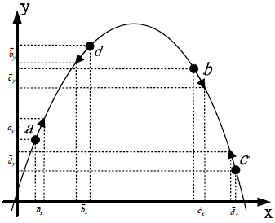
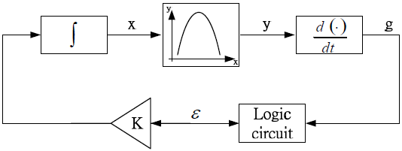
Background
A block diagram of an ESC control system [1]
The ESC is an adaptive control approach that reaches the control target via filtered and driving signals with uncertain or unknown information in some aspects. A major advantage of ESC is that it does not require a system model, and is capable of improving the system performance. Applications of ESC might be found in nonlinear control issues, and nonlinear local minimum and maximum localizations.

Slide 6
Extremum seeking control methods
Based on perturbation and averaging method
A block diagram of an sinusoidal ESC control system [1]

Slide 7
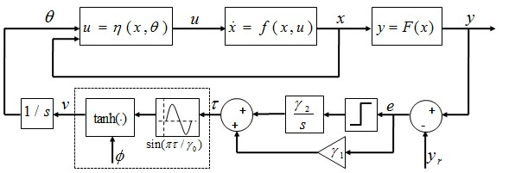
Extremum seeking control methods
Based on sliding mode control method
A block diagram of an sinusoidal ESC control system [1]

Slide 8
Extremum seeking control methods
The other ESC methods (see [2])
Neural network ESC
Approximation based ESC
Perturbation based ESC
and etc.

Slide 9
Extremum seeking control methods
Extending derivatives and integrals from integer-order (IO) to FO has a firm and long standing theoretical foundation. Adding FO controllers to IO systems, there is a better flexibility in adjusting FO than using IO controllers.
IO Controller + IO Plant
FO Controller + IO Plant
FO Controller + FO Plant
IO Controller + FO Plant
Concepcin A. Monje, YangQuan Chen, Blas Vinagre, Dingyu Xue and Vicente Feliu (2010). “Fractional Order Systems and Controls - Fundamentals and Applications.” Advanced Industrial Control Series, Springer-Verlag, www.springer.com/engineering/book/978-1-84996-334-3 (2010), 415 p. 223 ill.19 in color.

Slide 10
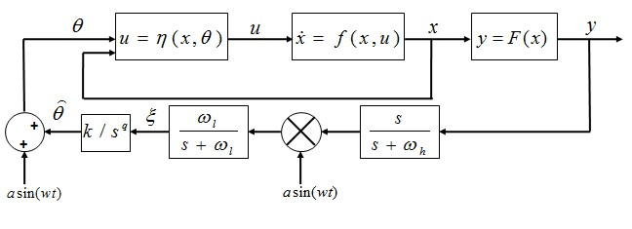
Extremum seeking control methods
The fractional-order ESC method
The FO sinusoidal based ESC
A block diagram of an FO sinusoidal ESC control system

Slide 11
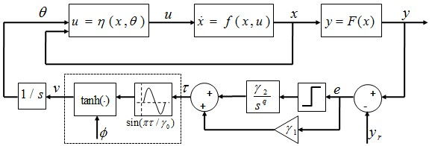
Extremum seeking control methods
The fractional-order ESC method
The FO sliding mode based ESC
A block diagram of an FO sinusoidal ESC control system

Slide 12
System descriptions
Photovoltaic system
Solar Panel
DC-DC Power
Converter
Power
Solar energy is a key opportunity for increasing the role of renewable energy in the electric grid. Solar cells produce direct current electricity from sun light, which can be used to power equipment or to recharge a battery.
Power
Current Sensor
Voltage Sensor
ESC
Maximum power point tracking
MPPT
Load
General scheme of Solar Array with MPPT

Slide 13
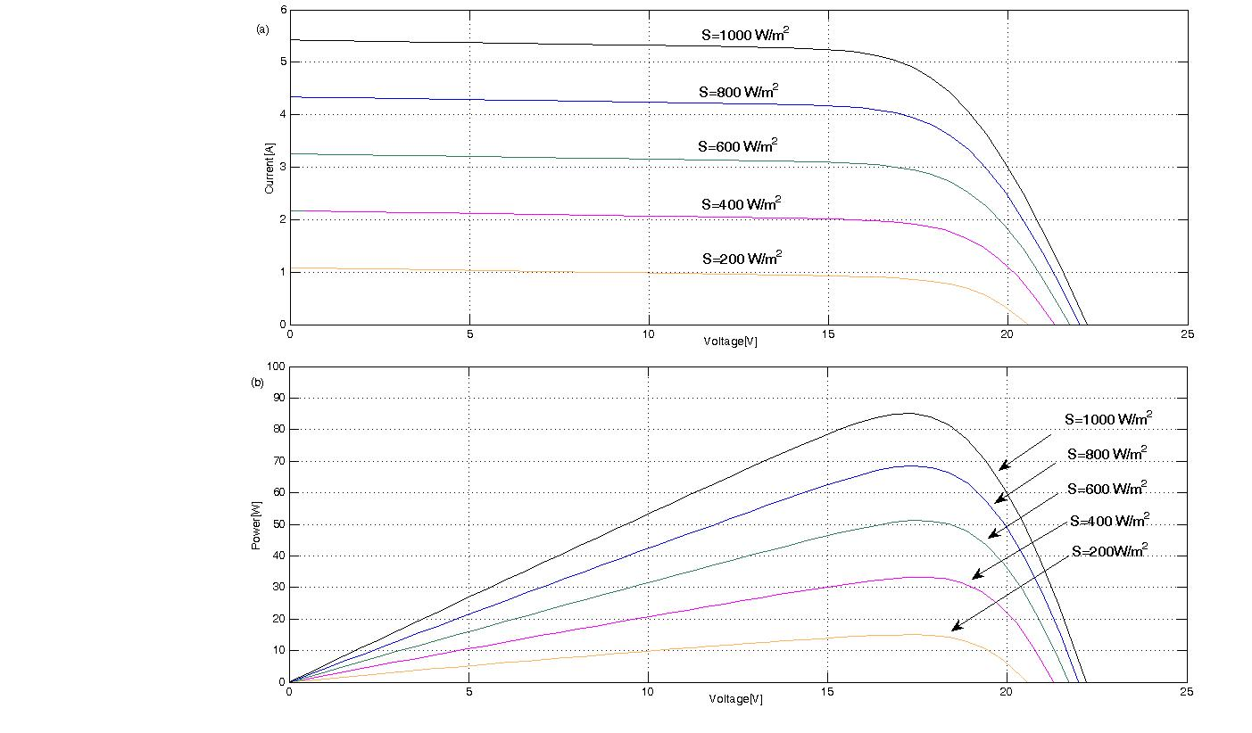
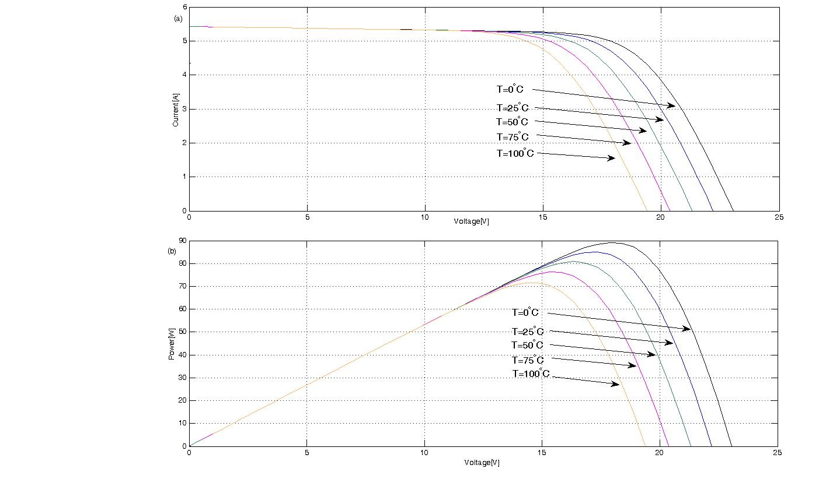
System descriptions
Photovoltaic system
Figures show the P-V curves for varying irradiance and temperature. In these figures, PV cells operate best in full sunlight and cold temperature.
Characteristic I-V and P-V curves for varying irradiation levels and varying temperature levels

Slide 14
System descriptions
Photovoltaic system
A model of a moderate complexity is used in Gow and Manning [1]. The net current of the cell is the difference of the photocurrent I_{L} and the normal diode current I₀ :
The PV module provides 48 watts of nominal maximum power, and has 36 series connected polycrystalline silicon cells.

Slide 15
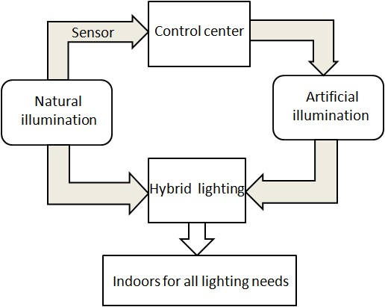
System descriptions
Lighting system
Electric lighting is a major energy consumer since the demand of huge illumination. One obvious way to save electrical energy usage for lighting is to supplement artificial light with natural light.
The general scheme of hybrid lighting

Slide 16
System descriptions
Lighting system
Since natural light remains complex to manage, hybrid lighting must have active control of light levels at all times. Fortunately, sensors can provide the feedback to lighting systems. Special lamps under the control law can automatically turn on and off to illuminate those areas, or the brightness of these lamps automatically turn up and down, so that the room has a uniform light level.
The goal of maintaining the right level of illumination can be achieved by separately adjusting the brightness of each lamp, and this adjustment will further more affects the energy usage. Hence, an adaptive minimum energy cognitive lighting control strategy is proposed to balance this adjustment.

Slide 17
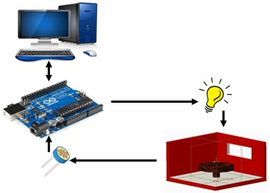
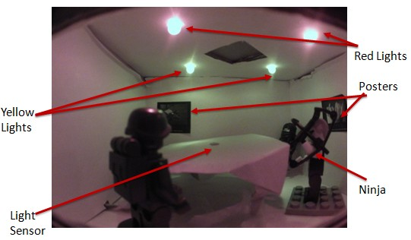
System descriptions
Lighting system
The Arduino-based Physical test plant developed at MESA lab.
The indoor of miniature office.

Slide 18
System descriptions
Lighting system
In the whole loop, I denotes the output of current source, which can sustain the right level of illumination in the miniature office. In order to separately adjust the brightness of the near lights and far lights, I is split into two parts I₁ and I₂. I₁ represents the current that is used in the near lights and I₂ denotes the current that is used in the far lights. The following equations describes the current (I = I₁ + I₂) and electrical energy (E)
where the proportional parameter $ω$satisfies $0≤ω≤1$.

Slide 19
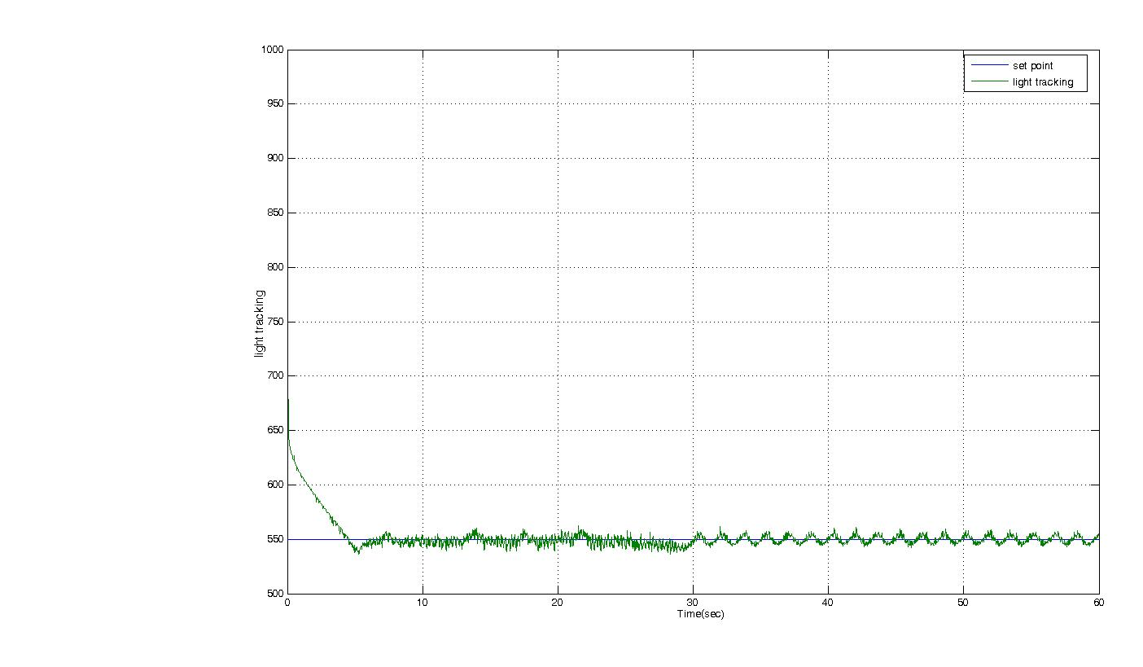
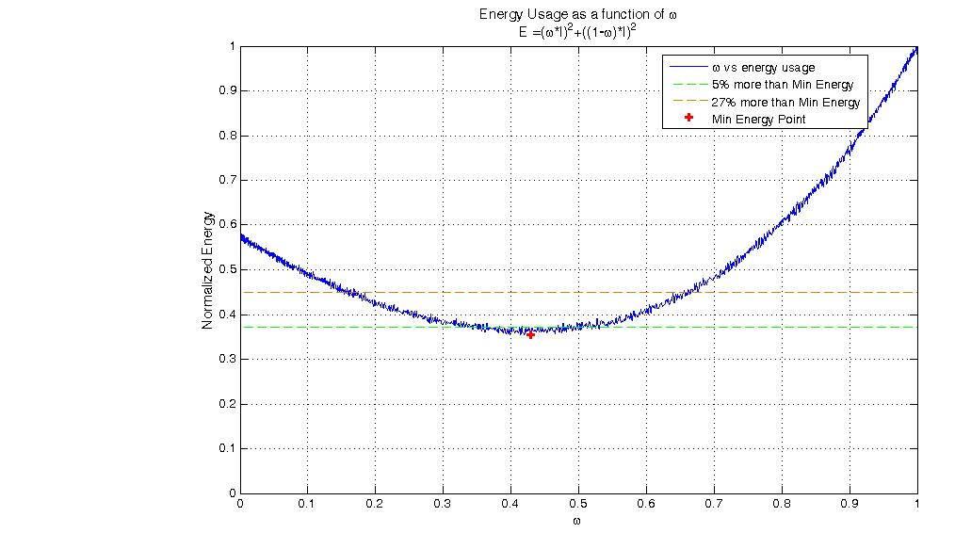
System descriptions
Lighting system
The illumination of the miniature office under PID controller.
The changes in electrical energy E with $ω$.

Slide 20
Simulations results
Photovoltaic system
We describe the design of the proposed MPP. Consider the following auxiliary first order nonlinear system:
To maximize the PV array power output, we can employ the three classes of ESC method for the nonlinear maps.
The parameters of the neural network ESC in [3] are used.
The parameters with and
and , of the SM-ESC are used.
The parameters in sinusoidal ESC are selected.

Slide 21
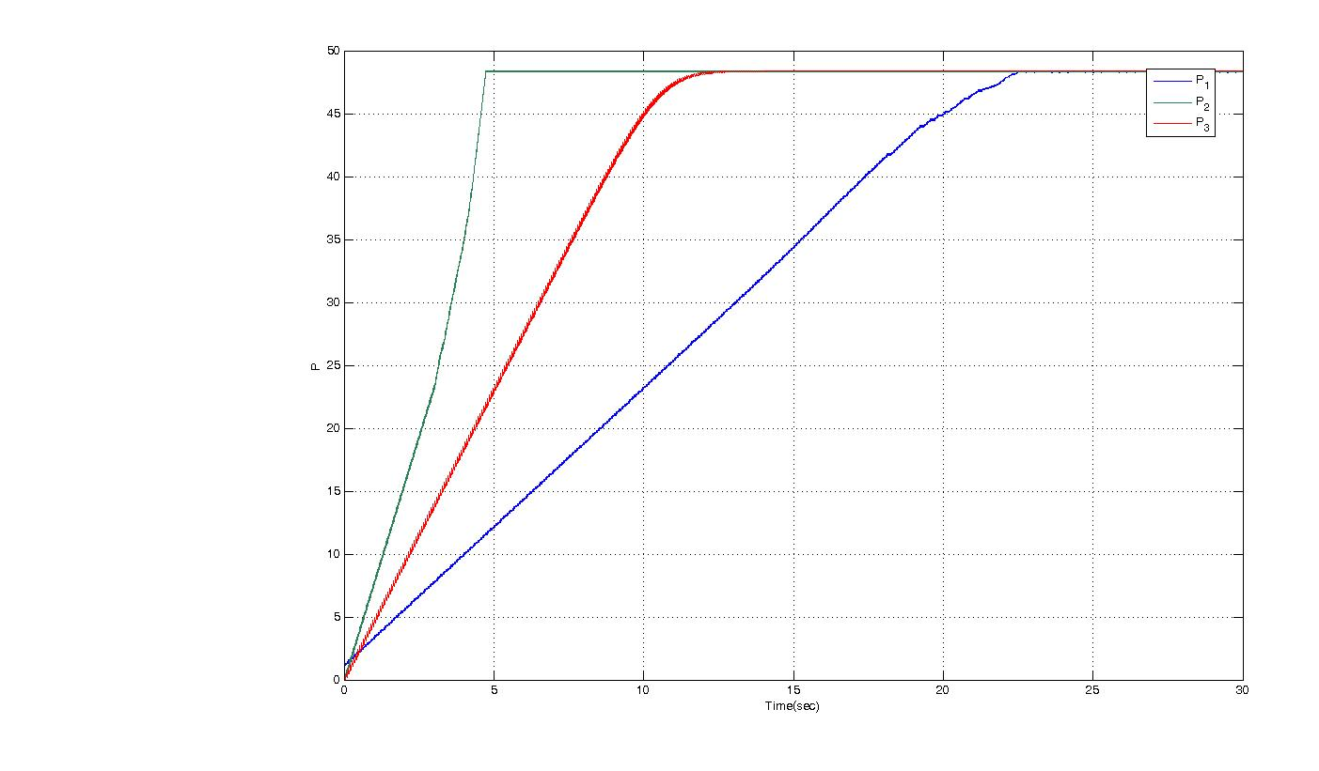
Simulations results
Photovoltaic system
The figure shows the output P₁under the neural network ESC law, P₂ under the SM-ESC law and P₃ under the sinusoidal ESC law converge to the MPP with an acceptable convergence speed.

Slide 22
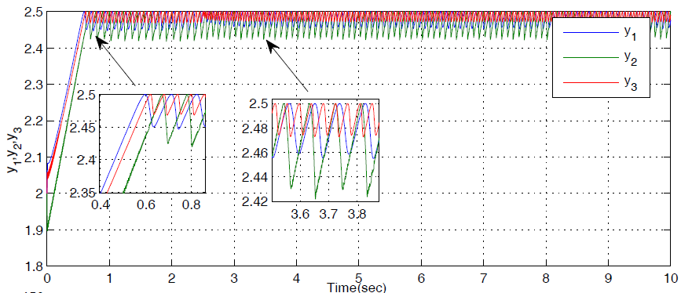
Simulations results
Photovoltaic system
The figure shows the output P₁under the FO SM-ESC law with q=0.55, P₃ under the FO SM-ESC law with q=0.3 and P₂ under the SM-ESC law converge to the MPP with an acceptable convergence speed.

Slide 23
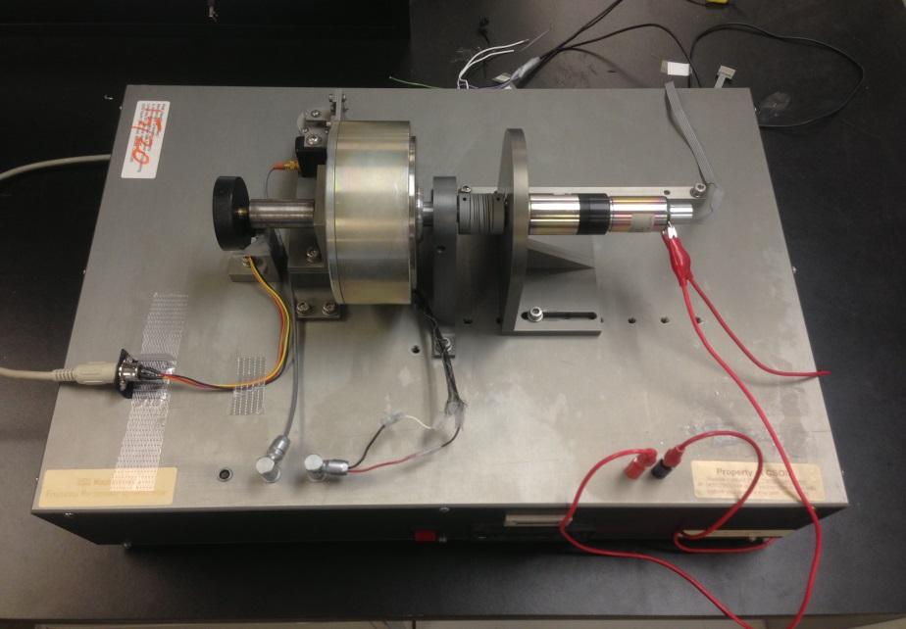
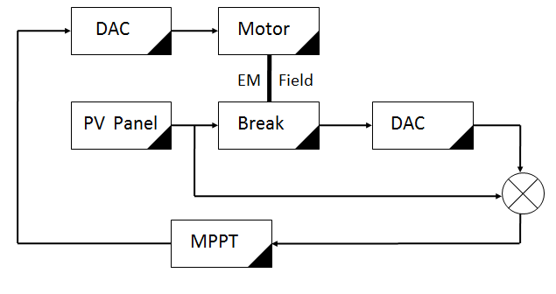
Experimental results
Photovoltaic system
The fractional horse power dynamometer.
Modeling the OV panel using the fractional horse power dynamometer in [4].

Slide 24
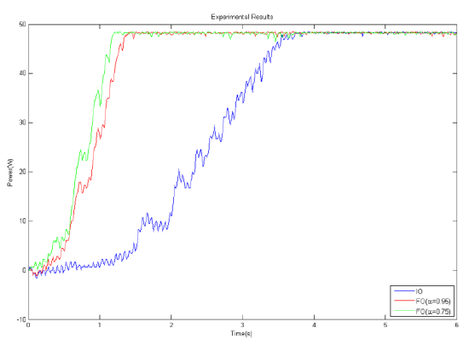
Experimental results
Photovoltaic system
The figure shows the time response of the PV model when applied the FO sinusoidal ESC with q=0.95 ,0.75in [4].

Slide 25
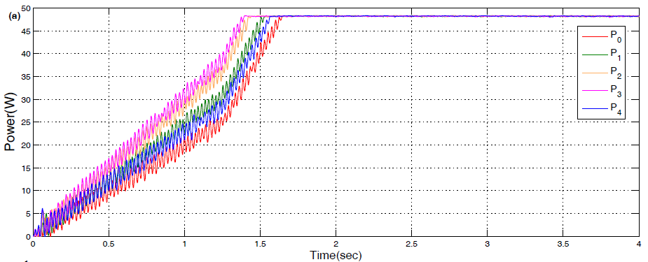
Experimental results
Photovoltaic system
The figure shows the time response of the power of the PV model when applied the FO SM-ESC with q=0.9 0.8,0.69,0.58.

Slide 26
Arduino + Simulink = Simple/Easy Plants
Experimental results
lighting system

Slide 27
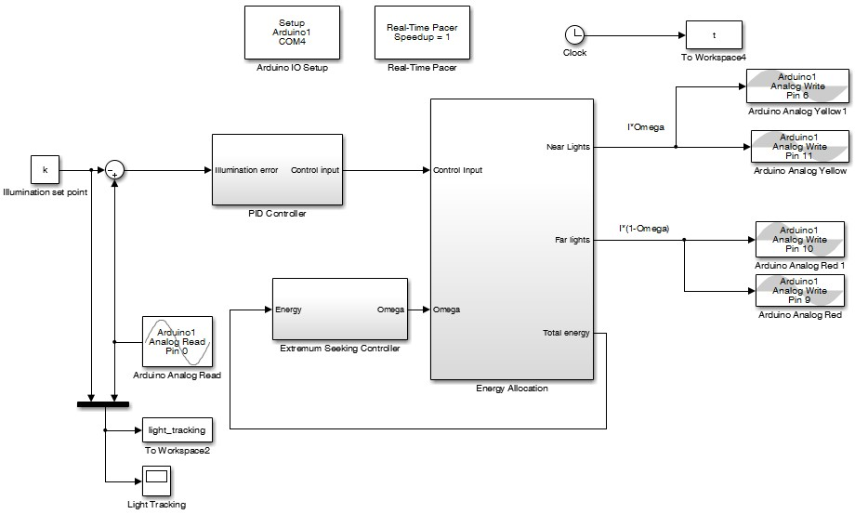
Hardware-in-the-Loop Simulink
Experimental results
lighting system

Slide 28
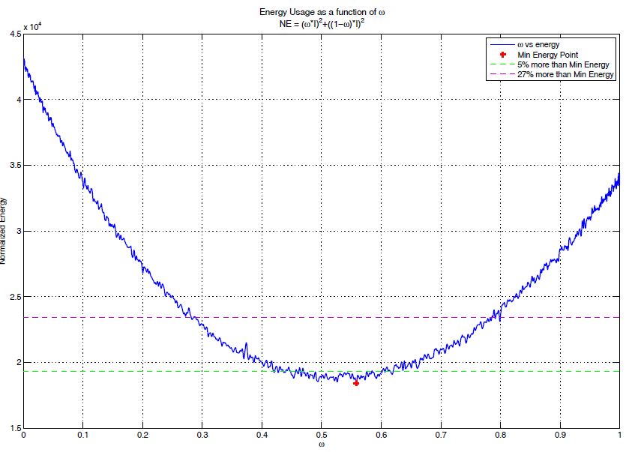
Experimental results
lighting system
The changes in electrical energy E with $ω$.

Slide 29
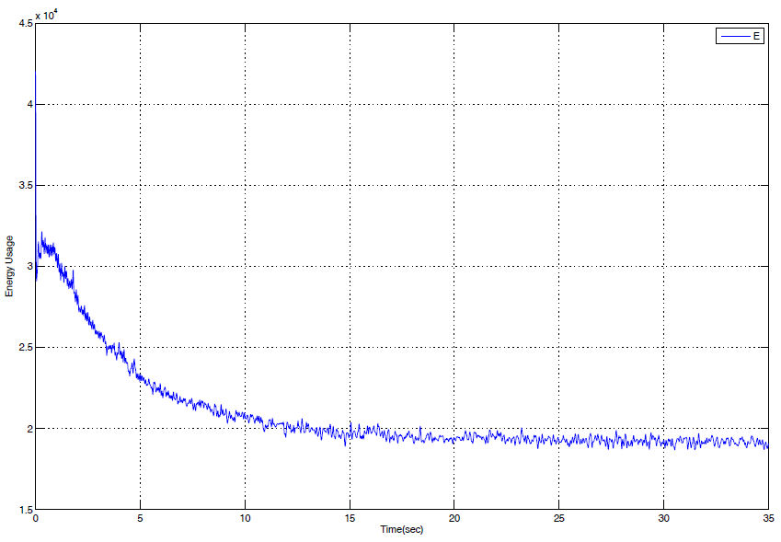
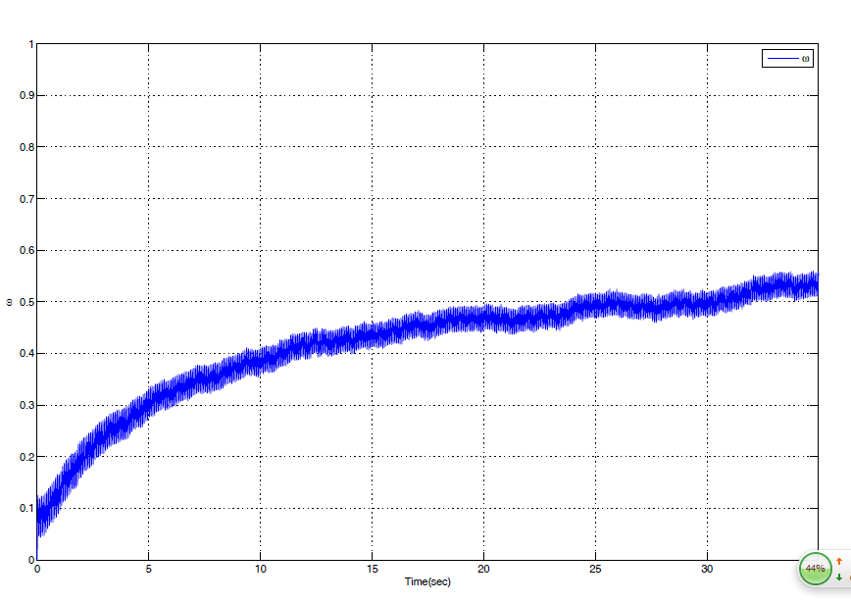
Experimental results
lighting system
The energy E under the sinusoidal ESC law.
The energy $ω$ under the sinusoidal ESC law.

Slide 30
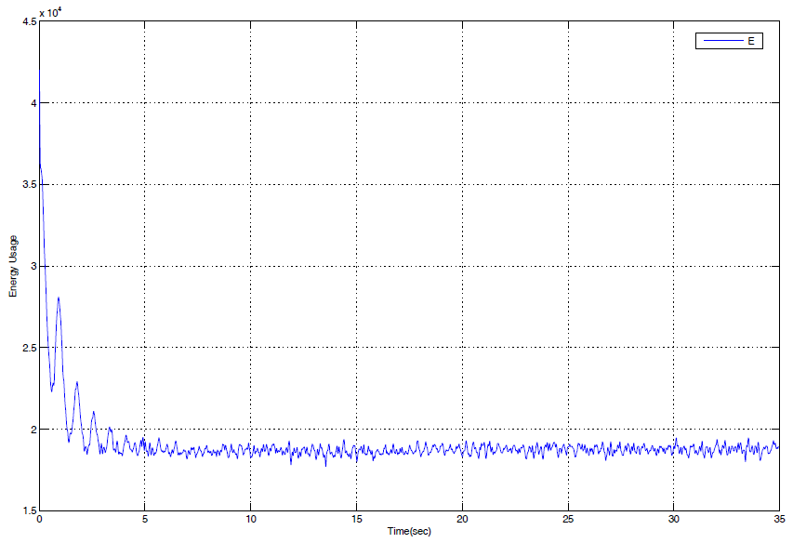
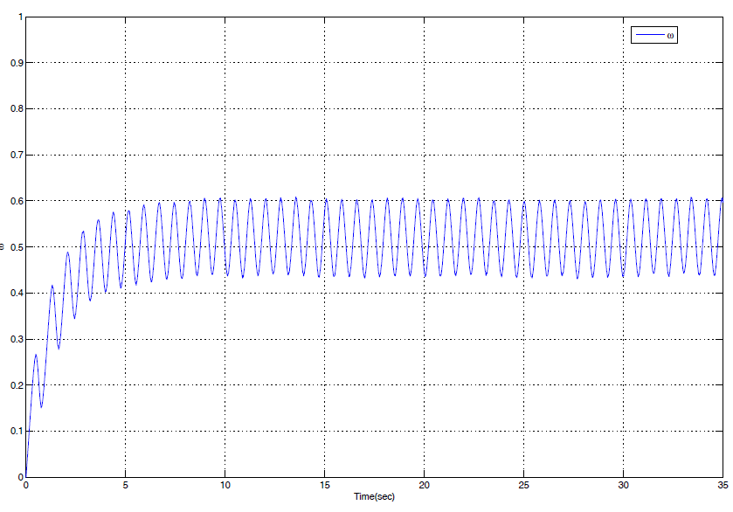
Experimental results
lighting system
The energy E under the SM-ESC law.
The energy $ω$ under the SM-ESC law.

Slide 31
Experimental results
lighting system
E-ω curve, while the indoor illumination reaches the set point light level.

Slide 32
Experimental results
lighting system

Slide 33
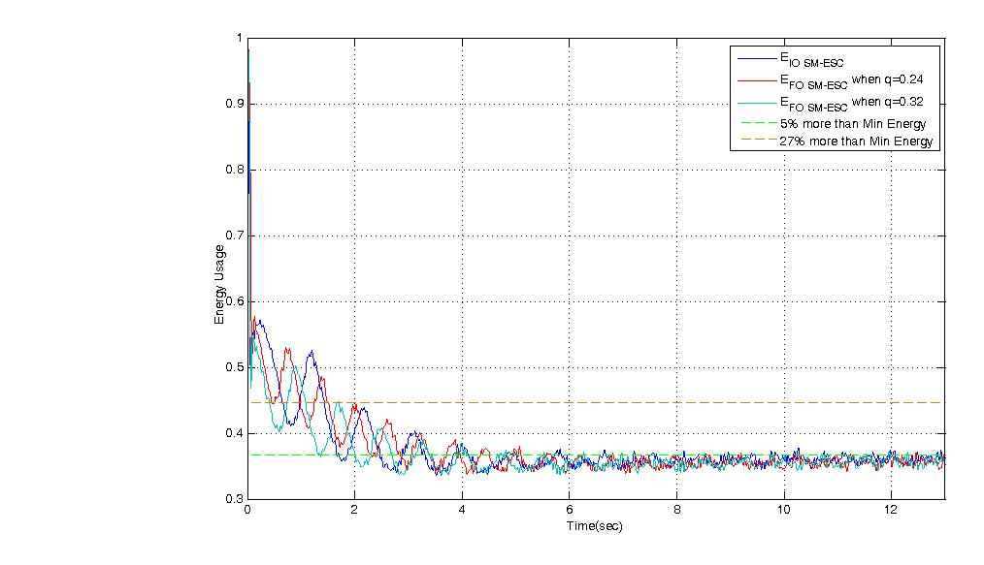
Experimental results
lighting system

Slide 34
Reference
1. Walker, G., 2001. “Evaluating MPPT converter topologies
using a MATLAB PV model,” J. Elect. Electron. Eng.,
21(1), pp. 45-55.
2. C. Zhang and R. Ordonez. Extremum-Seeking Control and Applications: A Numerical Optimization-Based Approach. Springer
Verlag, 2011.
3. Calli, B., Caarls,W., Jonker, P.,Wisse, M., 2012. “Comparison
of extremum seeking control algorithms for robotic applications,”
in 2012 IEEE/RSJ Int. Conf. Intelligent Robots
and Systems, pp. 3195-3202.
4. H. Malek, S. Dadras, and Y. Q. Chen. A fractional order maximum power point tracker: Stability analysis and experiments. In Proceedings of the 51th IEEE Conference on Decision and Control, pages 6861-6866. IEEE, 2012.

Slide 35
Thank you! Any Questions?

