Slide 1
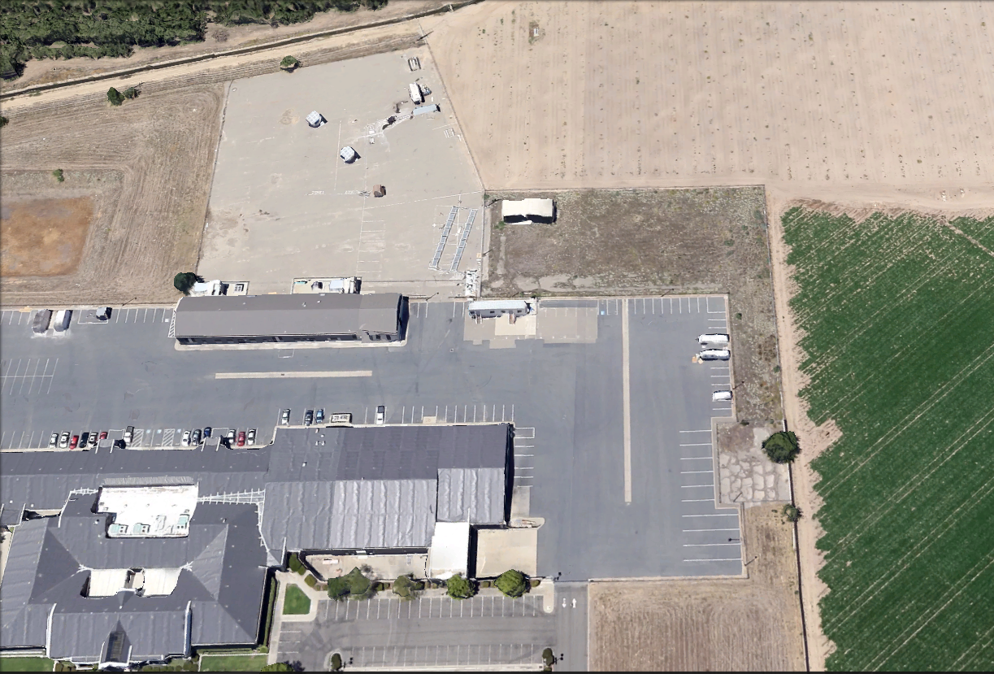
UC Merced Castle Research Facility
MESA Lab @ UC Merced
Scientific Data-drone Test Site (official since 7/24/14)
Scientific Data-drone Hangar
UCSolar.org
MESA Lab

Slide 2
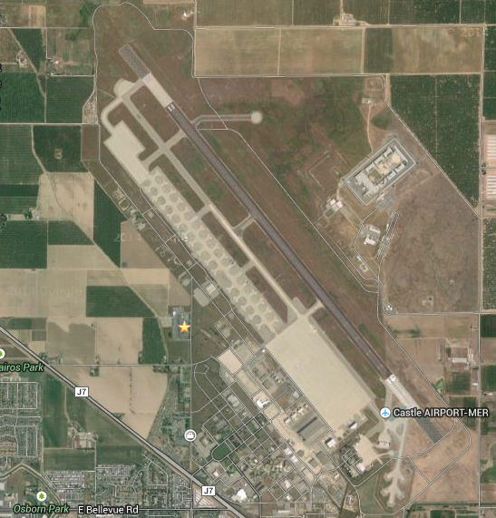
Castle Park Flyer Zone
UC Merced Castle Research Facility
Addr: 4225 Hospital Road, Atwater, CA 95301

Slide 3
Castle Park Flyer Zone

Slide 4
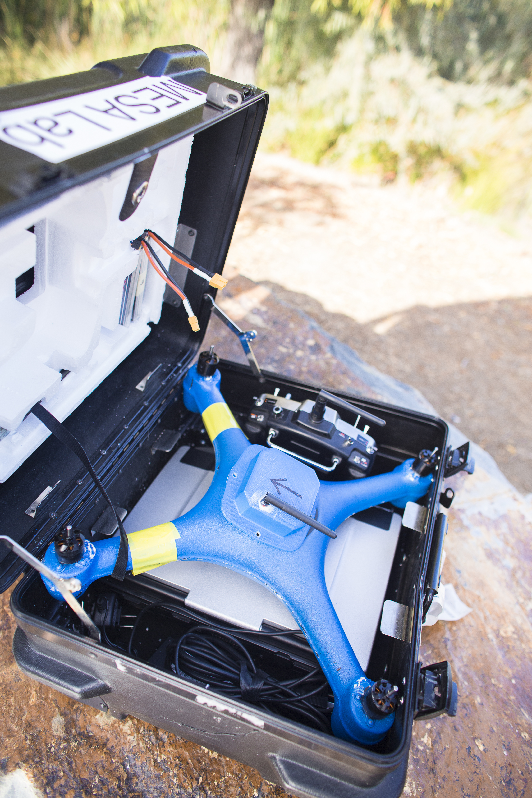
CITRIS funded scientific water quality (eDNA) drone Test Platform Design - Assembly

Slide 5
1st FAA CoA Site – UC Merced

Slide 6
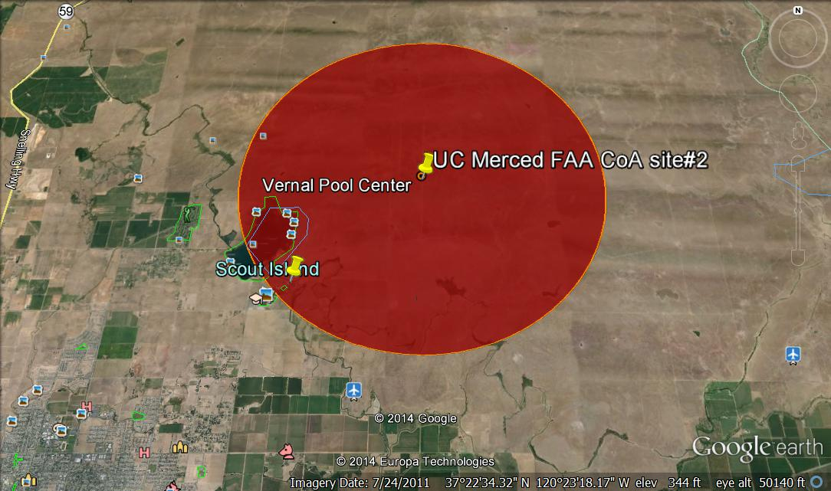
2nd FAA CoA Site – UC Merced (26 square miles in red, 2.5 nautical mile in radius)

