Slide 1
PID2018 Benchmark Challenge: Model Predictive Control Using A General Purpose Optimal Control Problem Solver - RIOTS.
Sina Dehghan, PhD student in ME
MESA(Mechatronics, Embedded Systems and Automation) LAB
University of California, Merced
E: sdehghan@ucmerced.edu
Under supervision of:
YangQuan Chen
April 27th 2019
CITRIS/CPAR Control Theory and Automation Symposium

Slide 2
Outline
PID2018 Benchmark
MPC (Model Predictive Control)
MPC using RIOTS (RMPC)
RMPC plus Conditional Integral Implementation
Results and Discussion
Conclusion

Slide 3
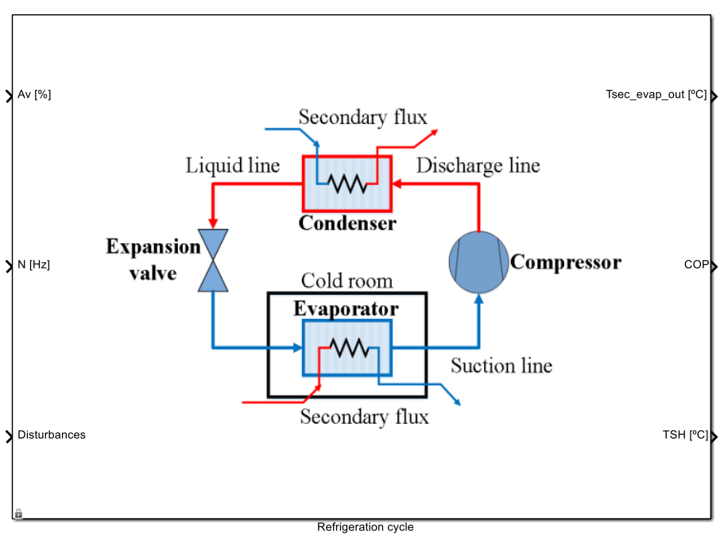
PID2018 Benchmark
One-stage-compression, one-load-demand vapor-compression refrigeration cycle. (Bejarano et. al. [1])
Two input, two output:
Controlled Variables:
Outlet temperature of the evaporator secondary flux, $T_{sec⁡_evap_out}(^{∘}C)$
Degrees of Superheating, $TSH(^{∘}C)$
Manipulated Variables:
Compression valve opening $10<Av<100$ (%)
Compressor speed $30<N<59 (Hz)$
Nonlinear
Highly Coupled

Slide 4
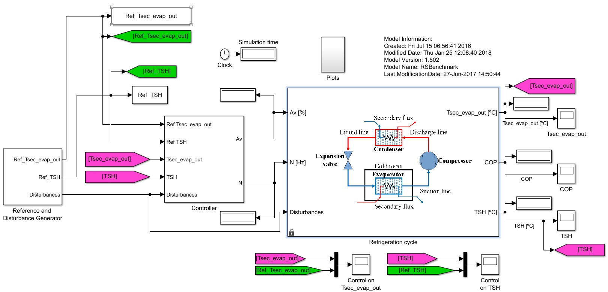
PID2018 Benchmark

Slide 5
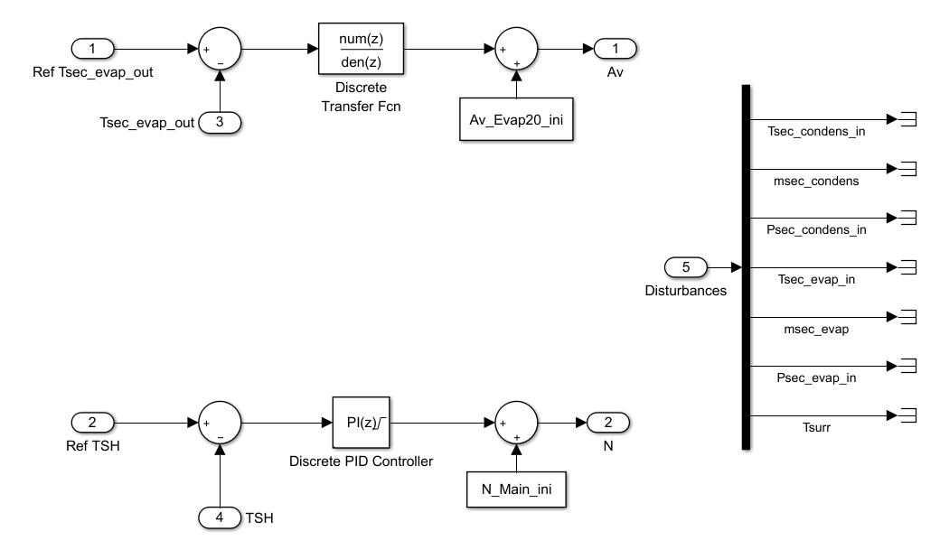
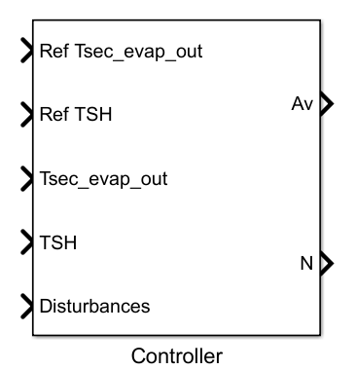
PID2018 Benchmark: Original Controllers
Controller 1: Discrete Decentralized PID
Controller 2: Multi-Variable (MIMO) PID

Slide 6
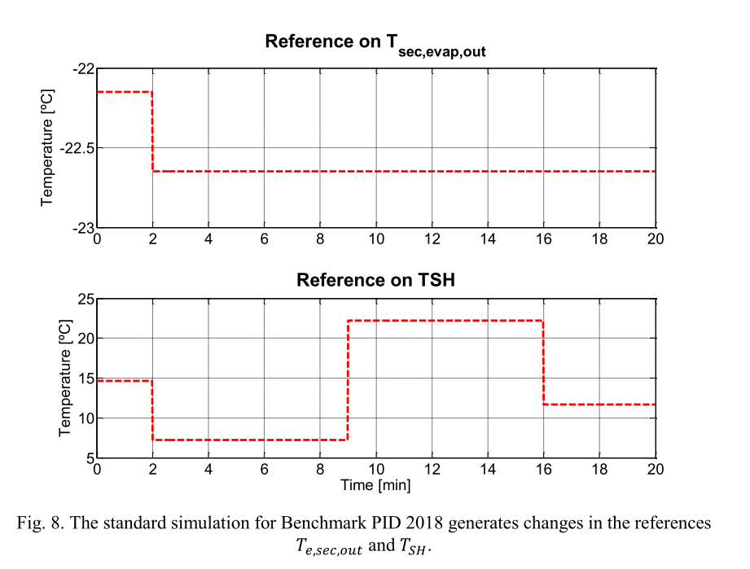
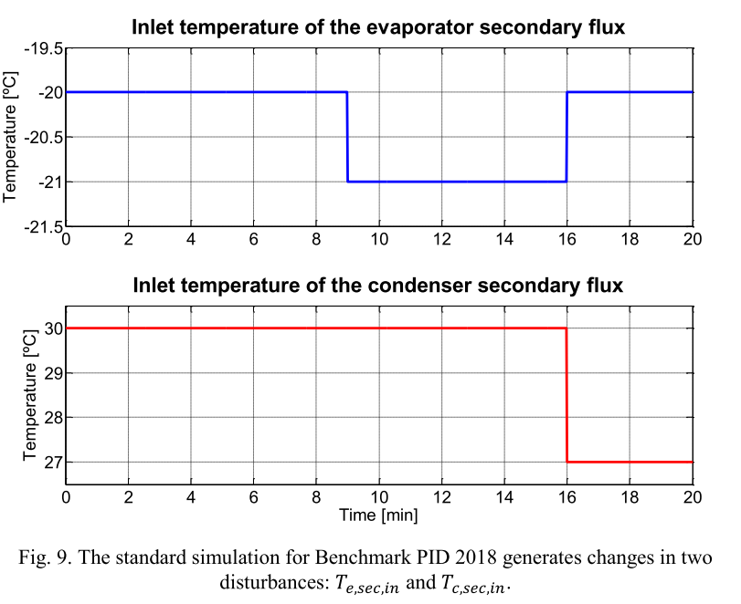
PID2018 Benchmark: References, Disturbances

Slide 7
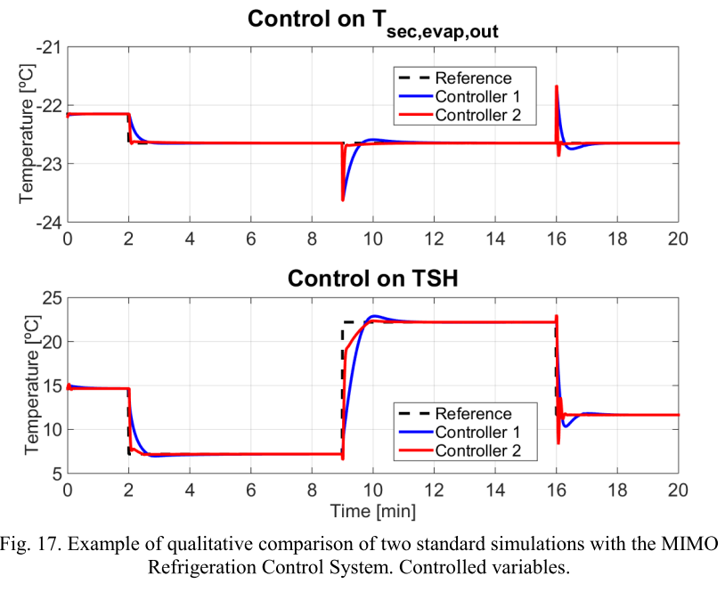
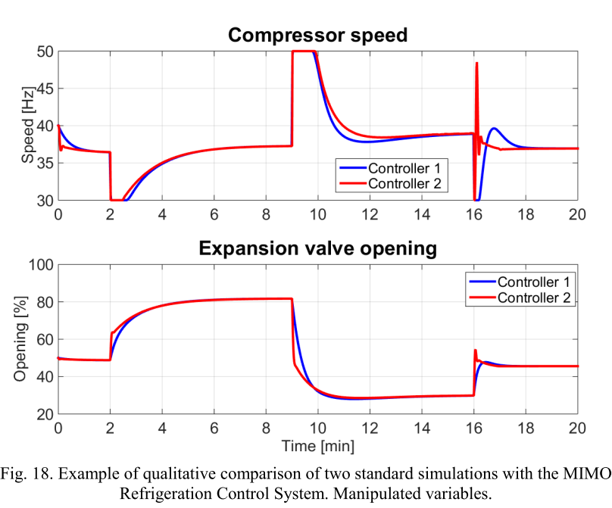
PID2018 Benchmark: Result Comparison
Qualitative Comparison of C1 and C2
Saturation: $30<N<59, 10<Av<100$

Slide 8
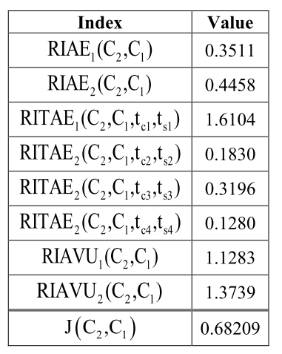
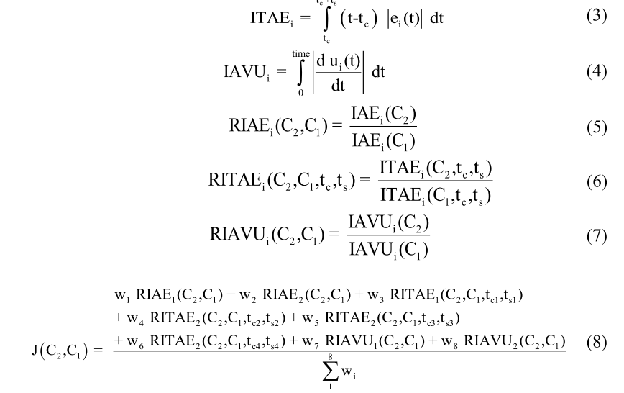
PID2018 Benchmark: Result Comparison
Qualitative Comparison of C1 and C2

Slide 9
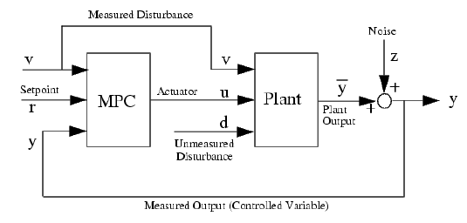
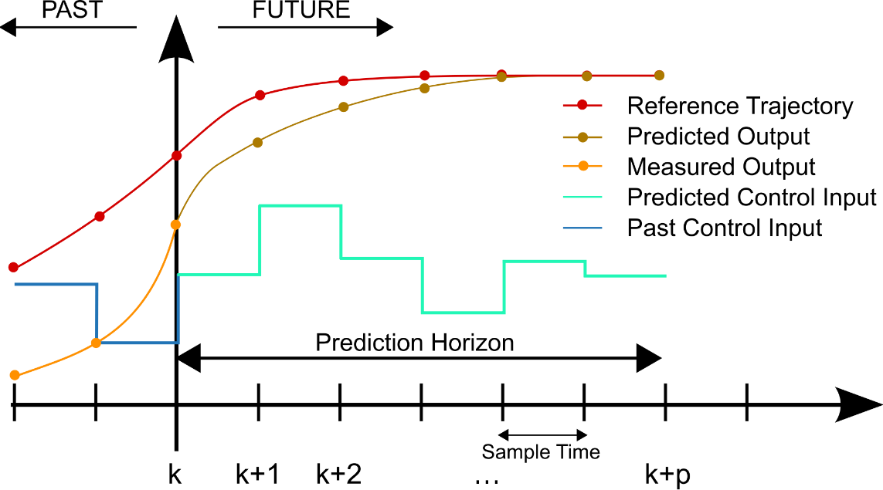
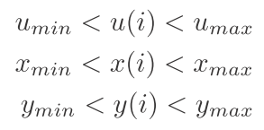
MPC
Graph source: https://www.researchgate.net/figure/238709333_fig3_Figure-3-Block-Diagram-of-a-SISO-Model-Predictive-Control
For the system described as:
General optimization objective function:
Common Constraints:
Graph source: https://math.stackexchange.com/questions/1098070/model-predictive-control
Notes:
Since the ﬁrst MPC was established in 1970’s, different types of MPC have been proposed, such as , GPC,
EHAC etc.

Slide 10
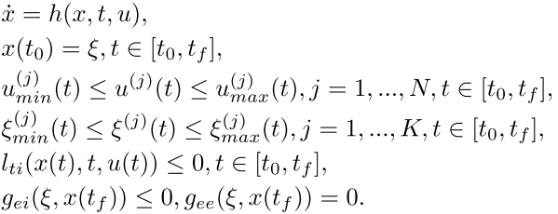
MPC using RIOTS (RMPC) Christophe Tricaud and YangQuan Chen[2]
RIOTS (Recursive Integration Optimal Trajectory Solver) [3]
How to implement?
Set-up the following functions:
sys_init.m: Information about optimal control problem such as order, number of constraints …
sys_h.m: Define $h(t,x,,u)$
sys_l.m: Define $l_{o}(t,x,u)$ and $l_{ti}\left(t,x,u\right)$
sys_g.m: Define $g_{o}\left(ξ,x\left(t_{f}\right)\right)$, $g_{ei}\left(ξ,x\left(t_{f}\right)\right)$, and $g_{ee}\left(ξ,x\left(t_{f}\right)\right)$
sys_Dh.m, sys_Dl.m, and sys_Dg.m provide derivative of above functions with respect to $x$, and $u$.
Call the function riots()
Notes:
The subscripts o , ti , ei , and ee on the functions stand for, respectively, “objective function”, “trajectory constraint”, “endpoint inequality constraint” and “endpoint equality constraint”.

Slide 11
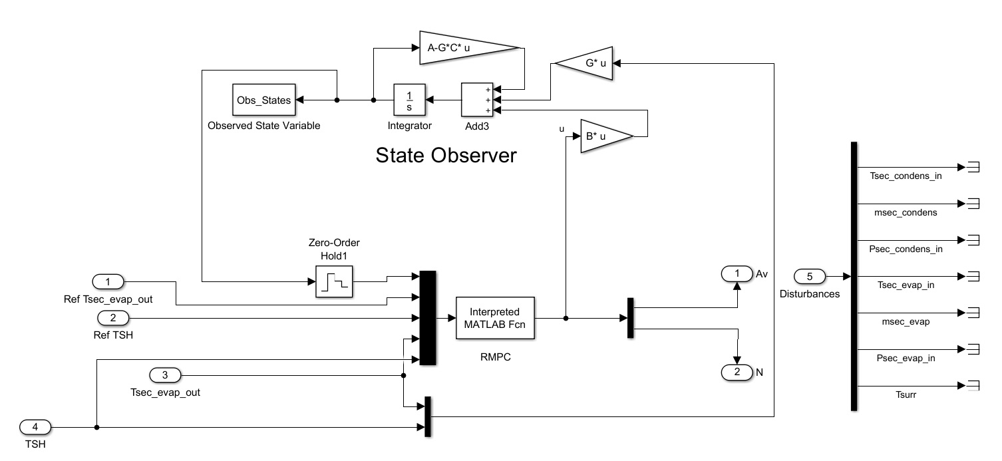
RMPC Implementation
A 4th order state space model (A,B,C,D) is identified by using MATLAB system ID toolbox.
Step changes are applied to both inputs and direct state space ID is performed.
4th order model
Extra states
Need for Observer

Slide 12
Conditional Integrator
Nonlinear, highly coupled system
Very rough linear modeling
Error in steady state behavior of the model
Steady state error is unavoidable
A Conditional Integrator (CI) is added to compensate for steady state error by modifying the reference profile (for steady states) fed to the OCP solver:
$r_{MPC}$: The modified reference for the optimal control problem solver.
$r_{d}$: The desired output or the original reference.
$K_{I}$: The integral gain.
$i$: Index determining any sample for which the error $r_{d}\left(i+1\right)−y(i)$ is less than some threshold $e_{th}$.

Slide 13
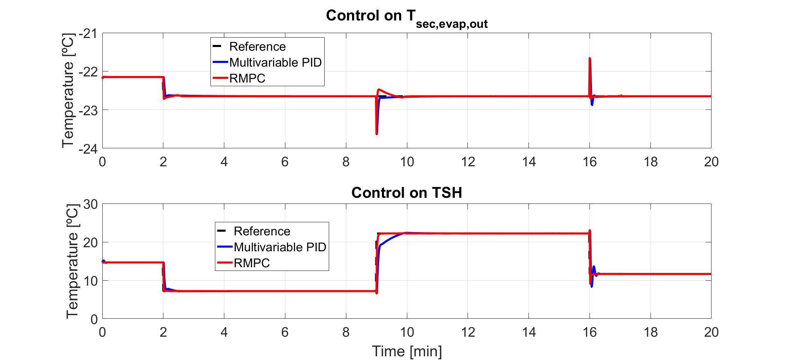
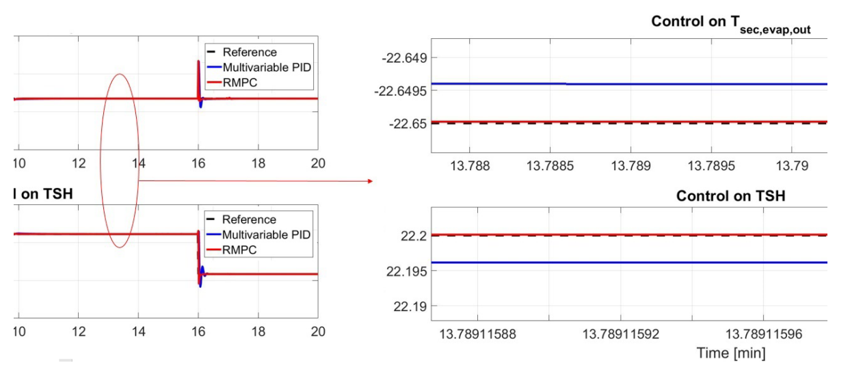
Results and Discussion
RMPC vs $C_{2}$(Multivariable PID)
Improvements:
Faster and less oscillatory response
Steady State error is reduced significantly

Slide 14
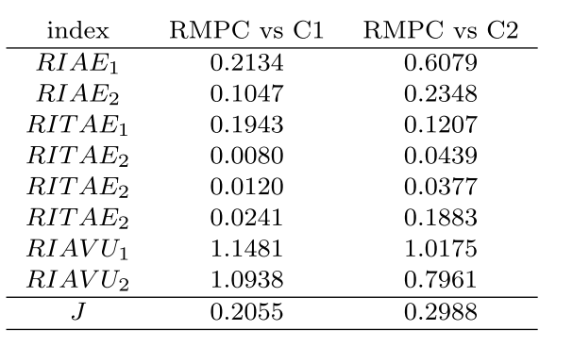
Results and Discussion

Slide 15
Conclusions:
A straightforward method for implementation of MPC for MIMO systems using a general optimal control problem solver, RIOTS, is introduced. (RMPC)
RMPC method shows significant improvement in transient behavior of the system introduced in PID2018 Benchmark problem. However, there is some steady state error due to utilization of a rough model for the system.
A conditional integrator is added to the RMPC scheme to compensate for the steady state error.
RMPC plus conditional integrator shows more than 70 percent improvement to the overall controller performance index of the multivariable PID.
Performance could be improved by optimal tuning of MPC and CI parameters.
A comprehensive comparison of RIOTS toolbox with other available OCP solver toolboxes seems necessary and informative.

Slide 16
References
[1] Bejarano, G., Alfaya, J.A., Rodrguez, D., and Ortega, M.G. (2017a). Benchmark for PID control of refrigeration systems based on vapour compression. http://www.dia.uned.es/~fmorilla/benchmarkPID2018/.
[2] C. Tricaud and Y. Q. Chen, Linear and nonlinear model predictive control using a general purpose optimal control problem solver RIOTS 95, Proc. of the Chinese Control and Decision Conference, 1552–1557, 2008.
[3] A. Schwartz, E. Polak, and Y. Q. Chen, RIOTS Manual : A Matlab Toolbox for Solving Optimal Control Problems, May 1997.
[4] T. Zhao, Z. Li and Y. Chen, "Fractional order nonlinear model predictive control using RIOTS_95," Fractional Differentiation and Its Applications (ICFDA), 2014 International Conference on, Catania, 2014, pp. 1-6. doi: 10.1109/ICFDA.2014.6967366

Slide 17
Questions
Thank you for your attention!

Slide 18
RMPC: Controller Details
MPC objective function:
Condition Integrator:
Luenberger Observer:

Slide 19
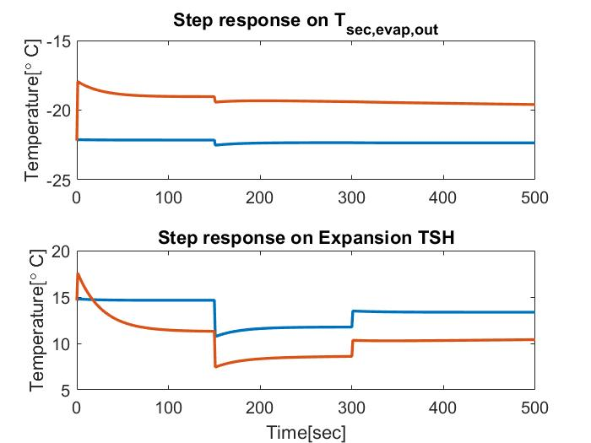
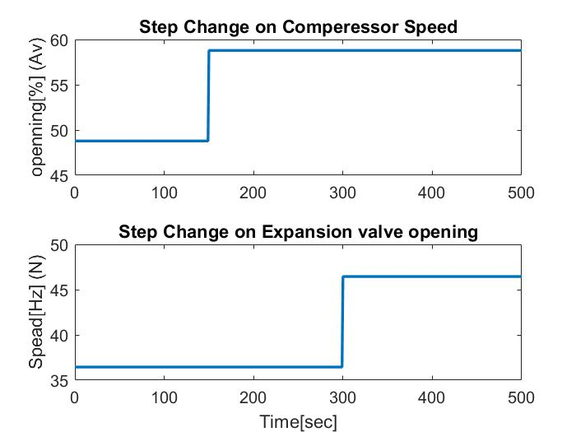
RMPC: Identification Details
Direct state-space MIMO identification using Matlab toolbox: 4th order model.
Model doesn’t need to be accurate, only need to grasp dynamic behavior

Slide 20
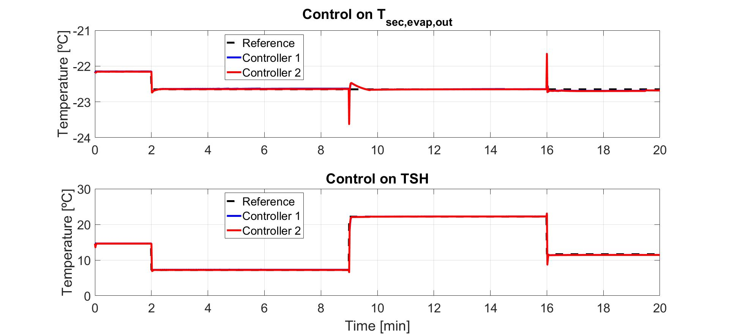
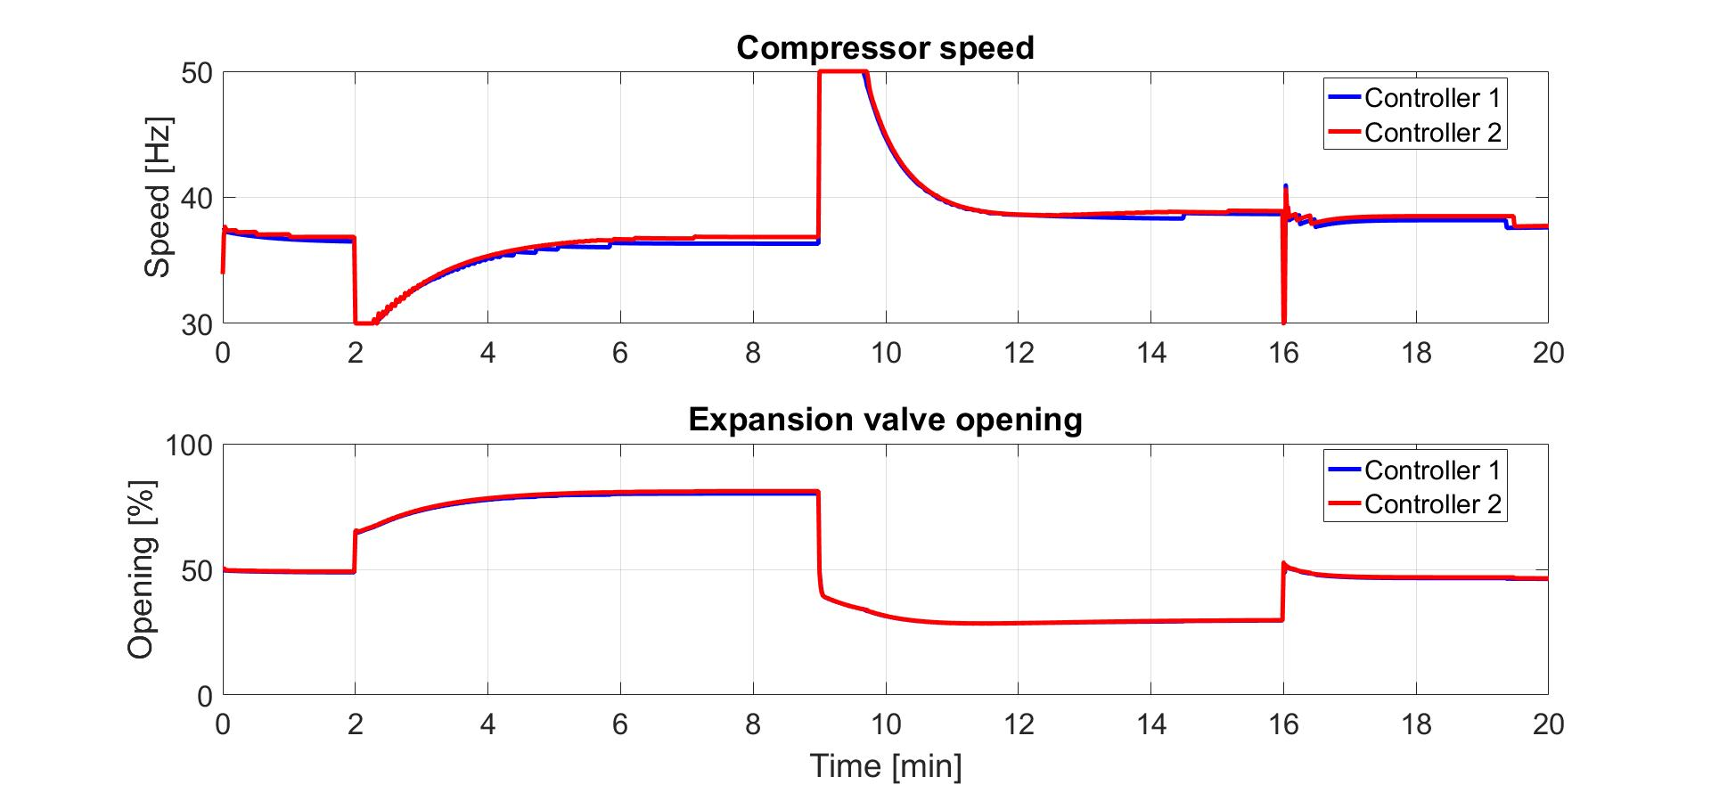
RMPC: Robustness Test w/o CI
5% change in S
J = 0.6939
[U,S,V] = svd(A);
A = U*(S+0.05*S)*V’;
A =
-7.2301 0.0671 -0.0006 0.0004
0.0775 -7.4412 0.0025 -0.0010
-8.8877 0.6420 -0.0360 -0.0042
0.2561 -10.0853 -0.0134 -0.0040
$δ$A =
0.2922 0.2129 0.0018 0.0003
0.2132 -0.3050 0.0007 0.0000
0.3429 0.2845 0.0004 0.0001
0.2828 -0.4177 0.0001 -0.0001
$δS$ =
-0.6334 0 0 0
0 0.5664 0 0
0 0 -0.0012 0
0 0 0 -0.0000

Slide 21
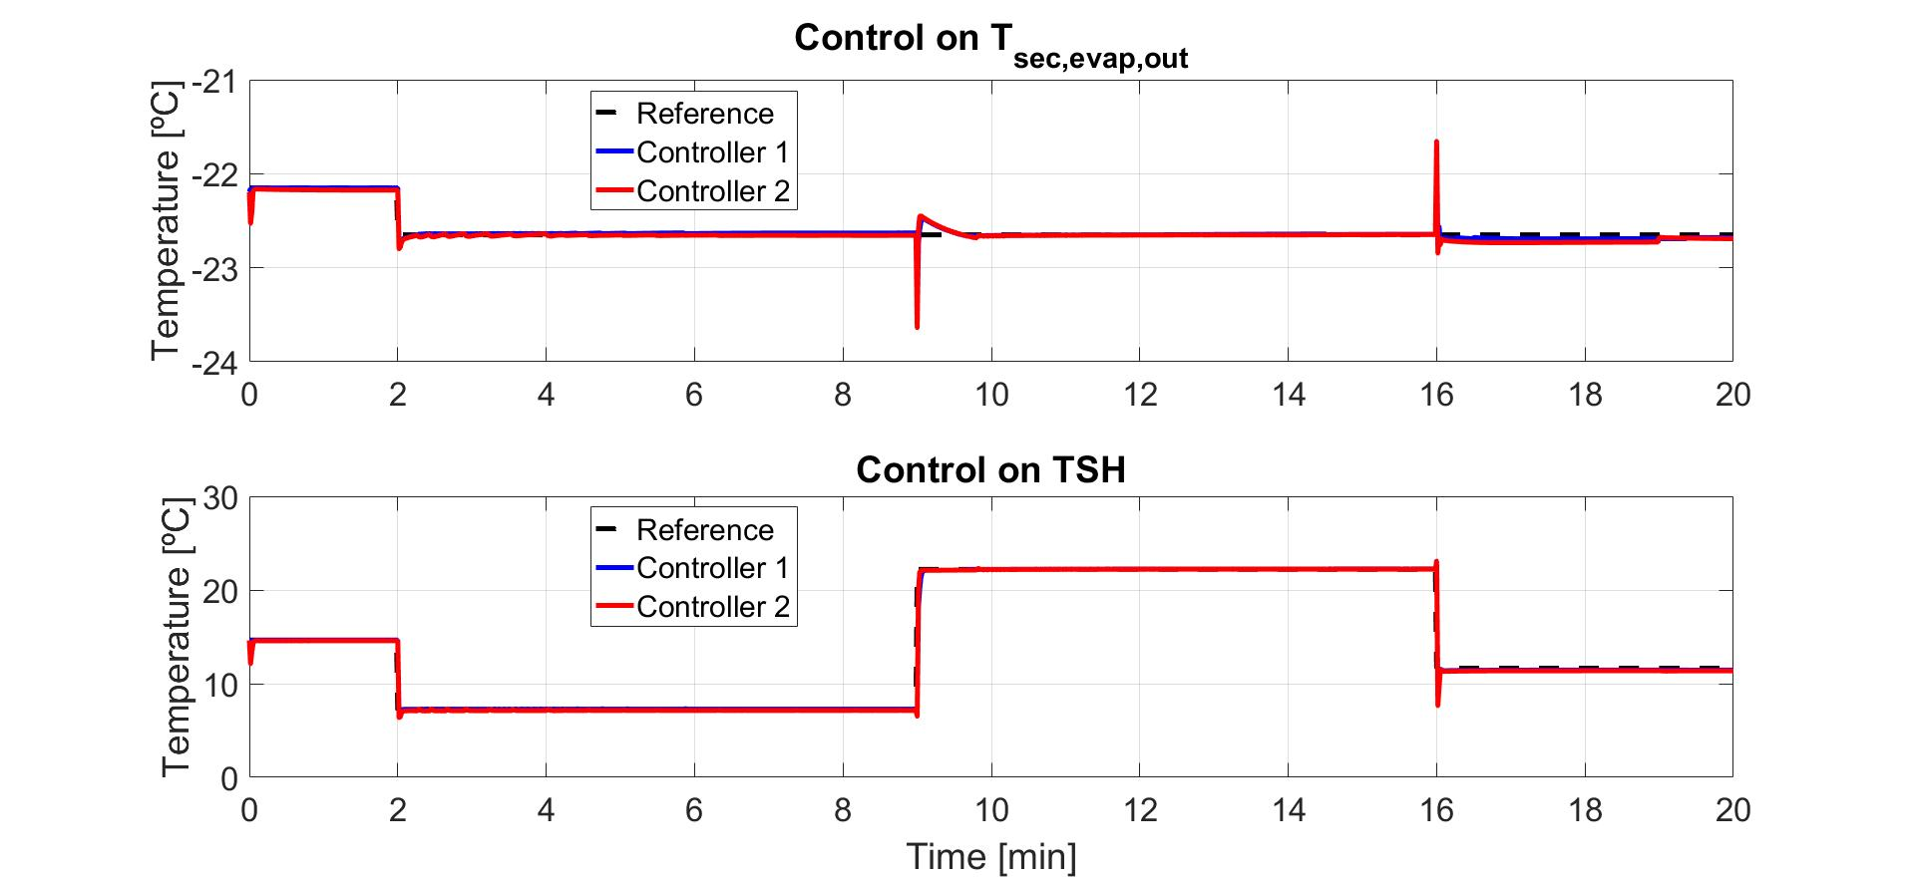
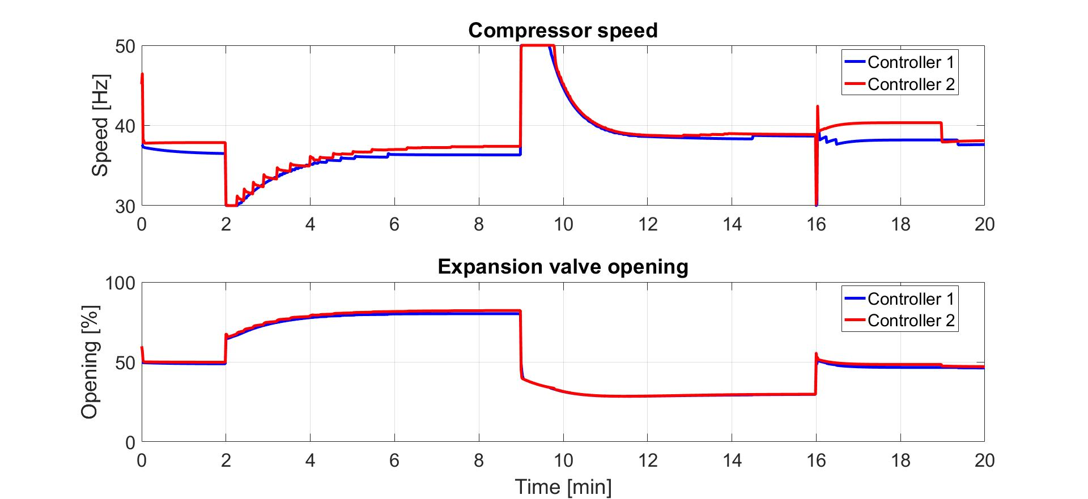
RMPC: Robustness Test w/o CI
5% change in S
J = 0.8967
[U,S,V] = svd(A);
A = U*(S+0.2*S)*V’;
A =
-7.2301 0.0671 -0.0006 0.0004
0.0775 -7.4412 0.0025 -0.0010
-8.8877 0.6420 -0.0360 -0.0042
0.2561 -10.0853 -0.0134 -0.0040
$δ$A =
1.4460 -0.0134 0.0001 -0.0001
-0.0155 1.4882 -0.0005 0.0002
1.7775 -0.1284 0.0072 0.0008
-0.0512 2.0171 0.0027 0.0008
$δS$ =
2.5338 0 0 0
0 2.2657 0 0
0 0 0.0050 0
0 0 0 0.0000

Slide 22
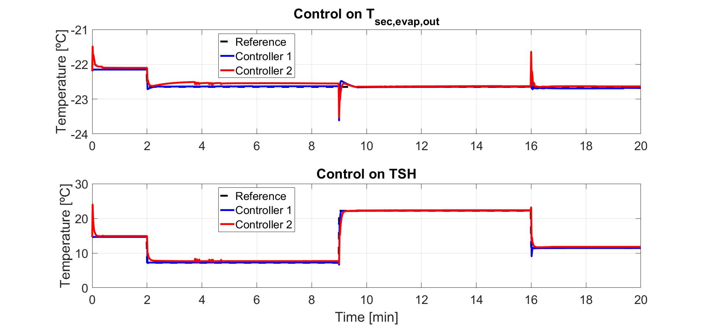
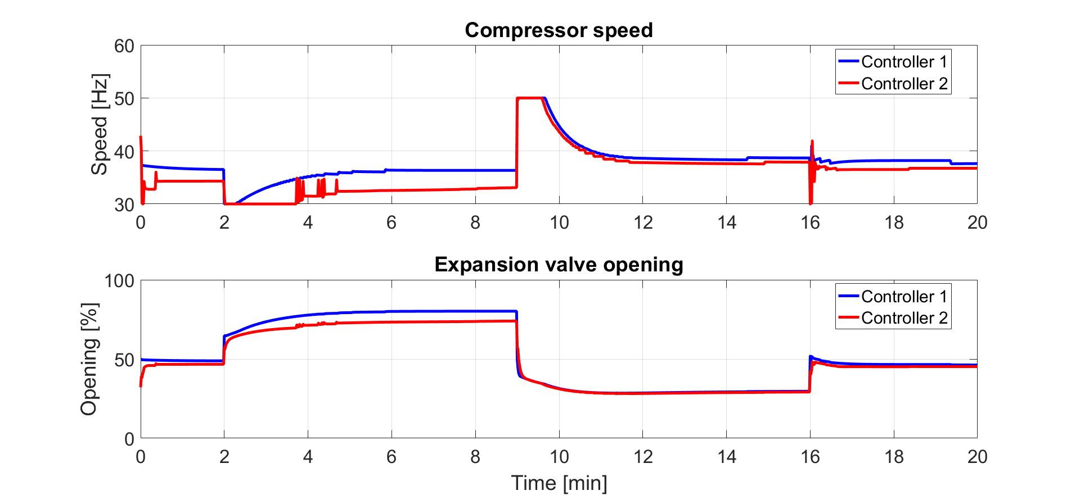
RMPC: Robustness Test w/o CI
50% change in S
J = 3.8378
[U,S,V] = svd(A);
A = U*(S+0.5*S)*V’;
A =
-7.2301 0.0671 -0.0006 0.0004
0.0775 -7.4412 0.0025 -0.0010
-8.8877 0.6420 -0.0360 -0.0042
0.2561 -10.0853 -0.0134 -0.0040
$δ$A =
-2.9217 -2.1293 -0.0002 -0.0003
-2.1318 3.0495 0.0008 0.0009
-3.4288 -2.8450 -0.0178 -0.0028
-2.8279 4.1771 -0.0072 -0.0000
$δS$ =
6.3344 0 0 0
0 -5.6644 0 0
0 0 -0.0125 0
0 0 0 -0.0001

Slide 23
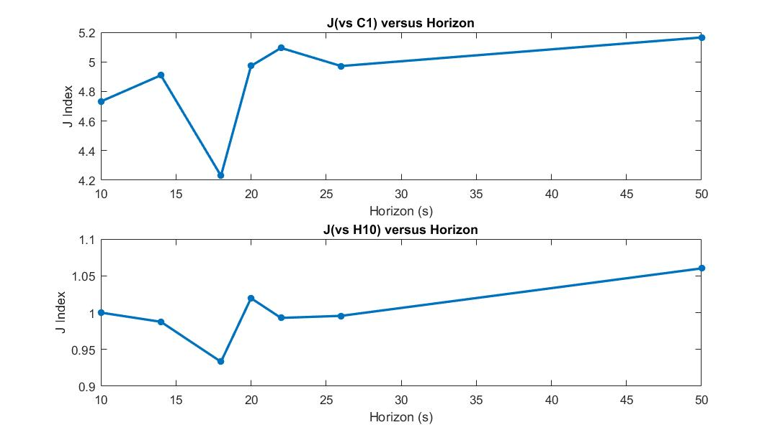
RMPC: Horizon Tuning

Slide 24
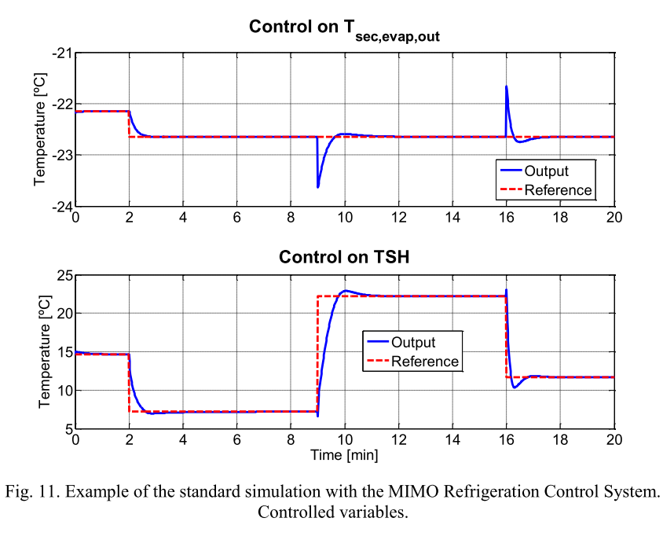
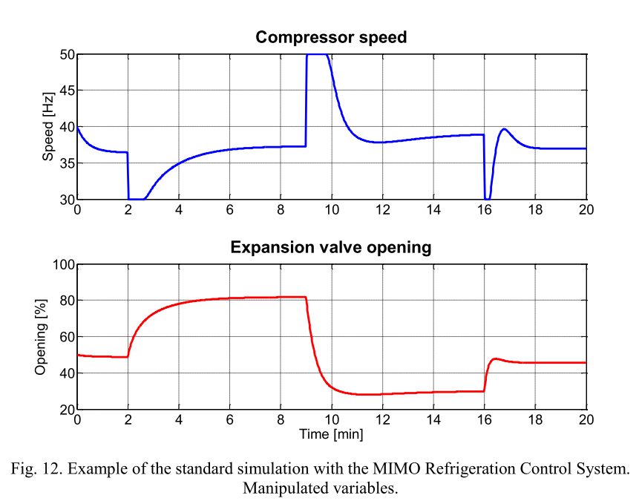
PID2018 Benchmark: Original Results
Controller 1: Discrete Decentralized PID
Controller 2: Multi-Variable (MIMO) PID
Saturation: $30<N<59, 10<Av<100$

